Slide 1
Leigh Ann Jacobson, CFRE
Jacobson Group Consulting
Everence Development Conference
September 25, 2025, 8-9:15 a.m.
Beyond the development office: How every leader plays a role in fundraising success
“Our mission is to grow your mission.”
Notes:
Welcome everyone! I’m Leigh Ann Jacobson, and I’ve spent most of my career helping mission-driven organizations raise funds in ways that reflect their values. I truly believe philanthropy happens beyond the development office and every leader plays a role in fundraising success!
“This session is about moving from a departmental view of fundraising to a culture of generosity. Fundraising isn’t just the development office’s job — it’s a shared ministry.”

Slide 2
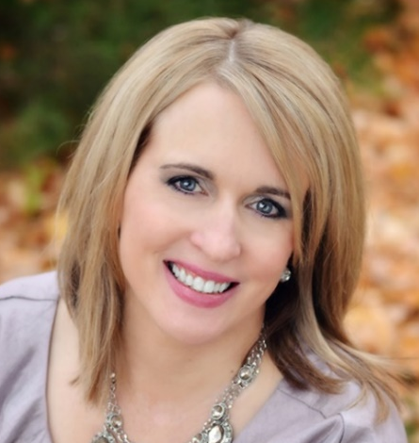
Hi there!
Leigh Ann Jacobson, CFRE Professional Biography:
Founder & Principal Consultant of Jacobson Group Consulting with over 25+ years of experience
Philanthropy executive and practitioner (now in Chicago northern suburbs)
Keynote and plenary speaker on leadership, nonprofit management, and fundraising topics
Accomplished fundraiser with a track record of securing seven-figure gifts
Niche in helping nonprofits with limited resources make an extensive impact
Decades of board level leadership with AFP (Association of Fundraising Professionals)
University of Notre Dame, Mendoza College of Business, Certificate in Executive Management and Yellow Belt Lean Six Sigma; Arcadia University, M.A. English; King's College, B.A. English
Notes:
“Lord Jesus, we thank You for the gift of this day and for the work set before us. Help us to walk in Your ways with humility and love. Keep us faithful in serving one another, and may our lives bring glory to God. Amen.”
Fund Development Executive and Consultant with over 25+ years of experience.
Founder & Principal of Jacobson Group Consulting.
Keynote and plenary speaker on strategic marketing, nonprofit management, and fundraising topics
Accomplished fundraiser with a track record of securing seven-figure gifts
Niche in helping nonprofits with limited resources make an extensive impact
Decades of board level leadership with AFP (Association of Fundraising Professionals)
University of Notre Dame, Mendoza College of Business, Certificate in Executive Management and Yellow Belt Lean Six Sigma; Arcadia University, M.A. English; King's College, B.A. English

Slide 3

Notes:
How many CEO or Executive Directors here today?
How many staff?
How many board or volunteers?
How many under 5 years of development experience?
ASK THEM TO SPEAK:
Some from each organization tell me about your organization and who’s with you today.
Name 1 thing you hope to get out today’s workshop
Ask: “In your organization, who outside the development office has inspired generosity?”

Slide 4



Beyond the development office:
How every leader plays a role in fundraising success
Notes:
I’m so honored to be with you today as we explore how every leader plays a role in fundraising success. How every leader’s faith-inspired living plays a role in fundraising success. “I see philanthropy as ministry in action.”
It’s especially meaningful to do this in partnership with Everence, whose mission—Together, we empower financial well-being for faith-inspired living—beautifully reinforces that our work as fundraisers is a form of faith in action.
Quick icebreaker:

Slide 5

Session Objectives
Reframe fundraising as a shared ministry of generosity.
Understand how every leader can model, advocate, and inspire giving.
Identify practical roles for board, staff, pastors, and volunteers.
Learn to communicate impact in everyday conversations.
Build a culture of philanthropy that sustains mission.
Recognize fundraising as discipleship and a way to invite others into God’s work.
Notes:
Speaker Notes (Approx. 3–4 minutes):
Set the Frame
“Everyone has a role: presidents, pastors, board chairs, faculty, volunteers. Each touchpoint is ministry.”
Today, we will focus on these key objectives:
Reframe fundraising as a shared ministry of generosity.
Understand how every leader can model, advocate, and inspire giving.
Identify practical roles for board, staff, pastors, and volunteers.
Learn to communicate impact in everyday conversations.
Build a culture of philanthropy that sustains mission.
Recognize fundraising as discipleship and a way to invite others into God’s work.

Slide 6


The 2° Shift
“Faith asks us to take small
steps daily — seeds of generosity
that grow into abundance.”
2°
Source: 2 ° Shift, Jacobson Group Consulting, 2022
Notes:
Does anybody here enjoy sailing or boating?
I’d like to introduce the 2 degree shift.
Think about this…you going to get a boatload of information today. My challenge to you is to find just a sliver – even if it’s just 2 or 3 things- of what you hear and implement it when you get back to your office. Those 2 or 3 things can make a big difference!
Think if it in sailing terms. If you’re sailing along and you adjust your course by just 2 degrees, the change is minimal at first when you first turn the boat. But as time goes on the IMPACT it has on your course is significant.
Click: We must remember --“Faith asks us to take small steps daily — seeds of generosity that grow into abundance.”

Slide 7

Why Fundraising is Ministry for Everyone
Giving flows from faith and values, not just budgets
Generosity = spiritual practice, not a
financial transaction
Leaders model faith in action / mission in motion
Our role = invite, listen, inspire
“Where your treasure is, there your heart will be also” (Luke 12:34).
Notes:
“Fundraising is inviting others to live generously. Every leader shares in that ministry.”
Giving flows from faith and values, not just budgets
Generosity = spiritual practice, not a financial transaction
Leaders model faith in action / mission in motion
Our role = invite, listen, inspire
Can anyone share a personal example of a donor who described their giving as faith or calling? Or What Scripture/faith principle shapes your view of generosity?
LAJ story: at Notre Dame: “One donor once told me, ‘This gift is not mine—it’s God’s. I’m just returning it to the place where it can do the most good.’ That’s the theology of generosity in action.”).
LAJ asks: “What Scripture or faith principle shapes your view of generosity?”
Close & Transition
“If this is our foundation—that fundraising is ministry—then the way we approach fundraising changes. It’s not about asking for money; it’s about nurturing a donor’s spiritual journey.
Let’s listen to a 2-minute video next that demonstrates this approach.

Slide 8
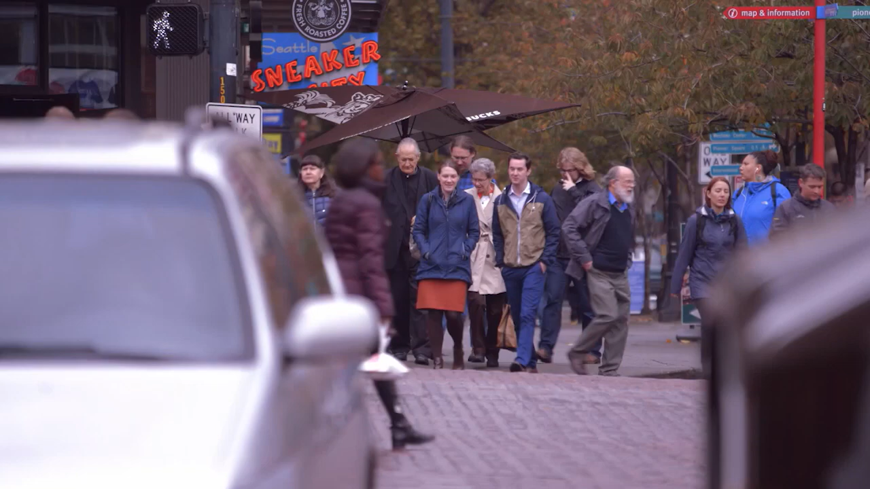
Notes:
Play 2-minute video
The reasons behind giving are personal and varied. That’s what World Vision learned in Seattle, where they interviewed several women and men on their reasons for giving. Reasons we heard for giving included feeling good, taking care of each other, giving because they are blessed, and returning the help they have received in the past.
Ask: “What values came through?”
Ask: “Which of these values echo biblical principles of stewardship, blessing, or community?”

Slide 9
Faith + Data Connection
Giving USA 2025:
Individual giving rose 8.2% (current dollars), still 66% of all giving. These gifts come overwhelmingly from people whose values and faith motivate generosity.
Contrast:
Religious giving is declining in aggregate, but individuals are directing their giving toward causes that embody their values (education, human services, international relief, etc.).
“values shift” → donors are directing faith elsewhere
Notes:
Faith + Data Connection
Giving USA 2025:
Individual giving rose 8.2% (current dollars), still 66% of all giving. These gifts come overwhelmingly from people whose values and faith motivate generosity.
Contrast:
Religious giving is declining in aggregate, but individuals are directing their giving toward causes that embody their values (education, human services, international relief, etc.).
That’s a signal: faith-inspired values are shifting where major gifts flow.
Interactive Component (5–7 minutes)
Prompt: “Think of your top 3 donors. What values drive them?

Slide 10
How to put this into action?
Frame your ask in values language
Mission-first messaging: Anchor proposals in why the work matters, not just what the work does.
Bridge faith to outcomes
Notes:
How do we put this action?? (see values language handout)
Frame your ask in values language: Instead of “We need $100K for this program,” say, “Your generosity helps ensure every student has the dignity of access to education, regardless of their means.”
Mission-first messaging: Anchor why the work matters, not just what the work does.
Bridge faith to outcomes: Make the case that the donor’s values live on through impact stories—students, families, and communities transformed.

Slide 11


Values alignment is the key to transformational giving.
Pair & Share: “This is discipleship, not just development.”
Notes:
Interactive Component (5–7 minutes)
Prompt: “Think of your top 3 donors. What values drive their giving? How does your organization reflect those values in your communication?”
Activity: Pair & Share: Reframe an appeal in values language. Ask participants to pair up and draft one sentence rephrasing an appeal to connect a donor’s values to the mission.
Report out: Invite 2–3 examples—highlight how even small shifts in wording move the conversation toward transformational giving.

Slide 12
Shared Ministry of Fundraising
Fundraising as shared ministry: a cycle of invitation, gratitude, and stewardship for impact.
Identify
Cultivate
Invite
Steward
Data confirms: generosity is sustained when mission is rooted in values.
Notes:
Fundraising as shared ministry: a cycle of invitation, gratitude, and stewardship.
And the good news is, when this cycle is done right, generosity is sustained when mission is rooted in values! Let’s look at that data now!

Slide 13
A Look into Charitable Giving – Giving USA Report (July ‘25)
Mission-Focused Growth: Donor enthusiasm for education, social good (public-society benefit), global relief (international affairs), arts, and environment continues to rise sharply—especially in areas that resonate with value-driven or impact-oriented causes.
Sustained Individual & Corporate Giving: Individual donors fueled most of the growth, supported by strong financial markets. Corporate philanthropy also rose notably, reflecting steady economic confidence.
Shifts in Sources: While individuals still dominate, corporate and foundation sources are representing a larger or stable share of total philanthropy. Meanwhile, bequests are declining.
Decline in Religious Giving: Although still a significant slice of the pie, religious giving declined by 1% in real terms, highlighting a long-term downward trend.
Notes:
“Data confirms: generosity is sustained when mission is rooted in values.”
Key Insights & Trends
Mission-Focused Growth: Donor enthusiasm for education, social good (public-society benefit), global relief (international affairs), arts, and environment continues to rise sharply—especially in areas that resonate with value-driven or impact-oriented causes.
Sustained Individual & Corporate Giving: Individual donors fueled most of the growth, supported by strong financial markets. Corporate philanthropy also rose notably, reflecting steady economic confidence.
Shifts in Sources: While individuals still dominate, corporate and foundation sources are representing a larger or stable share of total philanthropy. Meanwhile, bequests are declining.
Decline in Religious Giving: Although still a significant slice of the pie, religious giving declined by 1% in real terms, highlighting a long-term downward trend.

Slide 14
A Look into Charitable Giving – Giving USA Report (July ‘25)
Total Charitable Giving reached a new high of $592.5 billion in 2024, growing 6.3% in current dollars and 3.3% adjusted for inflation.
By Source:
  Individual Giving: $392.5 billion (8.2% growth current, 5.1% real) — remains the largest contributor at 66% of total donations.
  Corporate Giving: $44.4 billion, up 9.1% current and 6.0% real.
  Foundations: around $109.8 billion, up 2.4% current but flat or slightly down when inflation-adjusted
  Bequests: $45.8 billion, declining 1.6% current and 4.4% real
Source: GivingUSA.org
Notes:
Total Charitable Giving reached a new high of $592.5 billion in 2024, growing 6.3% in current dollars and 3.3% adjusted for inflation. **For the first time in three years, giving grew in inflation adjusted dollars as well (growing 3.3% in 2024), increasing the ability of nonprofits to deliver more on their missions. This is consistent with the average growth in giving of 5.5%.
The 2024 giving data confirms what many in the nonprofit sector have long believed: Generosity is not a fleeting response to crisis—it’s a sustained commitment. Donors’ desire to improve the world is deeply rooted. While it may waver amidst economic uncertainty, when paired with a strong economy, generosity becomes a catalyst for growth.
By Source:
Individual Giving: $392.5 billion (8.2% growth current, 5.1% real) — remains the largest contributor at 66% of total donations.
Corporate Giving: $44.4 billion, up 9.1% current and 6.0% real.
Foundations: around $109.8 billion, up 2.4% current but flat or slightly down when inflation-adjusted
Bequests: $45.8 billion, declining 1.6% current and 4.4% real

Slide 15

Discipline and stewardship are spiritual practices—faithfulness in the small things leads to abundance.
Notes:
“Faithfulness in small things → abundance.”

Slide 16
Building Your Fundraising Strategy
A fundraising strategy dictates how your organization
will generate funds in the short, medium, and long term.
It should form an integral part of your wider strategic plan and be formed around your organization's vision and mission.
Notes:
A fundraising strategy dictates how your organization will generate funds in the short, medium, and long term.
It should form an integral part of your wider strategic plan and be formed around your organization's vision and mission.

Slide 17
Our Case is Our Testimony
Together, co-create your Case for Support.
Fundamental principle of fundraising:
    “People give to people.”
Hope-filled stories, donor as co-laborer.
Steward (thank) your donors again — and again!
Source: Fundraising Strategy, Jacobson Group Consulting, 2022
Notes:
“Our case is a testimony — a way to witness God’s work through story.”
Together, co-create your Case for Support
Fundamental principle of fundraising
“People give to people”
Hope-filled stories, donor as co-laborer.
Steward (thank) your donors again — and again!

Slide 18
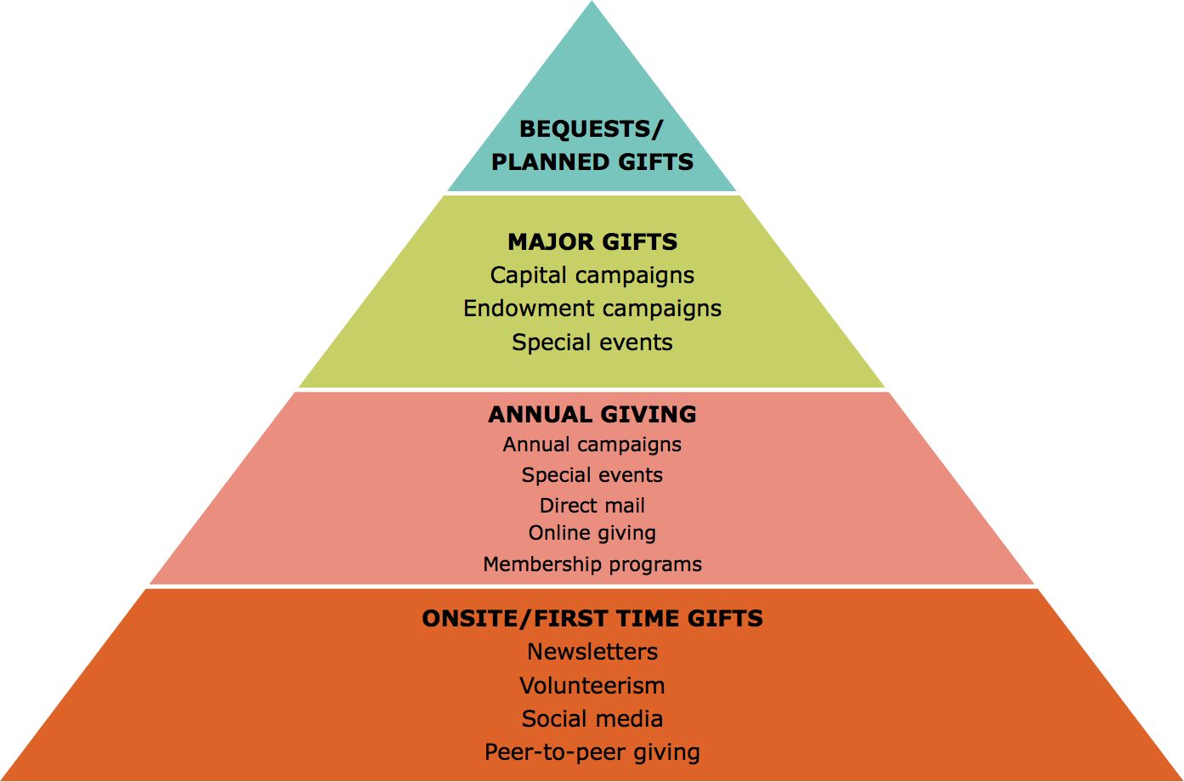
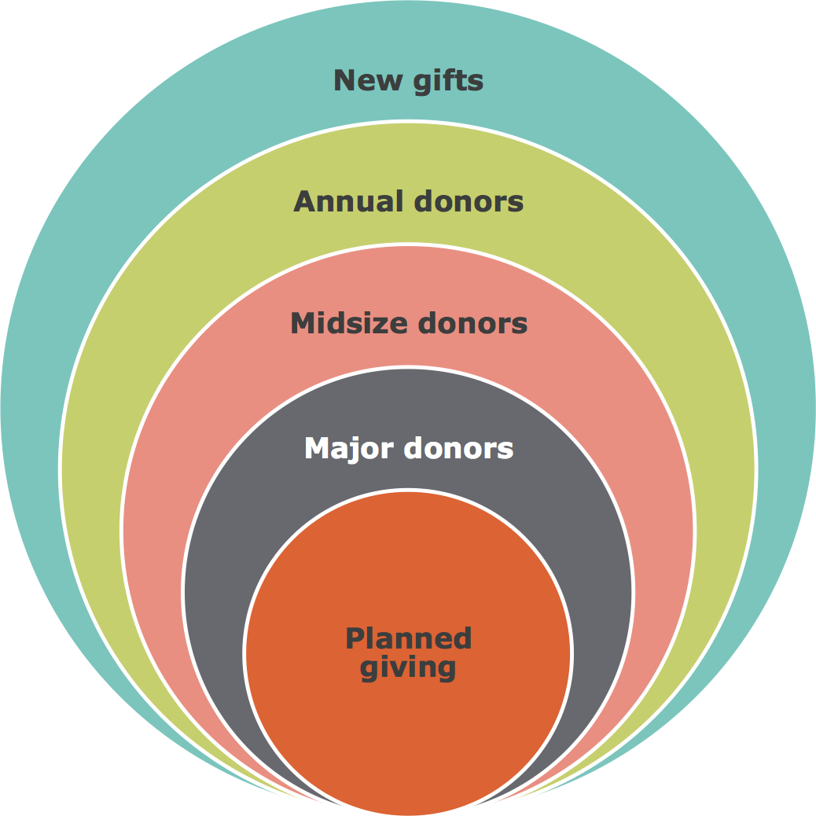
Source: BoardSource.com
Notes:
Fundraising professionals often refer to this work as “friend-raising” because it is all about relationships.
The traditional fundraising model as it relates to individual donors is The Giving Pyramid (LEFT). The idea is that there are different amounts of donors and different donor amounts within the pyramid. At the bottom of the pyramid are the largest number of donors giving the smallest charitable gifts. As you move up the pyramid, there are fewer donors giving more money.
For me, this visual model does not convey the spirit of fundraising. For me, fundraising and relationship-building are about bringing current and prospective donors closer to the inner circle of the organization. I like to think of it as spheres of influence. The idea is that the closer someone feels to the organization, the more likely he or she is willing to give in frequency and/or dollar amounts.

Slide 19
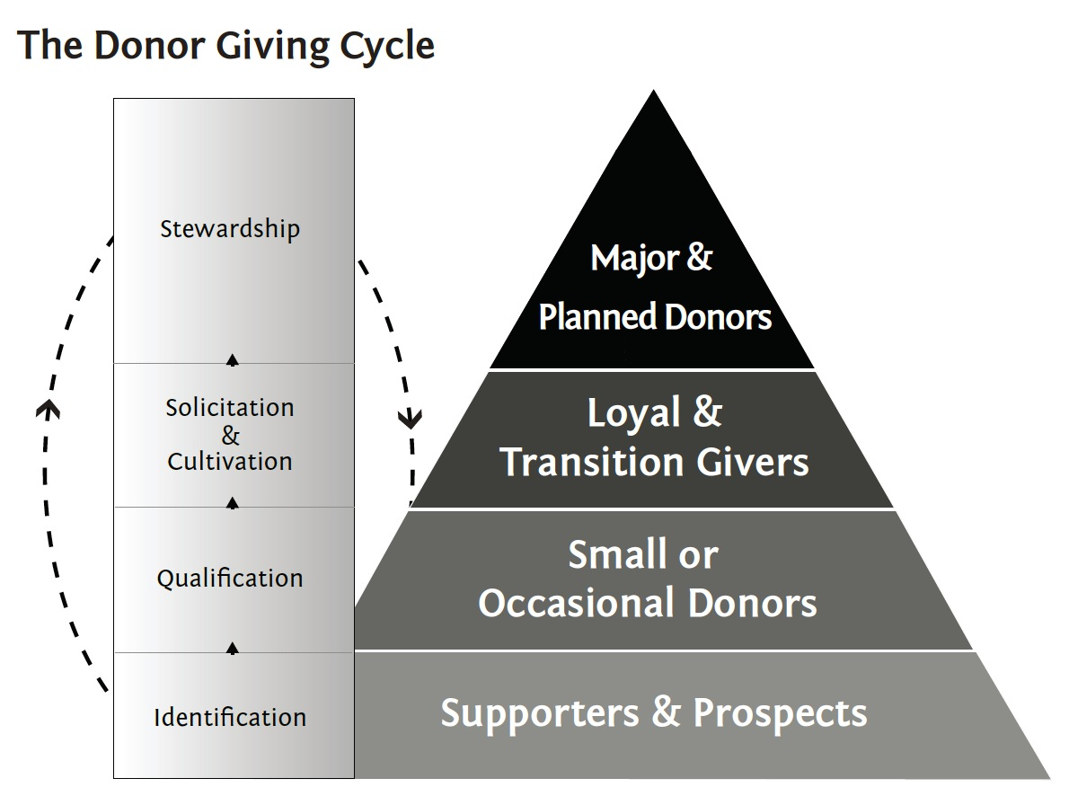
Source: Donor Giving Cycle, Jacobson Group Consulting, 2021
Notes:
Identification: Finding out who your donors and prospects are -- At the most basic level, this includes demographic data like age, gender identity, socioeconomic status, and location. For planned and major gift donors, you should also dig deeper to identify their interests and values.
Qualification: Evaluate your donors and prospects. Information that is particularly helpful to keep in mind includes: giving history, financial resources, areas of involvement, and interests. Wealth screenings help qualify as well.
Cultivation: Engage donors and prospects
To cultivate your donors and prospects, share resources, articles, and stories about the topics that matter most to them, invite them to activities and events, ask them to share their thoughts and opinions through a survey, involve them in your social networks, and if you haven’t already, meet with them for a one-on-one conversation where you can get to know them better.
4. Solicitation: Ask for donations based on what you know
*** EXTRA STEP: Recognition: Acknowledge your donor’s contributions
6. Stewardship: Build on your relationship

Slide 20
Sharing Your Fundraising Strategy
Co-create and share your Goals and Expectations
  What is your scale?
  What do you want to accomplish?
  Who’s on board?
Notes:
Set your Goals and Expectations What is your scale? A frequent comment is “my organization is not that big.” Today we want you to think “deep” not “big.” There are few gigantic non-profits, however small & impactful is great! Changing lives in your hometown or neighborhood is great! Define what you want to accomplish by what “impact” do we want to have? Is everyone in your organization on-board. What’s it like when the CFO/Finance isn’t in the game? your expectations must align with your goals, and most importantly, your resources!
We get what we MEASURE. If it’s really important, you will measure it! So what things are really important to set up as measurable expectations in your plan. How many of you have step trackers on today? You’re measuring your steps because it’s important to you. Take Weight Watchers for example. Why do they have weekly weigh-ins? Because the really important outcome is weight loss. Take time to log the results and compare the actual vs. planned. What things are really important here? Review whether or not you completed the activities necessary to have the opportunity to reach your goals.
# Donor Count, % Participation, how many donors you acquire, how many you retain, how many you upgrade (measured as Acquisition, Renewal, and Upgrade rates)
Human beings adjust their behavior based on what they’re measured against – how do you create stewardship processes that are built-into the donor cycle that are measured?
Communicate the measurements up, down, and across the organization
Systematize Weekly “RAPs”
The weekly “RAP’s” are the basic building block for performance management. Review and Plan. Review the previous week. Plan for the next week. @ND, development team followed Six Sigma guidelines (yellow belt). And our team had twice weekly 15 min standing SCRUM meetings. The meetings, the agenda, the questions simply become expected. Planning goes from being an annual activity to a weekly activity. Better Focus = Better Results

Slide 21
On Board vs. On the Board
Influential, affluent, passionate, committed
Lead with a Culture of Philanthropy mindset
Steward generosity as a ministry partner
Hold each other accountable for success
Use their talents to make a real difference
Engage in meaningful work with substantive dialogue
Find joy in their service
Notes:
“Boards are called to steward generosity as ministry partners, not just governors.”
Your BEST board would be one that’s “On Board” vs. on the board. A board that is comprised of a blend of Influential, affluent, passionate, and committed members.
Lead with a Culture of Philanthropy mindset
Steward generosity as a ministry partner
Hold each other accountable for success
Use their talents to make a real difference
Engage in meaningful work with substantive dialogue
Find joy in their service

Slide 22
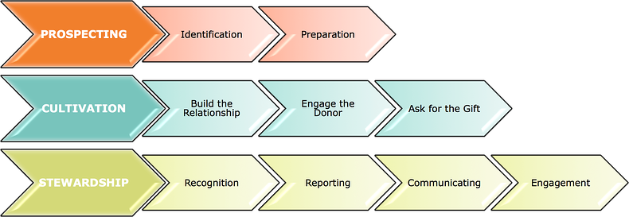
All Hands on Deck
Source: BoardSource.com
Notes:
So how does this happen? How do organizations get people to give and build lifelong loyalty to a mission?
Often nonprofit boards will hire an executive director or development director or even have a department of fundraising professionals to make it happen, and boards/volunteers will think they are off the hook from fundraising because they don’t have to actively solicit. Fundraising is more than making an ask!
In fact, organizations need all hands on deck with fundraising. Fortunately, there are many ways for board members and volunteers and other employees of the organization to get involved with the process of fundraising, which generally boils down to three steps: prospecting, cultivation, and stewardship.

Slide 23
Deciding when to ask and who asks?
Art & Science of the Ask
    Not only by quantitative analysis
    • Right Donor • Right Purpose • Right Amount • Right Solicitor • Right Time
    Donor’s inclination to give
Notes:
Profiling and segmentation takes a more sophisticated look at donors and focuses on finding the right combination of factors including the: Right donor; Right purpose; Right amount; Right solicitor; Right time and of course the Right Story.
Whether your Face-to-face with a donor, speaking to groups, writing direct mail letters, case statements, or developing online content … Profiling and Segmentation isn’t just nice, it’s necessary! Sometimes it can be overlooked due to lack of staff, re-prioritization, or the timing of the appeal has you racing against the clock. Make the time! Knowing your donors inclination to give, segmenting your database, and crafting the appeal and the ask with emotional narrative are all crucial steps in the planning process. Question: do any of you segment by constituency code? By donors or nondonors? By volunteers or clients? How about those who have attended your events?
Segmentation1 year lapsed (LYBUNT) — this group is usually on cue to give at the end of the year
First-time donors in the past year — spend more time with this group
Multiple year in a row givers — think recurring gifts
Bonus: Major donors — segment for portfolio assignment and attention
Gave sometime in the last several years (SYBUNT)

Slide 24
Ladder of Effectiveness
              Personal: face-to-face
          Personal letter
                With telephone follow-up
                Without telephone follow-up
      Personal telephone
                With letter follow-up
              Without letter follow-up
            Personalized letter-Internet
          Telephone solicitation/ phonathon
        Impersonal letter/ direct mail/ Internet
      Impersonal telephone/ telemarketing
    Fundraising benefit/ special event
  Door-to-door
Media/advertising/Internet
Notes:
STATE FACT: (READ)
In a recent State of Nonprofit Marketing Report published by Salesforce.org, only 33.6% of #donors agree and 6.4% strongly agree that “the communications I received from the #nonprofit were personalized for me.”
Those numbers aren’t okay. So 60% of donors feel letters aren’t personalized.
Communicate with your donors and prospects in a personal way—which, in turn, will help your organization attract, engage, steward, and retain the constituents that support the great work that you do.
Activity: ask participants to share one way they can “climb the ladder” with a donor this year.

Slide 25
Donor and Volunteer Stewardship
Giving USA Annual Report
This annual report on donor behavior will help you understand what is important to donors and ultimately where to focus your time for stewardship.
AFP Global Fundraising Effectiveness Project
The decrease in year-over-year donor retention underscores that nonprofits need to invest in stewardship, thanking past supporters, showing appreciation, and demonstrating impact.
Notes:
Giving USA 2022 includes data on donor behavior that will help you understand what is important to donors and ultimately where to focus your time.
For example, the consistent decrease in year-over-year donor retention underscores that nonprofits need to invest in stewardship, thanking past supporters, showing appreciation, and demonstrating impact (retention rate obtained from the Fundraising Effectiveness Project).

Slide 26

Notes:
Most important Practice of all!
[Query the room] for acknowledgement process and timing.
Thank donor for the impact, not just the money. Thank them for their trust. Thank them for joining you on your mission to___________.

Slide 27
Practices of Stewardship
Don’t just thank donors for their money ... thank them for the impact and experiences their investment brings to your program and service recipients.
Provide timely, thoughtful and well-crafted information to donors, clearly demonstrating the significance of their gift(s)
Ensure that the funds are administered according to the donor’s intent
Perform stewardship activities all year long
Seek to include stewardship in the greater organizational community of leaders
Notes:
Practices of Stewardship
Don’t just thank donors for their money ... thank them for the impact and experiences their investment brings to your program and service recipients.
Provide timely, thoughtful and well-crafted information to donors, clearly demonstrating the significance of their gift(s)
Ensure that restricted and endowed funds are administered according to the donor’s intent
Perform stewardship activities all year long (annual reporting, processes and procedures)
View stewardship as part of the cycle, along with identification, cultivation, solicitation, …
Seek to include stewardship in the greater organizational community of leaders

Slide 28
A Return to the Personal
​Research tells us that many donors will make another gift because of a personal thank you call.
Donors are likely to give again because of a positive experience at a donor appreciation event. ​
Donors give to make the world a better place.
Time, talent, and treasure …
&
… testimony, ties, and trust!
Notes:
Our work is to deepen their connections with our outcomes – the outcomes they fund – and to increase their philanthropy in making the world a better place.
Donors give to make the world a better place. We have a significant body of knowledge and plenty of best practices – enough to keep any of us busy for a long time with a lot of donors. These guide us toward authentic, sincere appreciation of donors and management of what messages we send them, how well we keep records, and how we manage relationships.
Time, talent, and treasure …
… testimony, ties, and trust!

Slide 29
  “Focus on the people first, not the numbers,
  and the numbers will take care of themselves.”
Notes:
This has been my faith anchor!
“ Focus on the people first, not the numbers,
and the numbers will take care of themselves.”
All the research, queries, and data analysis, no matter how extensive, cannot substitute for the knowledge gained through personal, meaningful interactions with our donors and prospects!

Slide 30

Virtual Coaching Offer
Jacobson Group Consulting will provide (1) one-hour virtual meeting, pro bono, to each registered organization to facilitate one-on-one or small group coaching within five months following this workshop (September – February).
Contact:
leighann@JacobsonGroupConsulting.com
to arrange a mutually convenient coaching session
Notes:
This is one of the ways I live out my faith—by offering my time and expertise as a gift to those whose work is bringing hope, equity, and transformation. I believe deeply in investing in those who are lifting others up. For me, it’s a faith-filled gift to you—an opportunity to invest in changemakers like you who are advancing values I hold dear: compassion, equity, access, and opportunity.

Slide 31
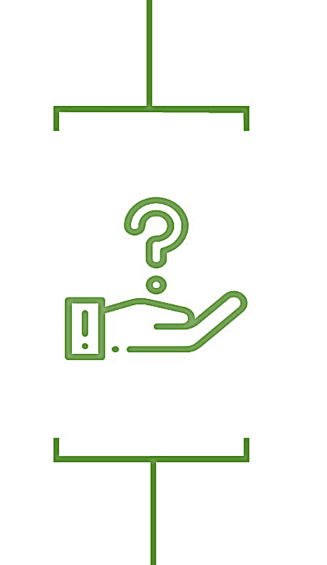
Questions and Feedback
“Faith asks us to take small
steps daily — seeds of generosity
that grow into abundance.”
Notes:
Let’s end where we started…
“Faith asks us to take small
steps daily — seeds of generosity
that grow into abundance.”
Go back to 2-degree shift – ask what they’ll take back!

Slide 32


Let’s connect!
Leigh Ann M. Jacobson, CFRE
Founder & Principal, Jacobson Group Consulting
leighann@JacobsonGroupConsulting.com
Direct Cell: 847-636-6618
www.linkedin.com/in/JacobsonGroupConsulting
www.facebook.com/JacobsonGroupConsulting

