Slide 1
Leigh Ann Jacobson, CFRE
Jacobson Group Consulting
Everence Development Conference
September 24, 2025, 10-11:15 a.m.
Mission-Focused Fundraising:
Tailored for Small Development Teams
“Our mission is to grow your mission.”
Notes:
Welcome everyone! I’m Leigh Ann Jacobson, CFRE. I’ve spent much of my career helping small but mighty development teams align their mission with donor passion in ways that inspire transformational giving.
This session is especially designed for small shops. My goal is to equip you with practical strategies—grounded in faith—that help you do more with heart and purpose, even with limited resources.
We’ll also explore how mission-focused work creates deep relationships with donors that often lead to major gifts.

Slide 2
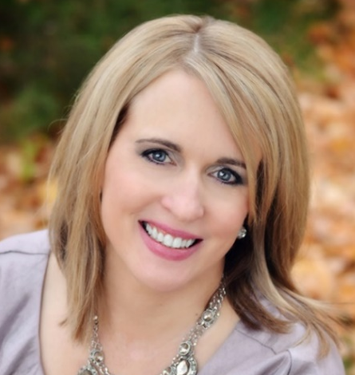
Hi there!
Leigh Ann Jacobson, CFRE Professional Biography:
Founder & Principal Consultant of Jacobson Group Consulting with over 25+ years of experience
Philanthropy executive and practitioner (Greater Chicago)
Keynote and plenary speaker on leadership, nonprofit management, and fundraising topics
Accomplished fundraiser with a track record of securing seven-figure gifts
Niche in helping nonprofits with limited resources make an extensive impact
Decades of board level leadership with AFP (Association of Fundraising Professionals)
University of Notre Dame, Mendoza College of Business, Certificate in Executive Management and Yellow Belt Lean Six Sigma; Arcadia University, M.A. English; King's College, B.A. English
Notes:
“Lord Jesus, we thank You for the gift of this day and for the work set before us. Help us to walk in Your ways with humility and love. Keep us faithful in serving one another, and may our lives bring glory to God. Amen.”
Fund Development Executive and Consultant with over 25+ years of experience.
Founder & Principal of Jacobson Group Consulting.
Keynote and plenary speaker on strategic marketing, nonprofit management, and fundraising topics
Accomplished fundraiser with a track record of securing seven-figure gifts
Niche in helping nonprofits with limited resources make an extensive impact
Former adjunct faculty member teaching fundraising classes at Indiana University South Bend
Decades of board level leadership with AFP (Association of Fundraising Professionals)
University of Notre Dame, Mendoza College of Business, Certificate in Executive Management and Yellow Belt Lean Six Sigma; Arcadia University, M.A. English; King's College, B.A. English

Slide 3




Mission-Focused Fundraising
“Inspiring donors to invest with heart, purpose, and faith.”
Notes:
This is the heart of today’s session: Inspiring donors to invest with heart, purpose, and faith. I’m going to present from the lens which I see -- philanthropy as ministry in action.
Fundraising is not just about revenue—it’s about inspiring donors to invest in something that matters deeply to them.
“When we anchor in mission, not money, we cultivate generosity that is sustainable, joyful, and faith-filled.
Icebreaker: “Take a moment—what’s one word that comes to mind when you hear ‘mission-focused fundraising’? Let’s share a few.”

Slide 4
Session Objectives
Clarify mission messaging to engage and inspire major donors.
Learn time-smart strategies for small shops to cultivate, solicit, and steward major gifts.
Strengthen donor communication by aligning shared faith values with transformational giving.
Leave with practical tools that lead to major gift support, even with limited capacity.
Notes:
Where we’re headed – 4 Session Objectives
“Here’s where we’re headed. This session is about equipping you to clarify and communicate your mission more powerfully, use strategies that work for lean teams, and align your messaging with faith-based values.”
“And most importantly, you’ll walk away with tools that will help you steward and grow major gift relationships—even without a large staff.”
Clarify mission messaging to engage and inspire major donors.
Learn time-smart strategies for small shops to cultivate, solicit, and steward major gifts.
Strengthen donor communication by aligning shared faith values with transformational giving.
Leave with practical tools that lead to major gift support, even with limited capacity.

Slide 5
Small Staff / Small Fundraising Team = BIG Results
Performance Multipliers
CEO = chief relationship-builder
Board = active in identifying and cultivating
Ask boldly: restricted and unrestricted gifts
Focus on strong management principles
Data-driven decisions
Notes:
Small Staff / Small Fundraising Team = BIG Results
“This is not about having more, but about doing more with heart, purpose, and faith.”
“Small staff doesn’t mean small impact. In fact, small shops often have the advantage of intimacy—you can get highly personal about impact.”
.” Small teams need performance multipliers on their side!
“But it requires clarity: your CEO must be the chief relationship-builder, and your board must be active participants in cultivation. Board = front door to an organization!
“Don’t hesitate to ask boldly—restricted and unrestricted gifts are both vital. Remember: donors aren’t choosing between good and bad, but between good and good.”
“With the right approach, small teams can achieve big results by focusing on strong management principles rooted in data-driven decisions.

Slide 6
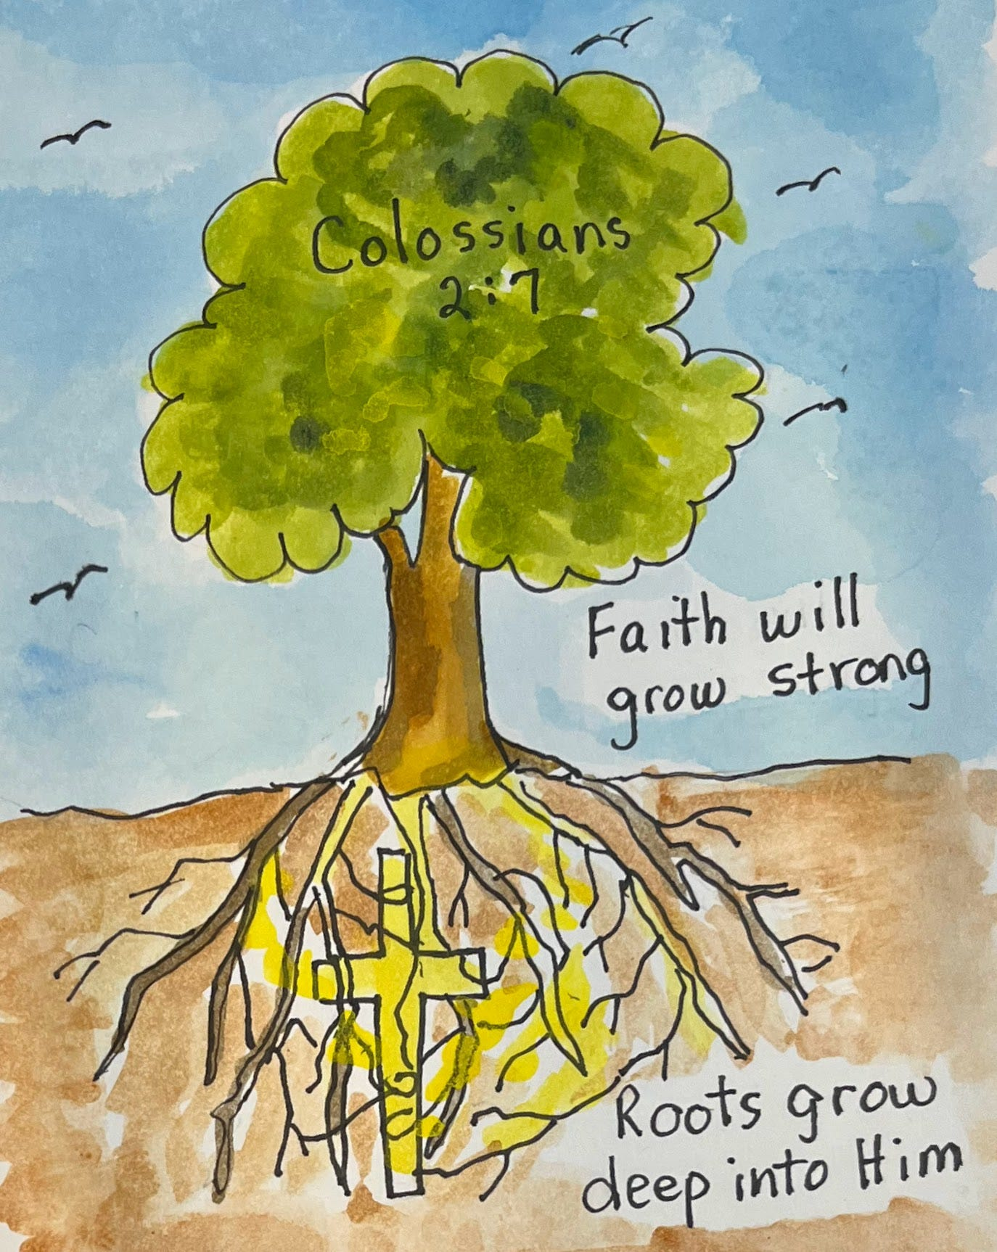
Fundraising Rooted in Purpose
Mission-first fundraising builds long-term trust
Reactive fundraising = short-term gains, mission drift
Root your work in faith, not fear—in mission, not money nor urgency
Notes:
Fundraising Rooted in Purpose
Mission-first fundraising builds long-term trust
Reactive fundraising = short-term gains or even mission drift
Root your work in faith, not fear; in mission, not money
“Fundraising can feel reactive—chasing deadlines or closing year-end gaps. But when we lead with urgency instead of purpose, we risk mission drift.”
“Mission-first fundraising builds long-term trust. When donors see you rooted in your values, they give because they share that faith and purpose—not because you’re desperate.”
“Scripture reminds us: ‘So then, just as you received Christ Jesus as Lord, continue to live your lives in him, rooted and built up in him, strengthened in the faith… and overflowing with thankfulness’ (Colossians 2:6–7).”
“I’ve seen this firsthand: once, our team faced a budget shortfall. Instead of sending a panic appeal, we told a single, heartfelt story of impact. Donors responded with joy, and we exceeded our goal. Mission, not fear, won.”
Engagement Prompt: “Think of a time you had to choose mission over urgency. How did it shape your results?”
LAJ SHARE: personal example where purpose won out over panic ---
*"A few years ago, our team faced a budget shortfall just weeks before the end of the fiscal year. The temptation was to blast out a last-minute email pleading for help to 'close the gap.' Instead, we took a step back and asked, ‘What is our mission here? What story do we need to tell that’s true to who we are?’
We decided to share a single, heartfelt story about one student whose life had been transformed because of donor generosity. We framed the message around gratitude and impact, not urgency and fear.
The result? Not only did we meet the goal—we exceeded it. More importantly, donors told us afterward they felt inspired and reconnected to why they give, not pressured. That’s the power of letting mission lead, rather than panic."*
Or…
*"When I first began working with a faith-based organization, we were planning a year-end appeal during a tough economic year. The leadership wanted to focus on the ‘need’—how behind we were in revenue. But as I prayed about it, I kept coming back to the verse in 2 Corinthians about giving cheerfully and from the heart.
Instead of focusing on what we lacked, we crafted a message celebrating how God had already worked through donors that year, and inviting them to continue the journey. The campaign raised more than expected, but the real win was the flood of responses saying, ‘Your letter lifted my spirit.’ Mission—and ministry—won out over fear."*
ASK 1-2 ATTENDEES TO SHARE: “When have you had to choose mission over urgency?”

Slide 7

The “Why” Behind Giving
Donors give to values, not programs
Giving is a spiritual act, an expression of faith and purpose
Your role:
invite others into your mission as co-laborers in impact
Notes:
(10 mins) The ‘Why’ Behind Giving (Slide 4 + Video)
““Donors don’t give to fund your line items—they give to align their lives with their deepest values.”
“Generosity is a spiritual act, a reflection of faith. Our role is to invite people into the mission as co-laborers in impact.”
Next, I’m going to a short 2-minute World Vision video on why people give. You’ll hear words like blessing, gratitude, care for others. Then we’ll discuss: Which of those values resonate with your donors?”

Slide 8
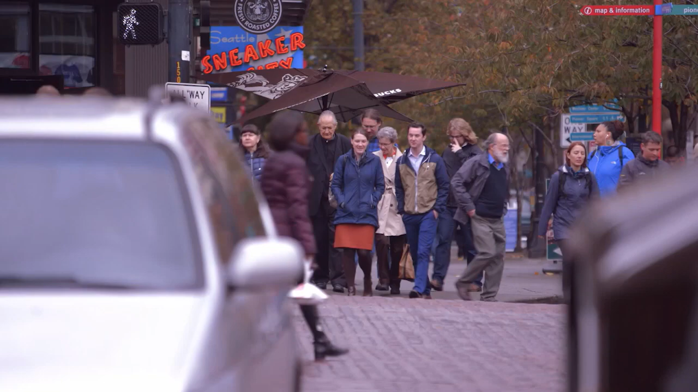
Notes:
The reasons behind giving are personal and varied. That’s what World Vision learned in Seattle, where they interviewed several women and men on their reasons for giving. Reasons we heard for giving included feeling good, taking care of each other, giving because they are blessed, and returning the help they have received in the past.
“What values came through?” Giving within your means and within your values makes you feel just as much joy as receiving something.
“What language would resonate with your donors?”
“Research shows 75% of donors say they give because they are moved by a story. It’s about values, not just budgets.”

Slide 9
Why Values Alignment Unlocks Major Gifts
Transactional vs. Transformational
Faith-based lens: generosity = discipleship in action
MG in Action: programs rooted in equity, justice, and opportunity—values rooted in their faith!
Notes:
Here’s the key: transformational giving happens when donor values and your mission align.”
Transactional gifts support programs. Transformational gifts support shared beliefs. That’s where major gifts are born!
A transactional gift happens when a donor responds to an appeal or covers a need. It is important, but it doesn’t usually change the donor or the organization. It solves a problem in the moment.
A transformational gift happens when a donor sees their values and faith fully aligned with your mission. Their giving becomes an expression of who they are and what they believe. It feels less like a donation and more like an investment in God’s work.
This alignment is what unlocks major gifts. Donors don’t stretch into five- or six-figure giving simply to meet a budget line. They give at that level because they see the mission as an extension of their values — stewardship, justice, equity, compassion, discipleship.
Faith-based giving is discipleship in action. When donors see their convictions lived out in your mission, their giving shifts from support to partnership.
“For example, donors don’t fund scholarships because they love tuition bills. They give because they value equity, justice, opportunity—all deeply faith-rooted values.”
When fundraisers lead with values and mission — not just numbers — they invite donors into something transformational. The message becomes: Your generosity isn’t just meeting a need, it’s advancing a vision you already believe in.
Major gifts aren’t bought with tactics. They are inspired through alignment. Our role in this ministry is to listen deeply enough to know what values are stirring in the donor’s heart and then connect those values to our mission.

Slide 10
How to put this into action?
Frame your ask in values language
Mission-first messaging: Anchor proposals in why the work matters, not just what the work does.
Bridge values to outcomes
Notes:
So, how do we put this action?? (see values language handout)
Frame your ask in values language: Instead of “We need $100K for this program,” say, “Your generosity helps ensure every student has the dignity of access to education, regardless of their means.”
Mission-first messaging: Anchor proposals in why the work matters, not just what the work does.
Bridge values to outcomes: Make the case that the donor’s values live on through impact stories—students, families, and communities transformed.

Slide 11


Values alignment is the key to transformational giving.
Pair & Share: “Reframing your appeal in values language.”
Notes:
Interactive Component (5–7 minutes)
Prompt: “Think of your top 3 donors. What values drive their giving? How does your organization reflect those values in your communication?”
Activity: Pair & Share: Reframe an appeal in values language. Ask participants to pair up and draft one sentence rephrasing an appeal to connect a donor’s values to the mission.
Report out: Invite 2–3 examples—highlight how even small shifts in wording move the conversation toward transformational giving.

Slide 12
Transactional vs. Transformational Giving
Transactional Giving | Transformational Giving
Meets an immediate need | Advances a vision aligned with values
Solves a short-term problem | Creates long-term, lasting impact
Motivated by obligation or request | Motivated by faith, values, and purpose
Donor = funder | Donor = mission partner
Supports a program | Invests in a calling or shared belief
Important but limited in scope | Unlocks major gifts and deeper engagement
Notes:
Transformational gifts are inspired through alignment. Our role in this ministry is to listen deeply enough to know what values are stirring in the donor’s heart and then connect those values to our mission.

Slide 13
A Look into Charitable Giving – Giving USA Report (July ‘25)
Total Charitable Giving reached a new high of $592.5 billion in 2024, growing 6.3% in current dollars and 3.3% adjusted for inflation.
By Source:
Individuals: $392.5B (66%) ↑
Corporations: $44.4B ↑
Foundations: $109.8B ↔
Bequests: $45.8B ↓
Source: GivingUSA.org
Notes:
Total Charitable Giving reached a new high of $592.5 billion in 2024, growing 6.3% in current dollars and 3.3% adjusted for inflation. **For the first time in three years, giving grew in inflation adjusted dollars as well (growing 3.3% in 2024), increasing the ability of nonprofits to deliver more on their missions. This is consistent with the average growth in giving of 5.5%.
The 2024 giving data confirms what many in the nonprofit sector have long believed: Generosity is not a fleeting response to crisis—it’s a sustained commitment. Donors’ desire to improve the world is deeply rooted. While it may waver amidst economic uncertainty, when paired with a strong economy, generosity becomes a catalyst for growth.
By Source:
Individual Giving: $392.5 billion (8.2% growth current, 5.1% real) — remains the largest contributor at 66% of total donations.
Corporate Giving: $44.4 billion, up 9.1% current and 6.0% real.
Foundations: around $109.8 billion, up 2.4% current but flat or slightly down when inflation-adjusted
Bequests: $45.8 billion, declining 1.6% current and 4.4% real
By Source:
“Individuals drive two-thirds of all giving—your major gift pipeline.”
“Corporate giving also rose, reflecting confidence in economic conditions.
Foundations stayed flat
Bequests declined, and foundation giving held steady.”
“The signal? For small shops, the best investment is still individual relationships.”

Slide 14
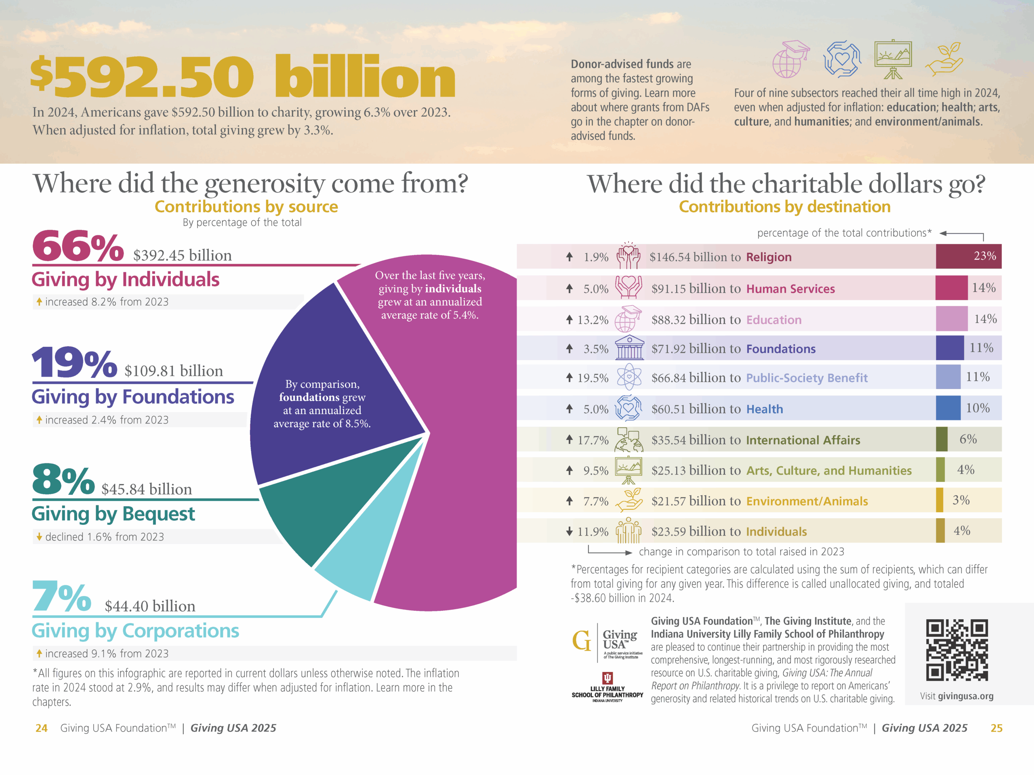
Notes:
Lots to unpack here. Let’s look to my upcoming slides for more pertinent findings.

Slide 15
A Look into Major Gifts– Giving USA Report (July ‘25)
Mission-Focused Growth: Donor enthusiasm for education, social good (public-society benefit), global relief (international affairs), arts, and environment continues
to rise sharply—especially in areas that resonate with value-driven or impact-
oriented causes.
Sustained Individual & Corporate Giving: Individual donors fueled most of the growth, supported by strong financial markets. Corporate philanthropy also rose notably, reflecting steady economic confidence.
Shifts in Sources: While individuals still dominate, corporate and foundation sources are representing a larger or stable share of total philanthropy. Meanwhile, bequests are declining.
Notes:
Key Insights & Trends
Mission-Focused Growth: Donor enthusiasm for education, social good (public-society benefit), global relief (international affairs), arts, and environment continues to rise sharply—especially in areas that resonate with value-driven or impact-oriented causes.
Sustained Individual & Corporate Giving: Individual donors fueled most of the growth, supported by strong financial markets. Corporate philanthropy also rose notably, reflecting steady economic confidence.
Shifts in Sources: While individuals still dominate, corporate and foundation sources are representing a larger or stable share of total philanthropy. Meanwhile, bequests are declining.
What does this mean for major gifts?
“Donors are increasingly motivated by value-driven causes: education, social impact, global relief.”
“Individuals remain the largest and most reliable source, but corporations are stepping up, especially in CSR-aligned partnerships.”
“Religious giving, though still significant, continues its long-term decline. Faith-inspired generosity hasn’t gone away—it’s just being directed differently.”
“For faith-based nonprofits, this means we need to show how our mission reflects lived faith values like justice, compassion, and service.”

Slide 16
Faith + Data Connection
Giving USA 2025: individual giving ↑ 8.2%
Religious giving ↓, values-driven causes ↑
Signal: Donors redirecting faith through
values-driven philanthropy
+ DAFs
+Bequests
Notes:
Faith + Data Connection
Let’s bring data and faith together. The Giving USA 2025 report shows individual giving grew 8.2%, making up two-thirds of all giving. And don’t forget DAFs and bequests are individual decisions too! This is your major gifts pool.
But note: religious giving is declining in aggregate. Instead, people are directing their giving toward causes that embody their values—like education, human services, and international relief.
This signals a shift. Donors still want their giving to be discipleship in action, but they’re expressing it through causes where they see faith and values lived out in practice.
So major gifts aren’t about slick proposals—they’re about values alignment. That’s when giving becomes transformational.

Slide 17

Decline in Religious Giving
Although still a significant slice of the pie, religious giving declined by 1% in real terms, highlighting a long-term downward trend —from 56% in the mid-1980s to just 25% over the past five years.
Notes:
Although still a significant slice of the pie, religious giving declined by 1% in real terms, highlighting a long-term downward trend. Religion still accounts for the largest share of donations at 23%, but that share is shrinking. It has fallen dramatically from 56% in the mid-1980s to just 25% over the past five years.

Slide 18

Opportunities and Growth Areas
Human Services Holds #2 Subsector Spot
Human Services giving: $91.15B (↑ 5% current, ↑ 2% real).
Corporate and Foundation Giving Poised for
Continued Growth
Major Gift Tip: Funders are looking for impact-driven programs, so it’s essential to demonstrate measurable outcomes and how investments support long-term systemic change. Tell human-centered stories & show measurable outcomes clearly.
Notes:
Human Services now surpasses Education, even as Education giving also grew significantly, signals a shift in donor priorities, which continue to prioritize basic needs and community supporting causes—especially in the wake of pandemic-era disruptions and ongoing economic uncertainty. This highlights the importance of articulating impact in human-centered terms and aligning messaging with the values driving donor behavior today.
Funders are looking for impact-driven programs, so it’s essential to demonstrate measurable outcomes and how investments support long-term systemic change.
Corporate giving remained steady at 1.1% of pre-tax profits, reaching a historical high in both current and inflation-adjusted dollars. Foundation giving was flat in real dollars year-over-year but exceeded $100 billion for the third consecutive year.
The Human services climb showcases donor concern for basic needs and community resilience.
Funders want measurable outcomes and systemic change—not just short-term relief.
For small shops, tell human-centered stories and show your measurable outcomes clearly.

Slide 19
Ladder of Effectiveness
              Personal: face-to-face
          Personal letter
                With telephone follow-up
                Without telephone follow-up
      Personal telephone
                With letter follow-up
              Without letter follow-up
            Personalized letter-Internet
          Telephone solicitation/ phonathon
        Impersonal letter/ direct mail/ Internet
      Impersonal telephone/ telemarketing
    Fundraising benefit/ special event
  Door-to-door
Media/advertising/Internet
Notes:
Not all fundraising methods are equal. Face-to-face remains the most effective—especially for major gifts.”
“Yet, Salesforce found 60% of donors feel nonprofit communication isn’t personalized. That’s a big miss—and a big opportunity.”
STATE FACT: (READ)
In a recent State of Nonprofit Marketing Report published by Salesforce.org, only 33.6% of #donors agree and 6.4% strongly agree that “the communications I received from the #nonprofit were personalized for me.”
“Small shops can win here. Personal touches—handwritten notes, follow-up calls—carry outsized weight.”
Activity: “What’s one way you can ‘climb the ladder’ with a donor this year? Jot it down.”

Slide 20
Action Steps: Turning Insights into Impact
🔹 Assess & Align – Evaluate current funding strategies and align with
donor interests.
🔹 Diversify Funding – Expand revenue streams through foundation grants, corporate partnerships, and community-driven giving circles.
🔹 Strengthen Storytelling – Use impact-driven narratives to connect with donors and showcase transformational change.
🔹 Deepen Donor Engagement – Build relationships through personalized stewardship and exclusive donor experiences.
🔹 Leverage Digital Tools – Maximize online giving, social media campaigns, and virtual events to reach new supporters.
Notes:
“Here are five practical ways to take today’s insights into action.”
“Assess your current strategies and align them with donor values.
Diversify revenue streams so you’re not overly dependent on one source.”
“Storytelling + personal stewardship is your superpower. Lean into that.”
“And don’t neglect digital tools—they expand your reach and complement the personal touch.”

Slide 21
Key Takeaways: Values-driven Philanthropic Growth
Generosity is not fleeting — it’s sustained commitment.
Donors want impact, outcomes, and systemic change.
Major gifts: donor investment requires deep trust and vision/values alignment.
Donors want their giving to be discipleship in action.
Notes:
“Here are the anchors: generosity isn’t fleeting—it’s sustained.”
“Donors are seeking measurable impact. They’re making major investments where they see systemic change.”
“Major gifts aren’t about clever asks—they’re about trust and values alignment.”
“Most importantly: for many donors, giving is discipleship. Our role is to minister to that journey.”

Slide 22
  “Focus on the people first, not the numbers,
  and the numbers will take care of themselves.”
Notes:
This has been my faith anchor!
“ Focus on the people first, not the numbers,
and the numbers will take care of themselves.”
“When you focus on people—their stories, values, and faith—the numbers follow naturally.”

Slide 23

Virtual Coaching Offer
Jacobson Group Consulting will provide (1) one-hour virtual meeting, pro bono, to each registered organization to facilitate one-on-one or small group coaching within five months following this workshop (September – February).
Contact:
leighann@JacobsonGroupConsulting.com
to arrange a mutually convenient coaching session
Notes:
As part of this conference, I want to offer each of you a one-hour virtual session with me, pro bono. This one-hour is for each organization (not person) present in my session. This is one of the ways I live out my faith—by offering my time and expertise as a gift to those whose work is bringing hope, equity, and transformation.
I believe deeply in investing in those who are lifting others up. It’s an opportunity for you to bring a real challenge or project, and I’ll help coach you through it.
Please reach out by email—we’ll find a time that works.

Slide 24

Questions and Feedback
Small teams can do mighty things when rooted in mission and ministry.
Notes:
Let’s pause here. What resonated with you today? What questions are on your mind?
Remember: small teams can do mighty things when they are rooted in mission and ministry.

Slide 25
See me at my other sessions!
The Ministry of Major Gifts: Building Relationships that Cultivate Generosity (for Mid-Size Shops) – Today @ 3-4:15 p.m.
Major gift work isn’t just a tactic—it’s a ministry of relationship-building. We’ll explore how mid-sized teams can deepen donor connections through strategic engagement, storytelling, and clarity of mission.
Beyond the Development Office: How Every Leader Plays a Role in Fundraising Success (for Non-Fundraisers) – Tomorrow 8-9:15 a.m.
Fundraising is a shared responsibility. This session is designed for presidents, deans, pastors, board members, and program staff who want to confidently step into their role
in advancing philanthropy. Because building a culture of generosity starts with
shared ownership.
Notes:
If you found today helpful, I’d love to see you at my other sessions. This afternoon, I’ll be talking about the ministry of major gifts for mid-size shops, and tomorrow, is for the nonfundraisers in attendance; we’ll look at how every leader can play a role in fundraising success.

Slide 26


Let’s connect!
Leigh Ann M. Jacobson, CFRE
Founder & Principal, Jacobson Group Consulting
leighann@JacobsonGroupConsulting.com
Direct Cell: 847-636-6618
www.linkedin.com/in/JacobsonGroupConsulting
www.facebook.com/JacobsonGroupConsulting

