Slide 1
Money and mission:
Fueling purpose, funding impact
Jeff Gingerich, Ph.D.

Slide 2
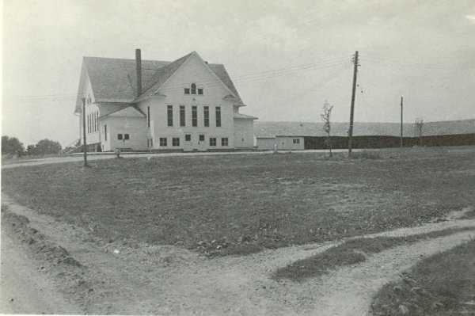
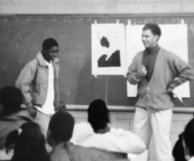
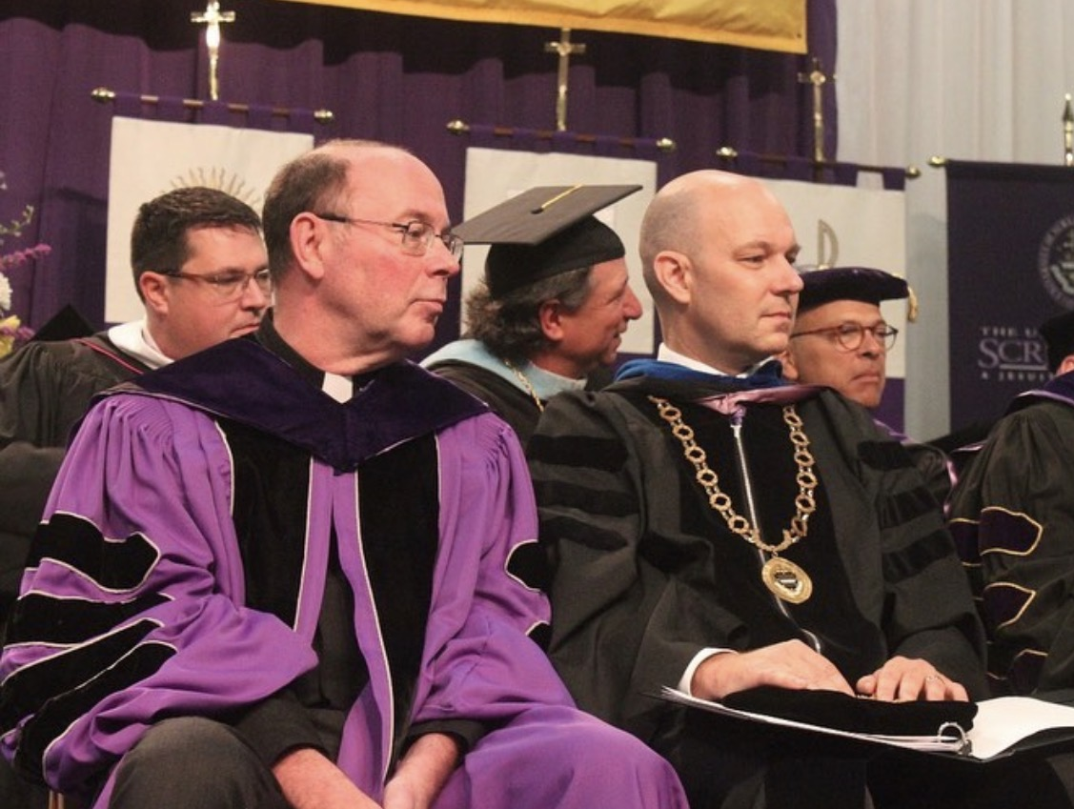
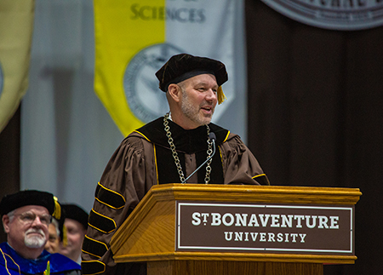
From Mennonite Farm boy to Franciscan Presidency
Iowa Mennonite School
Hesston College/ Eastern Mennonite College
Mennonite Central Committee
(New Orleans)
UPenn Dissertation on Philly Mennos
Bluffton College
Cabrini University
University of Scranton
St. Bonaventure University

Slide 3
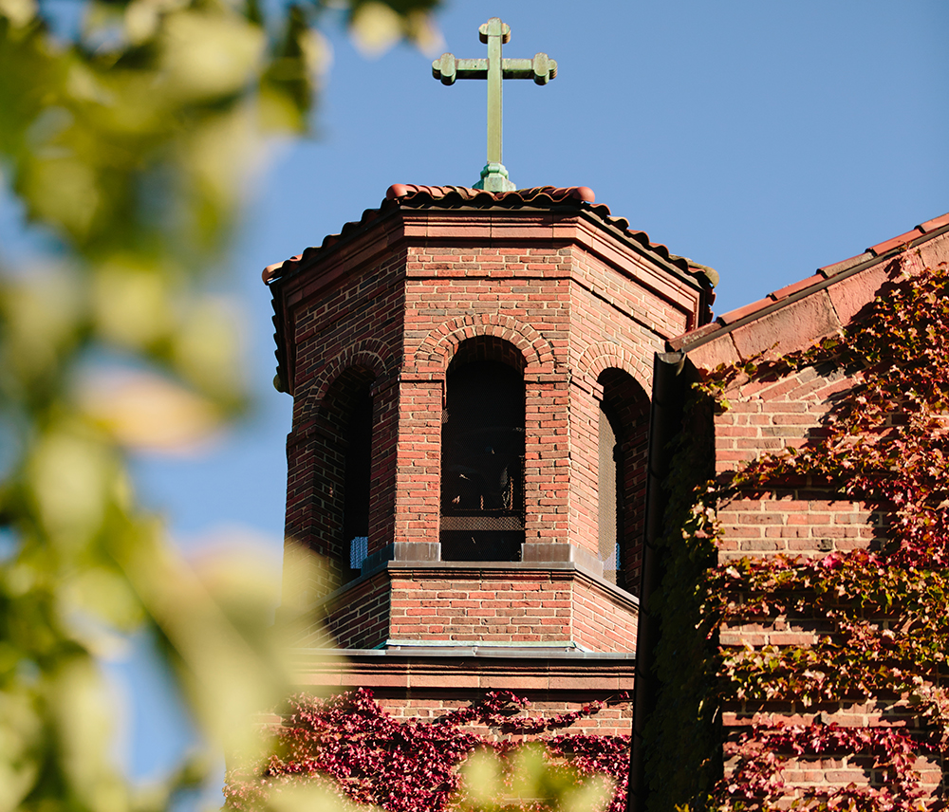
Introducing Mennonites to
St. Bonaventure University
What’s the difference between Mennonites and Amish?
Why would we consider Mennonites in Philadelphia to be one of the most ethnically diverse religious groups in
the U.S.?
And why does Jeff get nervous when gathering around a campfire with Catholics and Protestants?

Slide 4
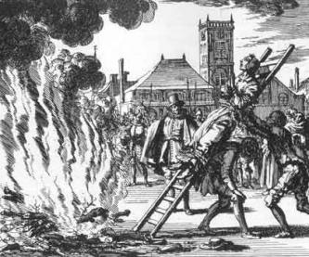
Reasons to avoid campfires…

Slide 5



Mission = Foundation of fundraising
No money,
no mission.
No mission,
No money.
Know mission,
Know money.
Money and mission are not oppositional.
Money is the fuel for impacting mission.

Slide 6
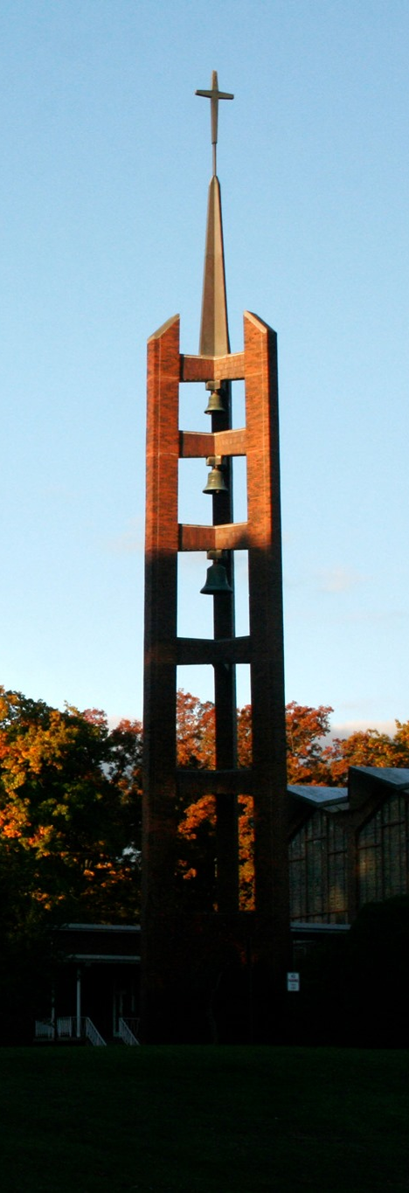
St. Bonaventure University
OUR MISSION:
St. Bonaventure is a Catholic university dedicated to educational excellence as informed by our Franciscan and liberal arts traditions. In the words of our patron, we believe that there should be “no knowledge without love,” and thus seek to transform the lives of our students, inspiring in them a lifelong commitment to service
and citizenship.
St. Bonaventure embraces students, faculty and staff of all faiths and cultures and strives to bring out the best in every individual through meaningful relationships. As an academic and spiritual community, we endeavor to prepare our students for the challenges they will face in their professional careers and personal lives.
OUR MISSION:
St. Bonaventure is a Catholic university dedicated to educational excellence as informed by our Franciscan and liberal arts traditions. In the words of our patron, we believe that there should be “no knowledge without love,” and thus seek to transform the lives of our students, inspiring in them a lifelong commitment to service
and citizenship.
St. Bonaventure embraces students, faculty and staff of all faiths and cultures and strives to bring out the best in every individual through meaningful relationships. As an academic and spiritual community, we endeavor to prepare our students for the challenges they will face in their professional careers and personal lives.
OUR MISSION:
St. Bonaventure is a Catholic university dedicated to educational excellence as informed by our Franciscan and liberal arts traditions. In the words of our patron, we believe that there should be “no knowledge without love,” and thus seek to transform the lives of our students, inspiring in them a lifelong commitment to service
and citizenship.
St. Bonaventure embraces students, faculty and staff of all faiths and cultures and strives to bring out the best in every individual through meaningful relationships. As an academic and spiritual community, we endeavor to prepare our students for the challenges they will face in their professional careers and personal lives.
OUR MISSION:
St. Bonaventure is a Catholic university dedicated to educational excellence as informed by our Franciscan and liberal arts traditions. In the words of our patron, we believe that there should be “no knowledge without love,” and thus seek to transform the lives of our students, inspiring in them a lifelong commitment to service
and citizenship.
St. Bonaventure embraces students, faculty and staff of all faiths and cultures and strives to bring out the best in every individual through meaningful relationships. As an academic and spiritual community, we endeavor to prepare our students for the challenges they will face in their professional careers and personal lives.

Slide 7
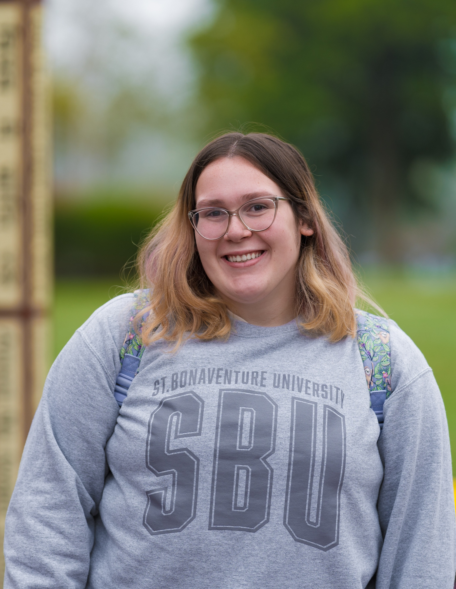
St. Bonaventure University
OUR VALUES:
Our Franciscan COMMUNITY affirms the unique dignity of everyone, each person reflecting the goodness of God, and invites all of our sisters and brothers to forge bonds of mutual acceptance and understanding that create a true sense of belonging.
We are a COMMUNITY…
  Nurturing COMPASSION.
  Seeking WISDOM.
  Building INTEGRITY.

Slide 8
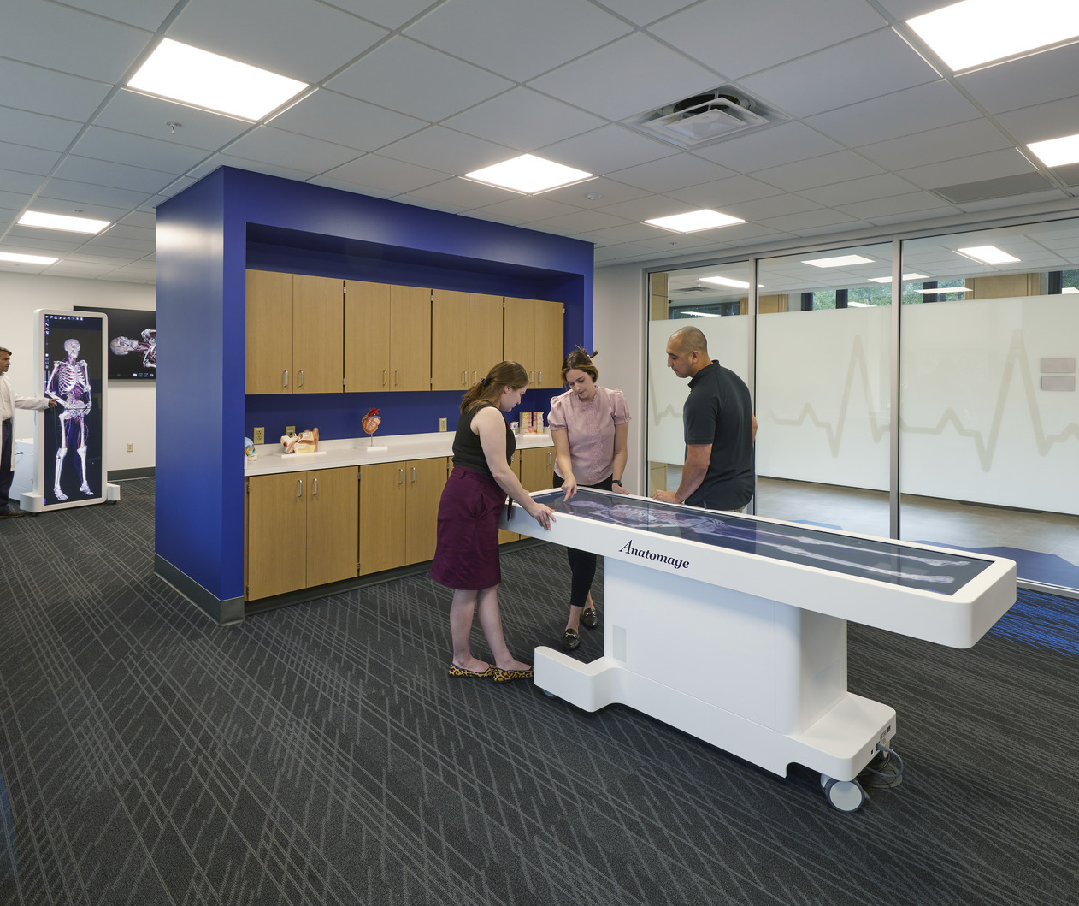
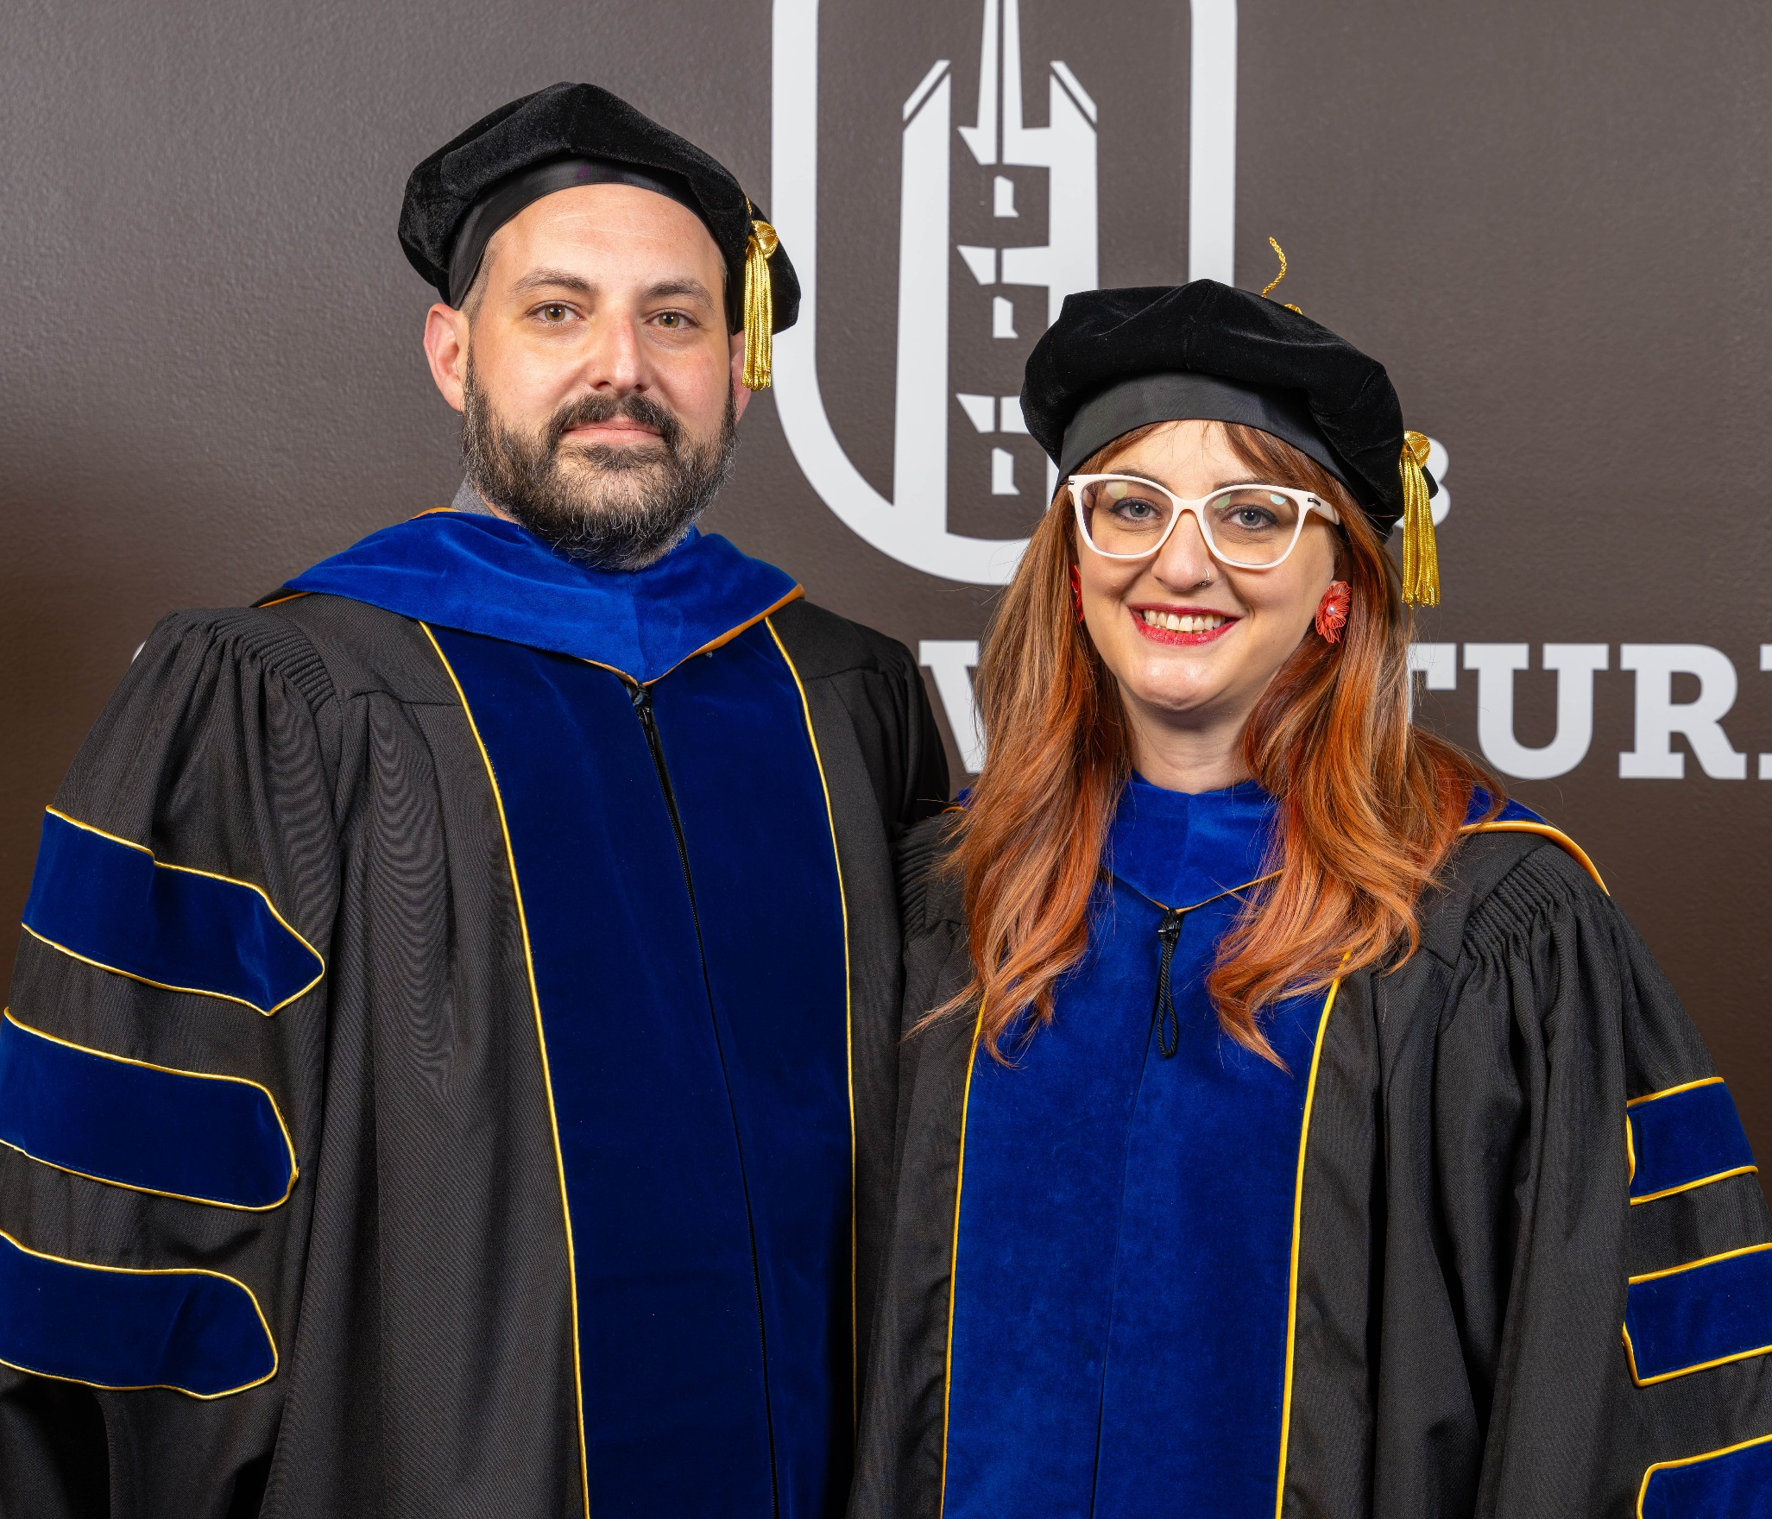
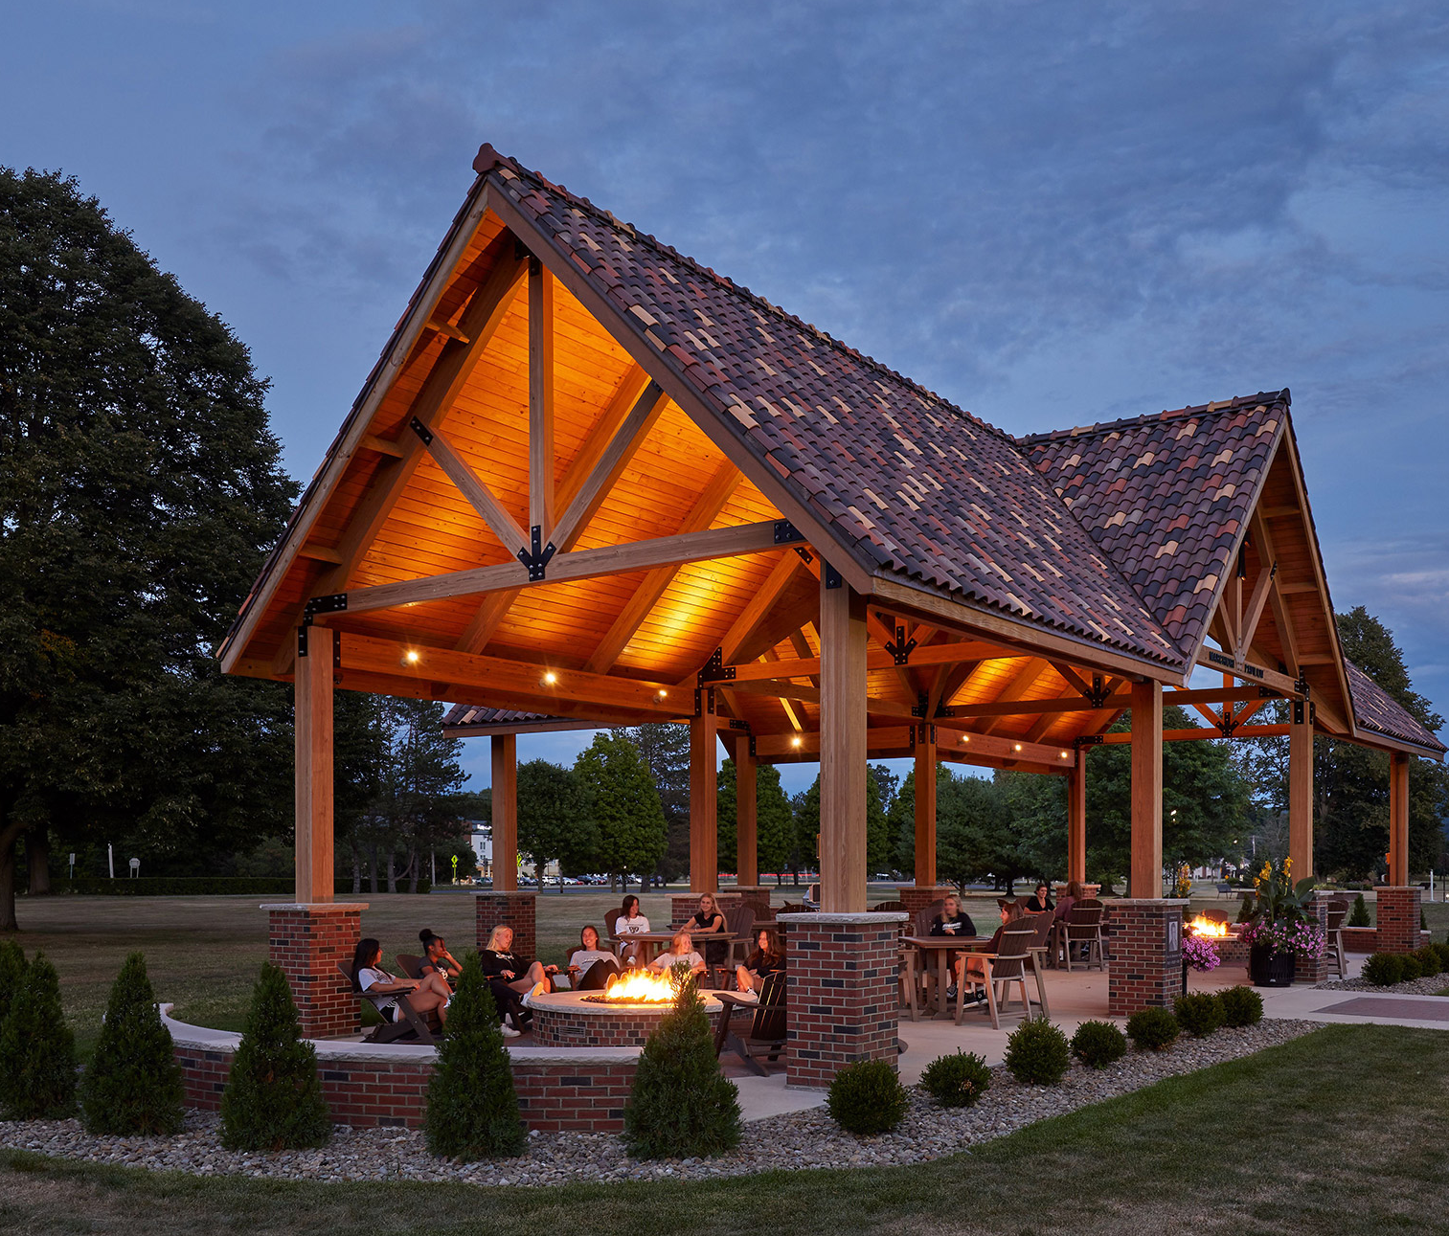
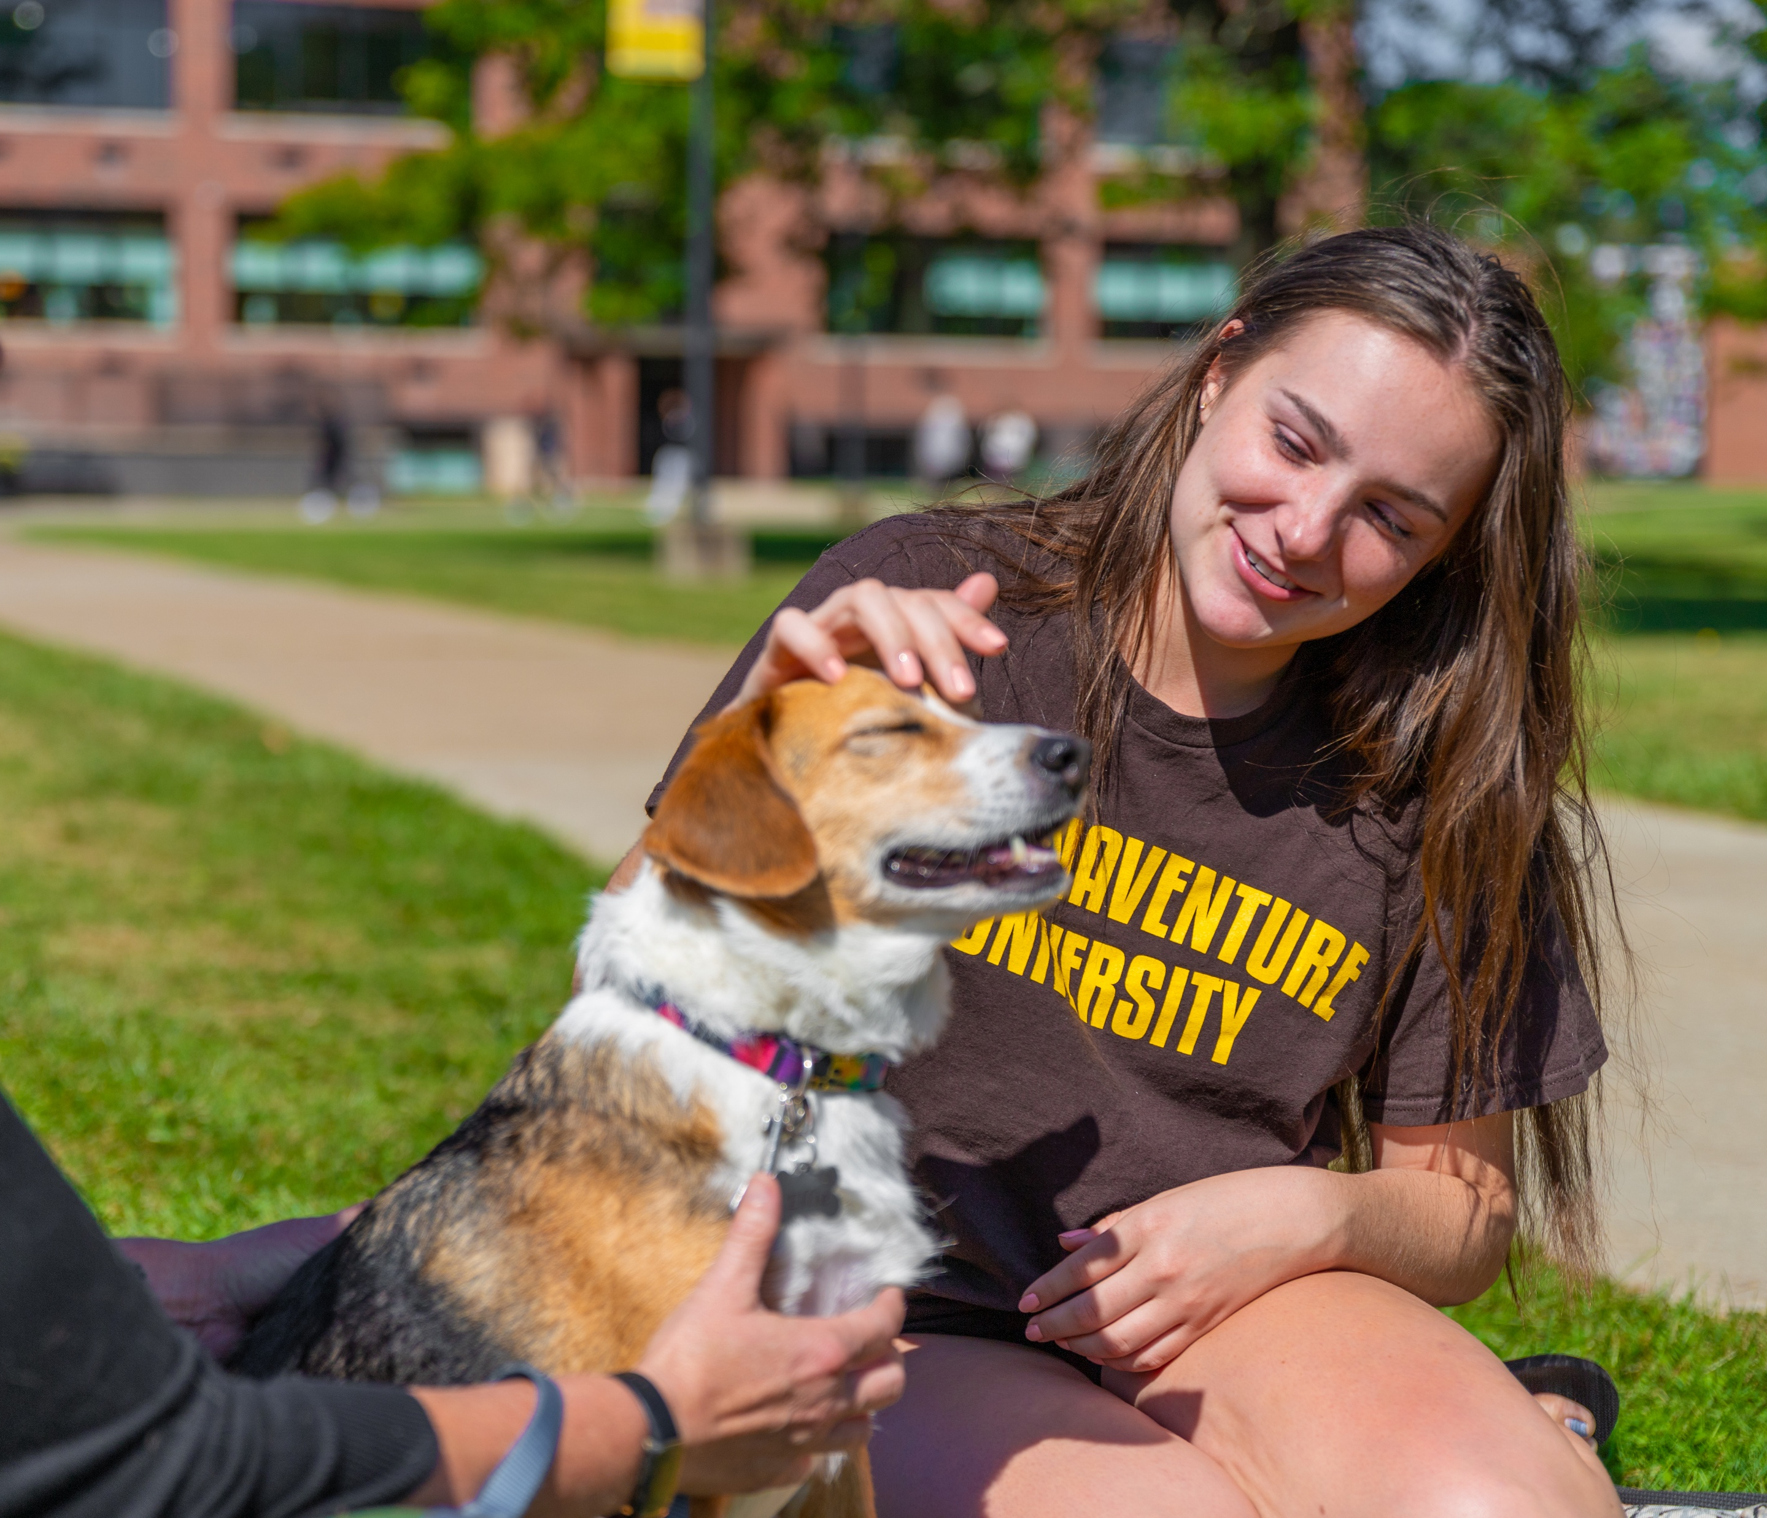

Money as a tool
A tool to…
Build and sustain innovation.
Compensate people in a just and equitable way.
Build
infrastructure.
Strategize and dream.
Fuel impact, achieve mission, strengthen values.
Money isn’t a goal. It’s the tool that allows the mission to thrive.

Slide 9
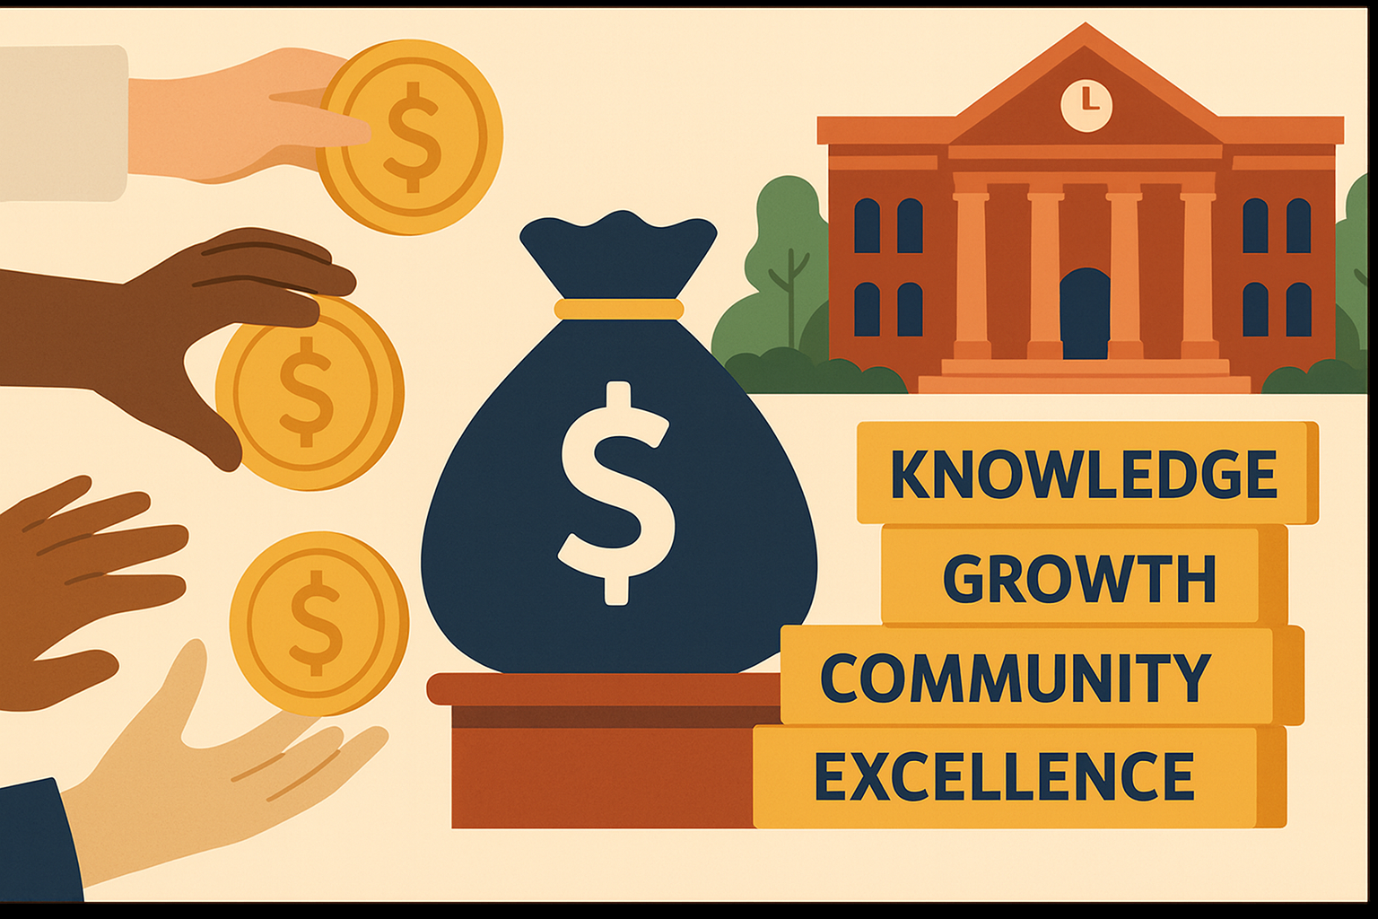
Impact Return
Donors are not just giving away money; they are investing in outcomes that they are passionate about.
For where your treasure is, there your heart will be also.
Matthew 6:21.

Slide 10
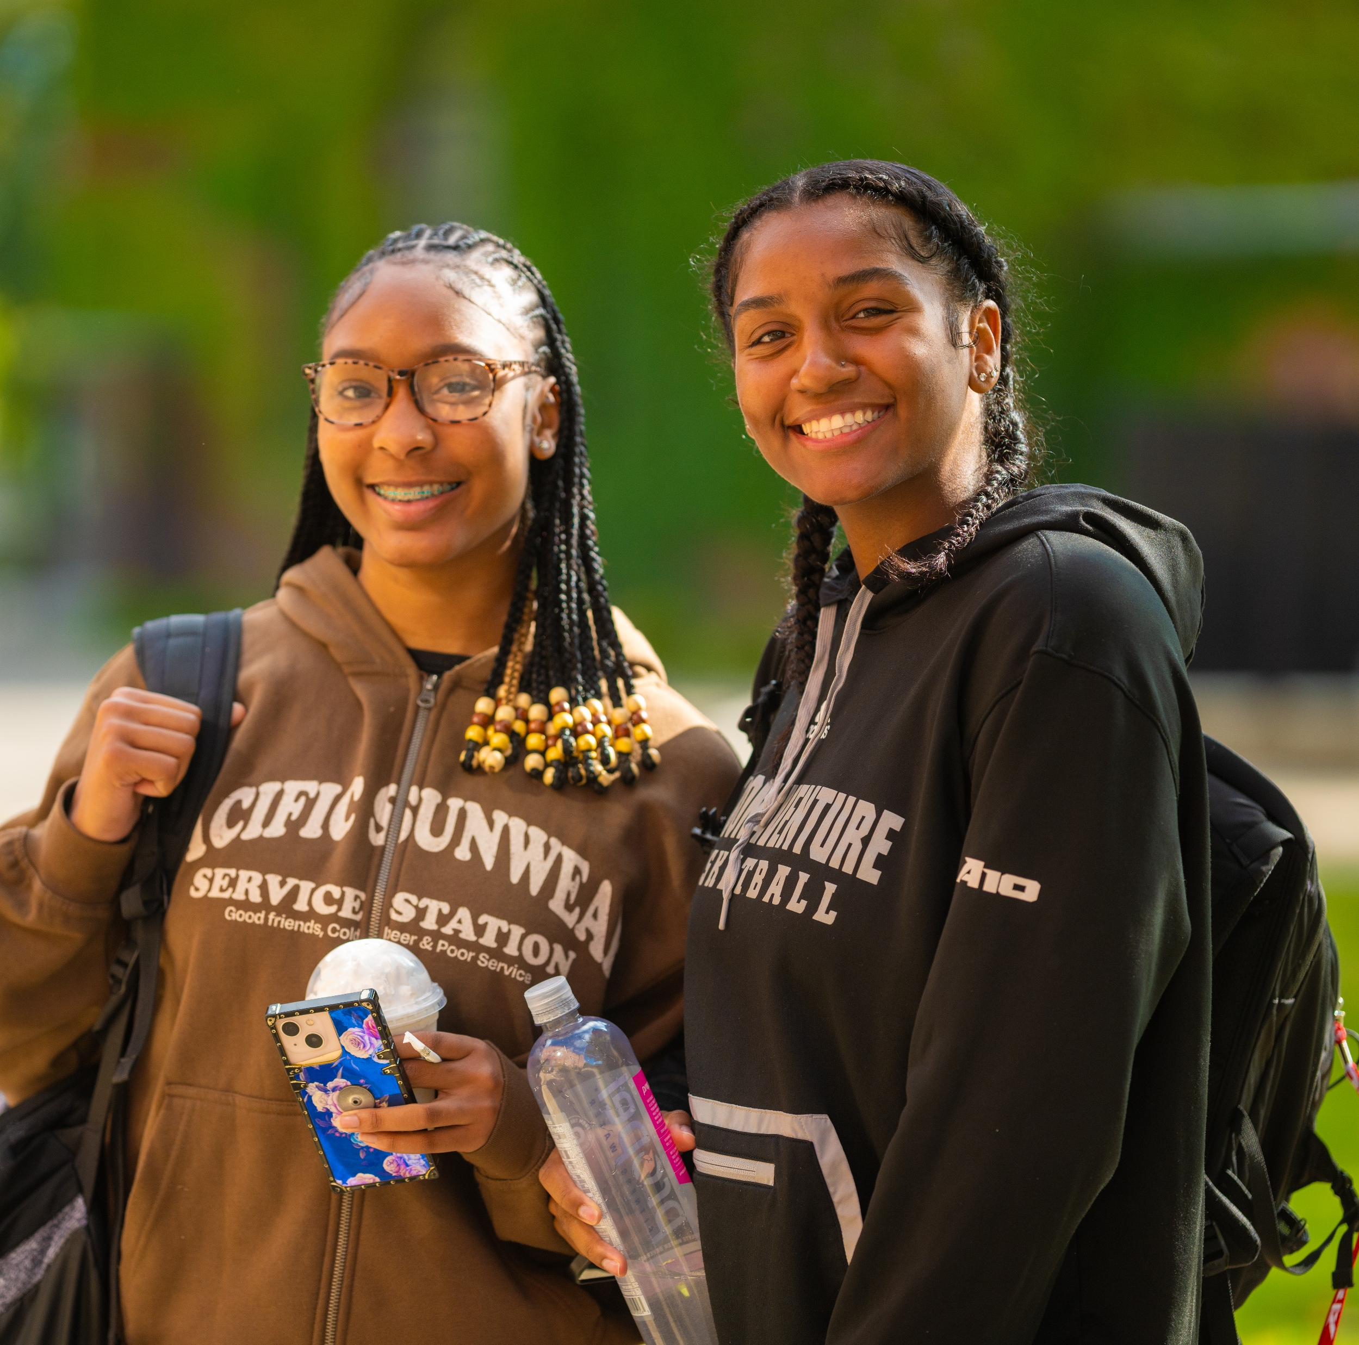
Fueling mission
CLARITY:
It is our responsibility to be crystal clear about our mission and the impact each dollar achieves. Be confident in that impact.
PARTNERSHIP:
Consider donors and granting agencies as partners in achieving mission. Continue to nurture this relationship even after the gift has been
made (stewardship).
INVESTMENT:
Donors are not just “buying” a product or a naming right…they are investing in their own values, personal mission, and passions.

Slide 11
It’s not always easy…
When core values do not align between donor
and organization.
When values align between donor and organization, but the means to achieve those values do not.
When values are not articulated or misperceived.
When crisis raises
emotions and fear.

Slide 12

Show me the money! …for mission
Have fun and consider fundraising as an opportunity:
to meet new people
develop deeper relationships
articulate your own personal passions and values in new ways
But as you excel in everything—in faith, in speech, in knowledge, in all earnestness, and in our love for you—see that you excel in this act of grace also.
2 Corinthians 8:7

Slide 13
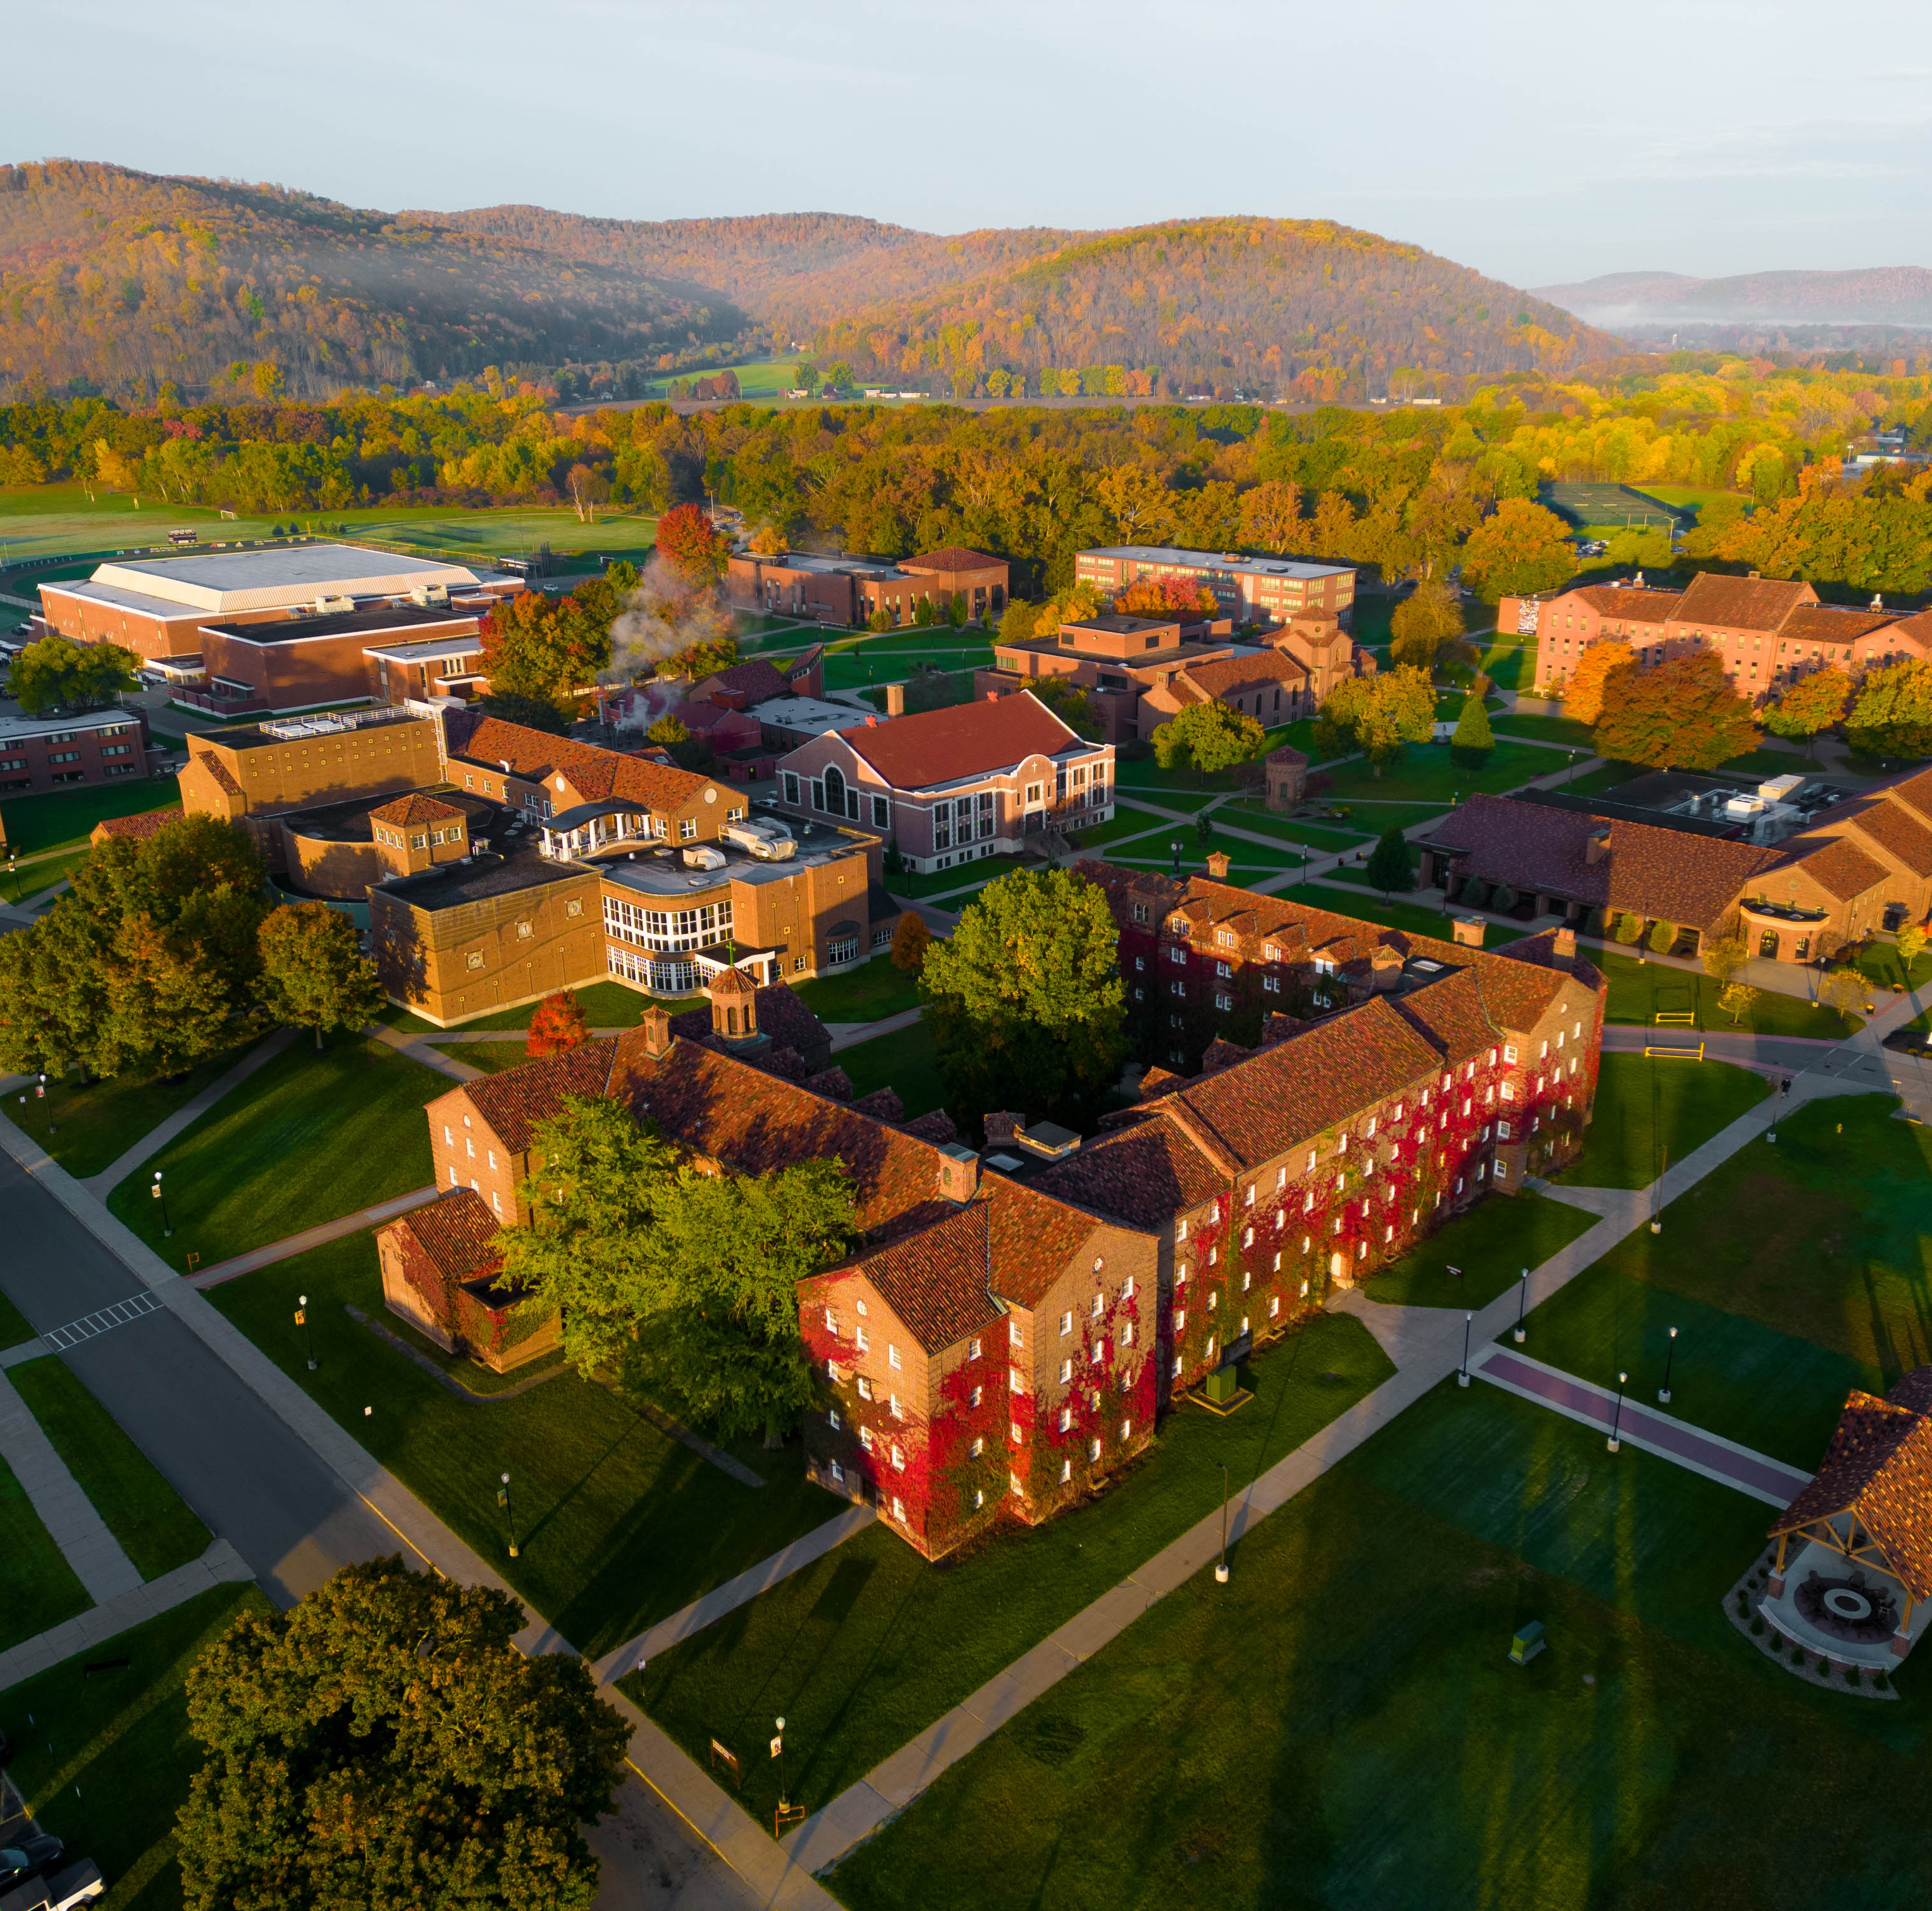
Questions and thoughts?

