Slide 1
Leigh Ann Jacobson, CFRE
Jacobson Group Consulting
Everence Development Conference
September 24, 2025, 3-4:15 p.m.
Ministry of major gifts: Building relationships that cultivate generosity
(For mid-size shops)
“Our mission is to grow your mission.”
Notes:
Welcome everyone! And to those who joined from my earlier session, welcome back! I’m Leigh Ann Jacobson, and I’ve spent most of my career helping mission-driven organizations raise funds in ways that reflect their values.
This afternoon we’re focusing on mid-size shops and the ministry of major gifts.
Major gift work isn’t just a tactic—it’s a ministry of relationship-building. Done well, it inspires donors to invest with heart and purpose.

Slide 2
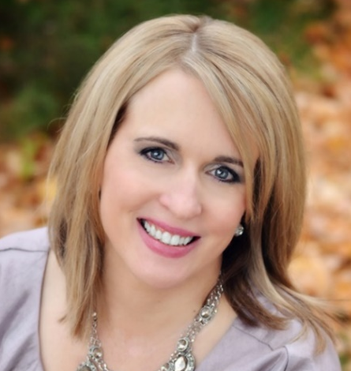
Hi there!
Leigh Ann Jacobson, CFRE Professional Biography:
Founder & Principal Consultant of Jacobson Group Consulting with over 25+ years of experience
Philanthropy executive and practitioner (Greater Chicago)
Keynote and plenary speaker on leadership, nonprofit management, and fundraising topics
Accomplished fundraiser with a track record of securing seven-figure gifts
Niche in helping nonprofits with limited resources make an extensive impact
Decades of board level leadership with AFP (Association of Fundraising Professionals)
University of Notre Dame, Mendoza College of Business, Certificate in Executive Management and Yellow Belt Lean Six Sigma; Arcadia University, M.A. English; King's College, B.A. English
Notes:
“Lord Jesus, we thank You for the gift of this day and for the work set before us. Help us to walk in Your ways with humility and love. Keep us faithful in serving one another, and may our lives bring glory to God. Amen.”
Fund Development Executive and Consultant with over 25+ years of experience.
Founder & Principal of Jacobson Group Consulting
Keynote and plenary speaker on strategic marketing, nonprofit management, and fundraising topics
Accomplished fundraiser with a track record of securing seven-figure gifts
Niche in helping nonprofits with limited resources make an extensive impact
Decades of board level leadership with AFP (Association of Fundraising Professionals)
University of Notre Dame, Mendoza College of Business, Certificate in Executive Management and Yellow Belt Lean Six Sigma; Arcadia University, M.A. English; King's College, B.A. English

Slide 3




The ministry of major gifts:
Building relationships that cultivate generosity
“Inspiring donors to invest with heart, purpose, and faith.”
Notes:
The ministry of major gifts is the heart of today’s session: Building relationships that cultivate generosity and inspire donors to invest with heart, purpose, and faith.
Fundraising is not just about revenue—it’s about inspiring donors to invest in something that matters deeply to them.
“When we anchor in mission, not money, we cultivate generosity that is sustainable, joyful, and faith-filled.”
Icebreaker: “Take a moment—what’s one word that comes to mind when you hear ‘mission-focused fundraising’? Let’s share a few.”

Slide 4
Session Objectives
Recognize major gifts as ministry.
Grow your major donor pipeline.
Cultivate & steward through listening/storytelling.
Equip leaders & board as partners.
Employ practical tools to sustain and enhance your major gifts program.
Notes:
This session is not just about fundraising mechanics—it’s about ministry. We’re talking about how major gifts work is truly a spiritual practice, a way of building relationships that cultivate generosity. We’re moving from transactional fundraising to transformational ministry.
Recognize ministry: “First, we’ll reframe major gifts as ministry. Instead of seeing it as asking for money, we’ll look at it as walking alongside donors in their own journey of generosity.”
Grow your major donor pipeline: “We’ll explore how to discern who your major donors are—not just by wealth, but by alignment of values and passion. It’s about listening for what matters most to them.”
Cultivate and steward: “We’ll talk about how to nurture those relationships—with intentional listening, storytelling, and personal engagement—so that giving becomes a joy, not an obligation.”
Equip leaders: “We’ll look at how to invite your CEO, pastors, or board members into the work as partners. They don’t need to be professional fundraisers, but they do need to share their story and invite others in.”
Employ practical tools: “Finally, you’ll leave with some concrete tools by applying Giving USA data to design a sustainable major gifts program—that make major gifts work manageable in mid-size shops.”
“So, our time together is about shifting perspective: from transactional fundraising to transformational ministry—because when we minister to donors, generosity grows.”

Slide 5

The Theology of Generosity
Giving flows from faith and values, not
just budgets
Generosity = spiritual practice, not a financial transaction
Donors = co-laborers with God in mission
Our role = invite, listen, inspire
“Where your treasure is, there your heart will be also” (Luke 12:34).
Notes:
“Before we talk about strategy, we must root ourselves in the theology of generosity.”
Anchor in Scripture & Faith
“Scripture reminds us: ‘Each of you should give what you have decided in your heart to give, not reluctantly or under compulsion, for God loves a cheerful giver’ (2 Corinthians 9:7).”
“This shows us that generosity is first and foremost an act of faith and joy. Donors don’t give because we pressure them. They give because they feel called to, because it aligns with their deepest values.”
Key Points
Faith and values drive giving
“When a donor makes a major gift, they’re not just funding a project. They’re expressing their values and faith in action.”
“Our job is to connect their heart with the mission, so giving becomes a natural expression of who they are.”
Generosity as spiritual practice
“For many people, giving is a discipline, like prayer or service. It forms their identity as disciples, and it brings them joy.”
“Major gifts can be one of the most powerful ways donors live out their discipleship.”
Co-laborers with God
“We must remember: we’re not asking donors to give to us. We are inviting them to give with God—to join in God’s work of justice, mercy, and transformation through our mission.”
Our role = invite, listen, inspire
Can anyone share a personal example of a donor who described their giving as faith or calling? Or What Scripture/faith principle shapes your view of generosity?
LAJ story: at Notre Dame: “One donor once told me, ‘This gift is not mine—it’s God’s. I’m just returning it to the place where it can do the most good.’ That’s the theology of generosity in action.”).
LAJ asks: “What Scripture or faith principle shapes your view of generosity?”
Close & Transition
“If this is our foundation—that giving is an act of faith—then the way we approach major gifts changes. It’s not about asking for money; it’s about nurturing a donor’s spiritual journey. And that brings us to the next question: What makes a gift “major”?”

Slide 6
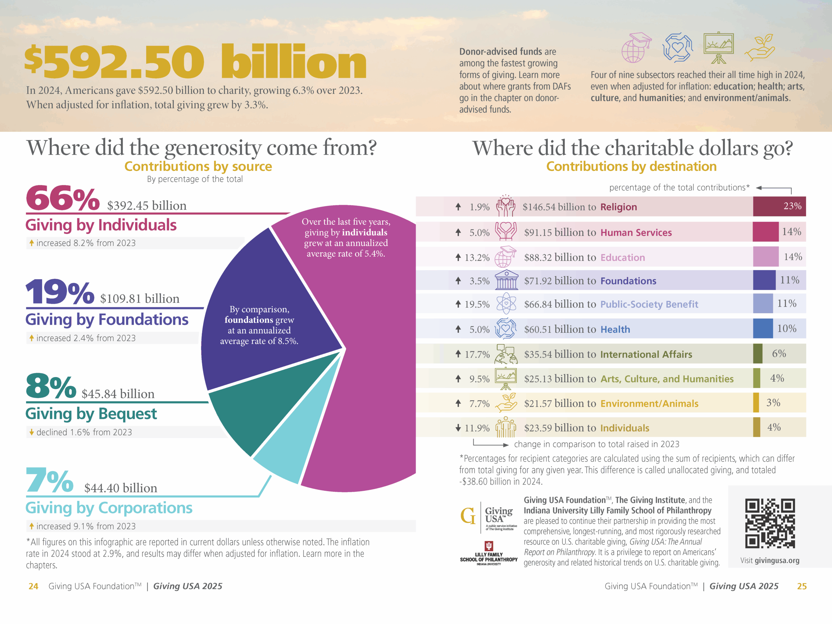
Notes:
Lots of GENEROSITY to unpack here. Let’s look to my upcoming slides for more pertinent findings.

Slide 7
Faith + Data Connection
Giving USA 2025: individual giving ↑ 8.2%
Religious giving ↓, values-driven causes ↑
Signal: Donors redirecting faith through
values-driven philanthropy
+ DAFs
+Bequests
Notes:
Faith + Data Connection
Let’s bring data and faith together. The Giving USA 2025 report shows individual giving grew 8.2%, making up two-thirds of all giving. Individual giving rose to 66% of all giving. These gifts come overwhelmingly from people whose values and faith motivate generosity.
And don’t forget DAFs and bequests are individual decisions too! This is your major gifts pool.
But note: religious giving is declining in aggregate. Instead, people are directing their giving toward causes that embody their values—like education, human services, and international relief.
This signals a shift. Donors still want their giving to be discipleship in action, but they’re expressing it through causes where they see faith and values lived out in practice.
So major gifts aren’t about slick proposals—they’re about values alignment. That’s when giving becomes transformational.

Slide 8

Decline in Religious Giving
Although still a significant slice of the pie, religious giving declined by 1% in real terms, highlighting a long-term downward trend —from 56% in the mid-1980s to just 25% over the past five years.
Notes:
Although still a significant slice of the pie, religious giving declined by 1% in real terms, highlighting a long-term downward trend. Religion still accounts for the largest share of donations at 23%, but that share is shrinking. It has fallen dramatically from 56% in the mid-1980s to just 25% over the past five years.

Slide 9
What Makes a Gift “Major”?
Major gifts are the largest donations that a
nonprofit receives.
Define major gifts by transformational impact, not just dollars.
A major giving program focuses on building relationships with a portfolio of prospects who have the capacity and inclination to make a major gift.
Notes:
Major gifts are the largest donations that a nonprofit receives. What defines a major gift for YOUR shop?
Define major gifts by transformational impact, not just dollars.
What is a major gift to your org? If you do not know, here is a way to find find out.
Pull the 25 largest gifts made to your organization in the past 5 years.
Examine the range of those gift sizes and eliminate any outliers.
Accounting for the remaining gifts, estimate a major gift minimum by figuring out the median of this range. This will help you capture the largest number of valuable prospects. For example, if your range is $5,000 to $10,000, you could consider $7,500.
Make sure you do not set the major gift amount bar too high. If you are seeking major gifts, your donor base needs to be capable of reaching that amount. Similarly, if you find that many donors are able to give that base amount, you may need to raise it or add higher levels with additional benefits.
These donations are often used to fund specific projects, meet fundraising goals, or go into general programs that help an organization accomplish its mission.
A major giving program focuses on building relationships with a portfolio of prospects who have the capacity and inclination to make a major gift.

Slide 10
Building Your Major Gifts Strategy
Set your Goals and Expectations
  What is your scale?
  What do you want to accomplish?
  Who’s on board?
You get what you MEASURE
  # Donor Count, % Participation, Rates for Acquisition, Renewal/Retention, and Upgrade
  We adjust our behavior based on what we’re measured against
  Communicate the measurements up, down, and across the organization
Systematize Weekly “RAPs”
  Review and Plan. Better Focus = Better Results
  Directive or Strategic?
  Part of the Culture of Philanthropy
Notes:
Set your Goals and Expectations What is your scale? A frequent comment is “my organization is not that big.” Today, think “deep” not “big.” Small & impactful is great! Changing lives in your neighborhood is spectacular! Define what you want to accomplish by what “impact” do we want to have? Is everyone in your organization on-board. What’s it like when the CFO/Finance isn’t in the game? your expectations must align with your goals, and most importantly, your resources!
We get what we MEASURE. If it’s really important, you will measure it! So what things are really important to set up as measurable expectations. How many of you have step trackers on today? You’re measuring your steps because it’s important to you. Take Weight Watchers for example. Why do they have weekly weigh-ins? Because the really important outcome is weight loss. Take time to log the results and compare the actual vs. planned. What things are really important here? Review whether or not you completed the activities necessary to have the opportunity to reach your goals.
# Donor Count, % Participation, how many donors you acquire, how many you retain, how many you upgrade (measured as Acquisition, Renewal, and Upgrade rates)
Human beings adjust their behavior based on what they’re measured against
Communicate the measurements up, down, and across the organization
Systematize Weekly “RAPs”
Weekly rhythm of “review and plan” (“RAP’s”) are the basic building block for performance management. RAPs keep you on track to get what you measure! @ND, development team followed Six Sigma guidelines (yellow belt). And our team had ice weekly 15 min standing SCRUM meetings. The meetings, the agenda, the questions simply become expected. Planning goes from being an annual activity to a weekly activity. Review & Plan became part of the culture.
Better Focus = Better Results

Slide 11

Discipline and stewardship are spiritual practices— faithfulness in the small things leads to abundance.
Notes:
Your MG strategy can be seen through a faith lens as well:
“Discipline and stewardship are spiritual practices—faithfulness in the small things leads to abundance.”

Slide 12

Why Values Alignment Unlocks Major Gifts
Transactional vs. Transformational
Generosity = discipleship
Bridge values to outcomes
“Frame every ask in values language.”
Notes:
Transactional vs. Transformational: A transactional gift supports a program; a transformational gift supports a shared belief. Major donors give when they see their values—and their legacy—reflected in your mission.
Faith-based lens: Generosity isn’t just about money—it’s discipleship in action. When donors believe that your organization advances their deepest convictions, their giving shifts from “support” to “partnership in ministry.”
Bridge values to outcomes; Here’s a Practical example: A donor may fund scholarships not because they like tuition subsidies, but because they value equity, justice, and opportunity—values rooted in their faith.
How do we put this action??
Instead of “We need $100K for this program,” say, “Your generosity helps ensure every student has the dignity of access to education, regardless of their means.”
Mission-first messaging: Anchor proposals in why the work matters, not just what the work does.
Bridge values to outcomes: Make the case that the donor’s values live on through impact stories—students, families, and communities transformed.

Slide 13
Transactional vs. Transformational Giving
Transactional Giving | Transformational Giving
Meets an immediate need | Advances a vision aligned with values
Solves a short-term problem | Creates long-term, lasting impact
Motivated by obligation or request | Motivated by faith, values, and purpose
Donor = funder | Donor = mission partner
Supports a program | Invests in a calling or shared belief
Important but limited in scope | Unlocks major gifts and deeper engagement
Notes:
Transformational gifts are inspired through alignment. Our role in this ministry is to listen deeply enough to know what values are stirring in the donor’s heart and then connect those values to our mission.

Slide 14
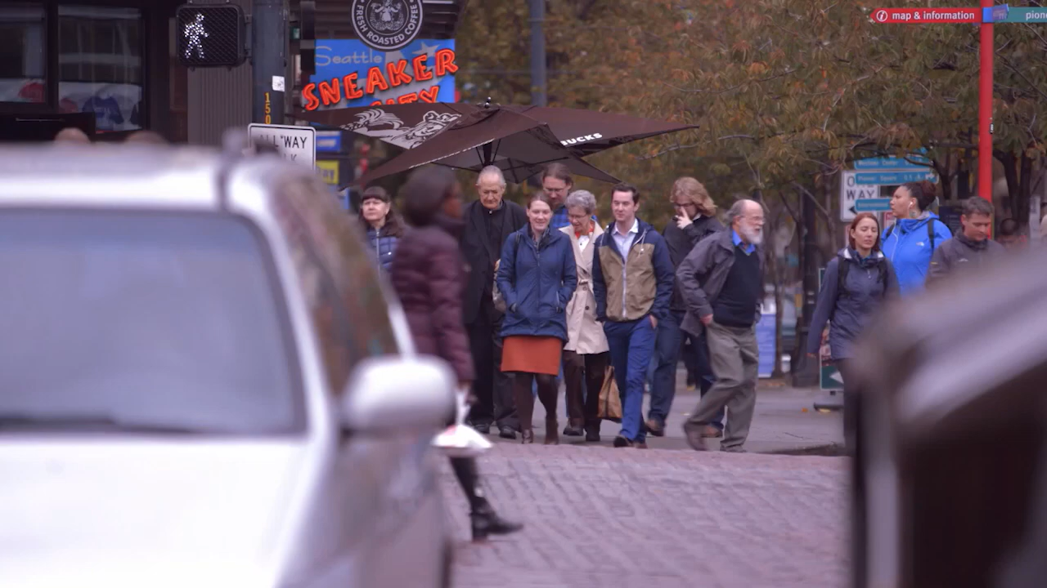
Notes:
Play 2-minute video
The reasons behind giving are personal and varied. That’s what World Vision learned in Seattle, where they interviewed several women and men on their reasons for giving. Reasons we heard for giving included feeling good, taking care of each other, giving because they are blessed, and returning the help they have received in the past.
Ask: “What values came through?”
Ask: “Which of these values echo biblical principles of stewardship, blessing, or community?”

Slide 15
Case for Support: Storytelling
  Building a Case for Support
The AFP Fundraising Dictionary defines the case as follows:
Case, n. the reasons why an organization both needs and merits philanthropic support,
usually by outlining the organization's programs, current needs, and plans.
  Storytelling to connect donors to mission!
            Narrative fundraising connects donors with your mission – “impact investing”
            Does your case emphasize problems, or opportunities for hope?
            Compelling, emotional, leads to an ask, and tied to donor values!
            Donor = hero in transforming their community by making a
            philanthropic investment
Notes:
A. First step in planning is imperative—it’s to build your Case for Support. The AFP Fundraising Dictionary defines the case as follows: Case, n. the reasons why an organization both needs and merits philanthropic support, usually by outlining the organization's programs, current needs, and plans.
TO DEFINE YOUR CASE FOR SUPPORT:
Describe your cause or case
Relate it to your community
Demonstrate it as real
Convince the donor that the cause is worth supporting by aligning it with their values!
Explain how the funds will be used
Create a sense of urgency
Donor’s connection with mission is built with stories that define your cause or case for support. “Impact” investing = for this to happen you tell the story to the donor!
One of the most effective ways to communicate your case for support is through story-telling. Stories connected with your mission. It is through stories that donors can visualize the impact their investment can make. Recognizing the power of story telling is hardly a breakthrough. There’s Homer, there’s Shakespeare—there’s even Spielberg. I’d like you to stop and think about the stories that you tell?
Does your case emphasize problems, or opportunities for hope? Hope-filled storytelling reflects faith.
Compelling, emotional, leads to an ask, and tied to donor values!
Donor = hero in transforming their community by making a philanthropic investment

Slide 16


Values alignment is the key to transformational giving.
Pair & Share: Reframe an appeal in values language.
Notes:
Interactive Component (5–7 minutes)
Prompt: “Think of your top 3 donors. What values drive their giving? How does your organization reflect those values in your communication?”
Activity: Pair & Share: Reframe an appeal in values language. Ask participants to pair up and draft one sentence rephrasing an appeal to connect a donor’s values to the mission.
Report out: Invite 2–3 examples—highlight how even small shifts in wording move the conversation toward transformational giving.

Slide 17

Major Gifts Model
Patience. Presence. Passion.
Strategy requires that you focus attention on people who have the capacity to give and the inclination to give
Only a few donors will make up most of the appeal/campaign
Major investment of face time with potential donors as you prepare for the “ask”
Right Donor • Right Purpose • Right Amount • Right Solicitor • Right Time
Always align your prospects values with your institutional values
Notes:
This model is about patience and presence. Donors give when they’re ready.
Strategy requires that you focus attention on people who have the capacity to give and the inclination to give
Few donors will make up most of the appeal / campaign
Require a lot of time with potential donors - prepare for “ask”
Major investment of personal, face time with potential donors
Careful timing of the solicitation for the right amount to the right priority – I often say you need the Right Donor, for the Right Purpose, asking the Right Amount, by the Right Solicitor, at the Right Time
Only ask for the gift when donors are ready! – not when your budget needs it or your quarterly or annual goals push you.
Always align your prospects values with your institutional values!

Slide 18
Metrics with Meaning
  The Plan
  Relationship vs. Transaction
  Personal engagement strategies
  Meaningful, measurable, and actionable
  The Ask
  Why are you asking me to give? How does this align with my values?
  What is the impact of my gift? How does this align with my ministry?
  Why now?
  The Focus: Track relationships, not just dollars
  80% of the funding comes from 20% percent of our donors
  80% of our total volunteer hours comes from 20% of our volunteers
  80% of our results comes from 20% of our time and effort
  *Metrics are accountability to donors and to God’s mission, not just numbers.
Notes:
The fundraising plan.
To be successful, your plan must be framed in relationships vs. transactions.
There are 3 simple rules for good metrics: Is your plan (1) meaningful, (2) measurable, and (3) actionable? That means having a plan in place for asking, thanking, and interacting with donors in ways that solidify their support over time. Developing a fundraising plan with metrics will help you maximize donor retention and increase the lifetime value of each donor.
B. The Ask. Before you make an ask, you must first answer these questions on behalf of the donor.
* Why are you asking me to give? *What impact will my gift have? *Why now?
Once you are able to do this, you take your ask from a transaction to a relationship. No matter how you make the ask, it must be delivered with emotion. With Direct Mail, emotion is the “stamp” of an appeal letter. With a Personal Ask, the emotion is in the narrative stories I talked about in my previous slide about building a Case for Support. The Emotion lies in the mission driven donor stories and testimonials about others who have made gifts. How these gifts stimulate and sustain other giving. On website, “Why I Give”, “Why I Volunteer”, “Why I Mentor”, etc.
The Focus Most fundraisers cannot answer those questions for all donors, yet most fundraisers can answer it for their top tier donors—oftentimes their top 20%. (Poll) Is everyone familiar with the 80/20 rule? (Pause) In 1906, Italian economist Vilfredo Pareto created a mathematical formula to describe the unequal distribution of wealth in his country, observing that twenty percent of the people owned eighty percent of the wealth. The Pareto principle (also known as the 80–20 rule, states that, for many events, roughly 80% of the effects come from 20% of the causes. In fundraising, it translates to:
80% of the funding comes from 20% percent of our donors
80% of our total volunteer hours comes from 20% of our volunteers
80% of our corporate sponsorships come from 20% of our industry/business relationships
80% of our results comes from 20% of our time and effort
The list can be endless and to varying degrees of course, but I like to focus on the last point the most; 80% of our results comes from 20% of our time and effort.
This leaves us with the sobering result of 80% of our efforts only leading to 20% of our results- which is not smart business. Fundraising professionals spend an enormous amount of time planning events, getting auction items, writing grants, researching potential donors, updating multiple social media sites, and recruiting volunteers; we may not however taking the time to evaluate these strategies for effectiveness and desired outcomes.
Therefore we must keep the focus on building strategic relationships (next slide)

Slide 19
The Rule of 3: Strategic Relationships
The Rule of 3
  3 Visits
  3 best prospects
  3 next-tier
  3 Priority Initiatives
Ministry is about presence—steward deeply, not thinly.
Notes:
The Rule of 3 Principle suggests that things come easier and info is more likely to be consumed in 3’s.
Nike’s “Just Do It” - Ready! Set! Go!
Keep the math simple! Can you have 3 visits a day, 3 days a week, 3 weeks a month? That would be 324 visits in a year. How many did you have last year? I would be willing to bet you’ll get more gifts and build better relationships the more visits you have.
Always be working on your best 3 prospects.
Determine 3 critically-important funding initiatives, commit them to memory and be well versed.
3 visits! -- Maximize the Relationship at Any Given Moment
So Visit with your donors. A phone call is not a visit. An email is not a visit. Also being in the presence of a prospect without any attempt to maximize the relationship at this given moment is not a visit. A visit is a structured one-on-one that includes discovery, dialogue around the 3 priority initiatives -- Vision/Program/Story -- with some progress toward a relationship goal. Think about how effective we can be with this focus, rather than just trying to have “points of contact.”
LISTEN! Apply first date principles to your meetings with a donor or prospect…​
Be curious. ​ Be aware. ​Listen! Make a connection. ​Follow up.
outline of the various activities to communicate with stakeholders
activities to manage their expectations/keep engaged with projects
Focus lets you steward deeply, not thinly; Ministry is about presence!

Slide 20

Hope is Not a Strategy
Hope is Not a Strategy
  Defining the Critical Elements
  Fail to Plan, Plan to Fail
  Newton’s First Law of Motion
B. More visits → deeper relationships → more generosity
  1 to 1
  Be Consistent
  Make Connections
C. Visit and Visit Often
  Visits + Asks = Income
  “Invite” donors to invest in your mission
  Donor’s Parallel Journey with client, cause, etc.
Notes:
Hope is not a strategy. I hope we make budget. I hope he calls me back. I hope we meet goal. I hope she says “yes.” Strategies are specific, action-oriented methods to achieve a goal. It is your action plan.
Benjamin Franklin said if you “fail to plan, plan to fail.” People rarely succeed accidently. You won’t accidently accomplish fundraising activities. You need to map out your plan. *Let’s go back in time to Pre-Navigation days. If you were driving from Chicago, IL to Lancaster, PA what would you do? Even Chicago native Clark Griswold had a “plan.” (Cue movie)
So maybe it wasn’t the best, most effective plan but he ultimately accomplished his goal; and this Chicagoan made her way here ☺
Can you determine what are the critical elements to reaching your goal? Is it “we will implement a planned giving program…” If yes, then what are the ACTION Plans…”Meet with the Development Committee chair on Sept 15”; “Design a brochure by Oct 31st”; “Identify a list of potential prospects from our donor database by Nov 15. Main PG brochure by Nov 30” These ACTIONS that can be put in a calendar and measured for accomplishment.
NEWTON’S FIRST LAW OF MOTION: “An object at rest stays at rest, an object in motion stays in motion with the same speed and direction unless acted upon by an unbalanced force.” What unbalanced forces keep you from staying – or even getting – in motion? Faith-lens: Hope without action isn’t stewardship.
B. More visits = More Income. Events are great, but get out and develop 1 to1 relationships. There is a phrase in sales “people buy from people.” Same in fundraising. People give to people. Make connections. Be consistent. People buy on emotion, justify with logic. The same is true for donations.
Visit and visit often. The more people you visit with and the more people you ask the more will say “yes”. Why do most people give? Because they are asked.
INVITE THEM TO GIVE. INVITE DONORS TO INVEST. INVITE THEM TO JOIN A DONOR SOCIETY.
“When we invite you to make a gift, we invite you to be part of our efforts to create a better xxxx by xxxxxx”
Get in the habit of being out of the office. Breakfast or coffee visits with donors are a great way to start every day. If you’re in the office, invite donors for visit with you there, give tours, etc.
Donor’s Parallel Journey with client, cause, someone/something helped by your organization

Slide 21
Evaluating with Stewardship Lens
The Knowing-Doing Gap
  Inspect what you Expect
  Demonstrate Progress – Dashboards, Scorecards, Calendars
  Accountability is a spiritual discipline
Measures and Metrics
  Input = Activities, Actions, Behaviors, etc.
  Output = Income, Retention, etc.
  Effectiveness = “What is driving your results?”
What does “Good” look like?
  Based on your organization, its resources, its budget, its determination
  Discipline and stewardship = faithfulness to commitments
  Celebrate!
Notes:
A. A big part of the human condition is one of not doing something unless we have to. We know we should exercise, eat lots of vegetables and less fried, salty and sweet foods. We know we should stop procrastinating. Knowing isn’t the problem. It’s the doing that gets us every time. In business it’s called the Knowing-Doing Gap.
Inspect what you Expect. NOT micromanaging. Communicate clear expectations. Decide what things are really important and all agree that we will ask about each. It ensures that things get done. Weekly RAP with the VP that he or she is going to ask me if I called that donor we talked about in our previous meeting, am I likely to call the donor?
Find ways to demonstrate progress. How do you know if you are reaching your goals? Dashboards and Scorecards should be shared and visible. The calendar is the most simple and telling dashboard. Look at your calendar. How many visits & calls did you have?
We’re accountable to the AFP Code of Ethics. We’re accountable to our donors by telling them where their gifts are going. we need to be accountable to our Plan. accountability is simply doing what we say we’re going to do. brings that Strategic Plan out of the drawer? “Accountability is a spiritual discipline—doing what we say we’ll do.”
B. Measure 2 things – Inputs & Outputs. What are activities, actions, behaviors create the desired outcomes. . We track event attendance, open rates, Appeals, Visits & Calls, Total revenue, Unrestricted Revenue, 1st Participation gift of the FY, Upgrades, Donor Loyalty Codes. We talk about them in our weekly RAP’s.
C. How will you know when you become good? What level of inputs and outputs make you good? This is based on your organization, its resources, its budget, its determination! Only you will know what good looks like. Accountability = spiritual discipline! Stay disciplined in your approach and your commitment for evaluation. Benchmark your program. But most of all, Celebrate success!

Slide 22
Who is a major gift prospect?
A potential major gifts prospect is anyone with evidence of:
Gratitude (for your mission and its impact)
Interest or Curiosity (interest in mission and knowing more)
Relationships (longstanding donor or mission recipient)
Family History (longstanding family involvement with organization)
Generosity (unsolicited donor or donor to other organizations)
Wealth (professional position, homes, children’s schools, travel)
Personal Contacts (connections to board or other leadership)
Other (foundation officer; someone with few or no heirs)
*We look for generosity of spirit, not just wealth. Look for open hearts.
Notes:
A potential major gifts prospect is anyone with evidence of:
Gratitude (for your mission and its impact)
Interest or Curiosity (interest in mission and knowing more)
Relationships (longstanding donor or mission recipient)
Family History (longstanding family involvement with organization)
Generosity (unsolicited donor or donor to other organizations)
Wealth (professional position, homes, children’s schools, travel)
Personal Contacts (connections to board or other leadership)
Other (foundation officer; someone with few or no heirs)
*We look for generosity of spirit, not just wealth! Look for open hearts.
Once identified, these potential donors need to be qualified, cultivated, and solicited — with the ask leading to thoughtful stewardship of the relationship.

Slide 23
  “Focus on the people first, not the numbers,
  and the numbers will take care of themselves.”
Notes:
This has been my faith anchor!
“ Focus on the people first, not the numbers,
and the numbers will take care of themselves.”
All the research, queries, and data analysis, no matter how extensive, cannot substitute for the knowledge gained through personal, meaningful interactions with our donors and prospects!
Pause for reflection if time allows.
How will I minister to donors in my next conversation?

Slide 24

Virtual Coaching Offer
Jacobson Group Consulting will provide (1) one-hour virtual meeting, pro bono, to each registered organization to facilitate one-on-one or small group coaching within five months following this workshop (September – February).
Contact:
leighann@JacobsonGroupConsulting.com
to arrange a mutually convenient coaching session
Notes:
This is my faith-filled way of giving back.
I believe deeply in investing in those who are lifting others up. It’s an opportunity for you to bring a real challenge or project, and I’ll help coach you through it.
Please reach out by email—we’ll find a time that works.

Slide 25
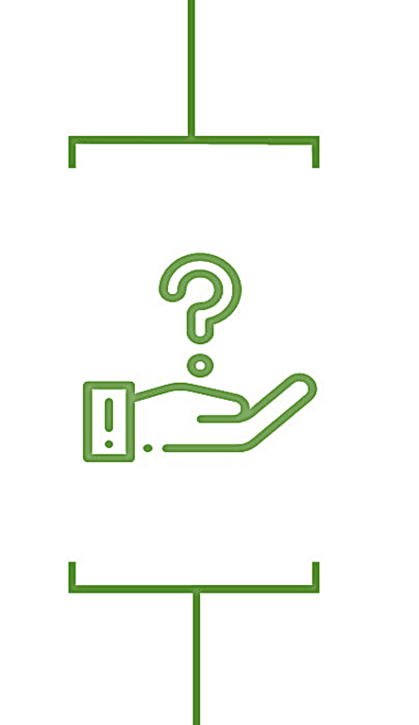
Questions and Feedback
Major gifts are ministry, and when you minister well, generosity multiplies.
Notes:
“Major gifts are ministry. When you minister well, generosity multiplies.”
Allow 5–7 min for Q&A.

Slide 26
See me at my other session!
Beyond the Development Office: How Every Leader Plays a Role in Fundraising Success (for Non-Fundraisers) – Tomorrow 8-9:15 a.m.
Fundraising is a shared responsibility. This session is designed for presidents, deans, pastors, board members, and program staff who want to confidently step into their role in advancing philanthropy. Because building a culture of generosity starts with shared ownership.

Slide 27


Let’s connect!
Leigh Ann M. Jacobson, CFRE
Founder & Principal, Jacobson Group Consulting
leighann@JacobsonGroupConsulting.com
Direct Cell: 847-636-6618
www.linkedin.com/in/JacobsonGroupConsulting
www.facebook.com/JacobsonGroupConsulting

