Slide 1
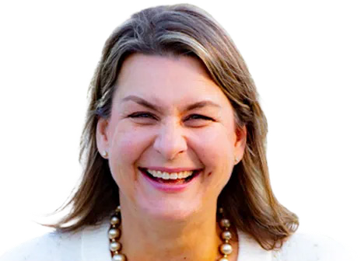
Inspiring confidence in donors
How financial planning builds confidence for charitable giving
Jen McCoy, CFP®,
Financial Planner
Everence®

Slide 2
Financial planning at Everence
A – ALIGN your life mission with your financial decision making
C – Increase CONFIDENCE in your financial future
E – EMPOWER you to give to the people/causes/organizations you care about

Slide 3

Financial planning
at Everence
Notes:
Refer to brochure in folder for discussion

Slide 4

If you were given $1,000,000 tax free, what would you do with it and why?

Slide 5
If you could wave a magic wand and fix one problem in your finances, what would it be?

Slide 6



Financial planning case studies
Case study A
Case study B
Case study C
35-year-old couple
50-year-old couple
73-year-old widower
Notes:
Each of these individuals are based off of actual Financial Planning clients
Each client had charitable desires
The discussion on charitable giving was different based on each case study
The method of giving and amount was different in each case
A note for fundraisers: Don’t miss out on young donors

Slide 7

Case study A
35-year-old couple
Early career; highly educated; no kids
$200,000 total income
Homeowners; no college debt
What would you ask this couple to encourage generosity?
Notes:
Describe couple
To group: What would you ask this couple to encourage generosity?
To group: What would be the best resource this couple could give?
To group: What would be the best method of giving?
“What is holding you back from giving as much as you want to give?”

Slide 8
Case study B
50-year-old couple
Mid/late career
Children in college
High expenses
$250,000 total income
What would you ask this couple to
encourage generosity?
Notes:
Describe couple
To group: What would you ask this couple to encourage generosity?
To group: What would be the best resource this couple could give?
To group: What would be the best method of giving?
“How can we use charitable giving to reduce your taxable income?”
By itemizing your taxes
Switching to pretax investing
Using 529s to reduce PA tax as a ‘pass-through’ for college expenses
Freeing up cash to give more

Slide 9
Case study C
73-year-old widower
Retired; no kids
Retirement income covers expenses
What would you ask this person to
encourage generosity?
Notes:
Describe individual
To group: What would you ask this couple to encourage generosity?
To group: What would be the best resource this couple could give?
To group: What would be the best method of giving?
“What difference in the world do you want to see?”
“Would you rather give during life or after you’ve passed away?”
Tools:
Qualified Charitable Distributions
Bequests

Slide 10
Thank you!
Questions?
Feel free to reach out with any
additional questions you have!
Phone: 717-394-0769
Email: jen.mccoy@everence.com

