Slide 1
This page for internal use only
How to use this template
This template was developed to help you create professional, effective presentations aligned with the Everence brand.
It includes a variety of slide layout and image options. Beyond the ones you may see as the “default” presentation, you can see and insert other options when you select Layout in the Home toolbar above.
It’s best to avoid too much text on the screen, as well as confusing visuals, clip art and other low-quality images.
Other on-brand images can be added directly to the slide over an existing image, which you can use as a size, cropping and layout guide.

Slide 2
This page for internal use only
How to use this template
Video and audio can add value but require additional steps for the best performance.
Please note the playback settings. Before finalizing the presentation, go to “file” and select “compress pictures” or “optimize media.” This helps make sure the presentation runs smoothly.
Make sure to test and run through the presentation to identify issues or problems.
Avoid extreme animated effects and transitions. If you must use them, select the most subtle ones and keep them consistent from slide to slide.
Marketing develops presentations and reviews or offers guidance to help you create or improve them. How we assist depends on the need, priority, scope and other factors, which are generally evaluated on a case-by-case basis.

Slide 3
Why BIG gifts happen?
Understanding donor motivation
Everence offers credit union products that are federally insured by NCUA. Investments and other products are not NCUA or otherwise federally insured, may involve loss of principal and have no credit union guarantee. Some Everence products and services may not be available in your state. ​
​
Certified Financial Planner Board of Standards, Inc. (CFP Board) owns the CFP® certification mark, the CERTIFIED FINANCIAL PLANNER™ certification mark, and the CFP® certification mark (with plaque design) logo in the United States, which it authorizes use​
Notes:
Everence Financial has been helping people incorporate their faith and values with their decisions about money for more than 75 years.
We offer banking, insurance and other financial services that encourage stewardship and generosity.

Slide 4

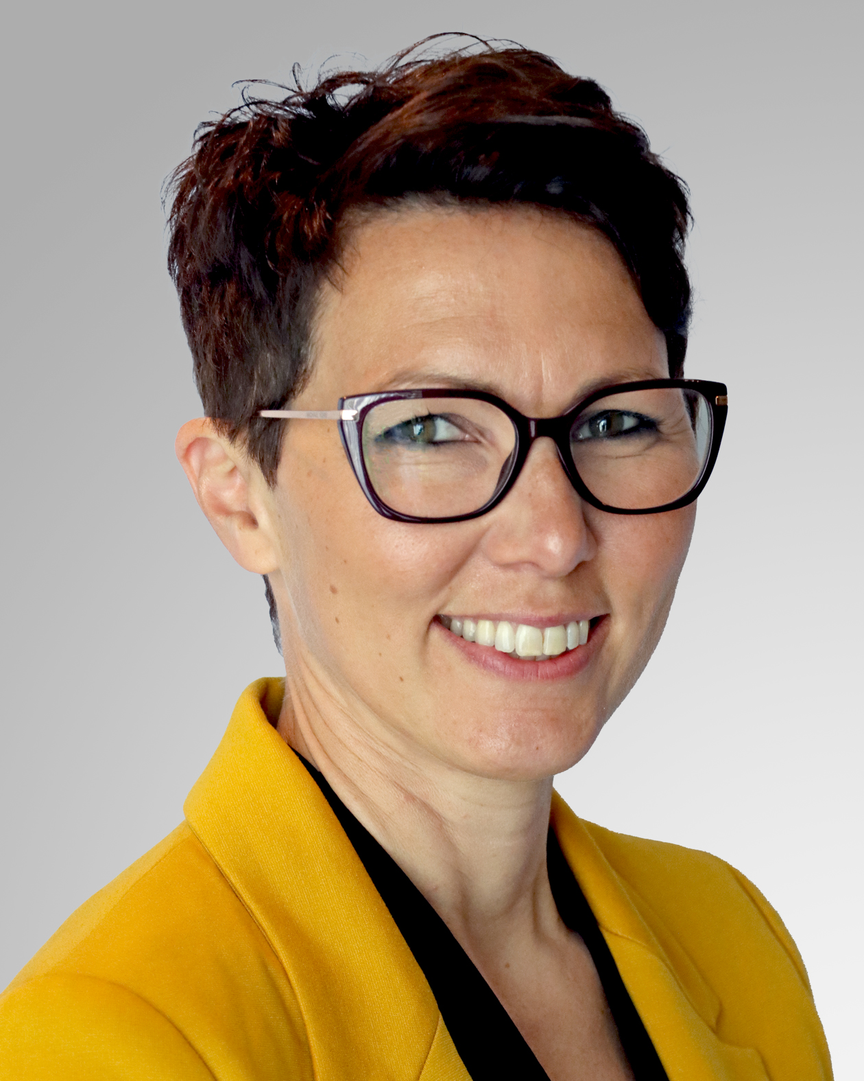
Presenters
Dennis LeFevre
Rachel Swartzendruber Miller
Everence Financial Consultant, CFP®
VP of Everence National Markets, PhD

Slide 5
My motivations:
Faith – Christian stewardship, tithe, generosity
Give thanks – Thanking God for provisions

Slide 6
My motivations:
Faith motivations
Family engagement, impact
and values
Leave a legacy

Slide 7
Together, we empower financial well-being for faith-inspired living.
OUR MISSION STATEMENT
Notes:
The Everence mission statement: Together, we empower financial well-being for faith-inspired living.

Slide 9
What are you hoping to learn?

Slide 10

What motivates BIG gifts:
Desire to leave a legacy
See a need you can meet
Giving thanks to places that impacted your life or family
Captivated by the mission
Helps others
Greater good

Slide 11
What motivates BIG gifts:
Intentional planning
Life event
Reduce tax liability
Desire to leverage the outcome
Recognition
Marketing/Promotion

Slide 12

Faith-based motivators
Everything belongs to God
Generosity as an act of worship
Response to God’s generosity
Community and mutual aid
Called to care, clothe and feed
Notes:
[“When it comes to end of life estate planning, Americans are understandably conflicted. It forces us to confront our mortality and consider the future of those we leave behind. And yet it’s also a vital aspect of financial management and the long-term security of our loved ones, which is why it may be surprising to learn that only 4 out of 10 Americans currently have an estate plan in place. According to Caring.com’s 2019 survey, 57 percent of U.S. adults do not currently have estate planning documents such as a will or living trust.” source: https://www.caring.com/caregivers/estate-planning/wills-survey/]
A 2019 survey (caring.com) found that 76% of adults say having a will is important. But, only 40 % of adults actually have an estate plan (that’s down 2% from the 2017 survey). 47% of those without estate documents said “I just haven’t gotten around to it.” (2017 survey)
Why do you think that may be?
Common responses include:
They haven’t gotten around to it.
They think they don’t have an estate or enough to worry about, etc.
Don’t want to talk about death, like, “If I talk about death, it might actually happen.”
That leaves 60 percent of people with no estate plan at all. Why is this significant? Well, I’ve already mentioned that by not having an estate plan in place, the state (instead of you) will determine what happens to your assets. But there’s more to it than just the legal ramifications. Yes, estate planning includes the documents and instructions needed to handle your affairs upon your death or if you are incapacitated. But it’s a way for you to have control over the direction of your assets, as well as take some heavy burdens off of the shoulders of your loved ones.
Another item of great significance when thinking about incomplete or incorrect estate plans is guardianship. Without appropriate documents in place, with the untimely death of parents, the state or local court decides who becomes the custodial and financial guardian of your children. This is an area you very much want to provide for in your estate plan, and not default to the court system or state.
In order to make sure you are able to leave the kind of legacy that’s important to you, it’s essential that you create and/or update your estate plan, and to include it as part of your broader financial plan. We understand that estate planning can be a daunting task, and it IS hard to know where to start or how to go about developing a plan. That’s why we partner with you to consider the things we’re talking about today.

Slide 13

Psychological motivators
  Association
  Identification
  Legacy
  Hyper-agency
  Tax avoidance
Source: Paul Schervish, Professor of Sociology, Boston University
Notes:
[“When it comes to end of life estate planning, Americans are understandably conflicted. It forces us to confront our mortality and consider the future of those we leave behind. And yet it’s also a vital aspect of financial management and the long-term security of our loved ones, which is why it may be surprising to learn that only 4 out of 10 Americans currently have an estate plan in place. According to Caring.com’s 2019 survey, 57 percent of U.S. adults do not currently have estate planning documents such as a will or living trust.” source: https://www.caring.com/caregivers/estate-planning/wills-survey/]
A 2019 survey (caring.com) found that 76% of adults say having a will is important. But, only 40 % of adults actually have an estate plan (that’s down 2% from the 2017 survey). 47% of those without estate documents said “I just haven’t gotten around to it.” (2017 survey)
Why do you think that may be?
Common responses include:
They haven’t gotten around to it.
They think they don’t have an estate or enough to worry about, etc.
Don’t want to talk about death, like, “If I talk about death, it might actually happen.”
That leaves 60 percent of people with no estate plan at all. Why is this significant? Well, I’ve already mentioned that by not having an estate plan in place, the state (instead of you) will determine what happens to your assets. But there’s more to it than just the legal ramifications. Yes, estate planning includes the documents and instructions needed to handle your affairs upon your death or if you are incapacitated. But it’s a way for you to have control over the direction of your assets, as well as take some heavy burdens off of the shoulders of your loved ones.
Another item of great significance when thinking about incomplete or incorrect estate plans is guardianship. Without appropriate documents in place, with the untimely death of parents, the state or local court decides who becomes the custodial and financial guardian of your children. This is an area you very much want to provide for in your estate plan, and not default to the court system or state.
In order to make sure you are able to leave the kind of legacy that’s important to you, it’s essential that you create and/or update your estate plan, and to include it as part of your broader financial plan. We understand that estate planning can be a daunting task, and it IS hard to know where to start or how to go about developing a plan. That’s why we partner with you to consider the things we’re talking about today.

Slide 14
What prohibits of BIG gifts:
Missteps by organizations or staff
Lack of relationship or engagement
Missteps in showcasing needs
Lack of proactive planning by donors and organizations
Lack of awareness related to tax liability
Lack of awareness related to charitable giving tools

Slide 15

Strategies for legacy giving
  Will bequest
  Beneficiary designation
  Retained life estate
  Charitable gift annuity
  Charitable remainder unitrust
  Easiest and most common
Notes:
[NOTE TO PRESENTERS: Again, this could be a place to share your own generosity story if appropriate. The example in Nos. 3 and 4 is from an Everence colleague.]
People who decide that they want to support charity often wonder about the appropriate amount. Here are a few ideas:
[CLICK]
Sometimes people choose a “fixed amount” to give to charity, but it’s important to think carefully about this and review the amount regularly. A colleague of mine shares a story from when she was working as a development officer at a non-profit organization. Naturally, she was ecstatic when her organization received a bequest of $750,000. However, her heart sunk when she got a copy of the will and saw that the woman’s congregation had received only $25,000 and a relative $10,000. The will had been written about 25 years earlier and included specific amounts for the church and relative, with the remainder to the charity. My colleague couldn’t help but wonder if that was how the woman would have wanted the money distributed if she knew the current value of her estate. Because of the unknown costs of health care and client needs, along with a changing market, it is impossible to what the amount in an estate will be, so instead of using a fixed amount for charity, we often recommend a …
[CLICK]
Fixed percentage. This can change over time. For example, perhaps we start by saying that since we have chosen to tithe from our income in life, we want to give 10 percent of our estate to charity as well. As our kids grow and “need” less, perhaps the percentage to charity grows. A good way to way to incorporate an increased percentage for charity is to…
[CLICK]
“Adopt” charity as a child. So for example, if you have two children, you might set up your estate so that one-third goes to the oldest child, one-third to the youngest, and one-third to a “child” named “Charity.”
[CLICK]
A fourth way is to define a certain amount that will be given to children or other heirs, with everything beyond that going to charity through a “residual bequest.”
The last two ideas can be combined. So, for example, another of my colleagues has identified an upper limit on the amount that will go to kids. Each child will receive one-third of the estate, up to this limit. Charity will also receive at least one-third, though it could receive more as the estate grows and the children’s portion is capped.
[Optional]
The act of giving itself is vital. The possibilities are endless and a matter of personal ministry.
The range of possibilities is endless, and a matter of your own personal mission and ministry. Most often it’s getting started that’s difficult. So, let’s play “What If.”
What if someone were to give you $100,000 on the condition that you must give it all away … to other people or charitable organizations. It might be helpful to think of it as a piece of your estate because this really is a parting gift -- alas you only have five minutes to live. Who would make your list? (Give the group 3-5 minutes.)
Done? Great. We’re not going to do anything with that list, but we hope you will take it with you and think about it … how does it compare with your current will? If you don’t have one, perhaps you just started.

Slide 16
Estate plan
76%
of adults say having an estate plan is important
Who has a will?
66%
Percent with a will
39%
34%
18%
40%
actually have one
18 - 34
35 - 44
45 - 54
55+
Age groups
Source: Caring.com 2019 survey
Notes:
[“When it comes to end of life estate planning, Americans are understandably conflicted. It forces us to confront our mortality and consider the future of those we leave behind. And yet it’s also a vital aspect of financial management and the long-term security of our loved ones, which is why it may be surprising to learn that only 4 out of 10 Americans currently have an estate plan in place. According to Caring.com’s 2019 survey, 57 percent of U.S. adults do not currently have estate planning documents such as a will or living trust.” source: https://www.caring.com/caregivers/estate-planning/wills-survey/]
A 2019 survey (caring.com) found that 76% of adults say having a will is important. But, only 40 % of adults actually have an estate plan (that’s down 2% from the 2017 survey). 47% of those without estate documents said “I just haven’t gotten around to it.” (2017 survey)
Why do you think that may be?
Common responses include:
They haven’t gotten around to it.
They think they don’t have an estate or enough to worry about, etc.
Don’t want to talk about death, like, “If I talk about death, it might actually happen.”
That leaves 60 percent of people with no estate plan at all. Why is this significant? Well, I’ve already mentioned that by not having an estate plan in place, the state (instead of you) will determine what happens to your assets. But there’s more to it than just the legal ramifications. Yes, estate planning includes the documents and instructions needed to handle your affairs upon your death or if you are incapacitated. But it’s a way for you to have control over the direction of your assets, as well as take some heavy burdens off of the shoulders of your loved ones.
Another item of great significance when thinking about incomplete or incorrect estate plans is guardianship. Without appropriate documents in place, with the untimely death of parents, the state or local court decides who becomes the custodial and financial guardian of your children. This is an area you very much want to provide for in your estate plan, and not default to the court system or state.
In order to make sure you are able to leave the kind of legacy that’s important to you, it’s essential that you create and/or update your estate plan, and to include it as part of your broader financial plan. We understand that estate planning can be a daunting task, and it IS hard to know where to start or how to go about developing a plan. That’s why we partner with you to consider the things we’re talking about today.

Slide 17

Charitable remainder unitrust
Income for life (often increases)
Significant flexibility
Excellent for appreciated assets
Immediate tax deduction
Defer capital gains
Can be added to
Can be funded by QCD*

Slide 18
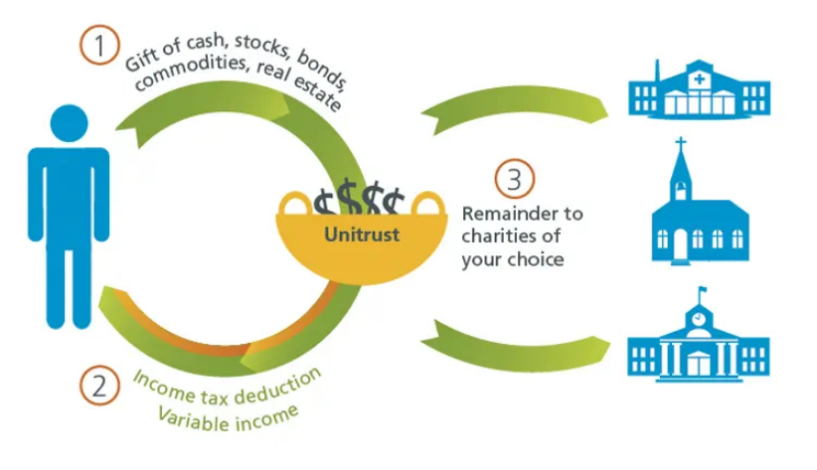
Charitable remainder unitrust

Slide 19
Recommendations

Slide 20
Unearth passion:
Develop a relationship
Listen to what matters
Authentic engagement
Ask for advice instead of money
Watch for mission, passion and money alignment
Notes:
We want to help people not only make a difference in their own stewardship journeys, but also make a difference in the lives of others.
Our Sharing Fund, MyNeighbor credit card, community development investing, church loans and charitable services are just a few examples of how we and our clients help others in our communities and around the world.

Slide 21
Learn, ask, seek, partner:
Increase knowledge related to charitable giving tools
Increase knowledge related to tax laws related to charitable giving, incentives, and opportunities
Build network of local lawyers, realtors, financial planners, and CPAs and offer that trusted network to
your donors

Slide 22
Together, we empower financial well-being for faith-inspired living.
OUR MISSION STATEMENT
Notes:
The Everence mission statement: Together, we empower financial well-being for faith-inspired living.

Slide 23
Questions?
2191379

Slide 24
Thank you!
2191379

