Slide 1

Bridging the Gap: Aligning Board and
CEO Strategy for Fundraising Success
Manuel Nuñez & Susan Huxman
Everence Development Conference
September 25, 2025
9:30-10:45 AM Federal AB Penn Square Marriott, Lancaster, PA

Slide 2
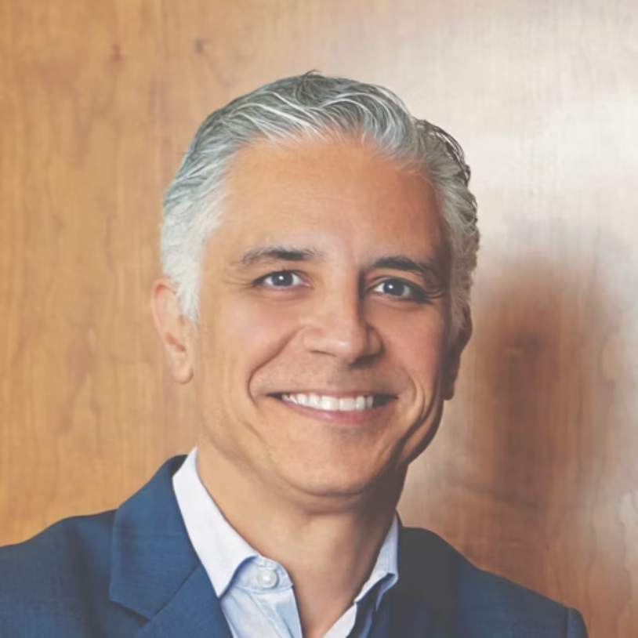
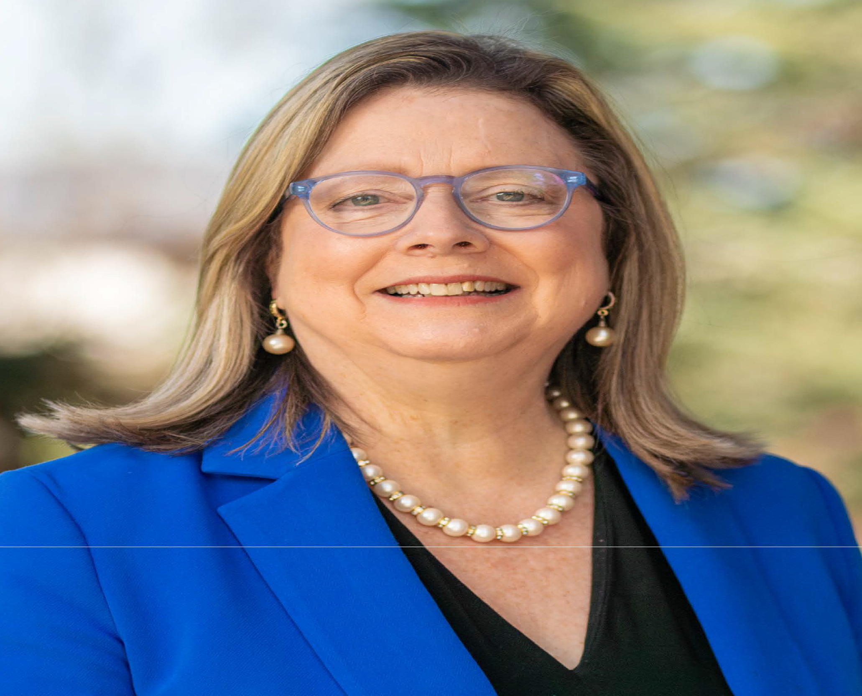
Who Are We?
And what do we know about Board-CEO Alignment?
Manuel A. Nuñez, MBA
Susan Schultz Huxman, Ph.D.
Associate Dean of Graduate Programs and Professor of the Practice in Management & Operations at Villanova School of Business. Currently Chair of the Board of Trustees for Eastern Mennonite University (EMU), Board member at Dock Mennonite Academy, and Board Director at Goodville Mutual Casualty Company.
President Emerita of Eastern Mennonite University (EMU) and former president of Conrad Grebel University. Professor of Communication who consults in strategic planning, brand narratives, fundraising, and reputation management. Currently chairs the Harrisonburg City and Rockingham County Chamber of Commerce.

Slide 3

Workshop Goal
Equip nonprofit leaders with strategies and tools to align board and executive roles in healthy board dynamics and fundraising—moving from passive approval to shared ownership and strategic engagement.
We'll need your help as this is a collaborative goal!

Slide 4

Live Poll: Fundraising
Board Strategy Involvement
Board Chair’s Understanding
How confident are you in your board chair’s understanding of your
fundraising model?
Member Participation
What percentage of your board
members are regularly involved in
donor cultivation or stewardship?
How involved is your board in shaping
the organization’s fundraising strategy?
Scan the QR Code to participate in the live poll

Slide 5

Interactive Question: Assessing Engagement
Describe your board's current engagement with fundraising in one word.

Slide 6












What We’ll Cover Today
Alignment Definition
Common Pitfalls
Understanding what alignment looks like
Board-CEO dynamics challenges
Action Planning
Healthy Relationships
Next steps and reflection
Signs of effective partnerships
EMU Case Study
Best Practices
Real-world application
Proven fundraising strategies

Slide 7

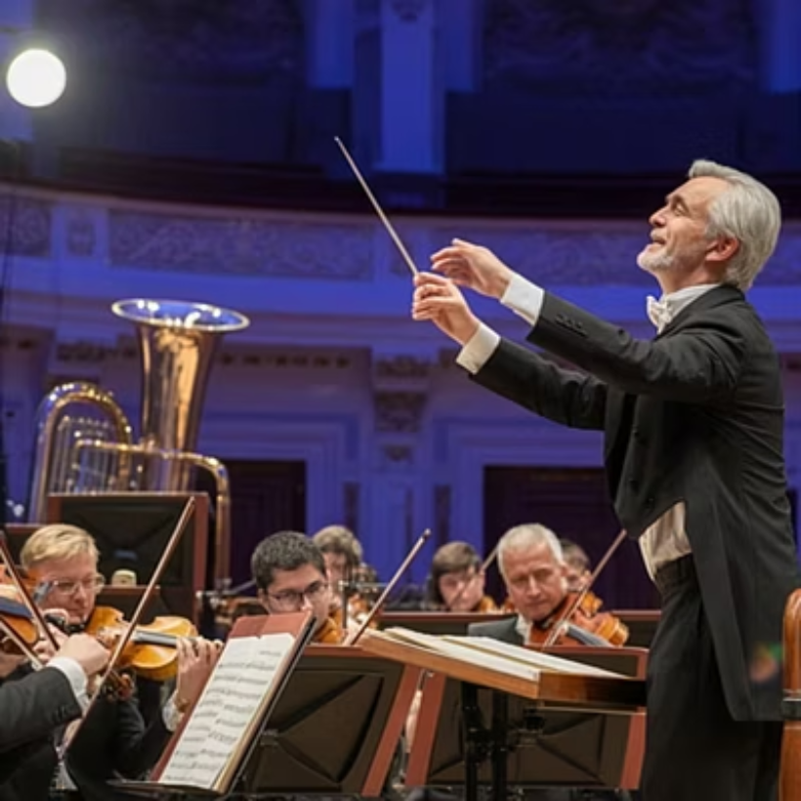
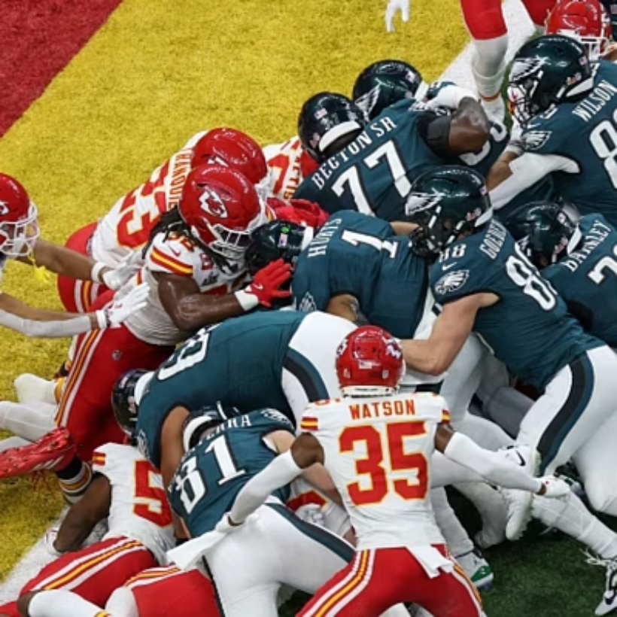

What Is Alignment?
We know it when we see it

Slide 8

What Is Alignment?
For a board and its CEO, alignment means sharing a unified purpose, a clear vision of success, and a strategic plan that channels diverse contributions into a cohesive, effective effort.
Without alignment, even the most skilled and experienced organizations can fall short of their potential.

Slide 9

Issues That Must Be Aligned
Strategic Direction
Financial Transparency
Unified vision for the organization's future
Clear understanding of fiscal health and goals
Board Governance
Risk Tolerance
Clarity around roles and responsibilities
Shared appetite for organizational risk
What others would you add?

Slide 10

Why Is Misalignment Hard to Spot?
1
Cultural Norms
Organizations that minimize naming conflict, vulnerabilities, and weaknesses
2
Meeting Structure
Board meetings that are too infrequent with agendas focused on reporting rather than "Big Picture" analysis and robust input
What other problems have you encountered?

Slide 11

Common Pitfalls in Board-CEO Dynamic
Passivity
Rubber-Stamp
Do you "sit" or "serve" on a board?
Actions approved without discussion
Blurred Roles
Reactive Approach
Where does governance end and
management begin?
Whack-a-mole response to
facing challenges
Under-Communicate
Underutilizing Orientation
Insufficient dialogue between meetings.
Inadequate board member preparation
and training

Slide 12

Healthy Signs of CEO-Board Relationships
1
2
3
Over-Communication
Strategic Discussion Time
Supportive Challenge
Between board meetings - the
cost of over-communicating vs. under-communicating
Devote time at each meeting
for "Big Picture" industry
position debates
Boards engage and challenge CEOs in sessions and "have their back"
in public
4
5
Unified Voice
Stakeholder Visibility
Boards speak with one voice after actions - any single voice can inadvertently become the board's voice
Board members are highly visible among key stakeholders and trained to listen well

Slide 13








Best Practices in Fundraising: Board-CEO Alignment
"With involvement comes investment"
Fundraising Committee
Model Philanthropy
Form a special steering committee connected to the board to maximize "transfer of credibility"
Board members demonstrate giving and practice role-
playing scenarios
Feasibility Studies
Strategic Alignment
Conduct thorough research before launching
campaign specifics
Tie fundraising goals explicitly to strategic plan, mission,
vision & values

Slide 14


Case Study: Eastern Mennonite University
Real-world application of board-CEO alignment principles in action

Slide 15

Action Planning & Reflection
This Month
This Quarter
Your Ideas
What's one action you can take this month to improve alignment?
What's one action you can take this quarter to improve fundraising engagement?
What's an idea you would add to our presentation on "Bridging the Gap" between CEO and Board?
"When there is a balance between accountability and support, CEOs are more equipped to deliver long-term value creation." - SpencerStuart, 2025

Slide 16
Bridging the Gap: Aligning Board and CEO Strategy for Fundraising Success
Questions & Discussion
Thank you!

Slide 17
SOURCES:
“15 Key ways CFO’s Can Stay aligned with Company board Members,” Forbes, Jan 25, 2023
“Better Together: 3 Ways to boost Board-CEO Collaboration,” McKinsey & Co, Sept 25, 2024. Survey conducted by Celia Hubert and Frithjof Lund.
Campaign Readiness Study for EMU: Douglas Mason and Tyson Pinion, GonserGerber Advancement Leadership Consultants, June 2023.
How do you know if you have a high functioning board? Casa Grande Consulting. Skip Meyers Consultant
“Closing the Confidence Gap: Why the Board-CEO Relationship Needs a Reset,” SpencerStuart
April 2025.
“Creating Board-Management Alignment: Director’s Roundtable,” SHRM Business, Jan 5, 2024.
EMU Board Orientation Materials for New Trustees. Revised yearly. 2017-2025.
“How to Maintain a Thriving Board-CEO Relationship,” Association of Community College Trustees, June 23, 2025.
“Piloting Through Challenges and Opportunities,” Melissa Morris-Olson, Blog post, July 24, 2025
“The Campaign for Eastern Mennonite University 2023-2028, Forward Together: Preparing Tomorrow’s Unifying Leaders, Preliminary Case Statement”
“Trouble at the Top: Meeting the Daunting Challenges of Today’s College Presidency,” The Chronicle of Higher Education,” Alexander Kafka. Special publication, p. 3-67.

