Slide 1
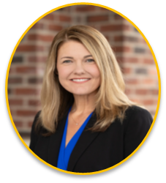
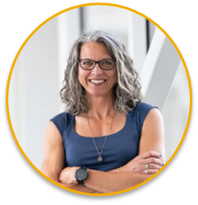
Lasting Bonds
The Joy of Drawing Donors Closer to Your Mission
Amanda Hickle – Director of Advancement, Landis Communities
Melissa Kalicicki – Donor Engagement Coordinator, Landis Communities
Notes:
BOTH
Thanks to Everence for having us. Explain relationship.
Amanda intro – role, # of yrs at LC, fundraising experience, one personal joy and one professional joy
Melissa intro – role, # of yrs at LC, fundraising experience, one personal joy and one professional joy (make sure explain Donor Comm & Mid-Level Giving)

Slide 2

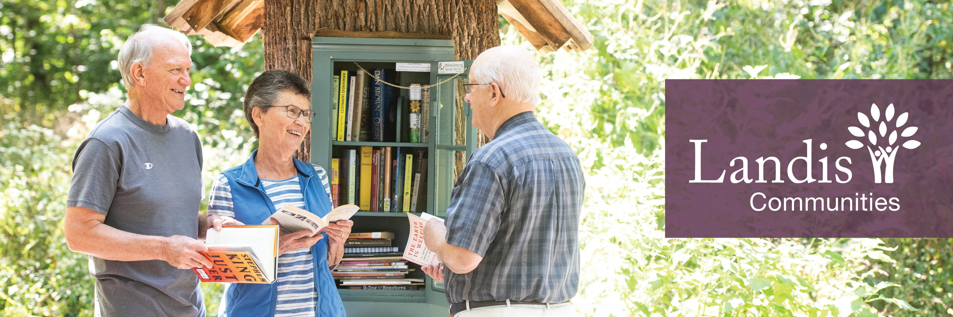
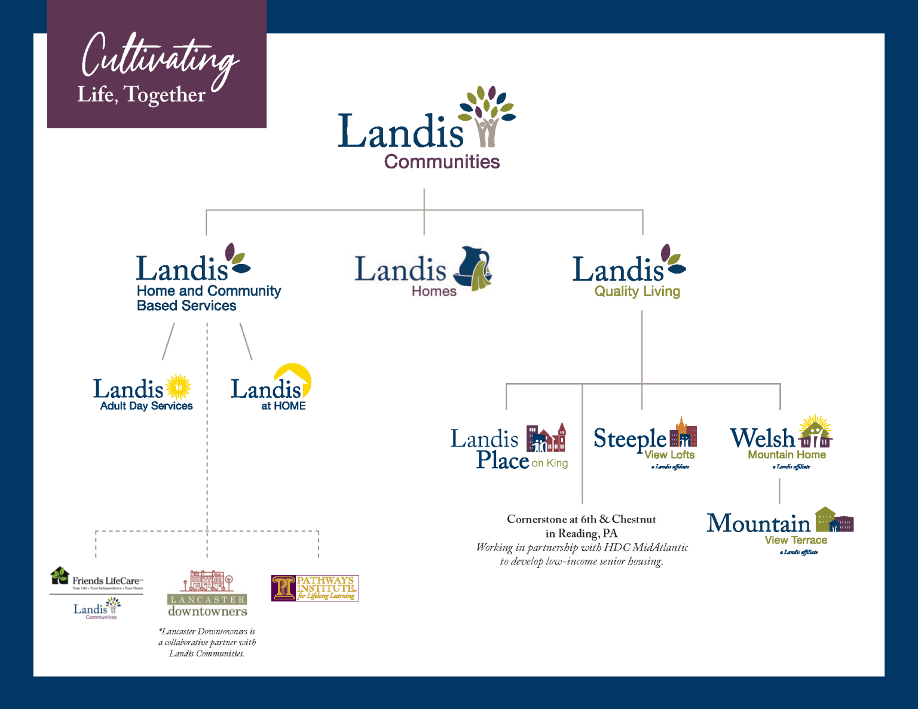
Landis Homes established in 1964 by Eastern Mennonite Board of Missions and Charities (now EMM) to serve retired Mennonite pastors and missionaries.
Established Landis Communities in 2008 to include Landis Homes, Landis HCBS and Landis Quality Living.
Now home to 1,000+ residents and clients throughout all communities and affiliates.
Mission statement: Following God’s call to creatively serve the diverse needs and interests of older adults by developing opportunities and collaborative relationships.
Vision: Enriching Lives
Values: Joy, Compassion, Integrity, Stewardship and Community
Notes:
AMANDA
Review brief history of organization
In order to engage with donors, we need clarity of mission, vision and values
How we may be different than your organization?
What you are raising $ for – i.e. youth services programs, arts, environmental protection, animals, older adults
Fundraising goals
# of donors (but, we’re all trying to increase)
Donor demographics (i.e. age, location, wealth level of donors)
Resources available for fundraising
How we may be similar to your organization?
We are a non-profit that raises charitable support from the community. We all find ourselves in philanthropic roles with our organizations – whether a staff or board member ( Dr. Michael Moody – philanthropy – “voluntary action for the public good.” The word "philanthropy" itself has Greek roots: philo- (loving) + anthrōpos (mankind)
We are interested in enhancing our donor engagement strategies (that’s why you’re here!)
We all want more donors and more revenue
We don’t have enough time in a day!
Questions for group (raise hands):
How big is your fundraising department/How many paid fundraising staff? 1-2, 3-5, 6+, 0
Organization budget size? $0-$250,000, $250,000 - $1 mil, $1 mil+
Age groups you’re fundraising from? Primary donor demo: 20-45, 45-65, 65+, All

Slide 3
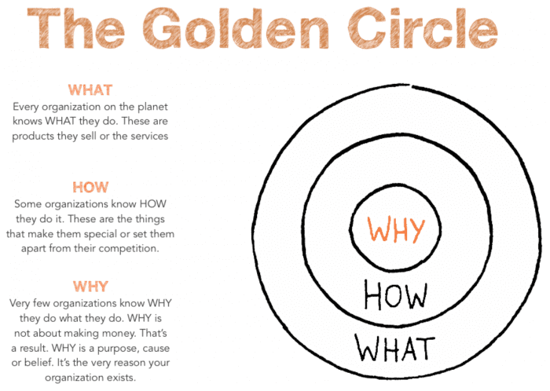
What will we cover today?
What is donor engagement?
Why is donor engagement critical?
What has worked for us –
Landis Communities?
What is working in the
nonprofit landscape?
How to enhance donor engagement at your organization?
What is working for you?
Simon Sinek – Start with the Why; How Great Leaders Inspire Action
Notes:
AMANDA
What is donor engagement? In order to do it, let’s break down what it is.
Why is donor engagement critical? What is important, but the “why” is critical. We’ll discuss some evidence based reasons it is important. Also remember your why related to mission - Simon Sinek – ‘Start with the Why; How Great Leaders Inspire Action’ TedTalk
What has worked for us – Landis Communities? Melissa will review.
What is working in the nonprofit landscape? Rapid fire of some cool ideas we’re seeing happening in the philanthropic landscape. Why reinvent the wheel when you slightly modify and use a proven tactic.
How to enhance donor engagement at your organization? How do we make it happen sometimes with limited time and limited resources.
What is working for you? The GOOD Stuff. Let’s hear from you on what is working in your organizations. CANDY ☺

Slide 4
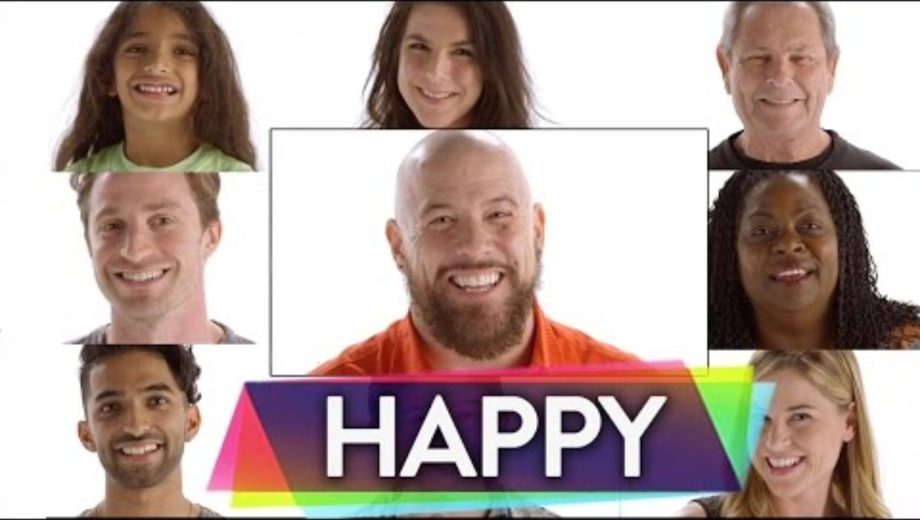
What brings us joy?
Notes:
AMANDA
PLAY VIDEO
Themes I hear in these: family, friends, activities (swimming, music, traveling napping, Oprah?), food (cheese, chocolate, chips and queso), places (beach), dogs.
This is a reminder that joy comes in many forms and each of your donors finds joy and fulfillment in different things. This example is very simple, but our job is to find out what brings our donors joy and fulfillment as it relates to our mission.
Donor engagement is more than asking for $, it’s about paying attention and noticing patterns. It’s about building connection and shared purpose with donors by thanking them, reporting back on impact (for what they gave or what they are passionate about), and getting to know them better.

Slide 5
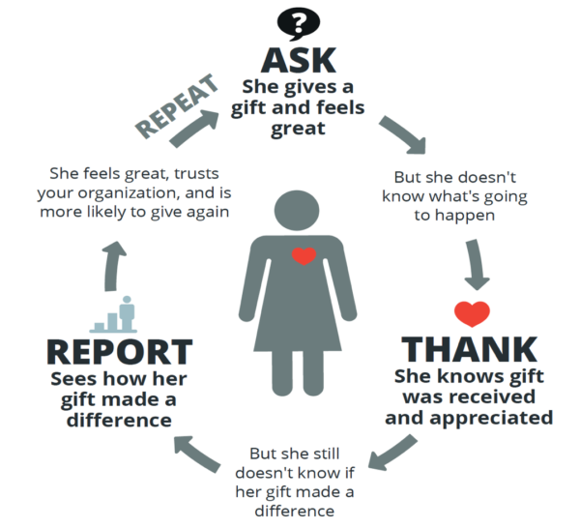
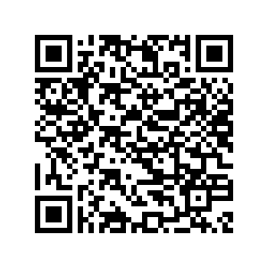
What is donor engagement?
An orchestrated cycle (virtuous cycle) of communicating with and building personal relationships with donors that results in stronger connections to the organization, increased revenue and happy people ☺
Donor engagement cycle:
  Asking donors to solve a problem with their gift
  Thanking them promptly
  and emotionally
  Reporting back to them on how their gift made a difference
  Rinse and repeat
The Better Fundraising Co.
www.betterfundraising.com
Notes:
AMANDA
- We use Better Fundraising’s model for donor engagement – Ask, Thank, Report, Repeat.
Donor engagement is a virtuous cycle. A virtuous cycle is a positive, self-reinforcing feedback loop where each positive event or outcome leads to another beneficial event, which in turn strengthens the original one, creating sustained growth and improvement over time. It's a chain of events where one desirable occurrence promotes the next, leading to an upward spiral rather than a static equilibrium or a decline.
“Doing those three things well, one at a time, and in the correct order causes donors to trust your organization. This makes it more likely they’ll give to your next appeal, and stay donors for years and years.”
So many of us do one or two of these – Ask, Ask, Ask without thanking or reporting. Or Report, Report, Report without getting to the ask. We might do two of these. But, we should be doing all of these and paying attention to the order.
Doing so:
Increases donor satisfaction
Increases fundraiser satisfaction. Instead of Ask Ask Ask…. Honors the donor.
Builds support and critical mass for your mission

Slide 6


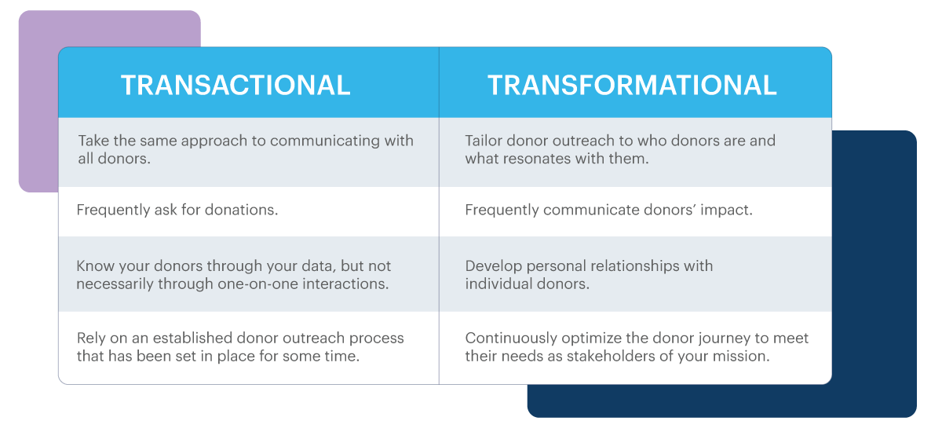
Transactional vs. Transformational (relational)
Donor Perfect - Create Your Transformational Fundraising Strategy in 5 Simple Steps
Notes:
AMANDA
- TRANSACTIONAL – put out hand – put something in my hand.
What are some words that come to mind when you think about transactional – Cold, greedy, short sighted, one-time, one-way, money, cash register (ching ching)
- RELATIONAL (which can be transformational) – put out hand – grab my hand, join me in doing a mutually beneficial relationship to do good for humankind
What are some words that come to mind when you think about relational – Warm, relationship, interaction, personal, reciprocal, handshakes/hugs
- STORY: A nonprofit senior living community in Pennsylvania had a loyal donor — we’ll call him Chuck. For nearly 15 years, he wrote a $1,000 check every December in memory of his late wife, Betty, who had once been a resident there. For years, the process was purely transactional. He received the standard appeal letter and a generic thank-you card each year. No one ever called. No one ever asked about his wife. It was a polite, professional exchange — but it lacked warmth.
When a new director of development came on board, she decided to do things differently. Instead of mailing another form letter, she called Mr. Reynolds and invited him to tour a newly renovated memory care unit — a project partly inspired by families like his. During the visit, staff members shared stories of how the upgrades improved daily life for residents — brighter rooms, safer layouts, spaces where spouses could spend time together more comfortably. One nurse remembered caring for his wife years ago and shared a fond memory. Mr. Reynolds was moved to tears. He said: “I’ve given for years, but this is the first time I’ve felt my gift — and my wife — were remembered.
”That year, instead of $5,000, Mr. Reynolds gave $100,000 to expand the renovations. Later, he included the community in his estate plan, ensuring future couples would benefit from compassionate, dignified care. Before that personal connection, Mr. Reynolds had told his accountant he might stop giving because he wasn’t sure the organization still valued his contribution. Lesson: Mail a letter, get a check. Necessary, but fragile. Relational: Build a connection, honor the donor’s story, show impact — and watch a loyal but quiet donor become a transformative partner.
Transformational can happen on a major donor, one-on-one basis, but we’ll also talk about strategies that can happen on a one-to-many basis.
REMEMBER TO THINK ABOUT DONOR EXPERIENCE.

Slide 7
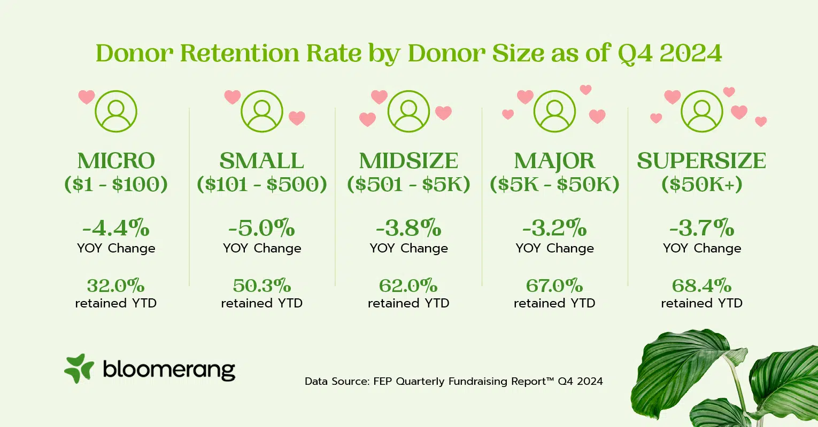
Why is donor engagement critical?
Deepens mission connection – You are helping those that support your organization to feel acknowledged, informed and fulfilled through their charitable giving while supporting the needs of
your organization
Increases RETENTION – National average between 35-45% for all donors, 20% for new donors. Retained donors are 10x more cost-effective than new donors
Increases gift size/donor lifetime value – More donors giving
bigger gifts
Builds trust and gains long-term buy-in (major gifts, planned
gifts, board members, volunteers, advocates)
Increases revenue and financial sustainability
They’ll take notice and you’ll stand out…
Notes:
AMANDA
Deeps mission connection – relational and transformational.
Increases retention – According to AFP, national retention rates are between 35-45% (4 donors in 10) with new donor retention at 20% (1 donor in 4). And, retention rates are going down – According to the Fundraising Effectiveness Project – a collab between Giving Tuesday and AFP. We’re losing donors! Attrition is the enemy. Retained donors are 10x more cost-effective than new donors.
Increase gift size/donor lifetime value – People give more because they are hearing back on the impact of their giving and they know people are listening.
Builds trust– “There is one thing that is common to every individual, relationship, team, family, organization, nation, economy, and civilization throughout the world—one thing which, if removed, will destroy the most powerful government, the most successful business, the most thriving economy, the most influential leadership, the greatest friendship, the strongest character, the deepest love. On the other hand, if developed and leveraged, that one thing has the potential to create unparalleled success and prosperity in every dimension of life. Yet, it is the least understood, most neglected, and most underestimated possibility of our time. That one thing is trust.” ― Stephen M.R. Covey, The SPEED of Trust: The One Thing that Changes Everything
Gains long-term buy-in – We want more people to support our organizations, but moreso, we should want people to buy-in to your organization in a long-term sense
Increase revenue and financial sustainability – Raise more dollars, and dollars that will stick around.
They’ll take notice and you’ll stand out –
Trivia (Candy): How many nonprofits in the United States: 1.8 million
How many nonprofits in PA: 84,000
How many nonprofits are in the greater Lancaster area: 5,000
Now, turning it over to Melissa Kalicicki, Donor Engagement Coordinator, to tell us more about what has worked for us at Landis Communities.

Slide 8


What's worked for us?
Thanking & Acknowledgement
Impact Reporting
Listening/Feedback
Creating Community
Notes:
MELISSA
I recognize that not all of you have the size team that we have, and if not, I’m hoping I can still give you some easy ideas for increasing your donor engagement.
There are A LOT of great things you can do, and that we can do more of, but here is what’s working for us.

Slide 9


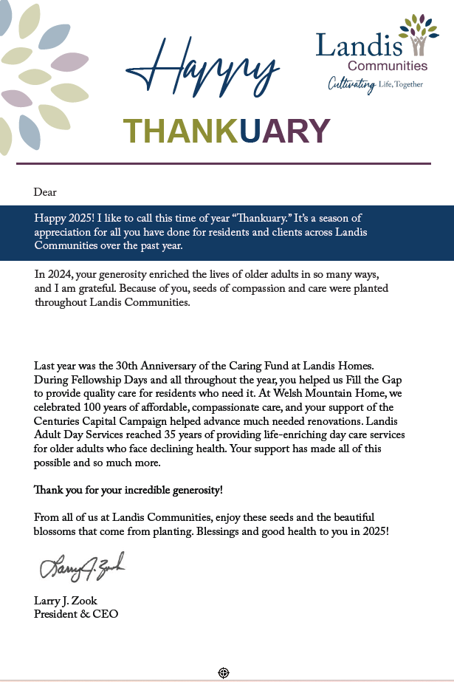

Thanking & Acknowledgement
‘Gratitude is the Attitude’
Timely, hand-signed IRS tax acknowledgement
Personal note – leadership/board/fundraiser
Phone call when appropriate – Listen for clues
‘Thankuary’
Donor Appreciation events
Special gift recognition – i.e., largest gift, planned gift commitment, special gift in honor/memory, milestone gift – 10 years, 50 gifts
Holiday cards/wishes
Notes:
MELISSA
It’s important to thank donors as soon as possible!
If you have the resources (staff), consider making a TY pipeline. For example, Major donors in our system and also donors giving at a certain level will receive a TY ack and a phone call from either our Director, Amanda, or our VP, Beth.
If you don’t have resources, a simple phone call or letter from you will do. Or you can get creative and recruit board members to help you make those thank you calls.
If you have time to sign the TY letter personally, that’s even better. The point is that donors will notice, if and how, you thank them. If done well, it will bring them joy and increase your retention rate. (for example I called a donor and they were so impressed with receiving a handwritten note, they decided to give again)
It’s important to track your conversation if you call, so you can learn if a phone call is a donor’s preferred method or if they don’t seem interested.
ThankUary – we have an established time of the year (Jan/Feb) where we specifically thank Legacy & Major donors from the prior year with a ThankUary ‘fun’ note and a small gift (a special baked bread). We ask a lot of our donors, so it’s important to thank a lot too!
I talk more about Donor appreciation events later, but we do hold at least one larger one a year. Every other year we do a large gala with dinner and entertainment, and then in the off years, we do entertainment and something lighter. We also vary who is invited. We also incorporate ‘Mission Moments’ with segments of donors. For example, donors who support the Caring Fund, we host a quarterly Coffee & the Caring Fund.
Special gift recognition – for specific donors, this is a very personal and validating acknowledgement. It can be as simple as a small note of appreciation for their years and commitment to helping others.
We also do communications with no asks – birthday cards, holiday cards, and welcome cards. We want them to know who we are and acknowledge them as well.

Slide 10
Impact Reporting
‘So What? For Who?’
    Newsletters, Appeals
    E-stories/E-mails
    Website
    Major/mid level donor conversations and visits
    Events
    Video
NEED QR code
Caring Fund Video
Landis Communities
Notes:
MELISSA
Impact Reporting : We have several ways to report the awesome benefits of your gifts!
Stories! Stories shared through newsletters and appeals are so important to highlighting the impact of a donor’s gift. If I’m writing for a newsletter or an appeal, often times, I will tweak those stories for our websites too. The more places a donor can see their generosity at work and the more opportunities they have to give, the better.
AMANDA ASKS: How do you find your stories?
2) Donor Newsletter three x a year for LC & 2x a year for WMH (different audiences). It doesn’t need to be fancy, but it should include a STORY of positive impact. If you don’t have time for a newsletter, then consider doing a regular written letter with a story, but make sure you do it! We include a low-pressure ask at the end of ours so our donor newsletters serve two purposes.
Appeals – generally, I include a story in appeals. Depending on the audience, you can use a closed-loop story or an open-ended need story.
It’s also important to note that often we think design plays a major role in giving, but not all of our appeals include designs. Many of them are just letters on letterhead. Brene Brown says, “Clarity is Kindness,” and that is true for appeal letters and design.
3) Also, we have incorporated E-stories. E-stories are emailed stories. We do not ask in these emails, just share joy. Again, sometimes we recycle a story from the donor newsletter for the E-stories. We do not include E-stories on months where we are running a major campaign.
4) Major & Mid Level donor conversations and visits – I could go really DEEP into this and do an hour on this subject alone. If you are a larger department, you might be lucky enough to have a Major & Mid-Level Giving Officer. Amanda and I serve in those roles and we work closely together on our caseloads, moving donors up or down based on their giving and investment in the organization. We each have a protocol for our caseloads, how we thank them, how we record their giving, and moving them when needed. Amanda primarily does one to one visits, whereas when I’m in my communications role, I’m interviewing and it’s one to one, but as a Mid Level Officer, I primarily communicate one to some. Visits and special offers vary between our roles.
One of the ways we connect, which I already mentioned, are Coffee & Conversation about the Caring Fund which we hold quarterly with a small group of segmented donors or volunteers who have been faithful giving to the Caring Fund. As a smaller event, we also show a special video and do some education on the history of the fund and how many individuals have been served over the years. The small group atmosphere allows donors to connect and to ask questions. But this point also leads me to the next way of reporting which is video.
5) Video- In the last few years, we have begun using more video in our communications. Example – The Caring Fund video. Many of the individuals interviewed for the video have been featured in donor newsletters, appeals, or other communications prior to being on video. We use video to support major funds like the Caring Endowment Fund and the caring Fund, but also to market events to others and thank donors. Sometimes we use short clips of videos for social media to support an ongoing campaign or fundraising event. While all video should adhere to your NPOs privacy/consent rules, they don’t have to be fancy to be effective.

Slide 11
Listening & Feedback
“When people talk, listen completely. Don’t be thinking what you’re going to say. Most people never listen”
- Ernest Hemingway
Donor surveys
Segmentation
Communication preferences
Event feedback
Personal conversations/individual feedback
‘Pulse checks’ – Can I ask you a
quick question? What do you
think about…?
Notes:
MELISSA
It’s important to listen to your donors. If you are communicating and listening well, you will know a donor’s preference. Some ways to track:
Donor Surveys – I confess we need to do these more often, but we try at least once a year to send out a donor survey. It’s important to record the feedback you get! And one more note on surveys, be mindful about crafting questions or you might not get the feedback you’re looking for or you might be unprepared for the feedback you receive.
Segmentation- this is an entire subject, however, if you know a donor’s passions, then you should make sure they receive offers that are in line with that. For instance, in our case, if they primarily support Welsh Mountain Home or have a connection there, we aren’t going to include them in every Landis Communities or Homes appeal or email. Generally, their publications and asks will be different.
Event feedback – often after an event, we will try to get volunteers, participants, and others to give us feedback on their experiences so we can make it better for the next year. Donors generally appreciate being asked and it creates a transparency that is good for everyone to share in a safe environment.
It’s also important to keep records. I usually add a note to a donor record if I called them and they prefer a letter or vice versa.
Pulse checks – our entire department is pretty good about this. We see a resident or have an impromptu conversation on the phone fairly often and can ask ‘how are things going?,’, or ‘how are you feeling about this?’ If you don’t see your donors often, ask them when you call to thank them or invite them to an event.

Slide 12
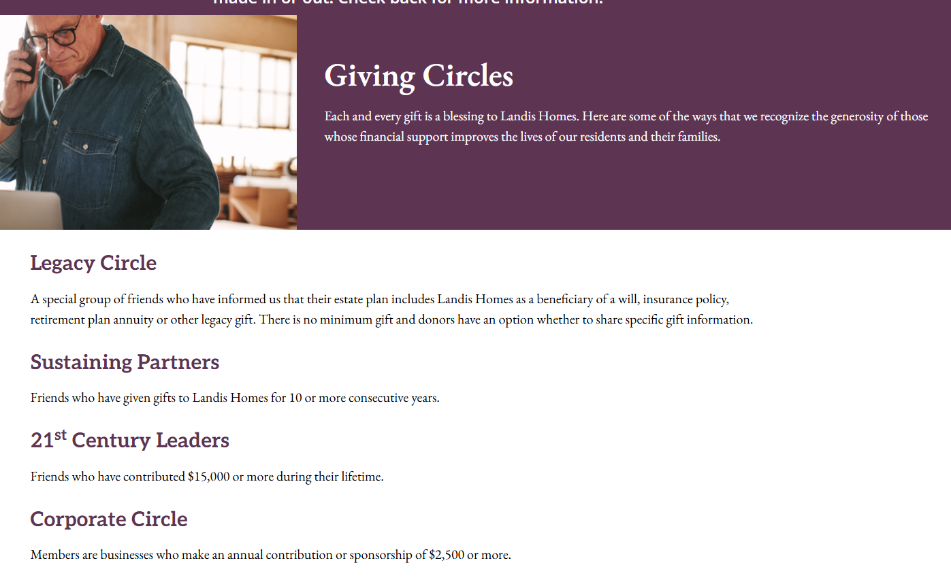
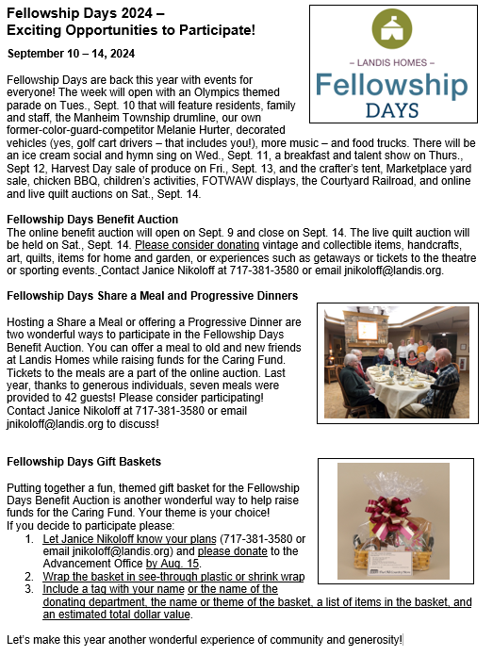
Creating Community
‘We Are Family’
Donor recognition circles
Recurring donations
Inclusive language
Volunteer opportunities
Milestone messaging
Notes:
MELISSA
Creating Community :
Donor Recognition Circles – Those who include you in their estate plans, those who give a certain amount over their lifetime. Some have monthly giving circles. The important thing is that you have some way to acknowledge a donor and include them in something special for their generosity. We generally do a donor appreciation event every year and invite specific circles to the event. It’s a wonderful way to acknowledge donors and create community.
Using inclusive language – we really try to honor every donor, not just those large givers. Recognizing all donors is important. Including offers of various levels is important. Thanking all of them, regardless of their capacity to give, is important.
Offer volunteer opportunities. Our Events Coordinator does a great job creating opportunities for donors and others to participate in events for Advancement. From pricing items for a yard sale, to baking goods for auction, to directing traffic… it’s important to give people a chance to get together in a community!
Last year, was 30 years of the Caring Fund. We did an entire year of Fundraising using that theme, because it was a wonderful milestone celebration! We made a huge campaign complete with Fellowship Day, Fill the Gap appeal, included it in the parade, complete with emails and social media and a full video in celebration. Celebrate those milestones!
AMANDA ADDS IN ABOUT UPCOMING CFE anniversary
In all, events pull people together and can also serve as wonderful acquisition tools! Donors like the idea of coming together as a community to help, so if you can keep that at the center, then you will do well.

Slide 13


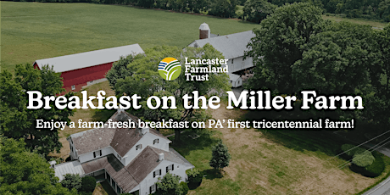
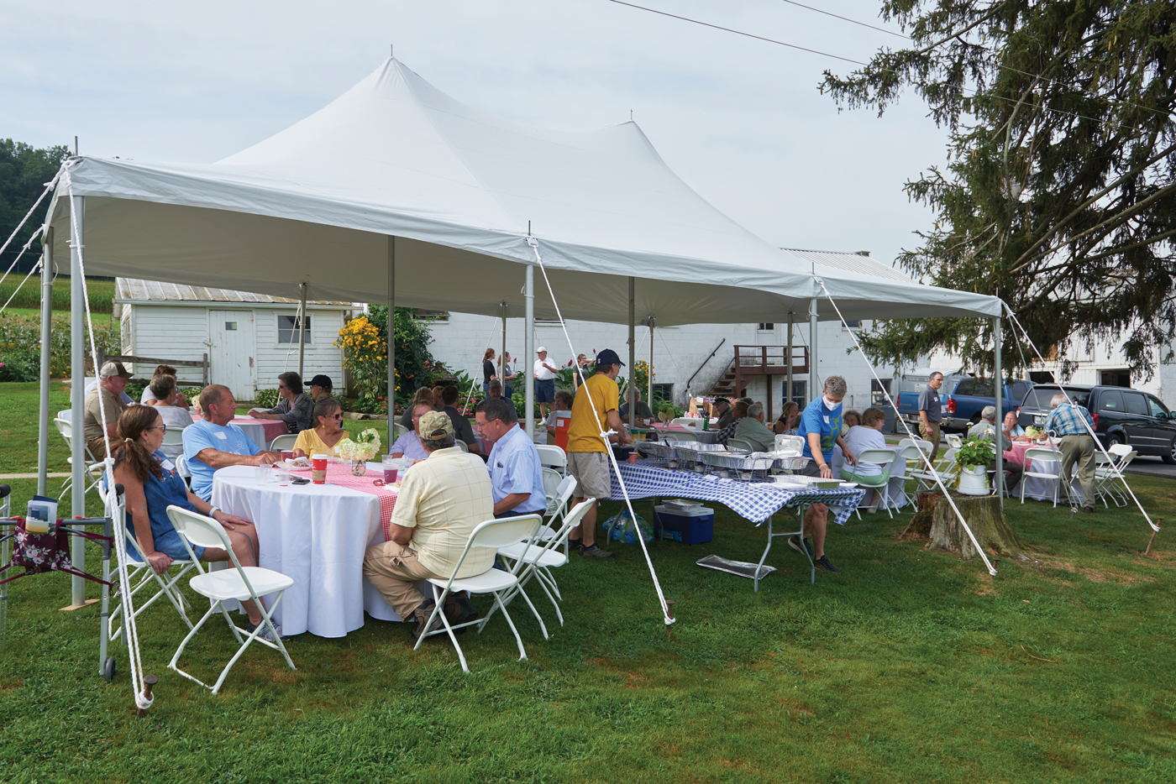
What's working out there?
Hearty ‘breakfast with a view’ on a Lancaster County preserved farm using farm products.
Donation to attend
Engages farm family to speak about why they choose to preserve their farm
Allowed attendees to ask questions about the farm and farm life
Sent them home with a “treat” from the farm and information about the organization
Followed up with a newsletter and appeal
Small shop: Host a tour – no meal, or alternatively host a CEO chat in person or online
Notes:
AMANDA
IMMERSIVE/BEHIND THE SCENES (BTS) EXPERIENCES
- Lancaster Farmland Trust – private non-profit that preserves farmland in Lancaster County.
Why?
Donors feel more connected to your mission by seeing the impact of the work and meeting the people affected by that work.
Make sure to have a follow up plan in place after the event!

Slide 14

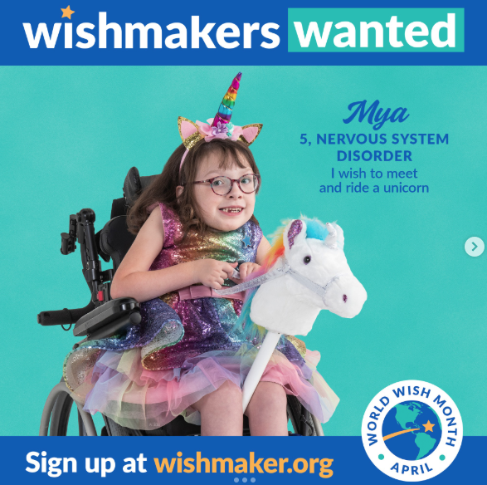
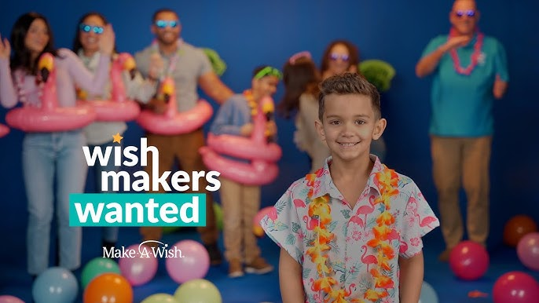
What's working out there?
Make-A-Wish Greater Pennsylvania and West Virginia
A Wishmaker® is a person, foundation or corporation that contributes a minimum of $5,000 -- enough to completely fund one wish. Wishpartners are those that contribute $500 to partially fund the cost of wish.
Wishmakers® receive full details of the wish they helped fund and are listed in our newsletter, annual report and website. Wishmakers also receive a Wishmaker plaque designed by a wish child.
Small shop: Launch giving circle in regular appeal, limit benefits
Notes:
AMANDA
RECOGNITION CIRCLES
How many of you have recognition circles at your organization?
Make-A-Wish® Greater Pennsylvania and West Virginia grants wishes in 57 counties in western, central and northeastern Pennsylvania and West Virginia. The chapter is headquartered in Pittsburgh and has seven regional offices in Charleston and Morgantown, WV, Erie, Pottsville, Punxsutawney, Scranton and York, PA. The President and CEO is Judith Stone.
This is a great way to connect donors to the work and quantify the impact. Example for Landis Communities – Days of Care. USE ON APPEAL REPLY CARDS.
Why?
Donors feel more connected to your mission and sense a tangible result from their giving.
Branding ‘creates community’ in a more impactful way.
You can modify based on your organization’s needs.
You can also scale benefits based on your time and budget
Does require management on organization’s part.
have opportunities for phone support, meal service, clothing boutique, personal care. LFT example – gleaning. BUT, could be as easy as mailings, property beautification.

Slide 15
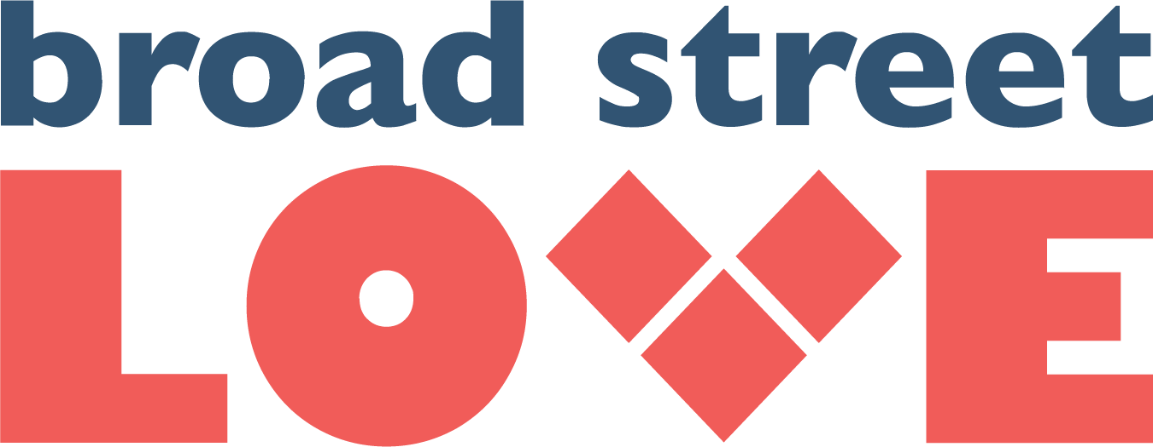
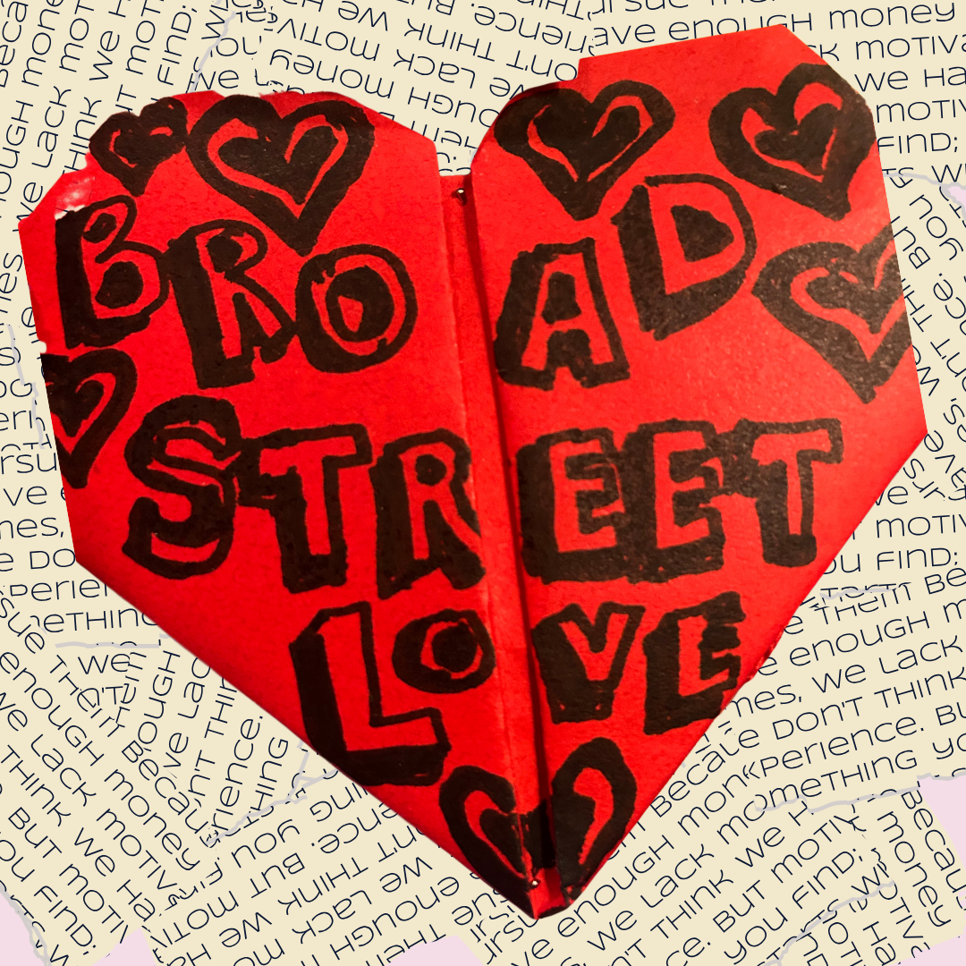
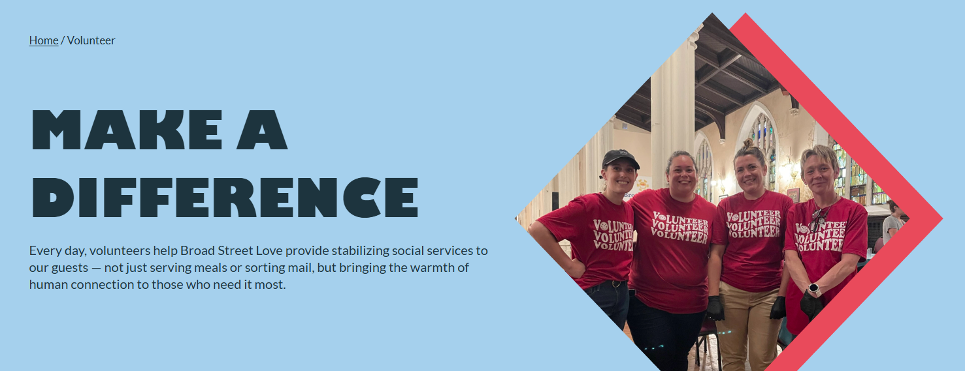
What's working out there?
Volunteers staff the mailroom that serves 5,000+
unhoused neighbors who use Broad Street Love as their mailing address.
Volunteers help sort and distribute mail to guests, helping them to receive important mail like birth certificates and social security checks and keep in touch with loved ones.
Four volunteers per 3 hr. shift so volunteers can work together and meet new people
Follow up with impact stories and giving prompts via email
Small Shop: Hold a one-day volunteering event
Notes:
VOLUNTEER OPPORTUNITIES
-Broad Street Love provides stabilizing services to individuals experiencing deep poverty. We aim to meaningfully reduce the deep trauma and suffering caused by scarcity and break the cycle of hardship, hunger, and housing insecurity in Philadelphia. Our staff greets volunteers with the same Radical Hospitality that we show our guests. That’s because as volunteers, they become ambassadors of Radical Hospitality, offering an open, welcome, and safe space for our guests.
Why?
Donors feel more connected to your mission by seeing the impact of the work and serving the people affected by that work. Dignity Centered Work. RELATIONAL
Make sure to have a follow up plan in place!
Does require management on organization’s part.
Also have opportunities for phone support, meal service, clothing boutique, personal care. LFT example – gleaning. BUT, could be as easy as mailings, property beautification.

Slide 16



What's working out there?
New Donor Survey
Why did you choose us?
What conservation issues matter most?
How are you involved
in conservation?
How did you hear
about us?
Active Donor Survey
What keeps you giving year over year
Rate how strongly you feel informed about our work
How likely are you to give again?
Lapsed Donor Survey
When you first gave a gift, what inspired you to give?
I will support again if/when ______
What matters to you (open response) “We promise to listen”
Small shop: Identify a focus group (4-5 donors) and make some calls to seek feedback
Notes:
AMANDA
SURVEYS
Why?
Really listens to donor. Hemmingway - "When people talk listen completely. Don't be thinking what you're going to say. Most people never listen.” Make sure you’re prepared to respond.
Donor led.
Be careful what you ask!! Carefully craft your survey and be ready to respond to negative AND positive feedback.

Slide 17

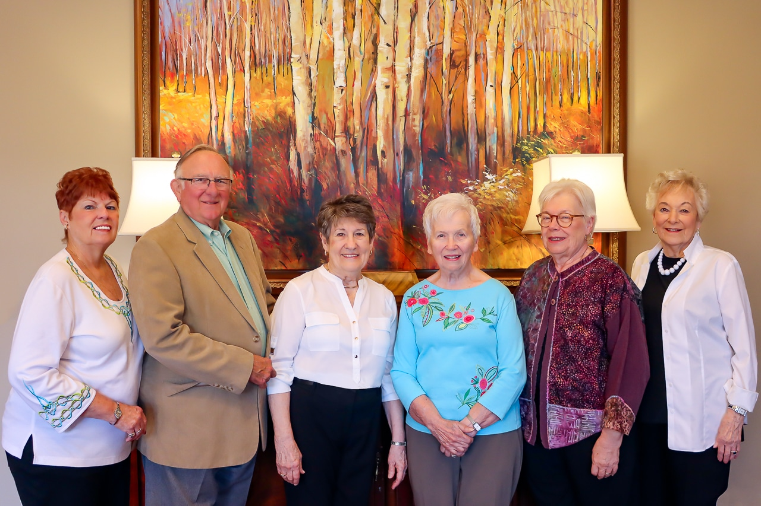
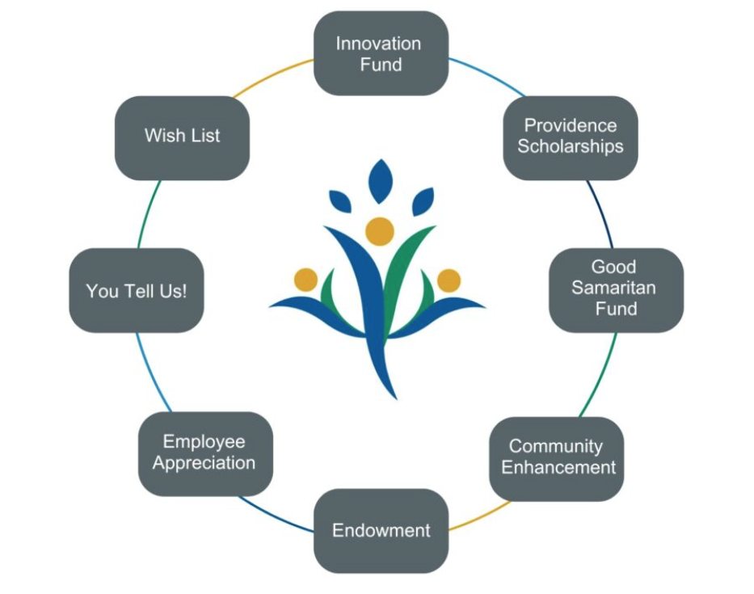
What's working out there?
Created “flexible” giving fund that can quickly act with new ideas and opportunities without waiting for the budget process.
Examples of projects identified by donors: Low vision support group, grief recovery group, lifeguarding backboard, staff training programs, brain health programs, memory support resources.
Four volunteers per 3 hr. shift so volunteers can work together and meet new people
Follow up with impact stories and giving prompts via email
Small shop: Form a giving circle for an existing fund
Notes:
AMANDA
DONOR DRIVEN FUNDS
-A Foundation established to serve older adults in Our residents live generously as volunteers within Providence Point, Baptist Manor and the Pittsburgh communities.
Why?
Aligns donor passions with transformational opportunities
Donor centered, resident led
Does require some management/oversight on the organization’s part.
Sometimes, donors see what we don’t see.

Slide 18
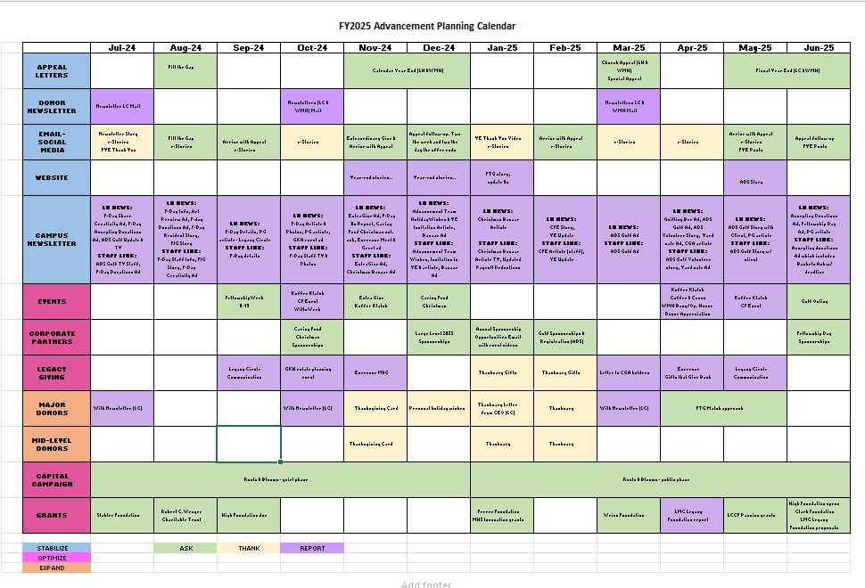
How do I enhance donor engagement at my organization?
Fundraising Plan – Stabilize, Optimize, Expand
Start small – start with Ask/Thank/Repeat, build out schedule using cycle
Donor Management Software (CRM)
Build your Toolbox – Segmentation,
Email marketing, moves management, AI
Set goals
Use compelling storytelling when you can
Notes:
AMANDA
-Fundraising Plan – How many in the room have a fundraising plan? Explain our plan.
-Donor Management software – if you don’t have a good CRM, consider an investment. We use Donor Perfect, but I also have some experience in Razor’s Edge. A good CRM is worth it’s weight in gold and can help you track data about donors, patterns, and touches.
-Build your Toolbox – Will have a resource page later, but we are always looking for ways to build our toolbox. New this past year – mid-level donor program. AI – use ethically and efficiently.
-Goals – Do you have goals? If not, you should. Not only revenue goals but retention goals.
-Use storytelling as much as possible. Tammy Zonker (Founder of Fundraising Transformed and the Intentional Fundraiser Podcast) Storytelling vs. Storyliving
..Hailing from Detroit, Marshall Mathers, aka Slim Shady or Eminem is one of the world’s greatest storytellers. He courageously tells the tales of the streets, the ugly underbelly of urban decay, poverty and the infectious ills it inspires. He does so with fierce courage, insightfulness, vulnerability, and empathy. He bludgeons a crack in the surface of that world, allowing us so-called civilized outsiders to see in – and perhaps more importantly empowering those within to see the possibility outside.
Excerpt lyrics from "Lose Yourself” by Eminem:

Slide 19
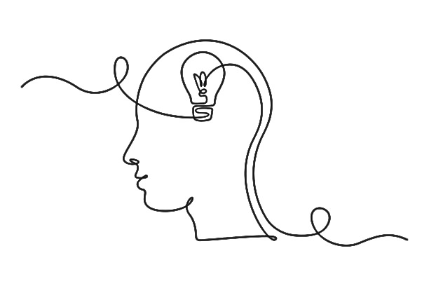
What’s working for you?
Notes:
Here’s the ‘You’ part of the agenda – the good stuff!
MELISSA opens conversation. Encourages short responses. CANDY!
AMANDA summarizes and wraps up.

Slide 20
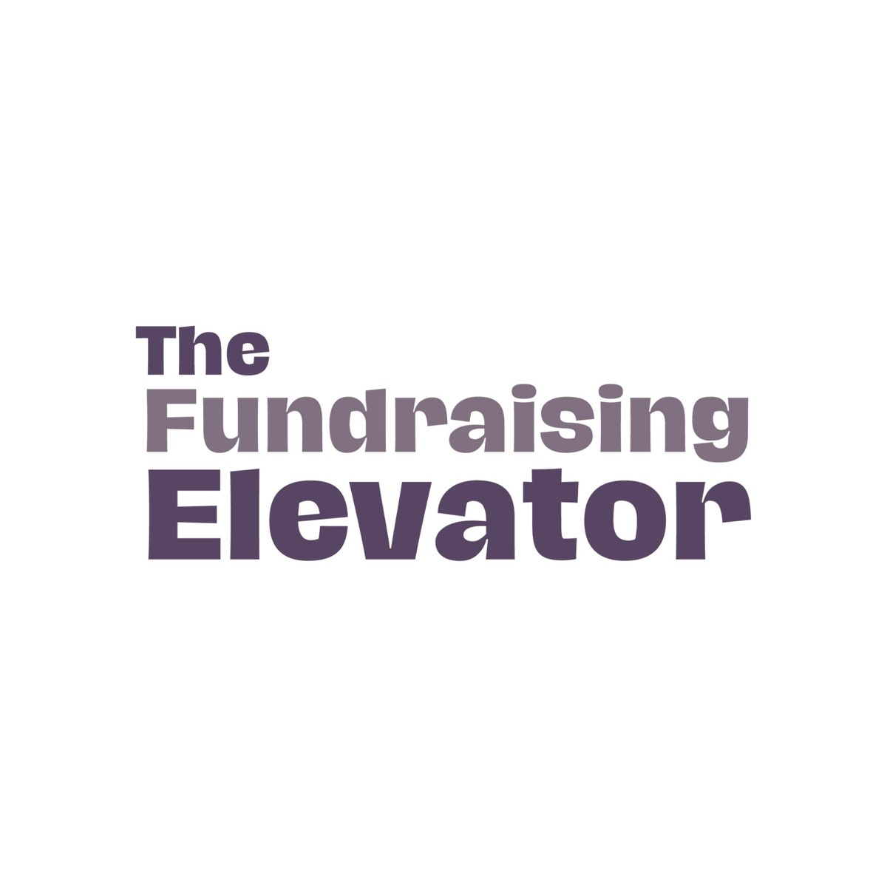
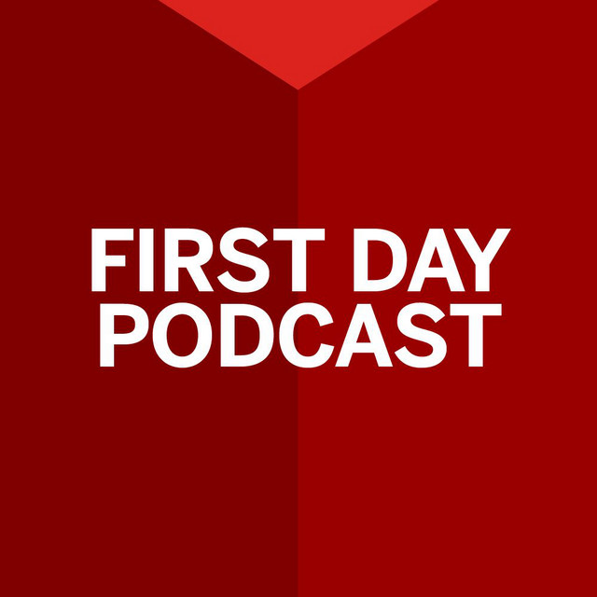
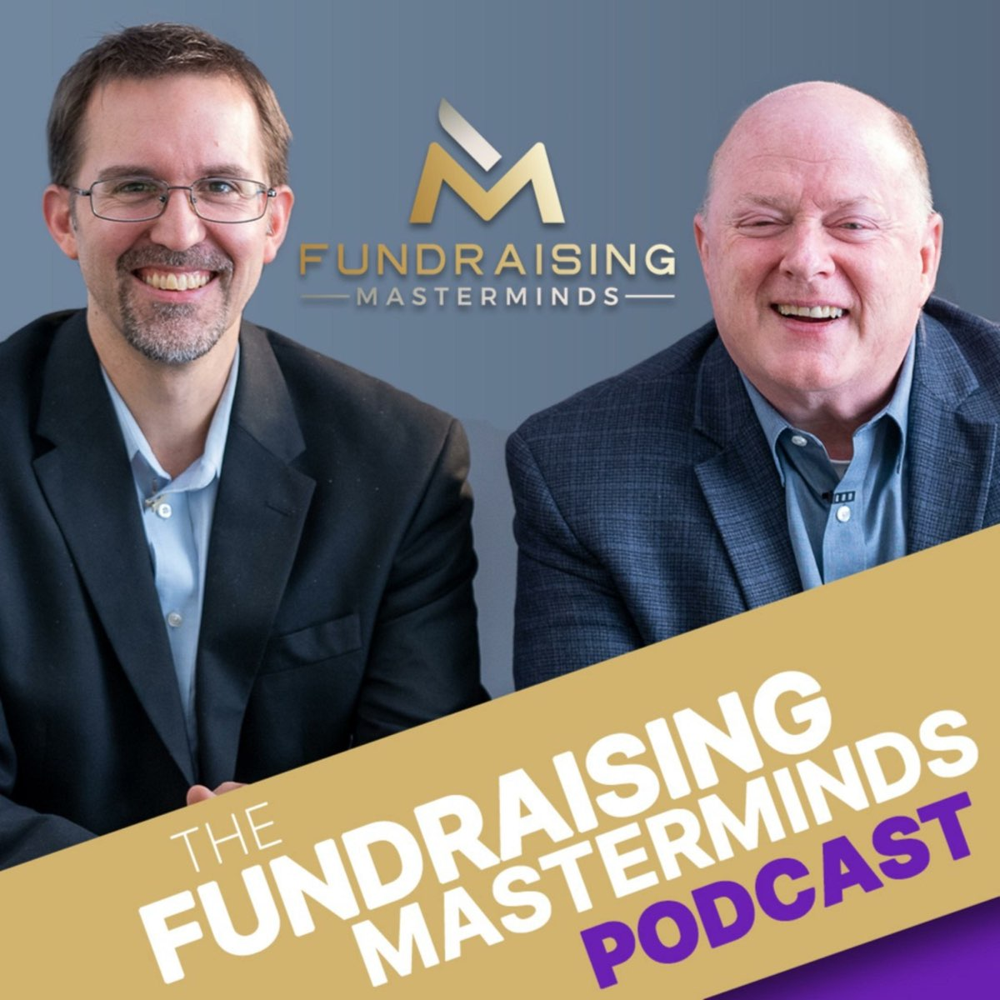
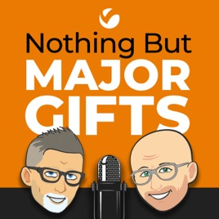
Resource List
Podcasts
Better Fundraising – www.betterfundraising.com Donor Engagement Cycle
Productive Fundraising – www.productivefundraising.com Donor Engagement+ - Chad Barger
Fundraising Transformed – www.fundraisingtransformed.com Storytelling – Tammy Zonker
Veritus – www.veritusgroup.com Majors/Mids Cultivation
Donor Relations Guru – www.donorrelations.com Donor eng. – Lynne Wester
The 4 Pillars of the Donor Experience
Nonprofit Storytelling Conference – San Diego - https://nonprofitstorytellingconference.com/
Start with WHY: How Great Leaders Inspire Everyone to Take Action by Simon Sinek
The Fundraising Elevator Podcast – Samantha Swain and Kristin Steele
First Day Podcast – Lilly Family School of Philanthropy
The Fundraising Masterminds Podcast – Jim Dempsey and Jason Galicinski
Nothing But Major Gifts – Veritus Group
Notes:
AMANDA
Pat on the back – you are doing a great job!
Take a photo of this slide if not enough time left.
Melissa and I are open books and are always looking to learn ourselves.

Slide 21
Thank you!
Amanda Hickle – Director of Advancement, Landis Communities
ahickle@landis.org, 717-381-3584
Melissa Kalicicki – Donor Engagement Coordinator, Landis Communities
mkalicicki@landis.org, 717-381-3586
Notes:
AMANDA
Thank Everence for having us.
Thanks to you.

