Slide 1
Making wishes clear
Guiding donors to align beneficiary designations with estate plans
Chandler Ingle, CFP®, CSRIC®
Financial Consultant, Everence®

Slide 2
You are in the stewardship business
  ”Teach those who are rich in this world not to be proud and not to trust in their money, which is so unreliable. Their trust should be in God, who richly gives us all we need for our enjoyment. Tell them to use their money to do good. They should be rich in good works and generous to those in need, always being ready to share with others.”
  1 Timothy 6:17-18 (NLT)

Slide 3
What your donors are asking
  How will I be remembered when
  I am gone?
  How much is enough for
  my children?
  When is it too early or too
  late to leave money to children/grandchildren?
  What’s the best way to leave a
  gift to charity?

Slide 4
Where assets can go

Slide 5
A final act of stewardship
1) Avoid or minimize tax consequences
2) Reduce headaches and costs for loved ones
3) Avoid probate

Slide 6
What is probate?
  Probate is a legal process that occurs when a person dies that involves the validation and administration of their will (if available).

Slide 7

Non-Probate
Probate
1.
2.
3.
4.
Ownership
Beneficiary Designation
Revocable Living Trust
Will
Joint with Rights of Survivorship:
Will
Life insurance
IRA
401(k)
T.O.D. real estate deed
P.O.D. account
RLT
Husband & Wife:
Probate
Minor’s Trust

Slide 8
Last will and testament
  Simple starting point
  and inexpensive
  Instructions for burial, services
  and memorials
  Guardianship directives for
  minor children
  Becomes effective at death
  *If you don’t have one, the state
  has one for you!

Slide 9
Avoiding probate: Beneficiary designations
Simple and, typically, free
to create
Supersedes the will
Transfers assets within weeks, not months/years
Does not allow for “strings attached” provisions

Slide 10
Avoiding probate: Revocable living trusts
Costly
A will substitute
Transfers assets without court supervision and non-public
No specific tax advantages
Allows for “strings attached” provisions

Slide 11
What in the world does this
have to do with fundraising?

Slide 12
Top five tips

Slide 13
Tip #1
Stop asking donors to include you in their will
Unlikely that their will is utilized (if they have a good estate plan)
Opportunity for you to add value to the donor

Slide 14
Tip #2
Start asking donors to include you in their beneficiary designations
Higher success rate
Easier for donor planning

Slide 15
Tip #3
IRAs are your best friend
Best type of asset to leave
to charity at death (and
while living)
Tax advantages to the donor

Slide 16
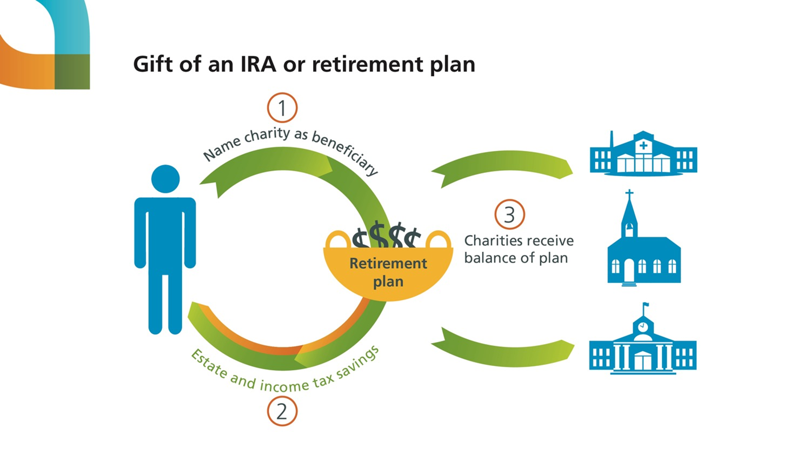

Slide 17
The Snyder family
How they envisioned their estate:
IRA balance
$250,000
Other assets
$250,000
Estate
Charity
$250,000
Daughter
$250,000
Fictitious story for illustrative purposes.
Notes:
Chad
[NOTE TO PRESENTERS: This and the next two slides could be considered optional, though it would be good to summarize their content because of the frequency with which this strategy can be helpful.]
Another easy way to make a gift upon death is by naming Everence Foundation or another charity as the beneficiary of your IRA or other qualified retirement plan such as a 401k or 403b. As I said earlier, if your heir receives money that has not been taxed, he or she will be required to pay income tax. Let’s look at an example.
The Snyders are beginning to think about estate planning. They have one child and an estate worth $500,000. This includes $250,000 in a bank account and $250,000 in an IRA. They would like to support their church and their child. They decide to leave half of everything to their daughter and half to their church.
This is how they imagine their estate being distributed.

Slide 18
The Snyder family
What happens if the IRA goes to the estate:
IRA balance
$250,000
Other assets
$250,000
Estate
24% tax bracket
Charity
$220,000
Daughter
$220,000
IRS taxes
$60,000
Fictitious story for illustrative purposes.
Notes:
Chad
However, remember our earlier slide about the three places assets can go? Here, the Snyders neglected to take into account the fact that their IRA has not been taxed. As a result, the estate will be required to pay the taxes on the IRA. Assuming a 24 percent tax bracket, this means that $60,000 of the IRA balance would first be paid to the IRS before the remainder of the estate is divided between the daughter and charity.

Slide 19
The Snyder family
If the charity is named as an IRA beneficiary:
IRA balance
$250,000
Other assets
$250,000
Estate
Charity
$250,000
Daughter
$250,000
IRS
$0
Fictitious story for illustrative purposes.
Notes:
Chad
The Snyders’ can get exactly what they wanted if they name the charity as an IRA beneficiary. In this scenario, the balance in the IRA would go directly to the charity without the charity paying any taxes. Then, the bank balance would be distributed to the daughter through the estate with no tax implication.
This is one of simplest and most common ways in which many people support charity through their estate planning. We would also welcome the opportunity to sit with your attorney, accountant or other professionals to explore how you might best support charity in your estate in your own situation.

Slide 20
Bonus Tip #3.5
Mention Qualified Charitable Distributions (QCDs)
Tax-free gifts for IRA owners over age 70 ½
Satisfies IRA owners' Required Minimum Distributions (RMDs)

Slide 21
Tip #4
Hire an estate planning attorney for donors
Opportunity for you to add financial value to the donor
Referral source for
additional gifts

Slide 22
Tip #5
Partner with an Everence consultant
Estate planning quarterback
Charitable specialists
Planned giving education and marketing support

Slide 23
Questions?

