Slide 1

From Survival to Sustainability
F
A Campaign That Changed Our Direction

Slide 2
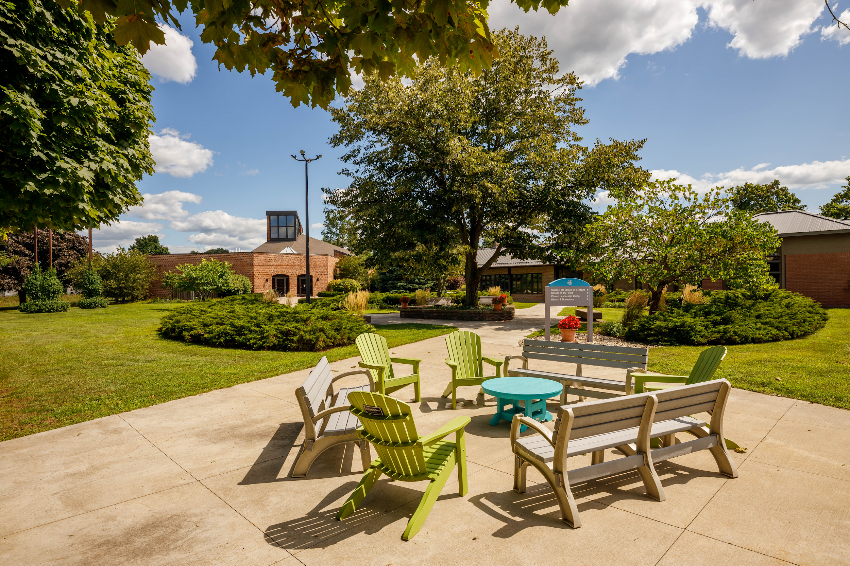
Setting the Scene
Historic low enrollment in 2019
Ten years of deficit budgets
Accrediting body requires biannual sustainability reports
  Risk of public warning
AMBS not tuition-driven
  10% tuition revenue

Slide 3
Original Campaign Concept
Traditional endowment model
  Local Leadership Renewal Initiative
  Global Leadership Collaborative
  Three years of Leadership Education Fund
    $1.6 million annual fund goal

Slide 4
Donor Feedback & Pivot
Donors loved the priorities…
…but not an endowment model
Preferred immediate impact & visual mission growth
Local Leadership Renewal
Global Initiative
  Started by predecessor at independent urging of donors
Shift to Catalytic Funding model
Raise $350K/year for 2 program initiatives for 10 years ($7 million)
Integrate 3 years of Leadership Education Fund ($5 million)

Slide 5
Campaign Structure
$350,000/year for 10 years for Local Leadership Renewal
$350,000/year for 10 years for Global Leadership Collaborative
Three years of the Leadership Education Fund (our Annual Fund) integrated into the campaign. ($5 million).

Slide 6
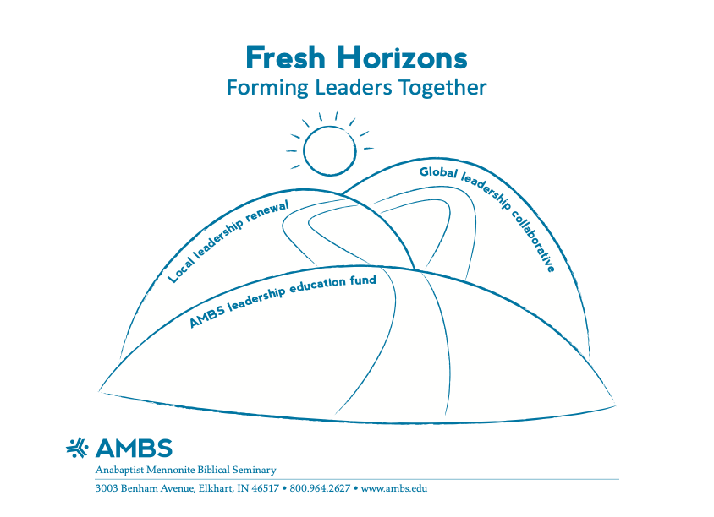
Completion Milestone
Campaign launched in 2021
Goal met in Fall 2024
On schedule & fully funded

Slide 7
Local Leadership Renewal - Impact
Practical Leadership Training Program
Short Adaptable Administrative Skill-Building Modules
Transition to Ministry
  For pastors in first 5 years of ministry
Doctor of Ministry in Leadership degree
  All start-up costs funded by campaign

Slide 8
Global Leadership Collaborative has produced:
Cohorts for master’s programs in Ethiopia & South Korea
A Graduate Certificate in Theology, in Spanish
Journey program for students in Southeast Asia, Sudan & Uganda
Lectureships in Indonesia, India, Kenya & Tanzania
Theological education consultations in the Andean region of South America & Asia

Slide 9
Broader Institutional Impacts
A 70% increase in enrollment since 2019
Six consecutive years of realistic balanced budgets
Five consecutive years with a modest surplus
Majority non-White student body for the first time (2021)

Slide 10
Broader Institutional Impacts - continued
Strengthened global & denominational partnerships
These additional programs have increased our engagement:
  by 122 new students
  by more than 431 church leaders, and
  15 collaborations with national church bodies

Slide 11
The Challenges Beneath the Success
In every single case, our international partners have defaulted on their financial commitments.
  Without campaign funding, these defaults could have
ended entire programs.
Because we secured 10 years of funding, we kept commitments to students & partners without interruption.

Slide 12
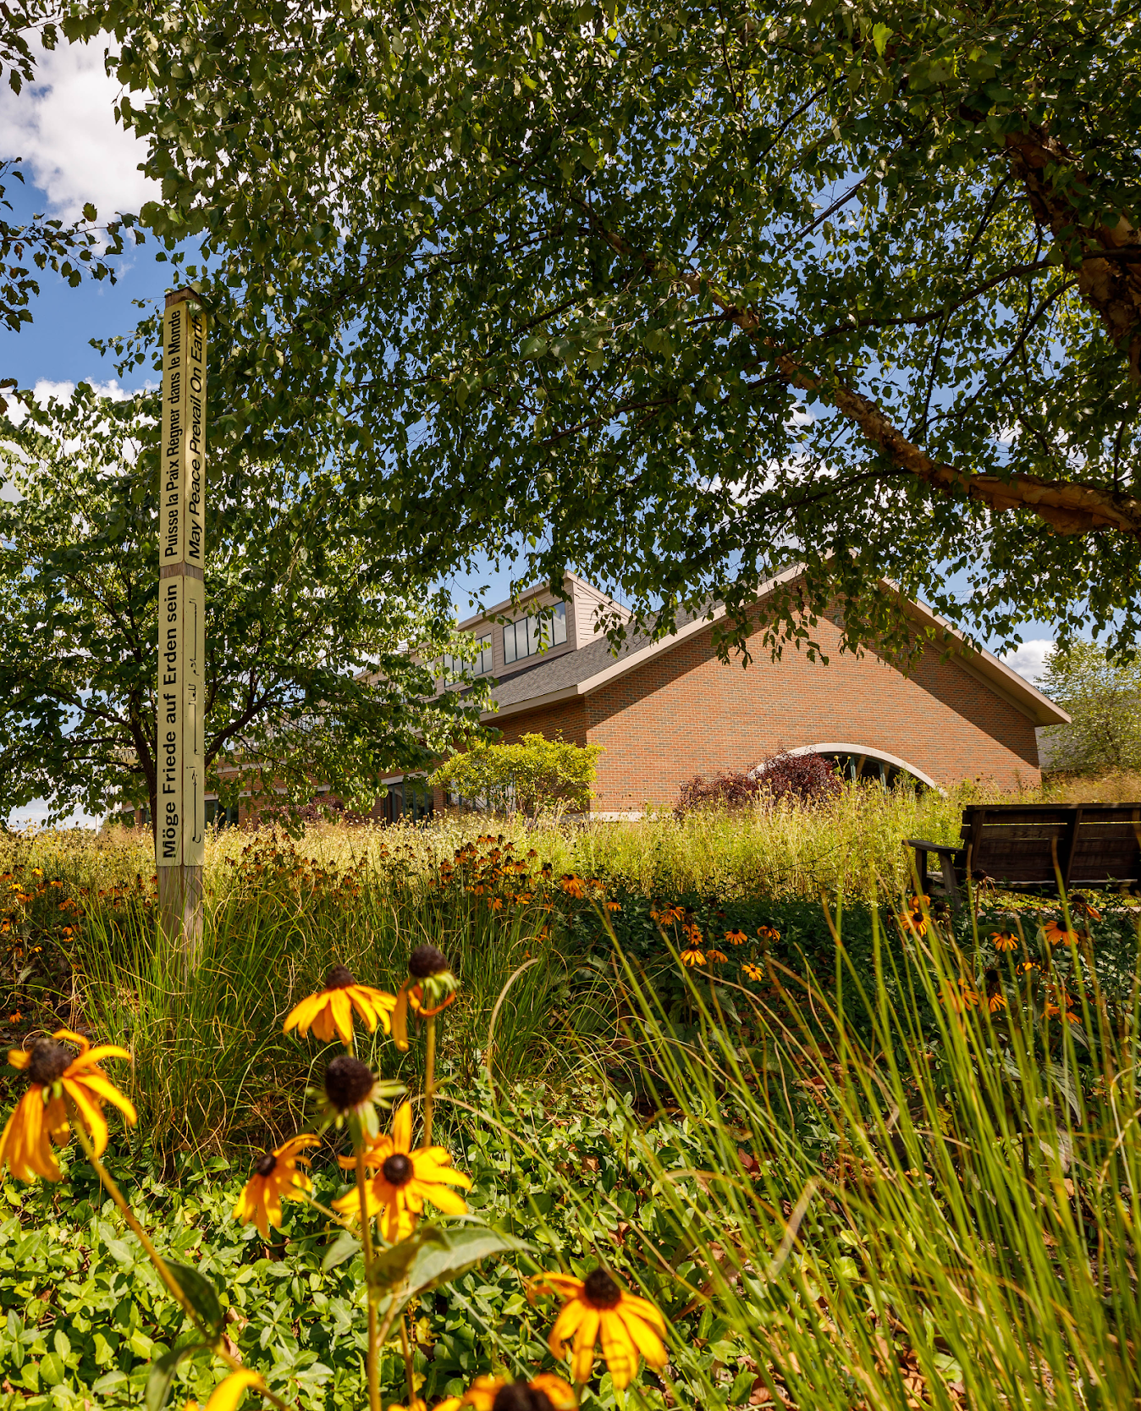
From Challenges to Success
The power of this model has helped AMBS develop a stronger & more sustainable trajectory than we’ve had for a long, long time.

Slide 13
Lessons Learned
Listen to donors & adapt the model
Integrate the annual fund into the campaign
Time-bound funding allows agility
Plan for partner defaults -- every partner defaulted
  Funding ensured continuity

Slide 14
Lessons Learned (continued)
Invitation-only partnerships protect contextual integrity
The change in culture from the endowment strategy to the catalytic funding model meant we needed to take quantitative results more seriously than in the past.
We have started counting & measuring what we were producing, which improved decision-making & created a culture change at AMBS.

Slide 15
A Sustainable Future
Repositioning the seminary financially, better positions us
to focus on endowment growth -- in 2025 and beyond.

