Slide 1
Stories from the field
Dennis A. LeFevre, CFP®
Financial Consultant
Everence offers credit union products that are federally insured by NCUA. Investments and other products are not NCUA or otherwise federally insured, may involve loss of principal and have no credit union guarantee. Some Everence products and services may not be available in your state.
Certified Financial Planner Board of Standards, Inc. (CFP Board) owns the CFP® certification mark, the CERTIFIED FINANCIAL PLANNER™ certification mark, and the CFP® certification mark (with plaque design) logo in the United States, which it authorizes use

Slide 2

It all starts with a relationship…
Notes:
It all starts with a relationship . . . .

Slide 3






Case 1
Worked for agriculture machinery company for over 50 years
The millionaire next door…
$
Involved in church and community
Single male, no kids
Notes:
Single male, never married, no kids
High school education
Worked for same ag machinery manufacturing company for over 50 years
Liked his work
Involved in his church and his community
Lived simply
Enjoyed his 1970 Chevelle and 2008 Toyota truck!
Millionaire nextdoor

Slide 4
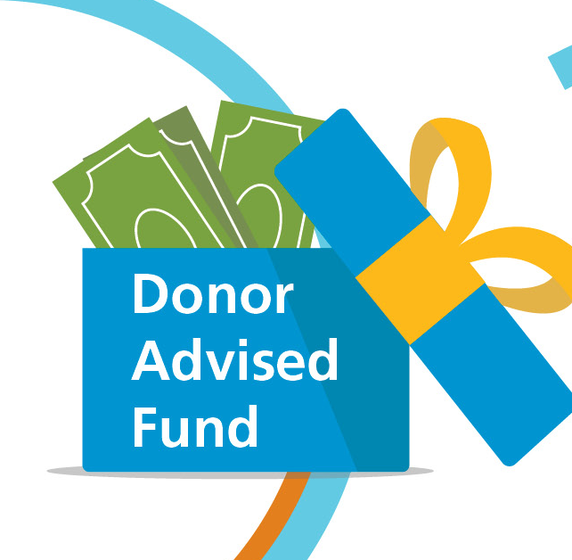
Case 1
How do I give money to charity anonymously?
Which led to the creation of a Donor Advised Fund. And that led to more conversations!
Notes:
First interaction was how can I give money to charity anonymously?
First gift was cash to a newly established Donor advised Fund
That led to more conversations!

Slide 5

Case 1
What are my options for avoiding capital gains on my investments?
Proposed a Charitable Remainder Unitrust
Notes:
Learned about a California commercial investment
Significant capital gains if he sold it
Proposed a Charitable Remainder Unitrust (CRUT)
Gift property
Avoid capital gains
Income for life
Charitable deduction available

Slide 6

Case 1
When I die, I want charities to receive my money…
Charities included:
Mennonite Central Committee
Mennonite Disaster Service
Local retirement community
Local hospital
Local church
Notes:
Led to future cash contributions to the CRUT
Eventually utilized Qualified Charitable Distributions (QCD) from his IRA
“When I die, I want the poor people to get my money”
Charities included:
Mennonite Central Committee
Mennonite Disaster Service
Local Retirement community
Local hospital
Local church

Slide 7


Case 2
Rental property
Significant capital gains if sold...
in California
Notes:
Charitable leader called me about his brother
Owned a rental property in California
Purchased years ago for $150,000
Now worth over $1 million
Significant capital gains if he sold it

Slide 8

Case 2
Gifted half the property to the charity, half to the CRUT
What can we do?
Charity
CRUT
At death, charity received the remainder
CRUT payout of 10% to his LTC
Notes:
“What can we do?”
Led to conversations about the brother’s financial situation
In his 80s with some health concerns
Could not qualify for LTC
Single male, never married, no kids
Wrinkle was that the property was in disrepair
Charity offered to handle the rehab
Brother created a CRUT
Gifted ½ of the property to the charity, half to the CRUT
CRUT payout was set to 10%
Paid for 10 months of his LTC
At his death, the charity got the remainder
CRUT benefits:
Avoided capital gains
Generated income to assist with LTC
Remainder went to support brother’s charitable organization

Slide 9


Case 3
Husband and wife clients
Multiple rental properties
Significant capital gains…
Notes:
Case 3
Investment clients, Husband & Wife, late 70’1
Held rental homes in portfolio for 20+ years
Long-term renters in place
Depreciated properties; capital gains if sold

Slide 10

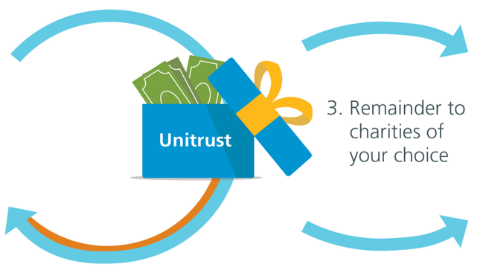

Case 3
Gift of rental property
Charitable gifts
Avoided capital gains
Income to replace rental income
Notes:
One renter decided to depart
Owner was not interested in renting again
Created a CRUT for the first property
Avoided capital gains
Created income to replace rental income
Second home renter decided to leave
Gifted second home into the CRUT
Additional charitable deduction
Increased income
Third long-term renter departed
Gifted home into CRUT
Additional charitable deduction
Increased income

Slide 11


Case 4
Three adult children
Funds in a bank CD
Husband and wife clients
Notes:
Investment clients
Husband/wife
Second marriage for him; first for her
3 adult kids from him

Slide 12


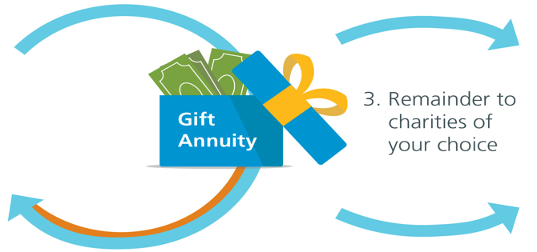

Case 4
Cash funds into a Charitable Gift Annuity
What options do you have?
$
6% rate
Charitable deduction wiped out income taxes for next six years
Notes:
Bank CD going from 2.5% inters to 0.25% on renewal
“What options do you have?”
Lucky question from me: What happens to these $$ when you die?
After a long pause . . . . .
“Probably go to charity. The boys don’t need it”
Led to option for a Charitable Gift Annuity
Rates were in the low 6% for their age
Charitable deduction wiped out income taxes for the next 6 years

Slide 13
Stories from your fields?
Notes:
Other stories from your fields?

Slide 14
Questions?
Notes:
Questions?

Slide 15
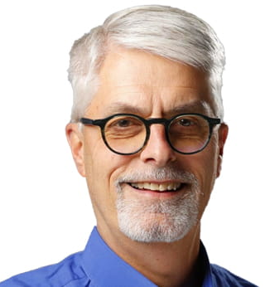
Thank you!
^{Dennis A. LeFevre, CFP}
Financial Consultant, Everence Financial®
719-401-2480
dennis.lefevre@everence.com

Slide 16
Thank you!

