Slide 1
Fundraising foundations:
Tips, truths and tactical advice for new pros
Elyse Kauffman, MBA Molly Helmstetter, CFRE
Charitable Consultant Director of Development
Everence PA Region New Hope Ministries PA

Slide 2
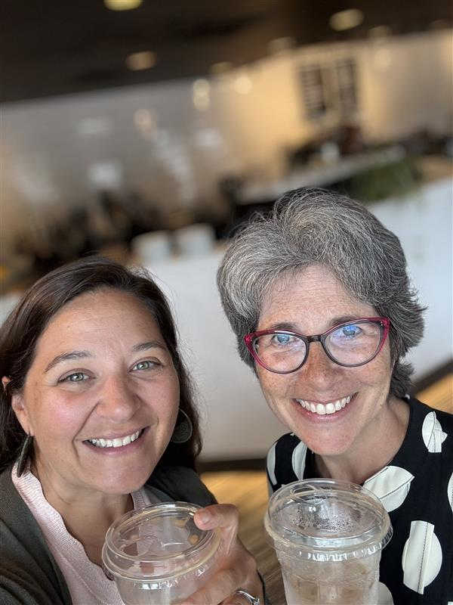
Getting to know Elyse and Molly
StrengthsFinder:
Woo
Positivity
Communication
Developer
Strategic
Fun fact: Lived in China for three years!
StrengthsFinder:
Belief
Connectedness
Developer
Positivity
Responsibility
Fun fact: Visited 40 out of 63 national parks!

Slide 3
Goals for today
Encourage
Energize
Educate
Elevate
Empower
….Entertain!

Slide 4

Be your authentic self
Missional alignment
Know your strengths
Self-care
Be curious
Connect with others
Find the joy

Slide 5

Myths about fundraising
Myths about fundraising
Asking is an art | 14
Donors give to organizations | 8
Fundraising is about money | 11
I wouldn’t want your job | 7
You must be rich to give | 10

Slide 6
Fundraising framework
Organizational culture of philanthropy
Donor Bill of Rights
Job description
Strategic plan
Fundraising budget

Slide 7

Everyday execution
Integrity
Gift acceptance policy
Systems
  Client Relationship
  Management (CRM)
  Time management
  Accountability

Slide 8

People power

Slide 9
Build Relationships
Board Members
Committee Members
Leadership Team
Program Colleagues
Volunteers
Marketing/
Comm. Colleagues

Slide 10

LET’S PAWS
What is one intentional step you want to take to thrive in the joy of your work?
Focus on either systems
or relationships.

Slide 11
Time-tested strategies
Prioritize donor visits and calls
Donor discovery techniques
Test, try, track and
maybe repeat (fundraising initiatives)
Diversify funding streams

Slide 12
Tactical advice: Building donor relationships
Authentic relationships
Listen > talk
Ask good questions
Follow up consistently
Understand your donors’ preferences
Show gratitude often
Engage in storytelling

Slide 13
Spotlight: Planned giving for newbies
Recent research
Understand the benefits of planned giving tools
Get comfortable discussing / accepting these gifts

Slide 14

Qualified Charitable Distributions (QCD)
Retirement plan participants, who have attained age 70 ½ or older, may make tax-free distributions from a Traditional IRA and donate the amount distributed to an eligible tax-exempt charitable organization.
Required Minimum Distributions (RMDs) begin at 73 years old (75 years old in 2033).
The total of all qualified charitable distributions for a single tax year cannot exceed $108,000 per individual.
Individuals who are employees, and not owners of 5% or more of their company may defer RMDs until retirement, even if that is after 73 or 75.
Notes:
Everence Financial has been helping people make decisions about their money that reflect their faith and values for more than 75 years.
We offer banking, insurance and other financial services in ways that encourage stewardship and generosity.
Key features of IRA charitable gifts
• IRA owners can transfer up to $100,000 per year to a charity (that legally qualifies)
• The donation must be sent directly to the charity. It cannot be channeled through a donor advised fund (such as the Everence gift fund) or a supporting organization.
• The gift is tax-free and so is not included in the donor’s adjusted gross income.
• The gift option is a tax benefit available to donors 72 or older. (Younger people can donate from their IRAs but they don’t receive the tax benefits).
• The gift can qualify for their annual “Required Minimum Distribution” (RMD) for IRA owners. This means they won’t pay taxes on the portion of the RMD given to charity.
• To make a gift, a donor must request a qualified charitable distribution from his or her IRA provider.

Slide 15
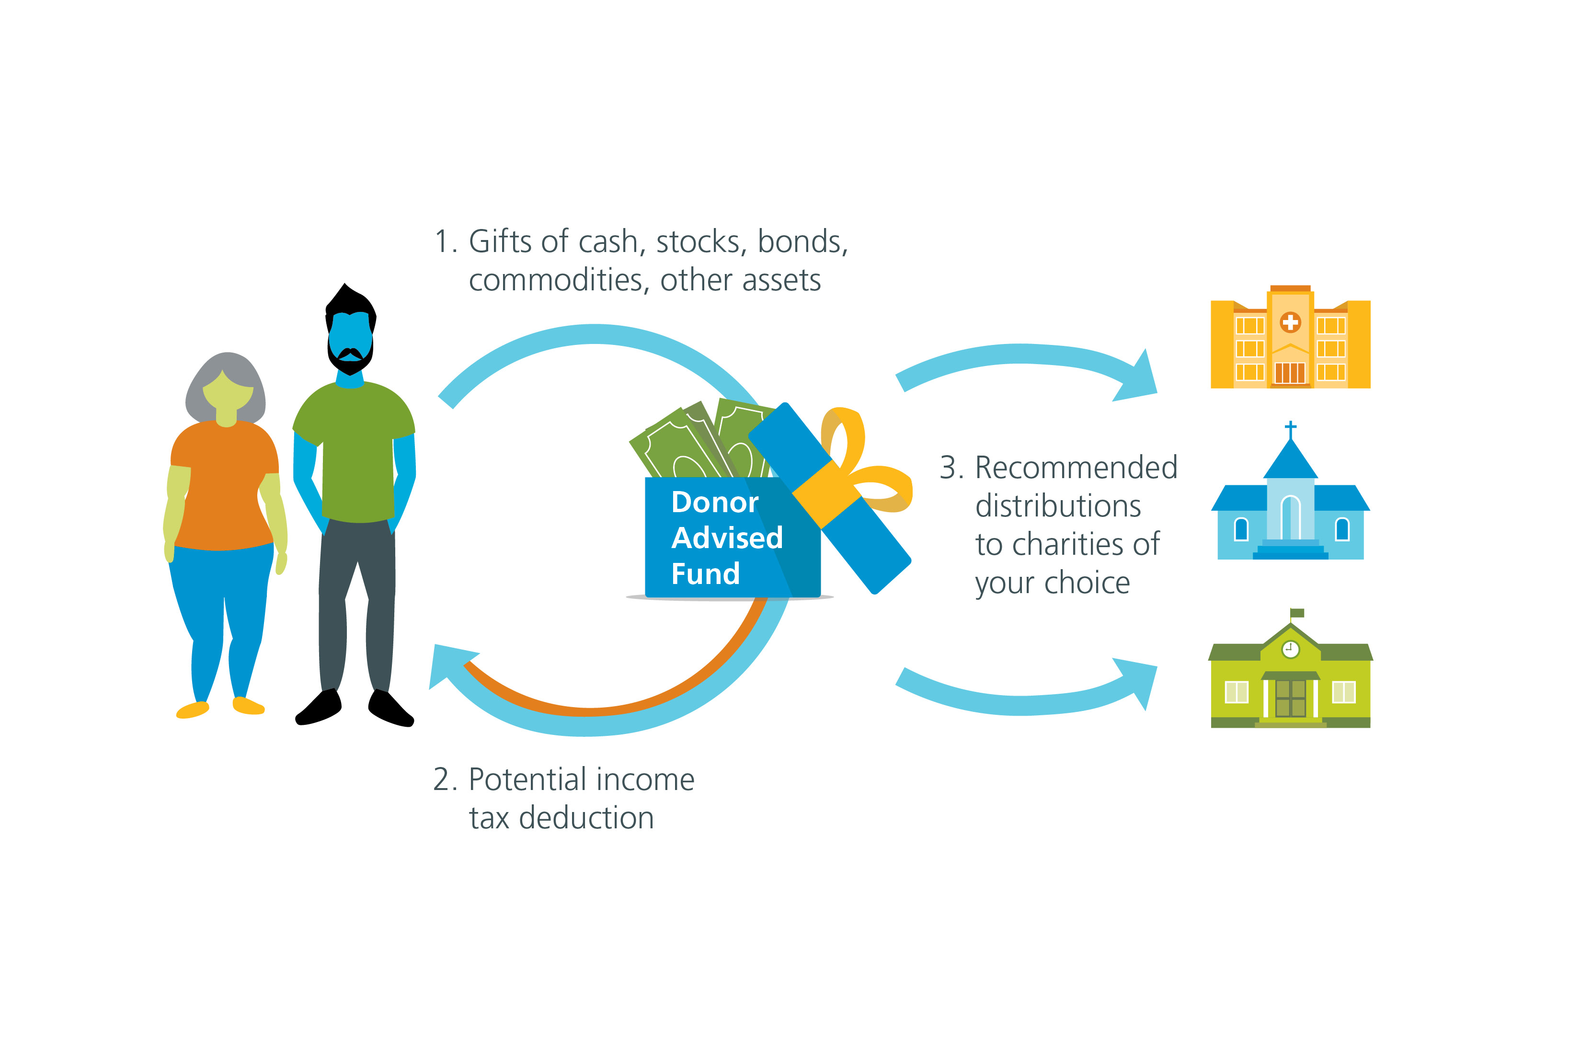
Donor Advised Fund (DAF)

Slide 16

Ideas to start now

Slide 17

LET’S PAWS
What is one action you can take before the end of 2025 to advance your focus on planned giving?

Slide 18

You’ve got mail
Future you is waiting!
Write down one action you will take before the end of 2025.
Sign it proudly!
😉

Slide 19

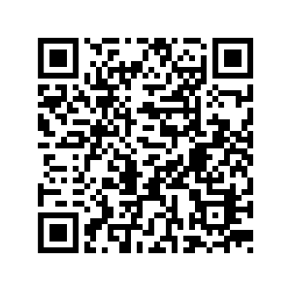
Bringing it all together
Review goals and key takeaways
Reference toolbox (QR code to link)

Slide 20
Questions and discussion

Slide 21

Thank you!
Let's chat!
You've got this!
We are cheering for you!
Let's connect:
Elyse Kauffman, MBA Molly Helmstetter, CFRE
Everence Foundation New Hope Ministries PA
elyse.kauffman@everence.com mhelmstetter@nhm-pa.net

