Slide 1
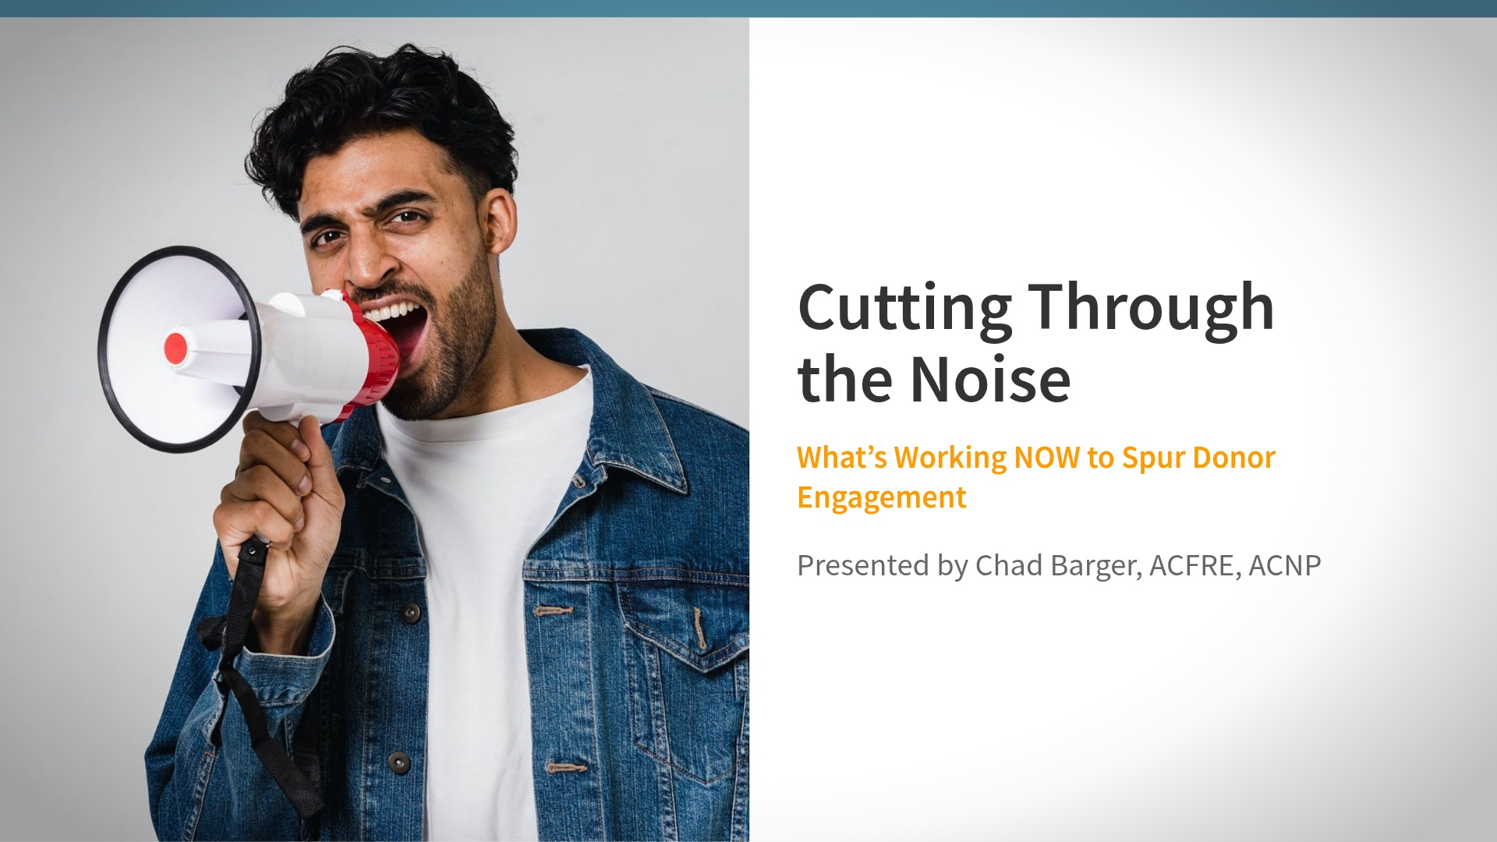

Slide 2
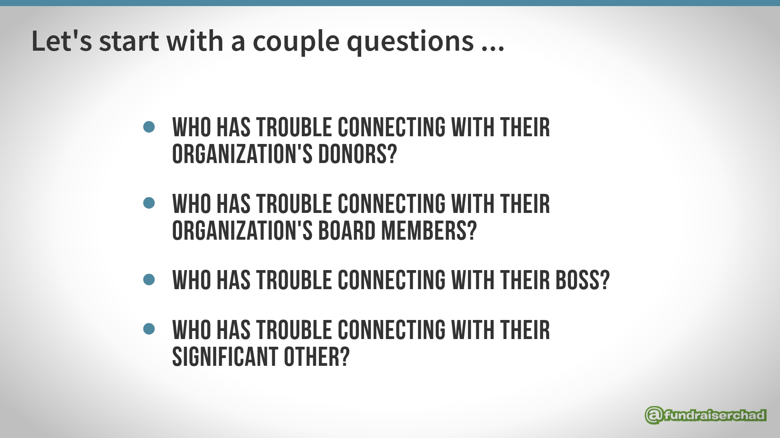

Slide 3


Slide 4
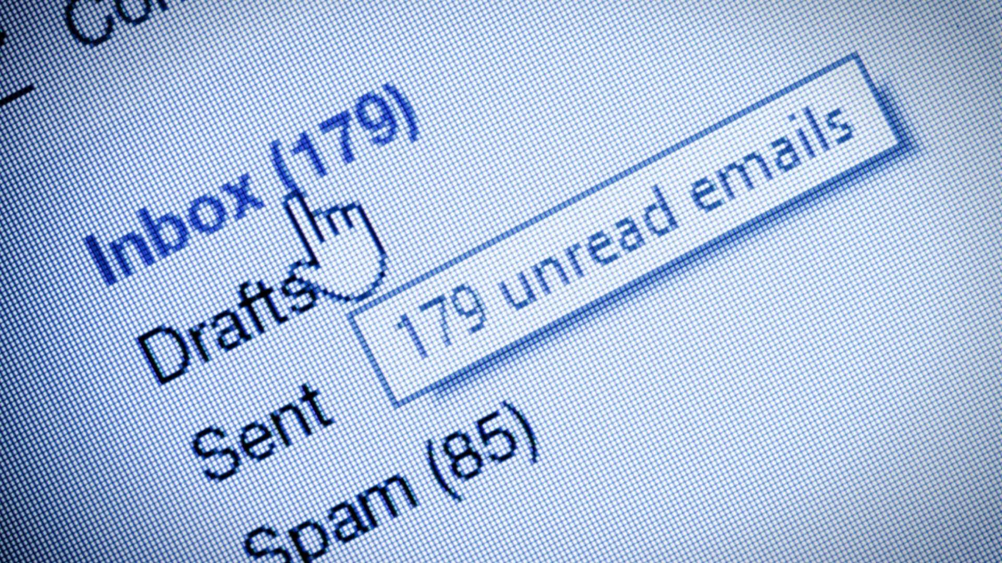
Notes:
Chad-Schedule and triage email

Slide 5
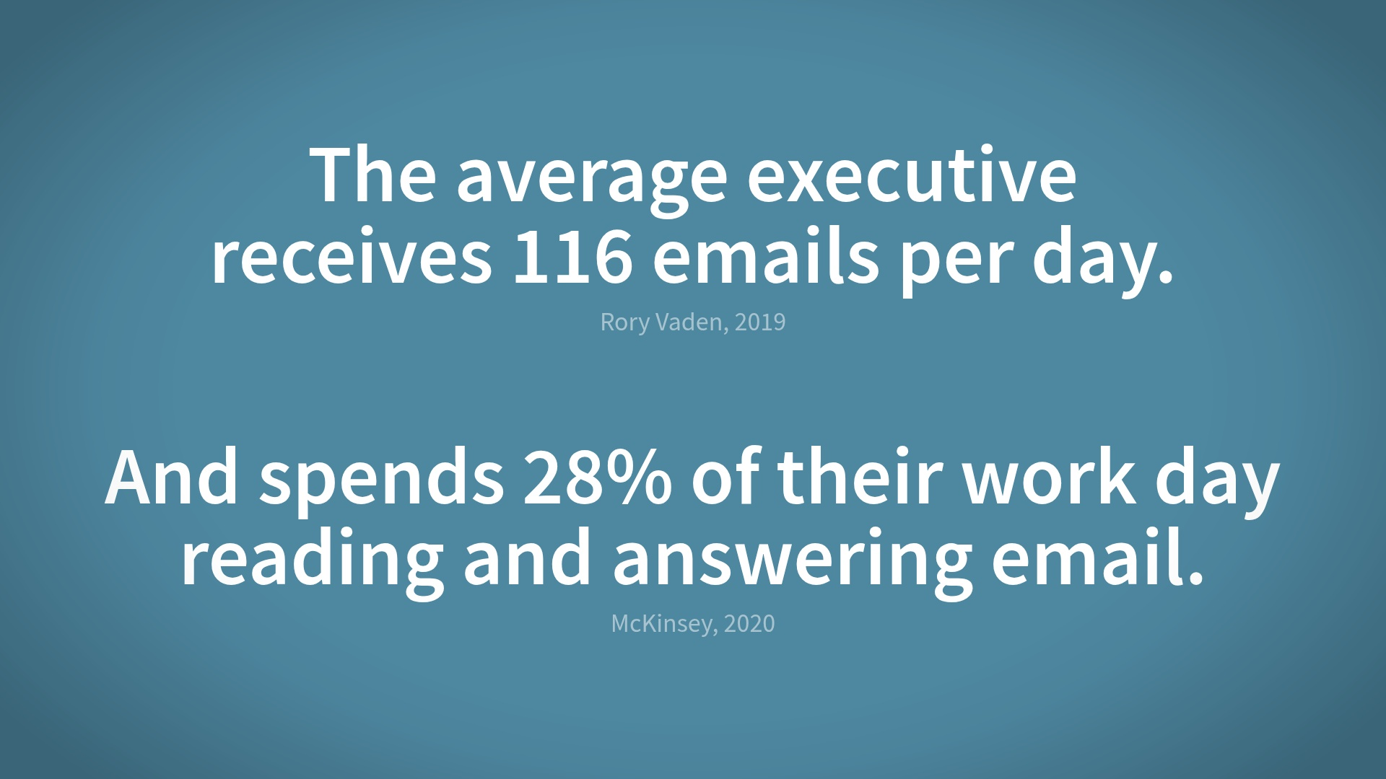

Slide 6
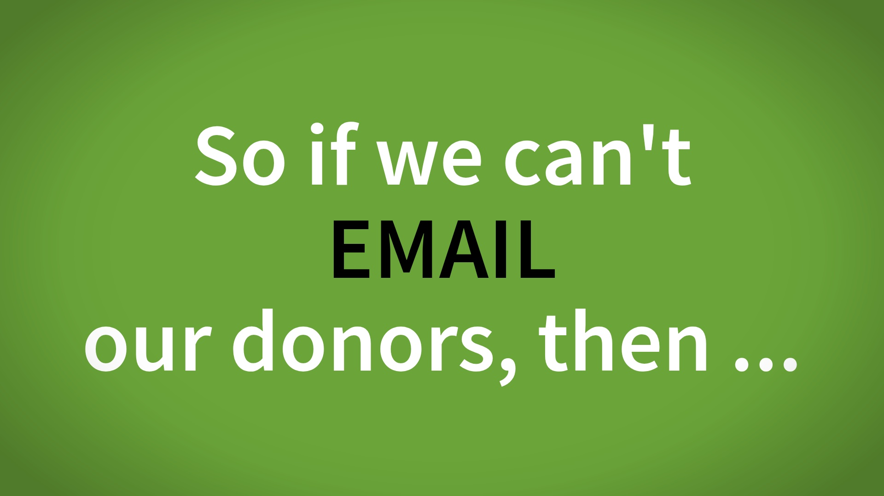
Notes:
Who has trouble connecting with your organization's donors?Who has trouble connecting with your organization's board members?

Slide 7

Notes:
Chad-Schedule and triage email

Slide 8
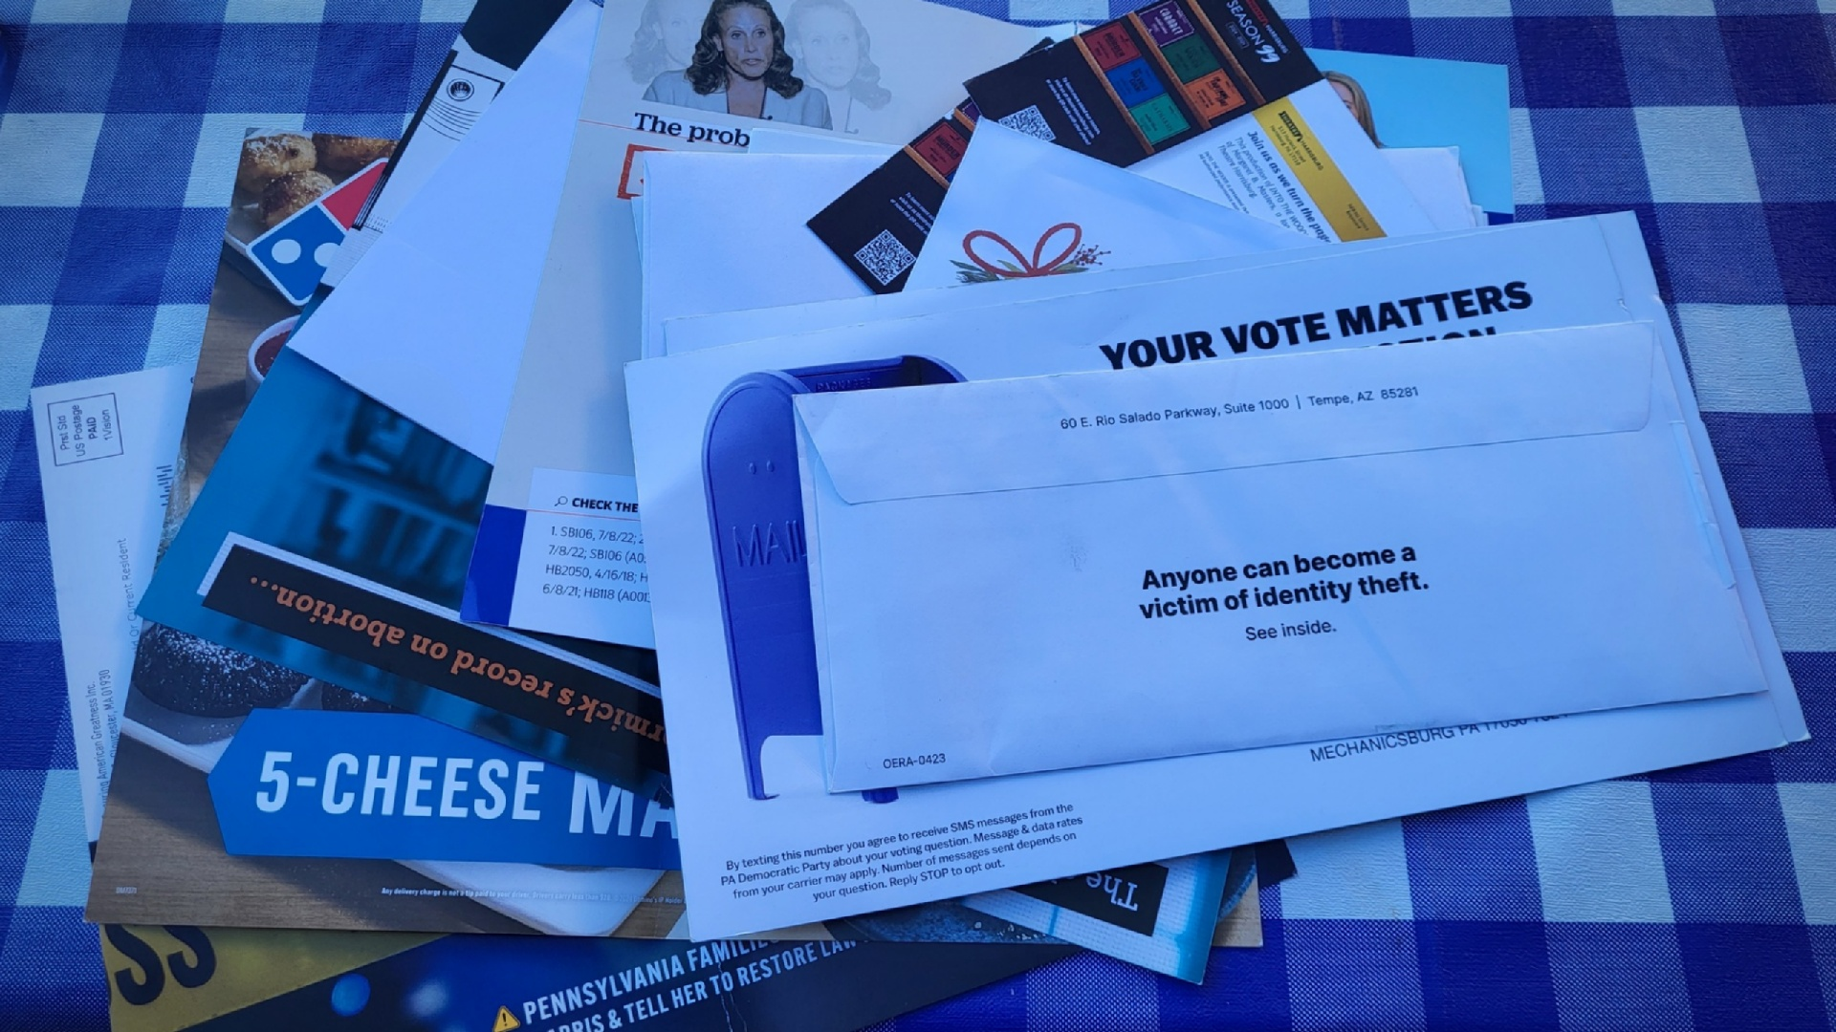

Slide 9
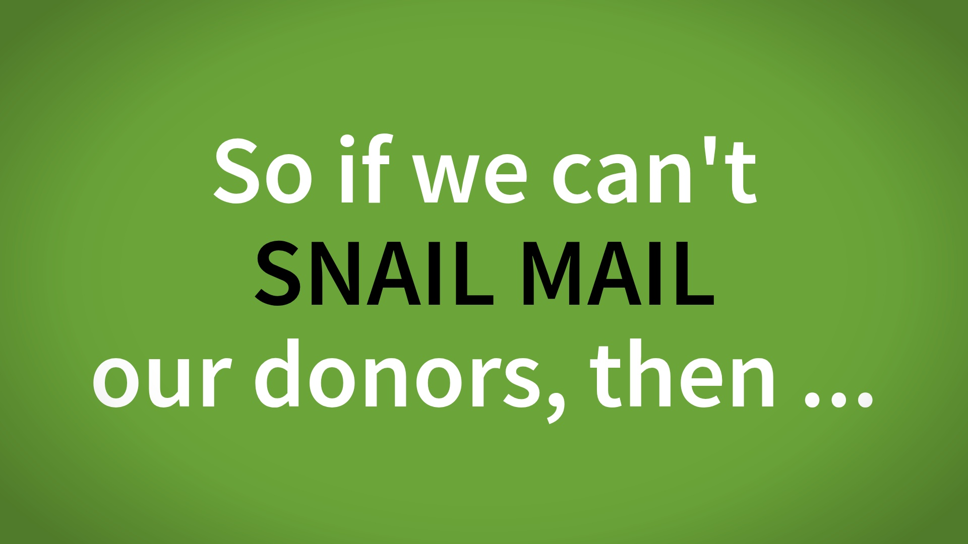
Notes:
Who has trouble connecting with your organization's donors?Who has trouble connecting with your organization's board members?

Slide 10
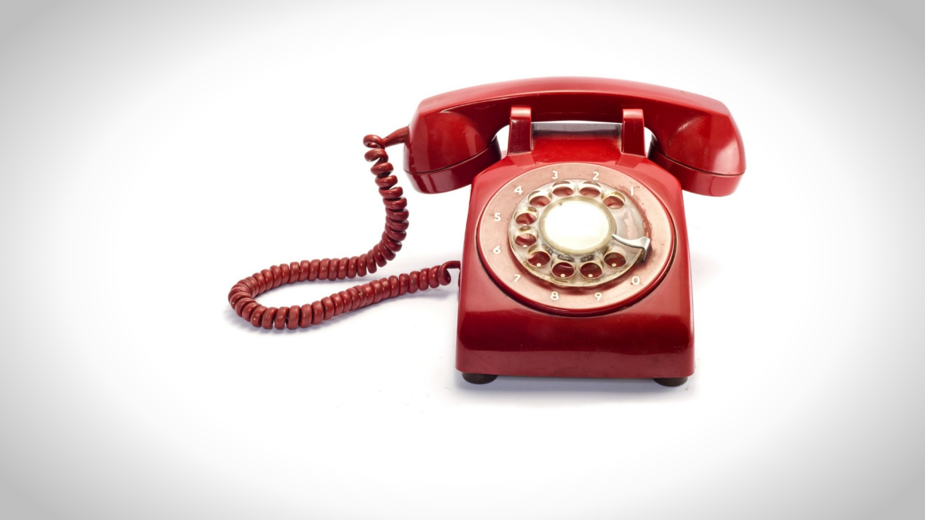
Notes:
Step 3 – make a follow up call / use the email and letter as your crutch to make the call easier

Slide 11


Slide 12
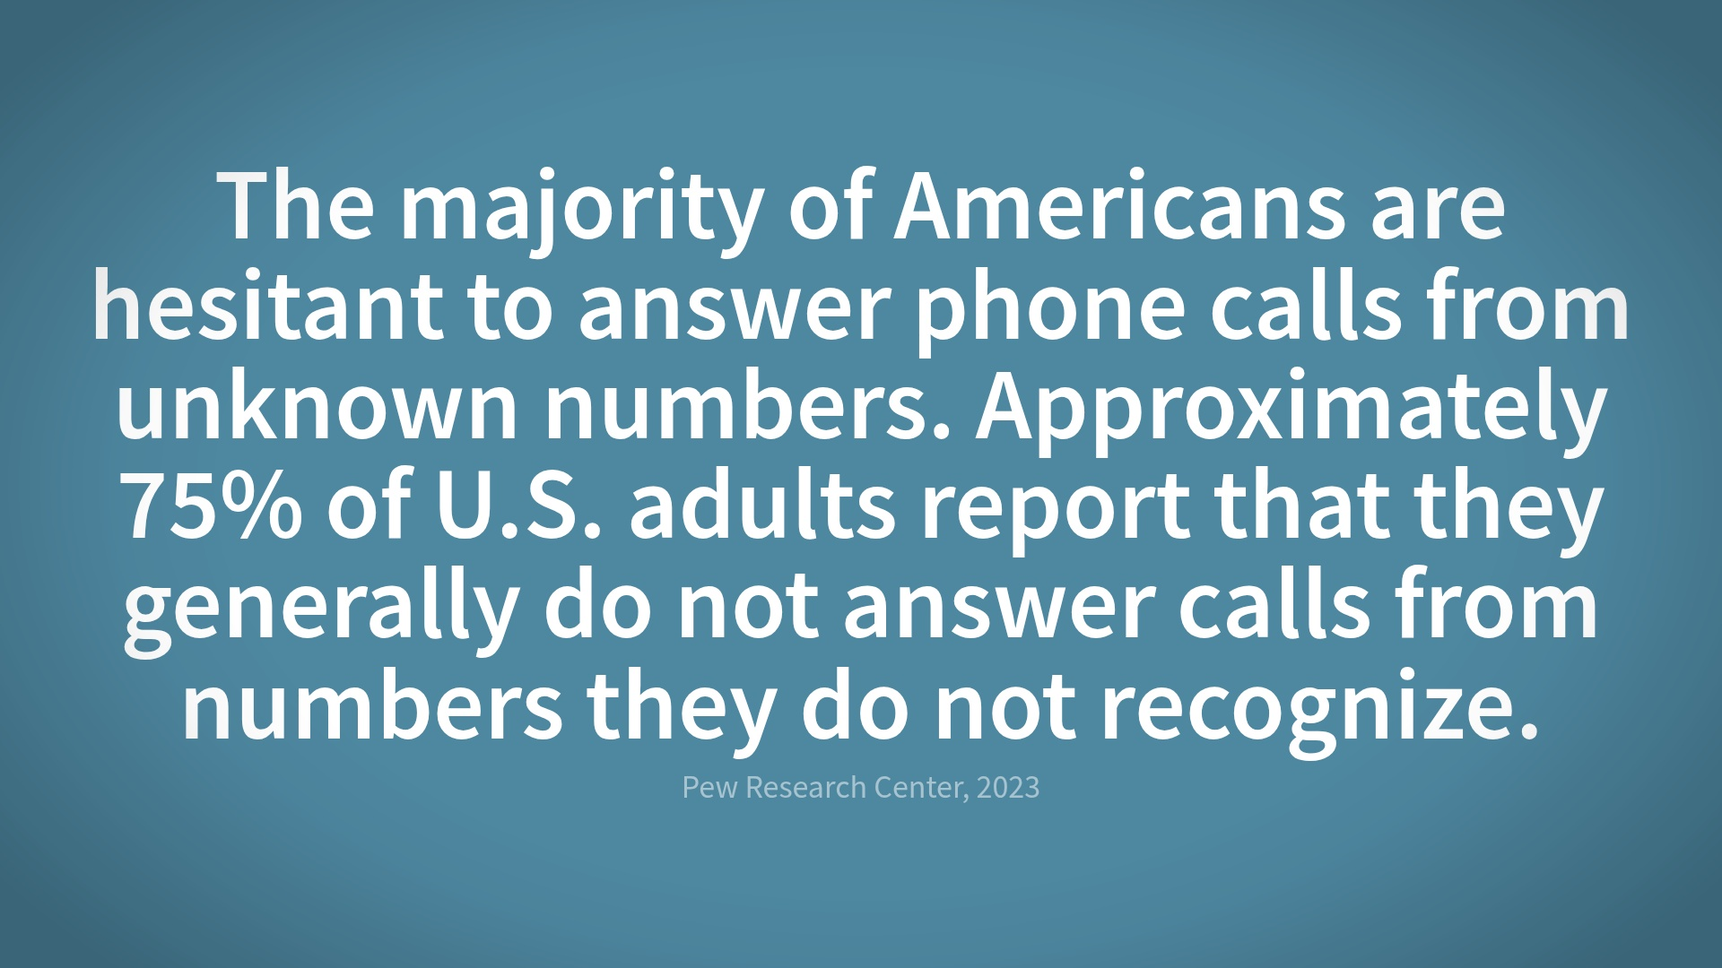

Slide 13
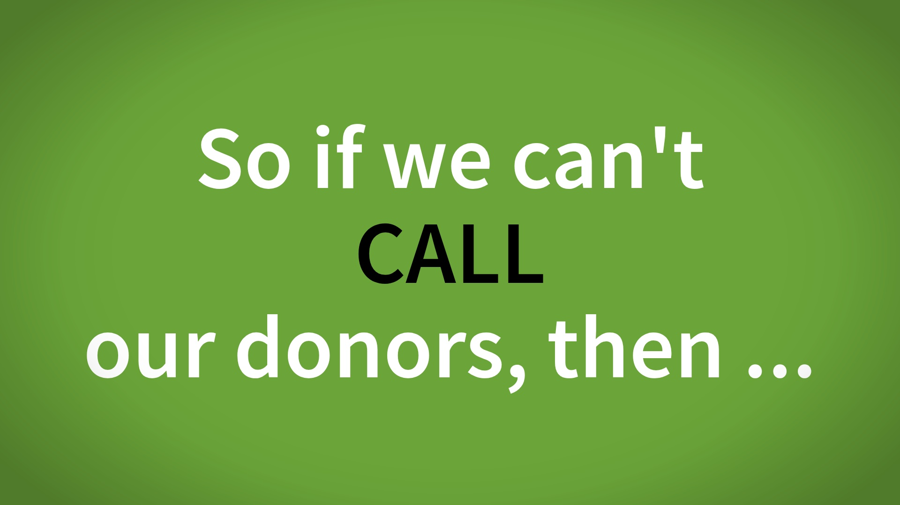
Notes:
Who has trouble connecting with your organization's donors?Who has trouble connecting with your organization's board members?

Slide 14
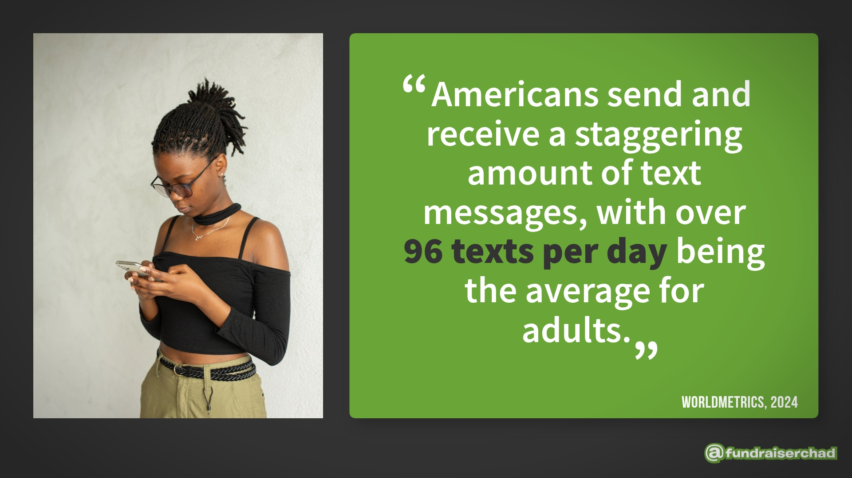

Slide 15


Slide 16
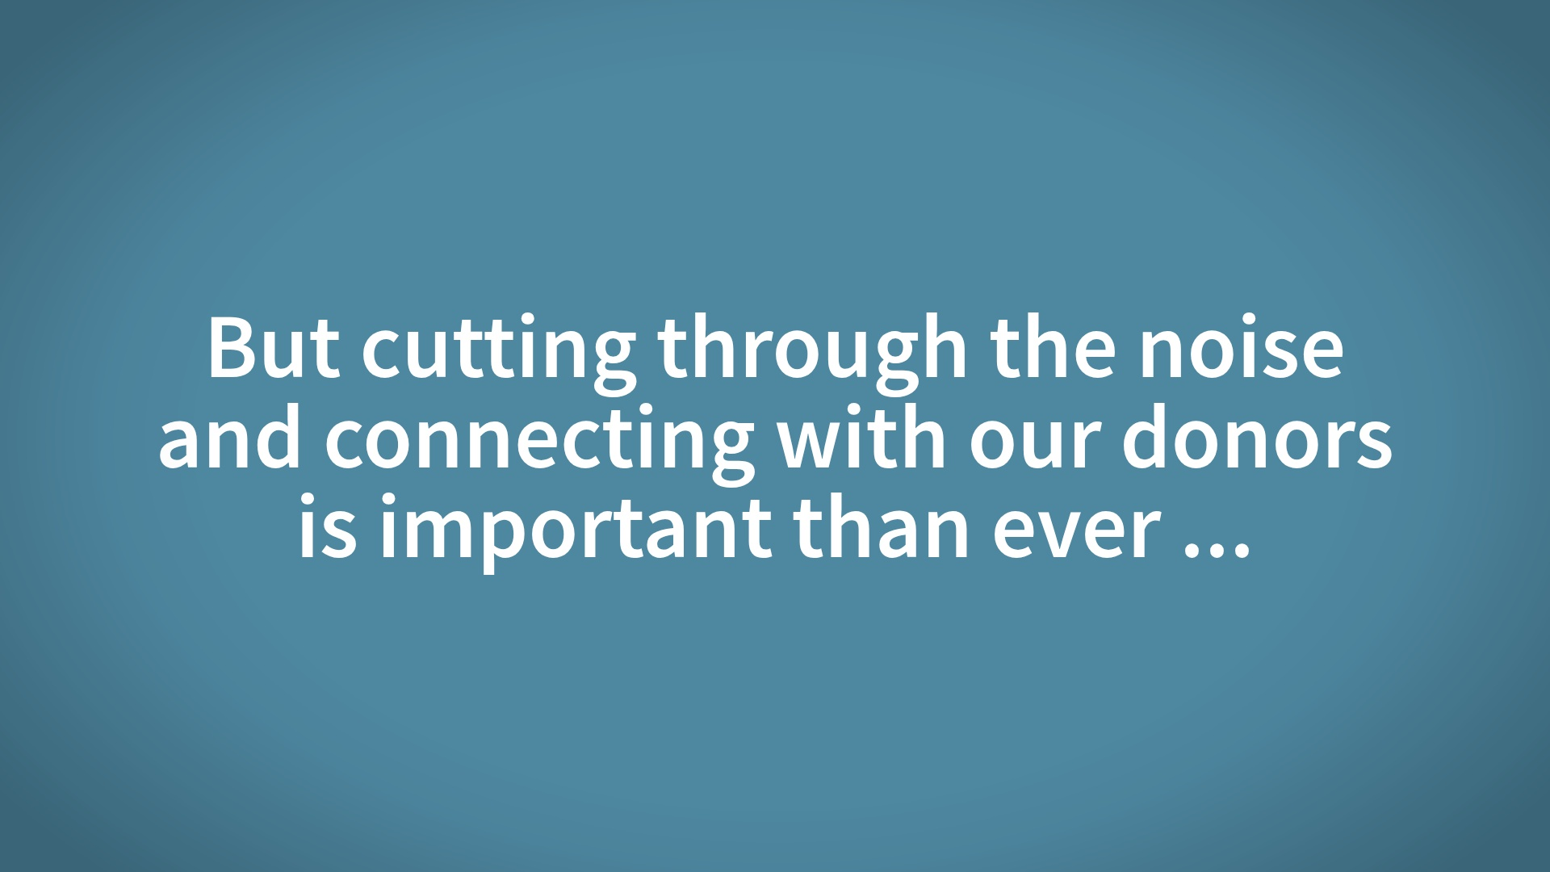

Slide 17
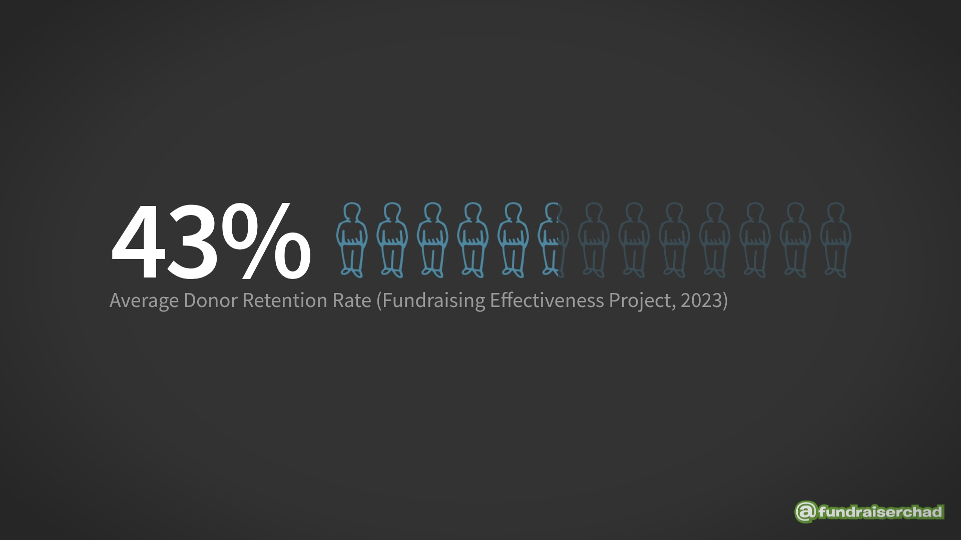

Slide 18
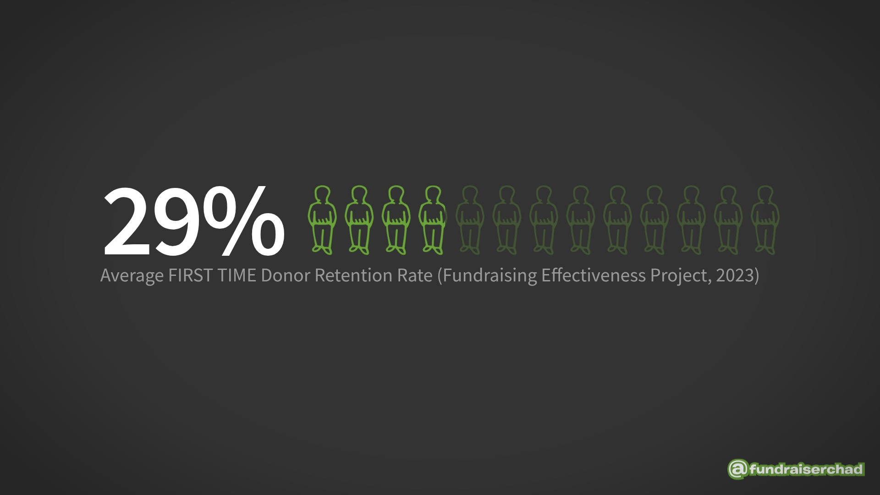

Slide 19


Slide 20
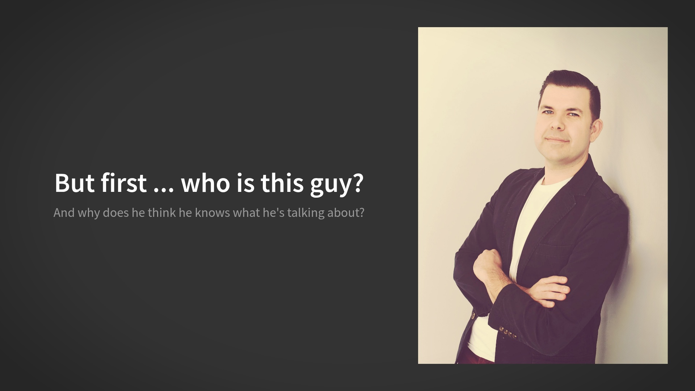

Slide 21


Slide 22
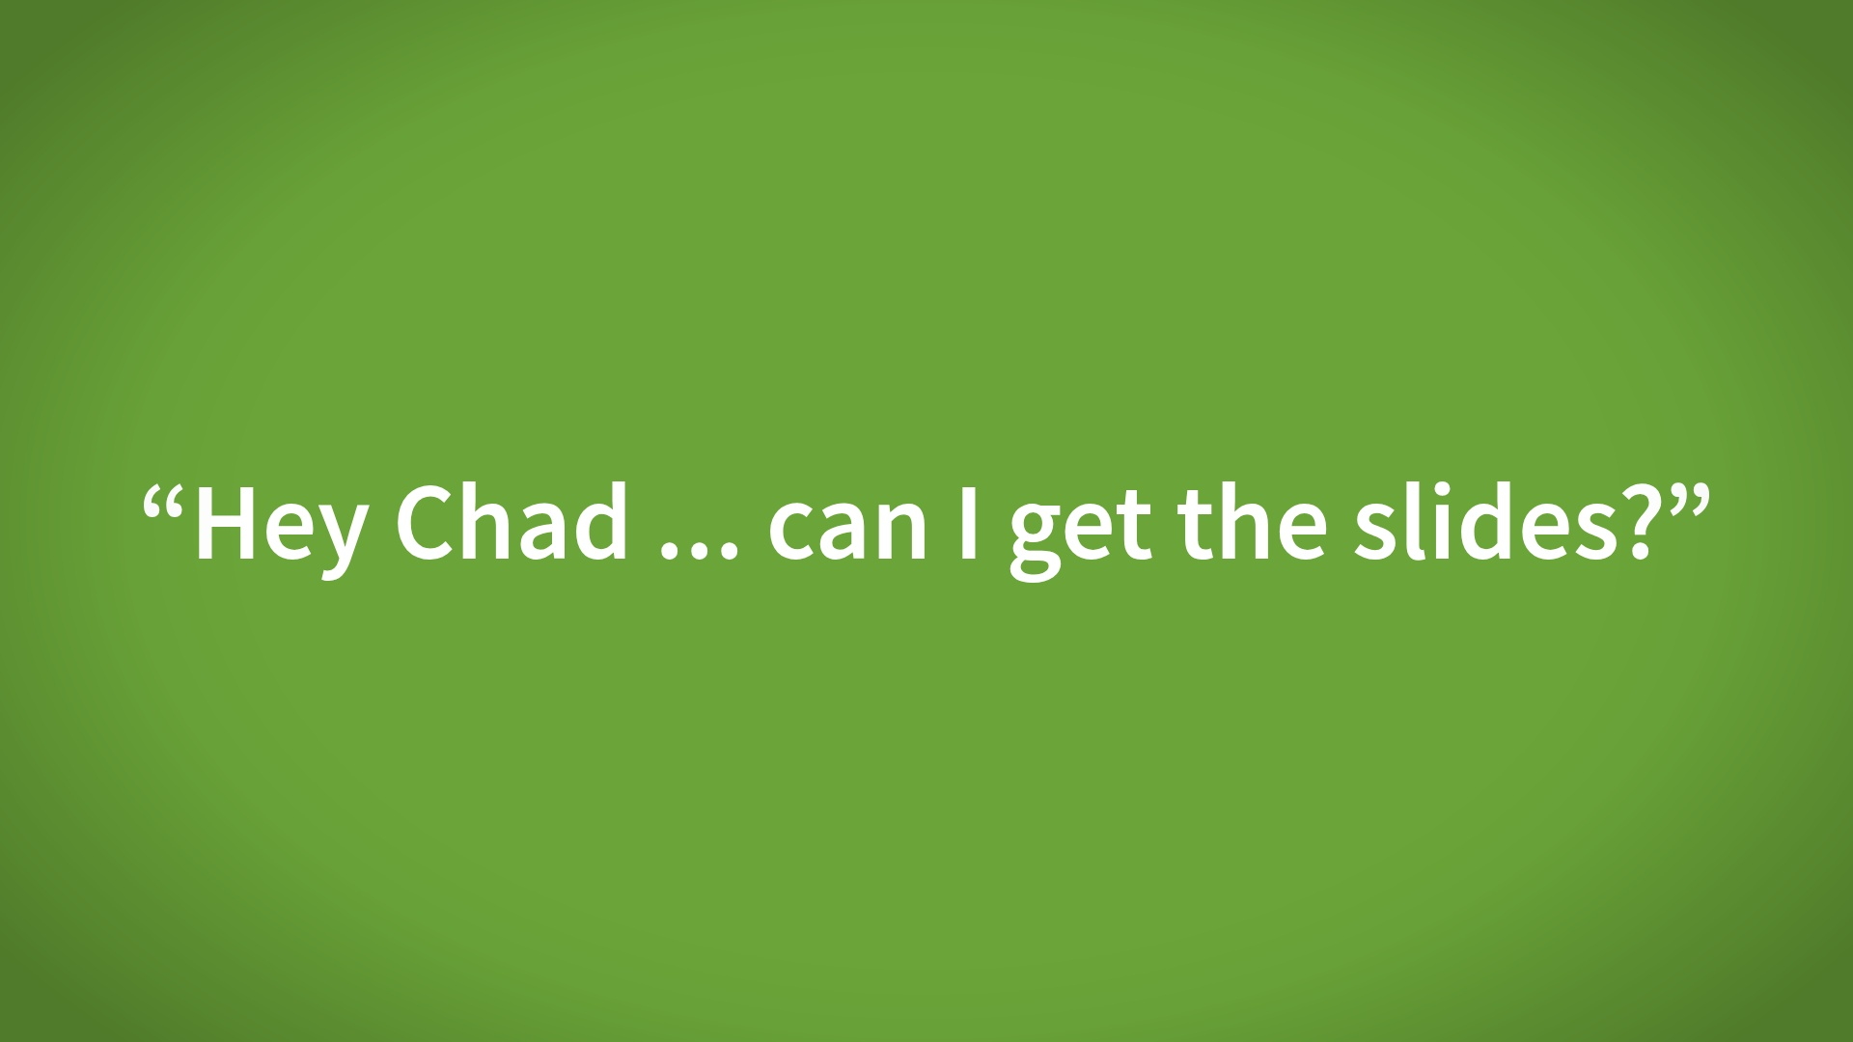

Slide 23


Slide 24
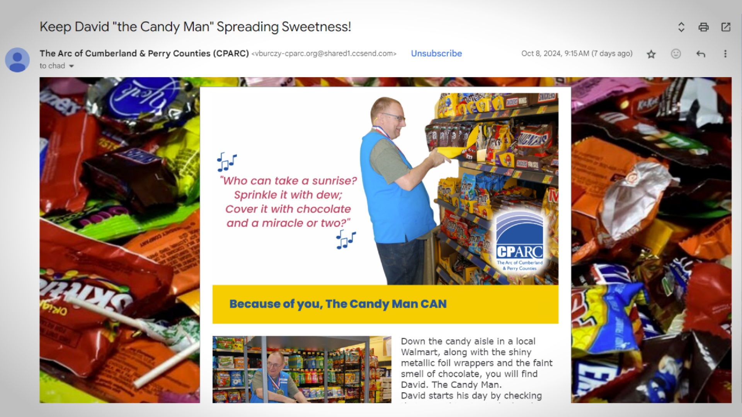

Slide 25
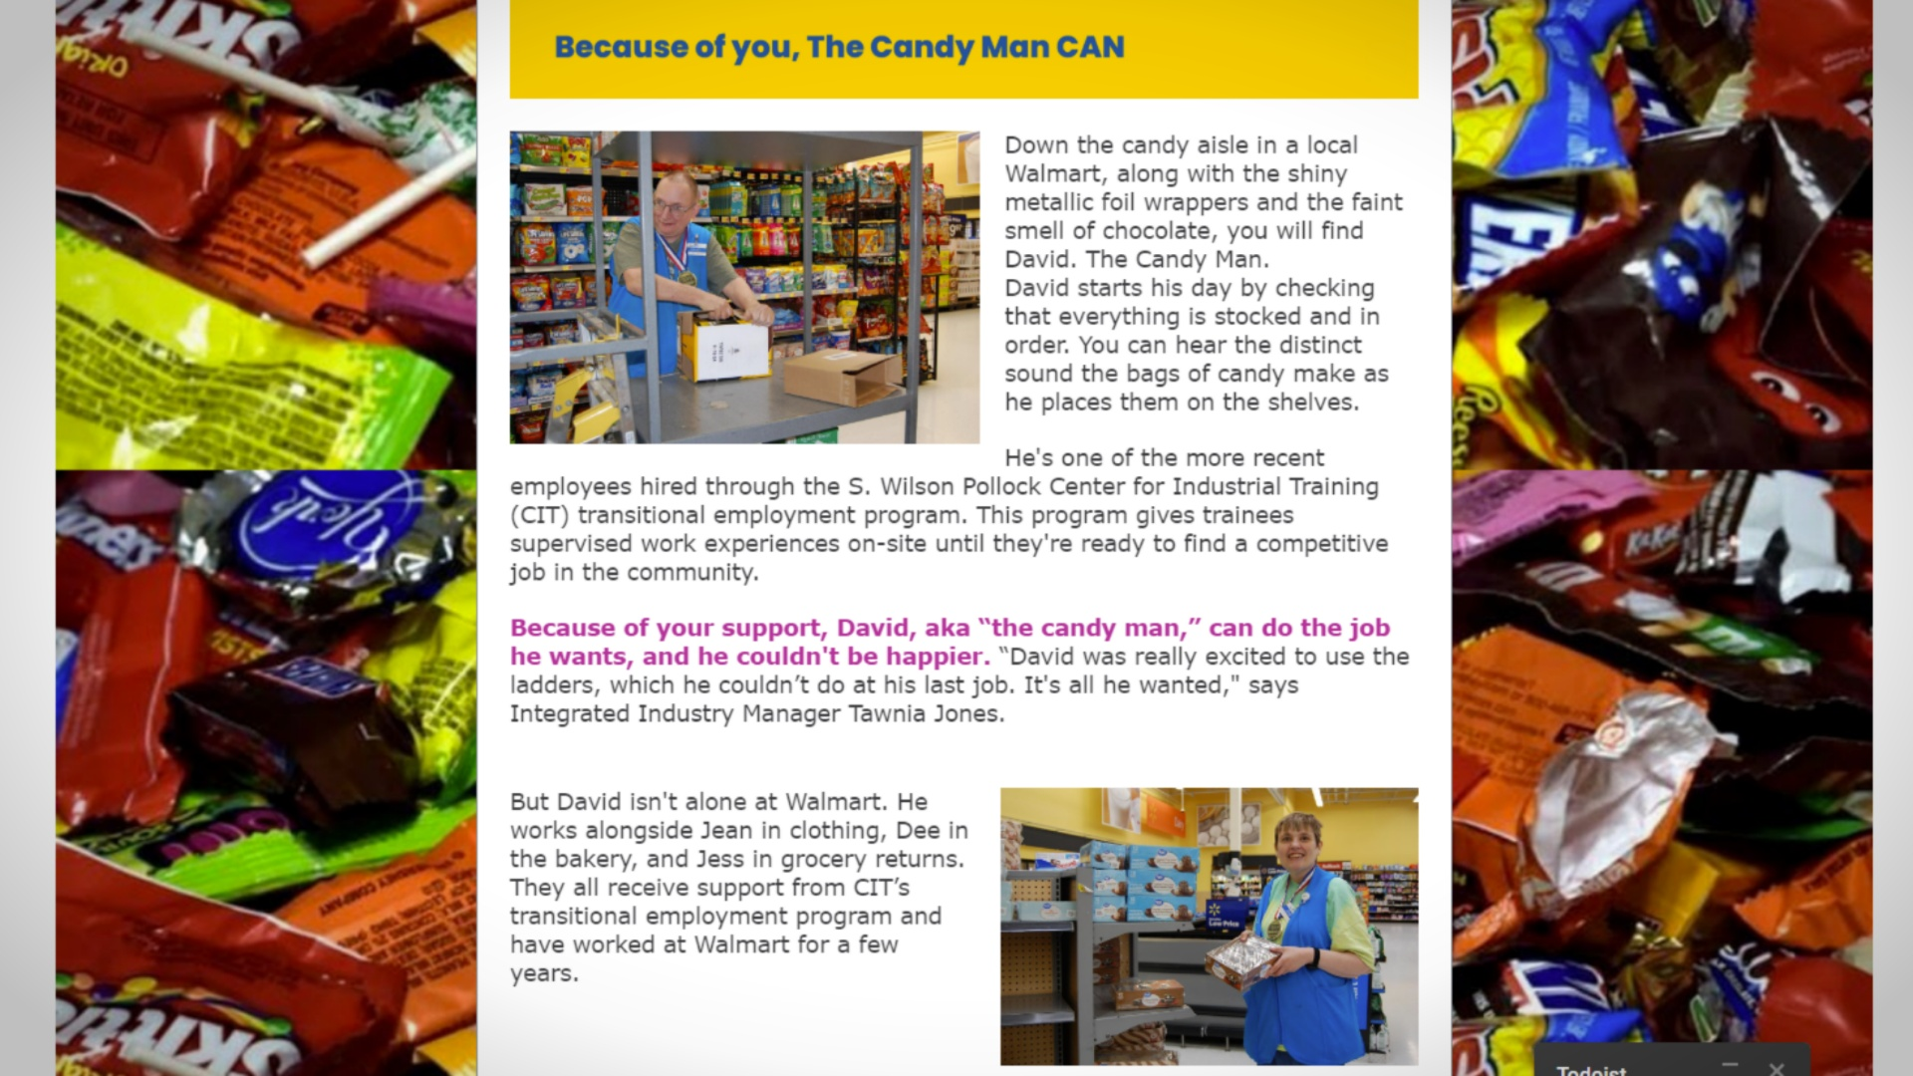

Slide 26
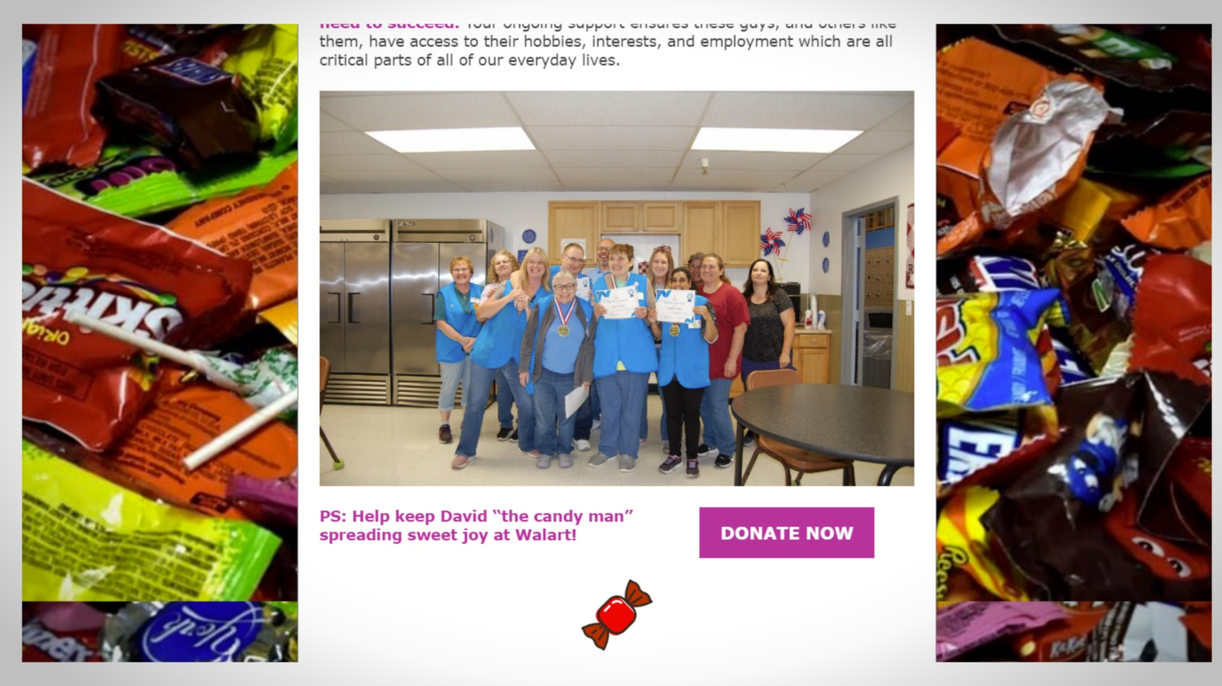

Slide 27
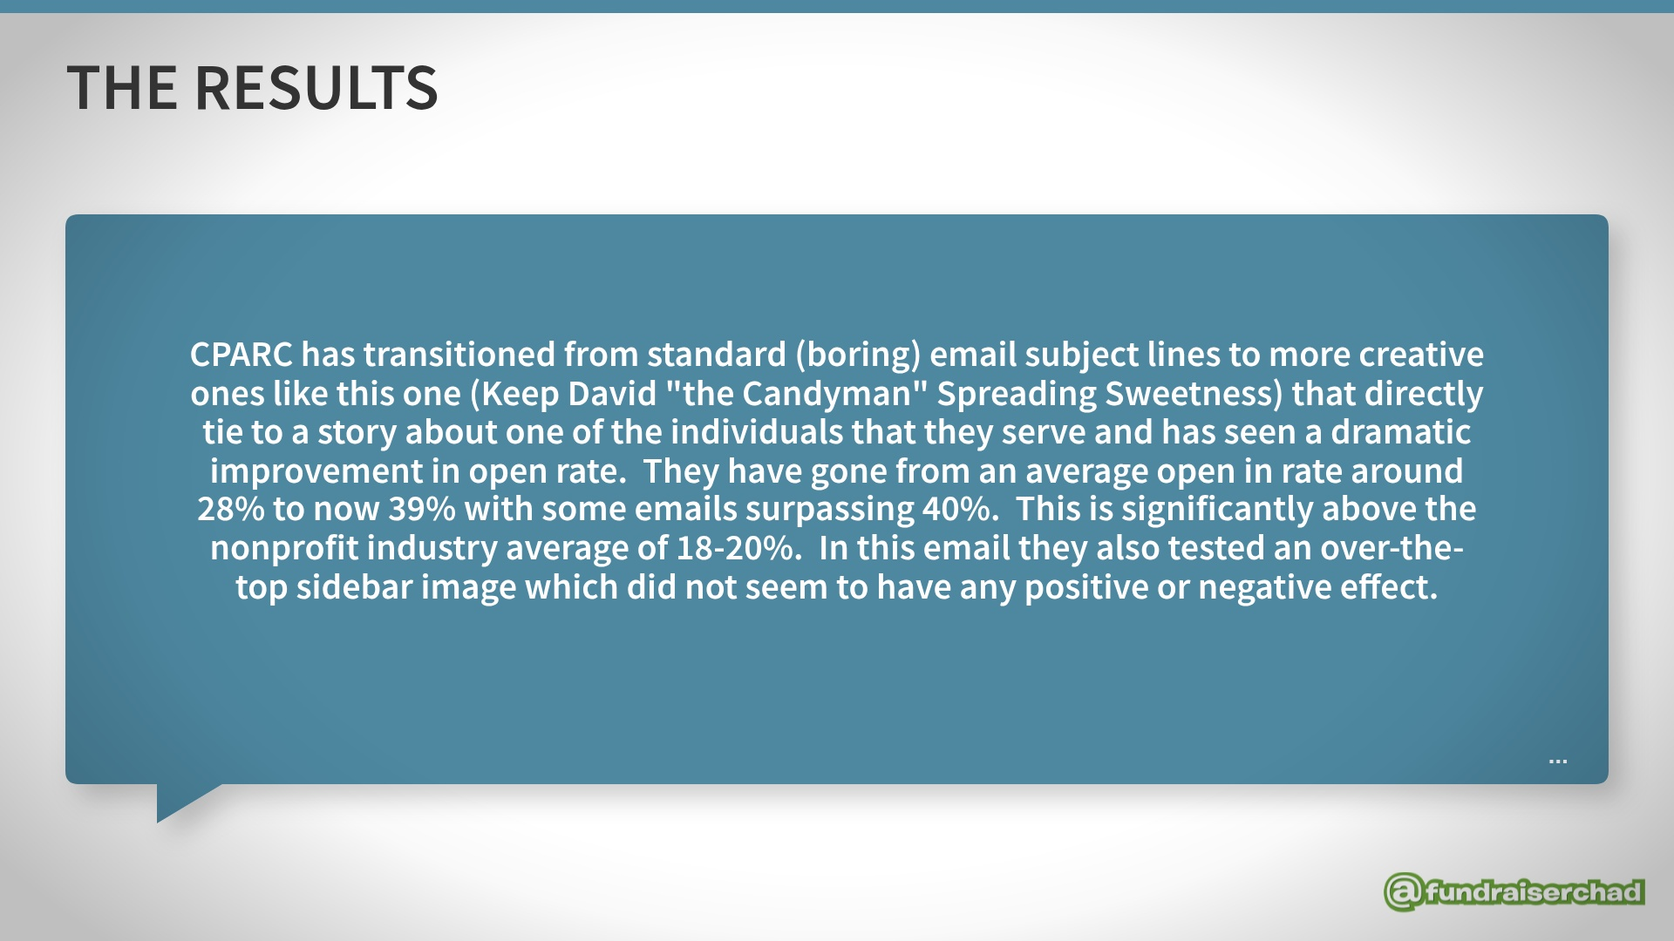

Slide 28
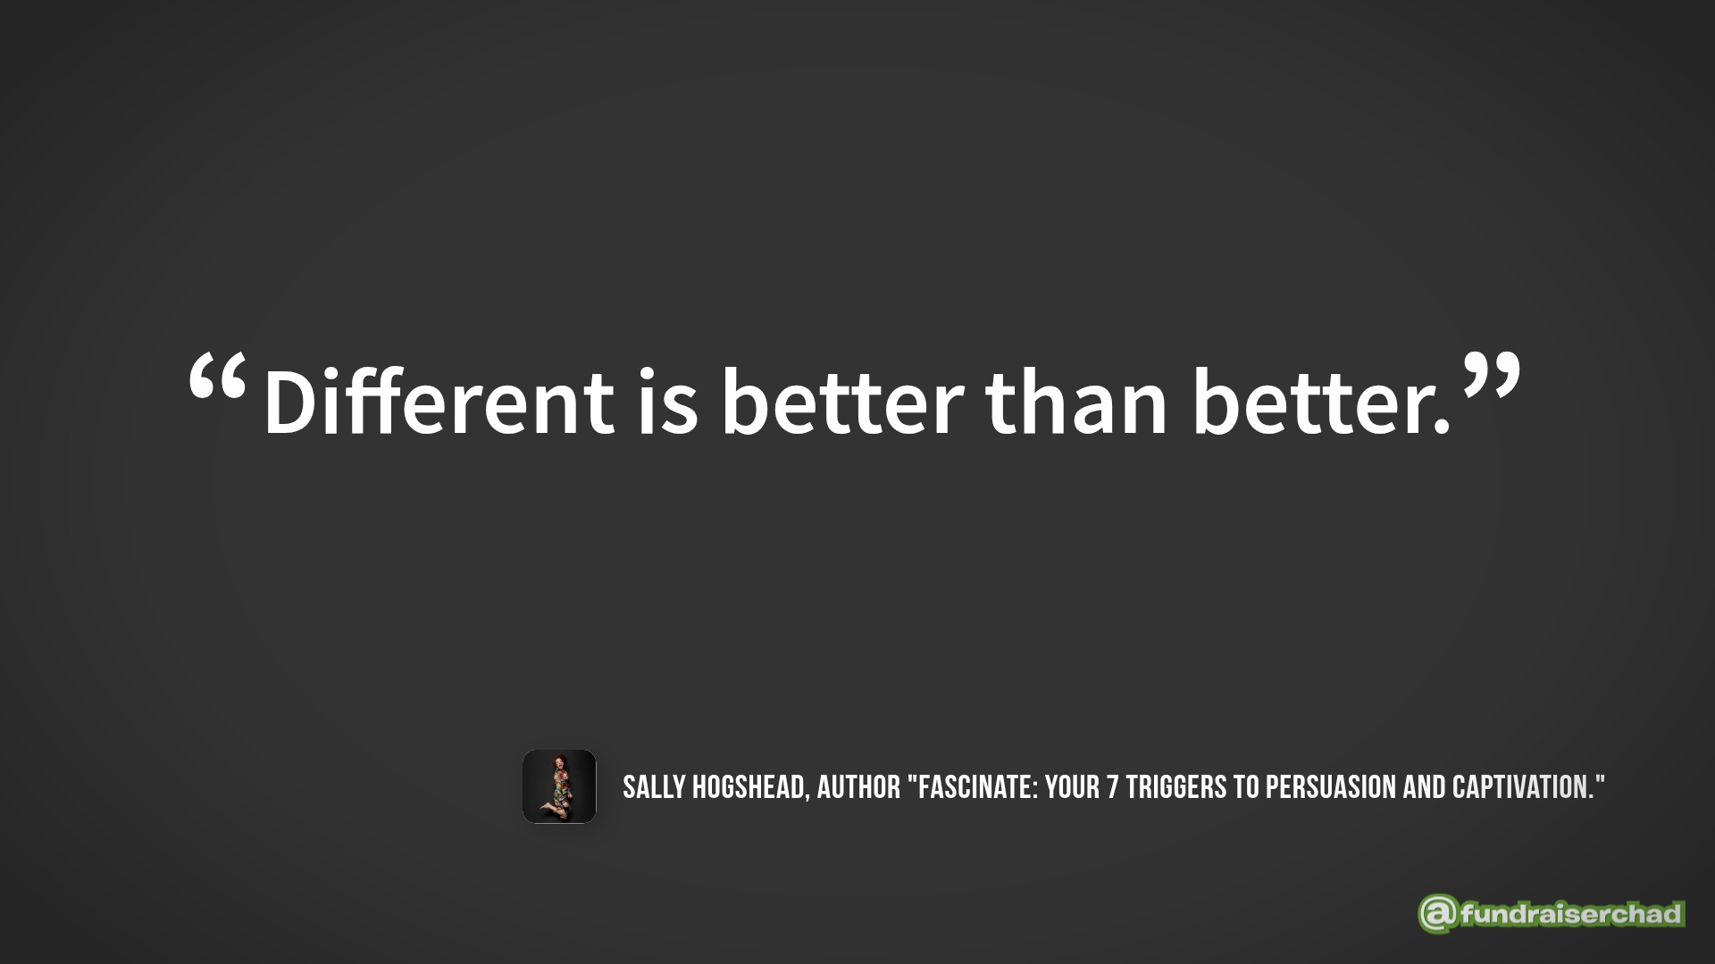

Slide 29
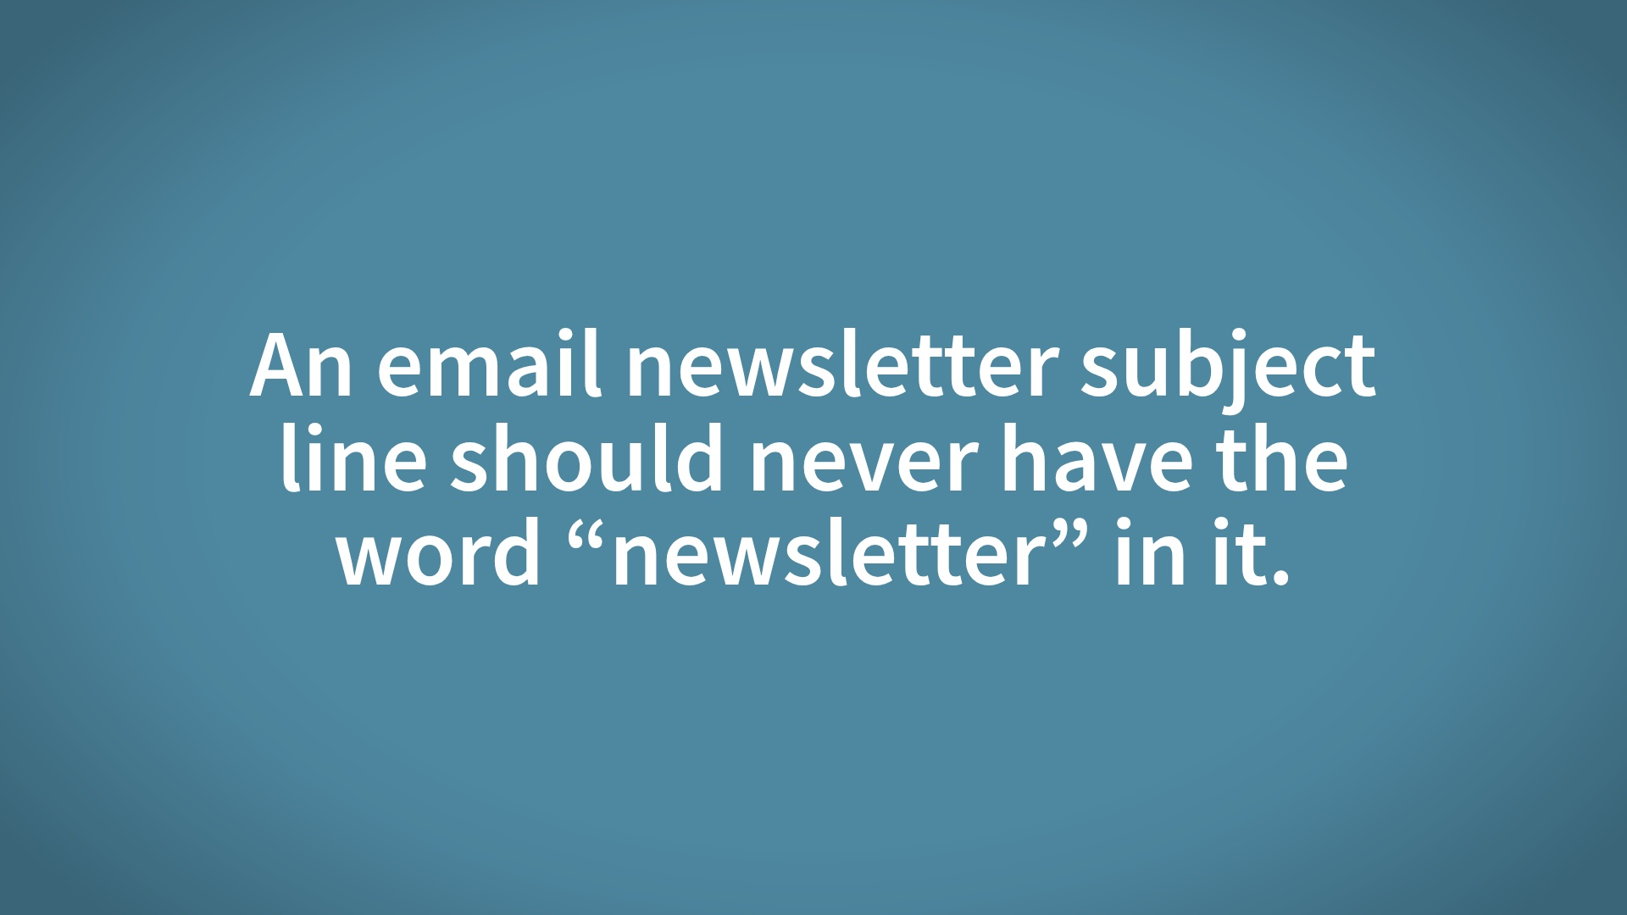

Slide 30


Slide 31
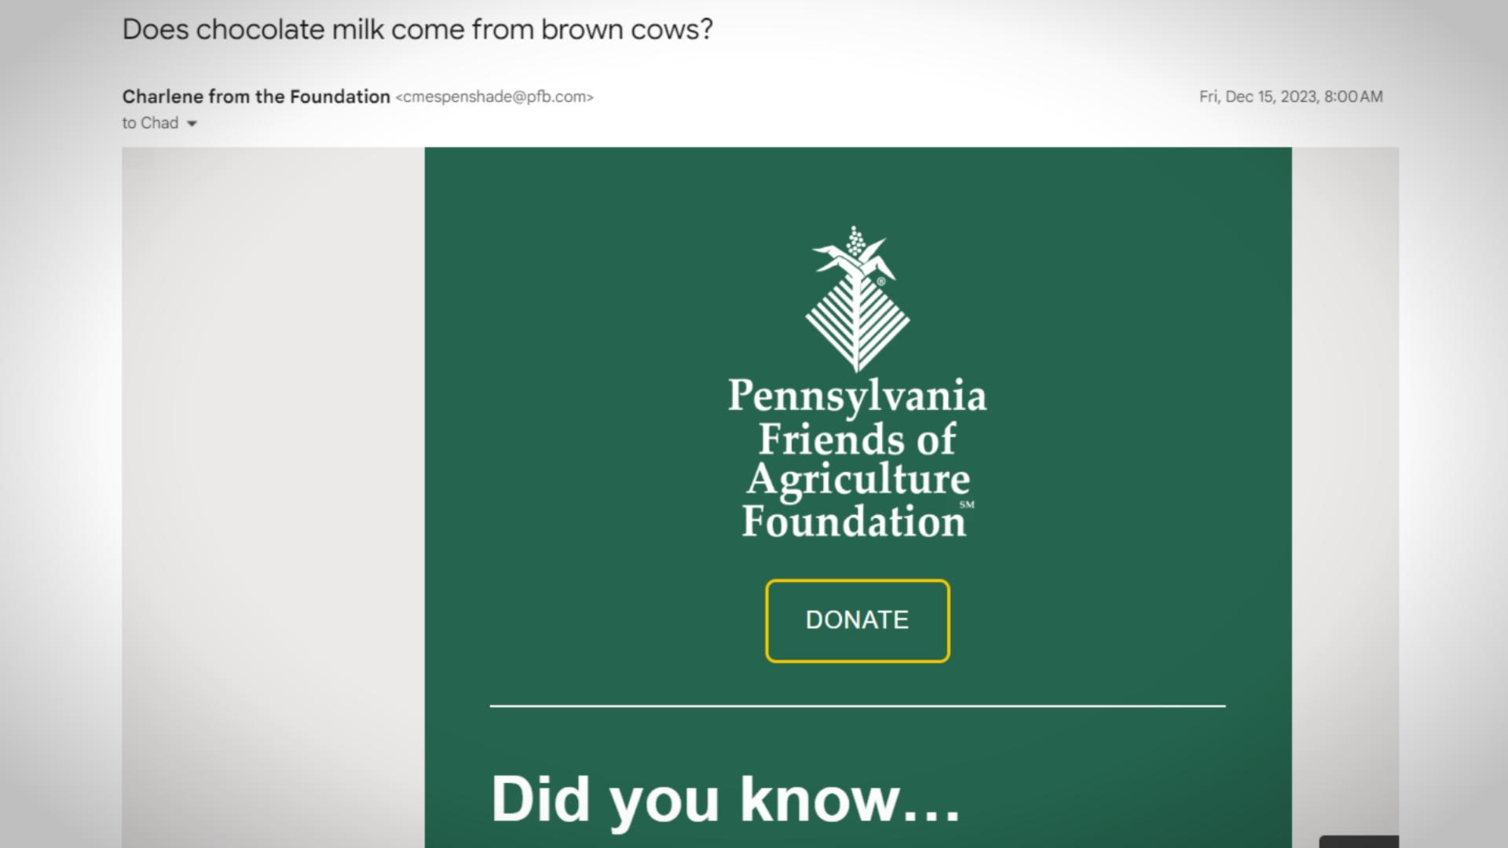

Slide 32
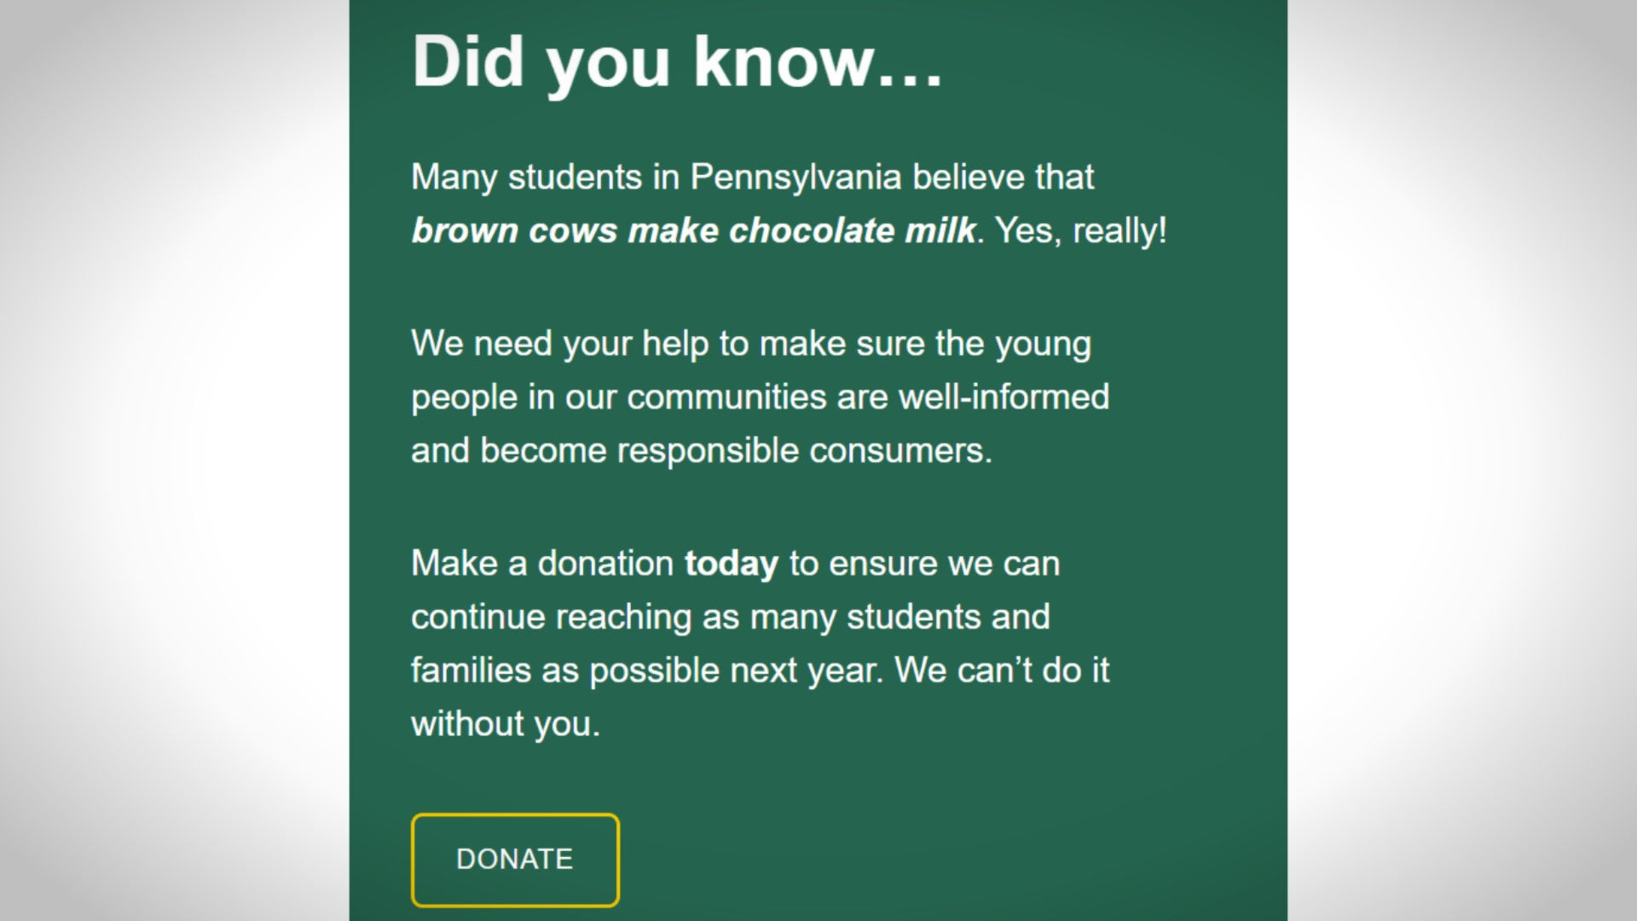

Slide 33
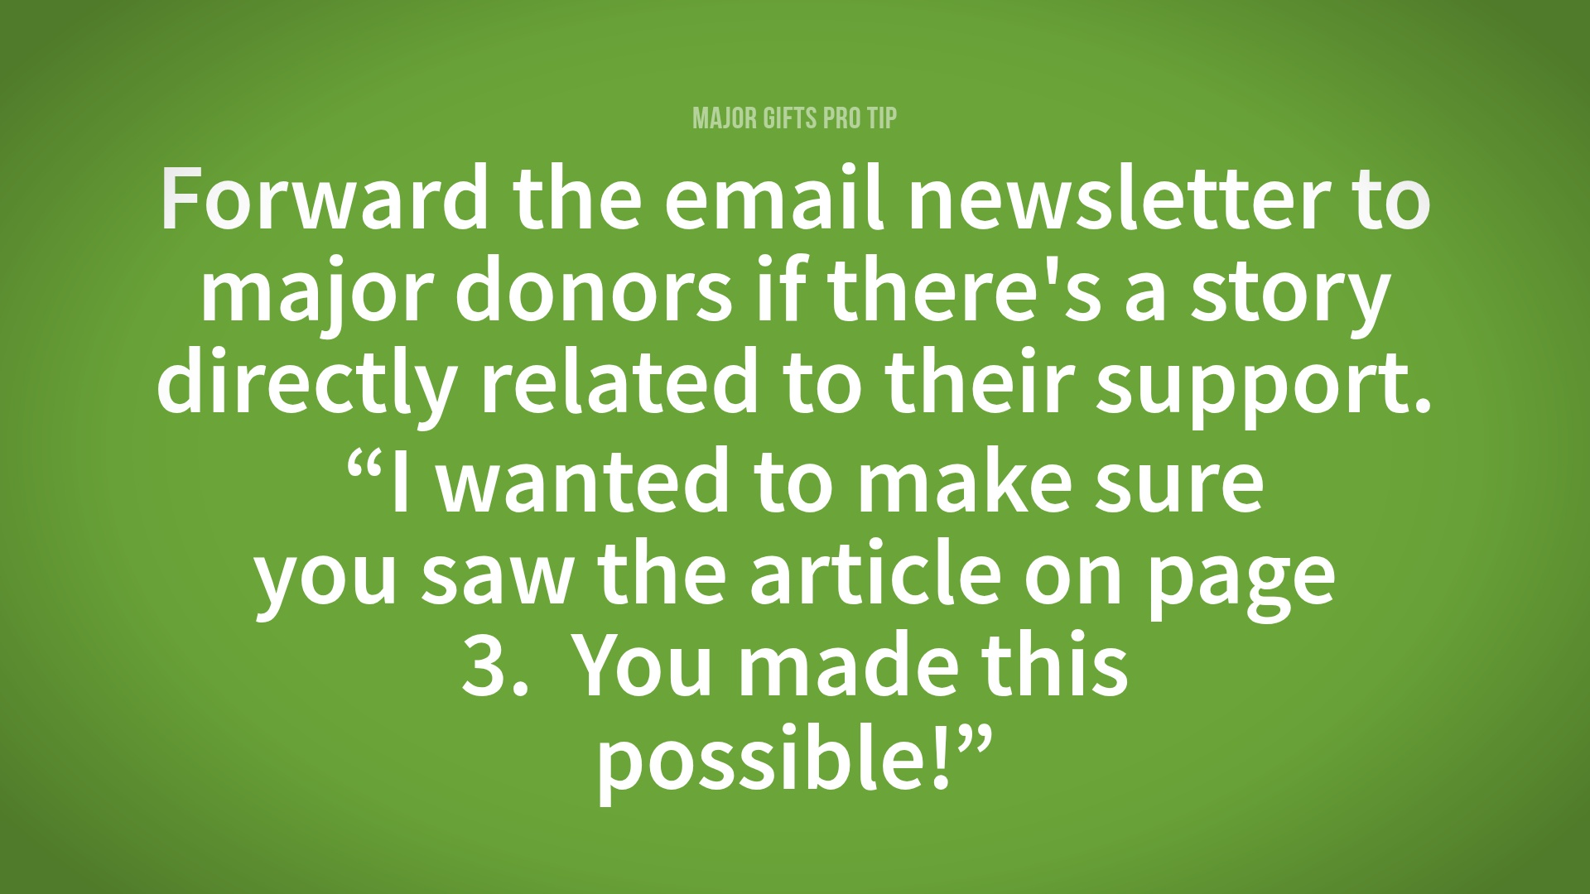

Slide 34
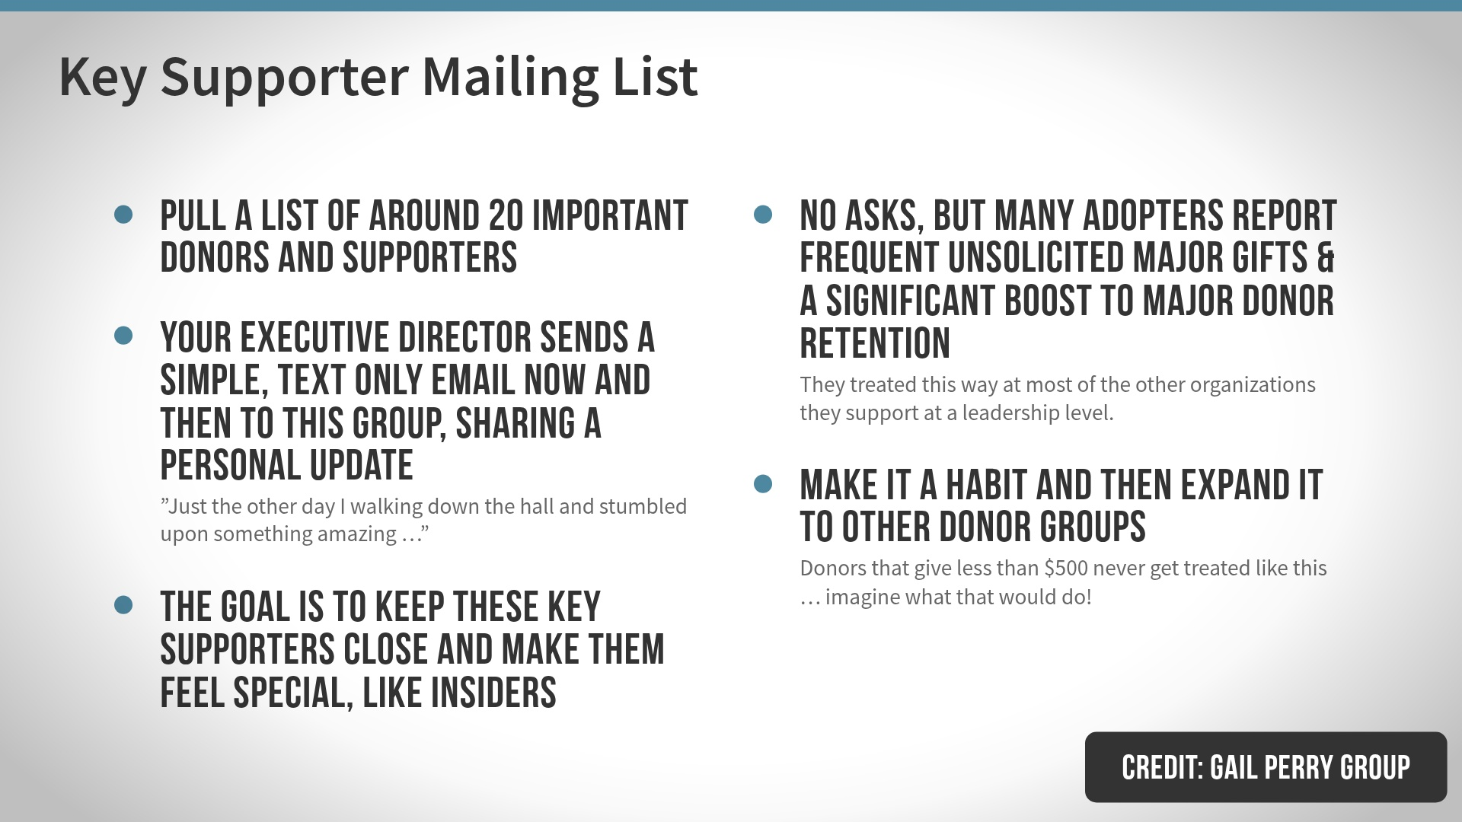

Slide 35
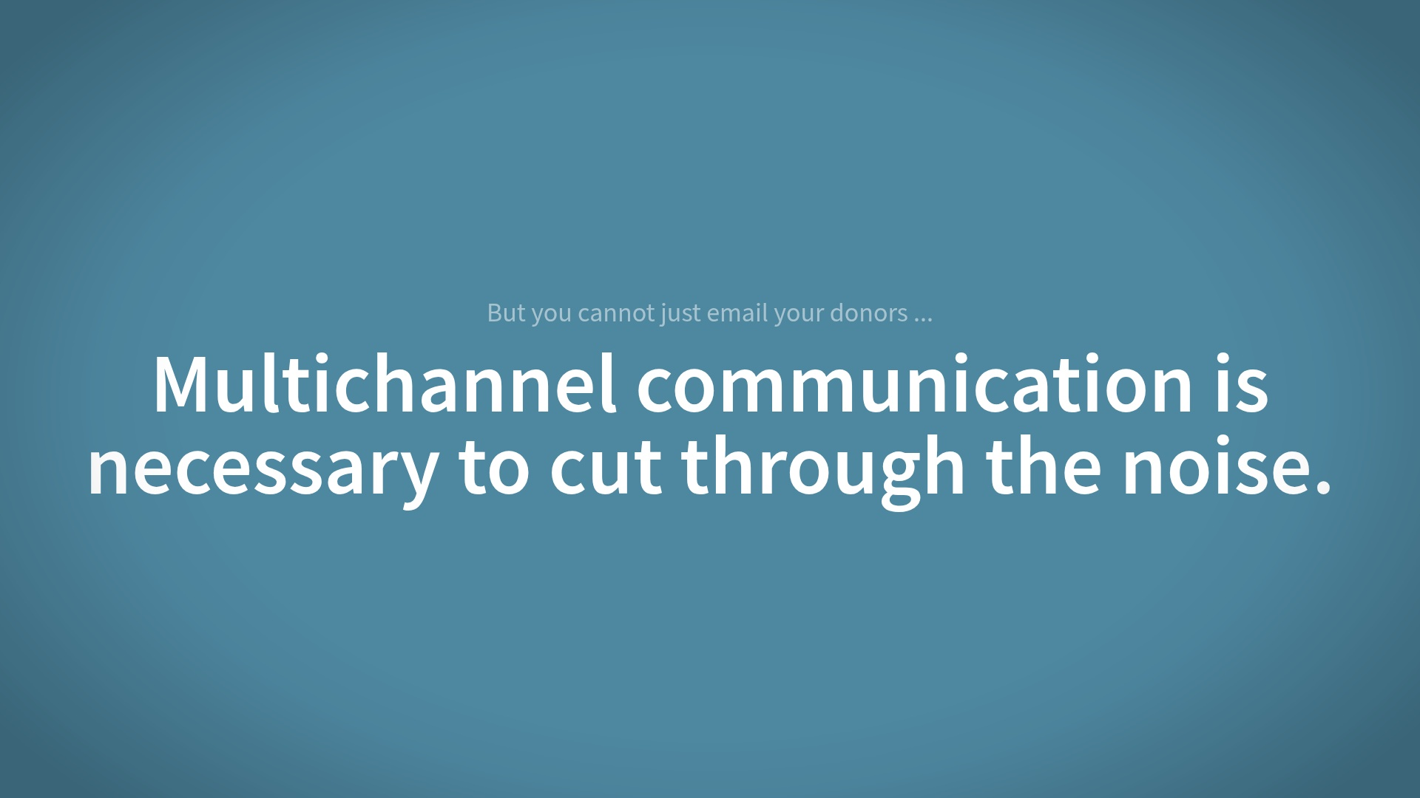

Slide 36


Slide 37
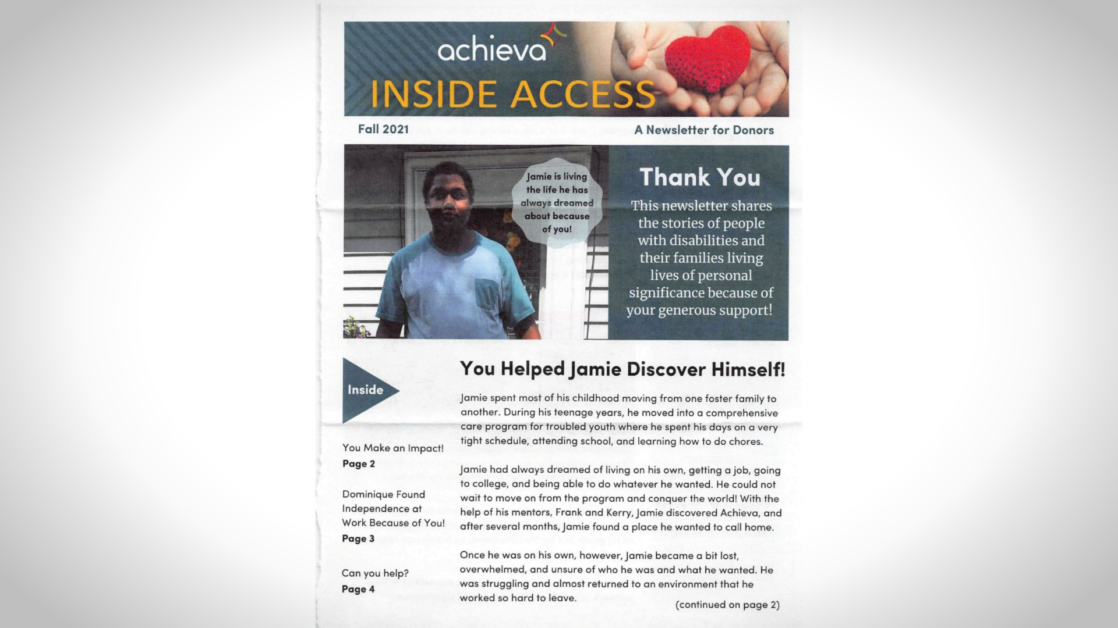

Slide 38
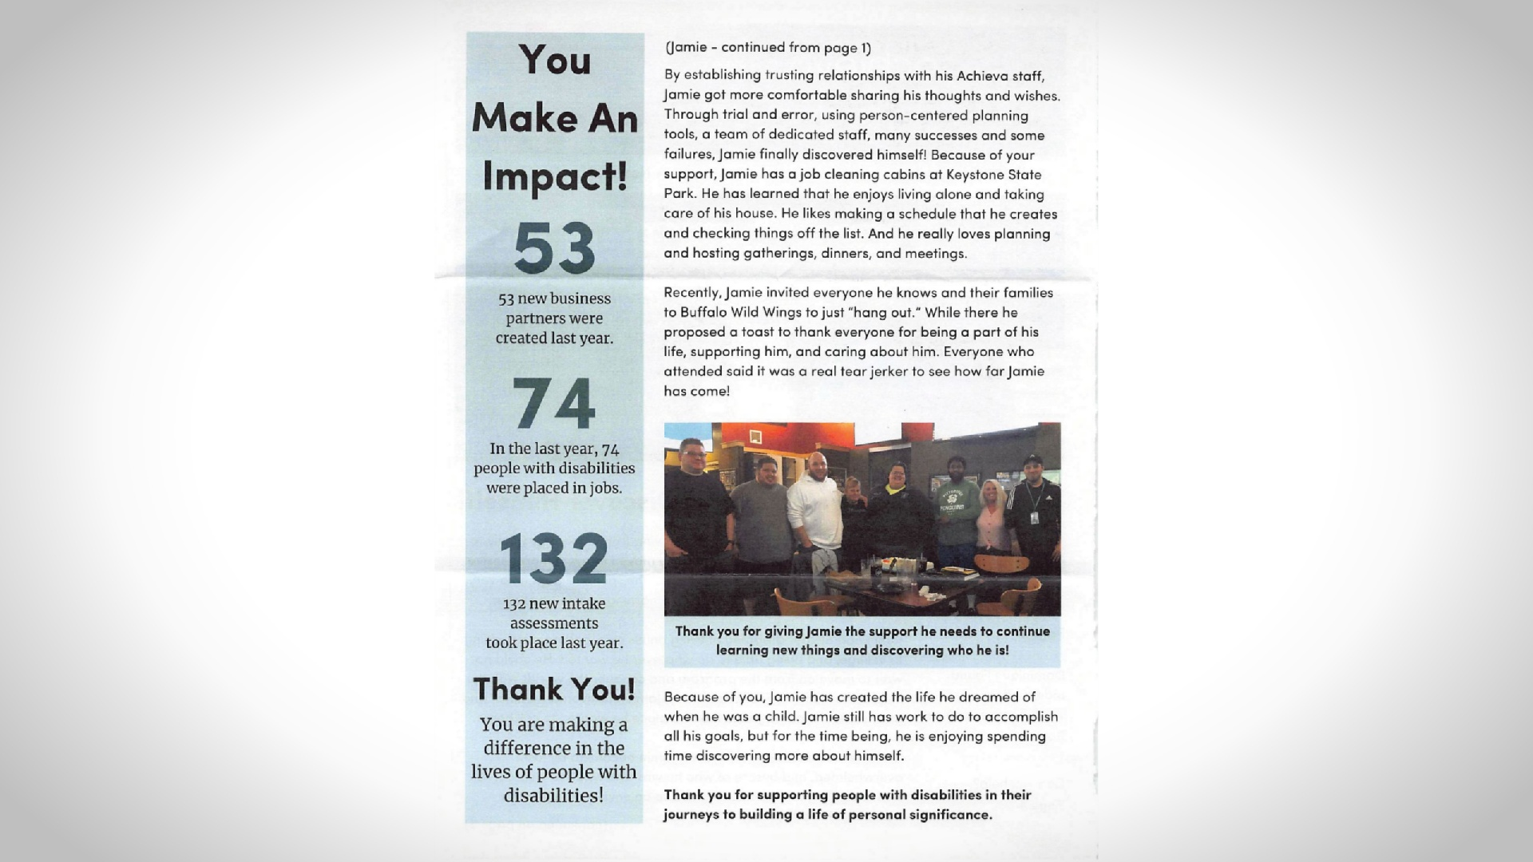

Slide 39
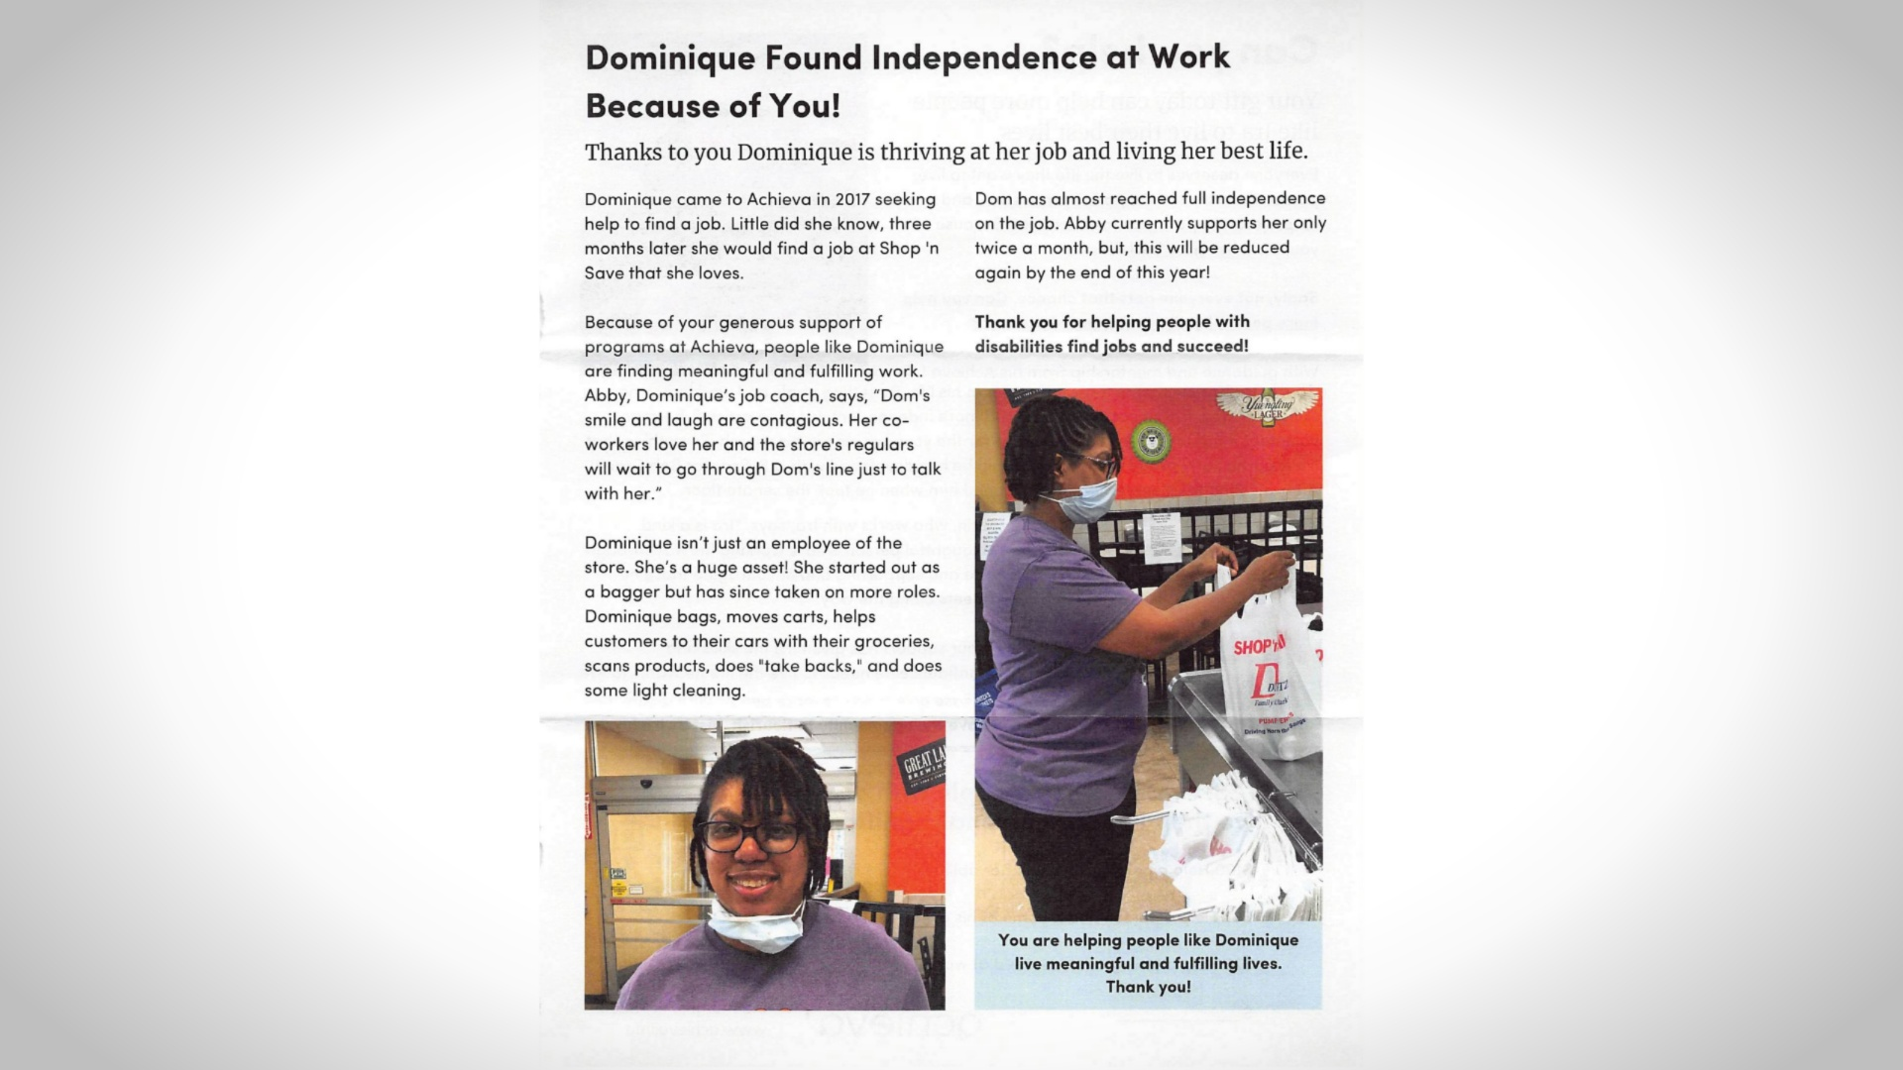

Slide 40
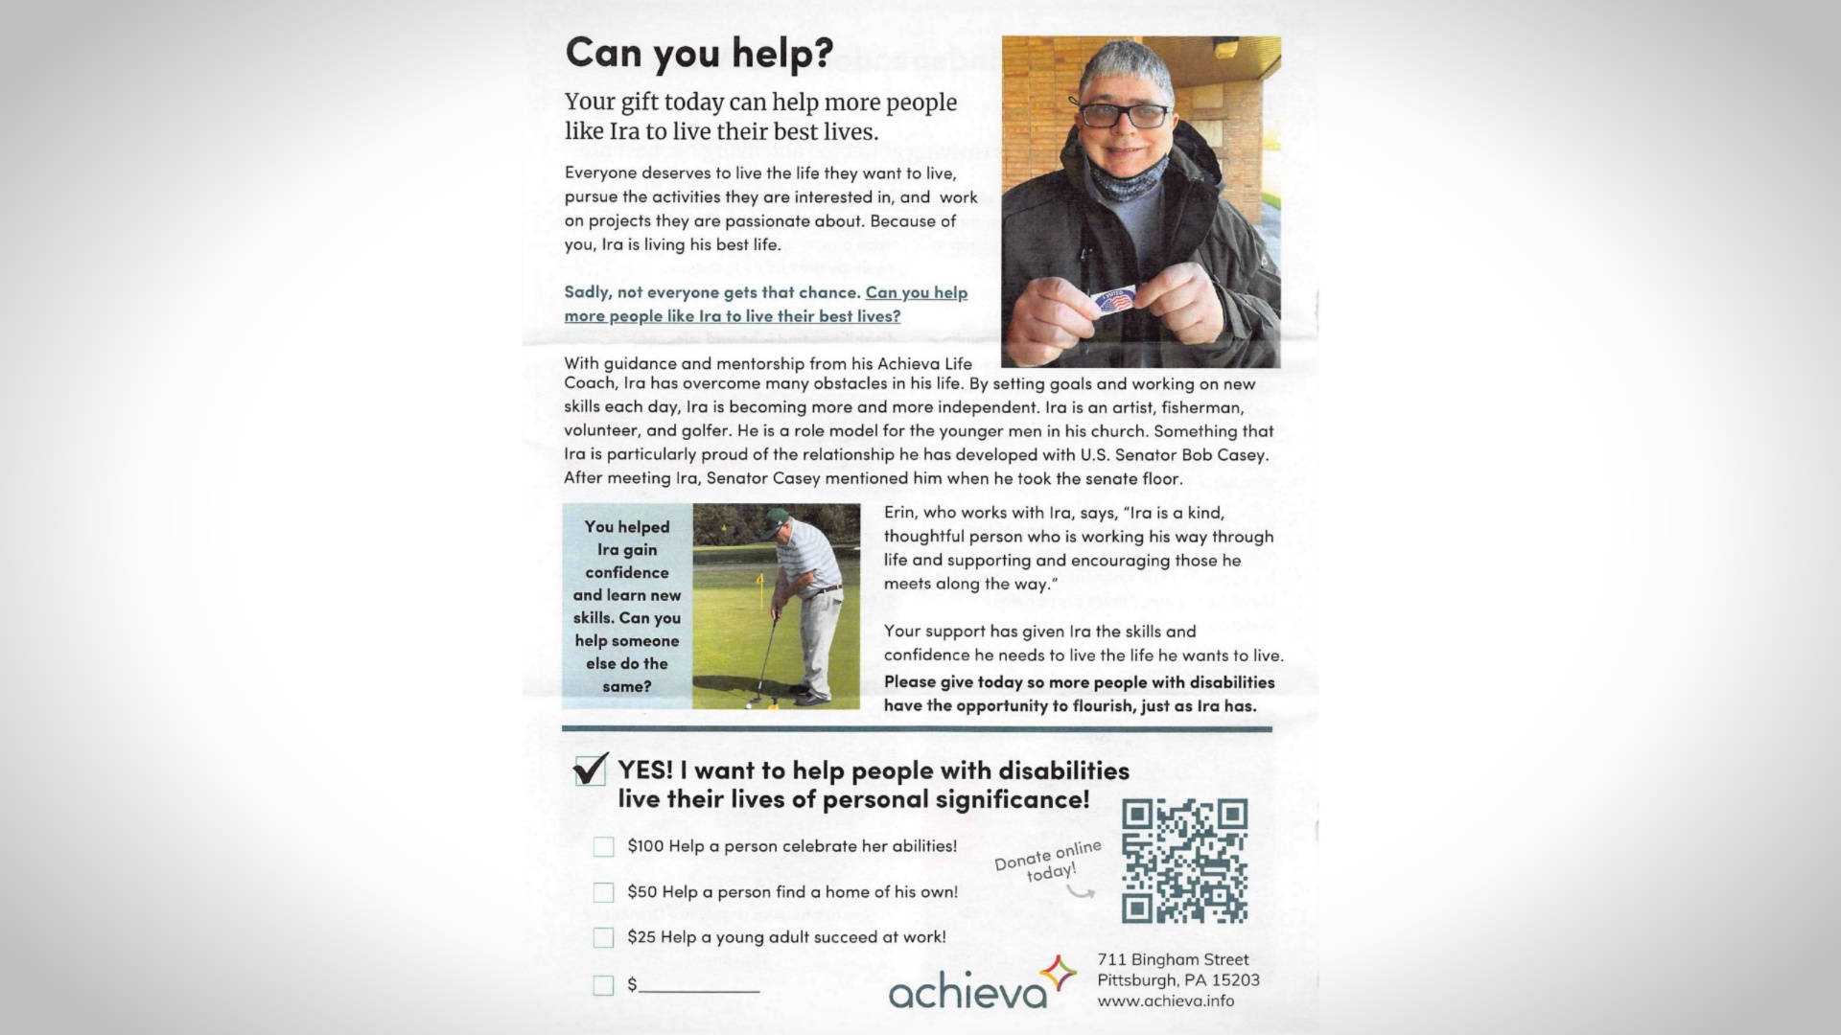

Slide 41
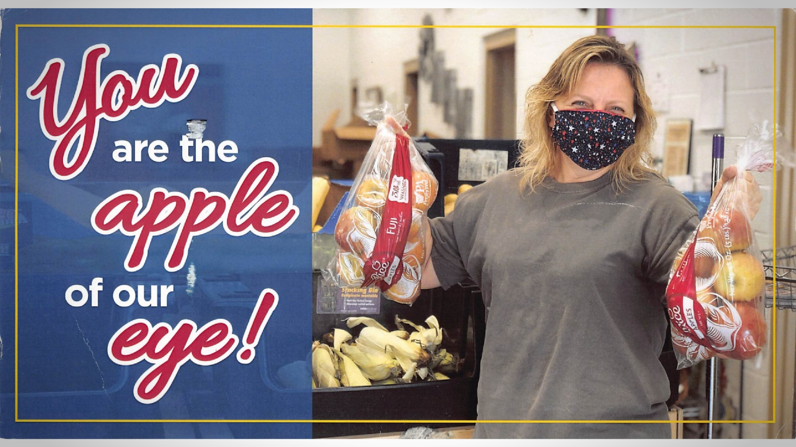

Slide 42
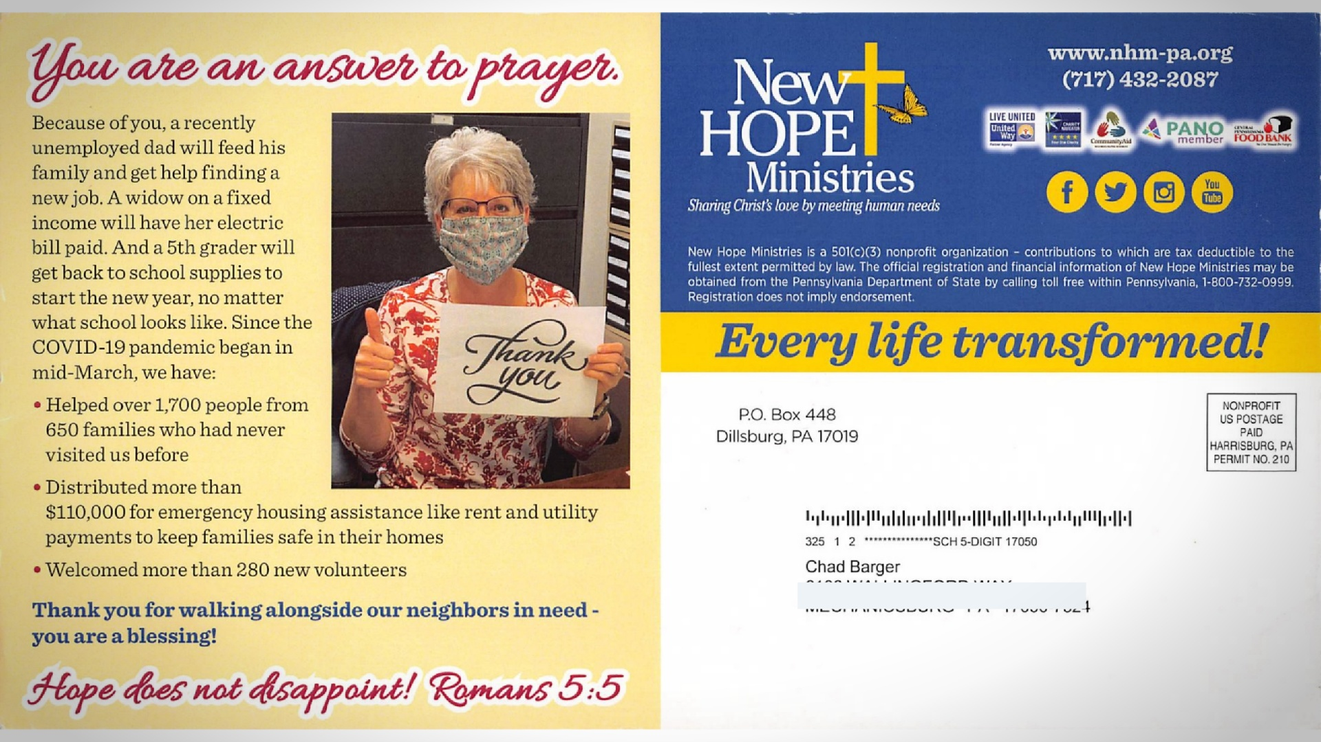

Slide 43


Slide 44

Notes:
Speak no more than 25% of the time

Slide 45
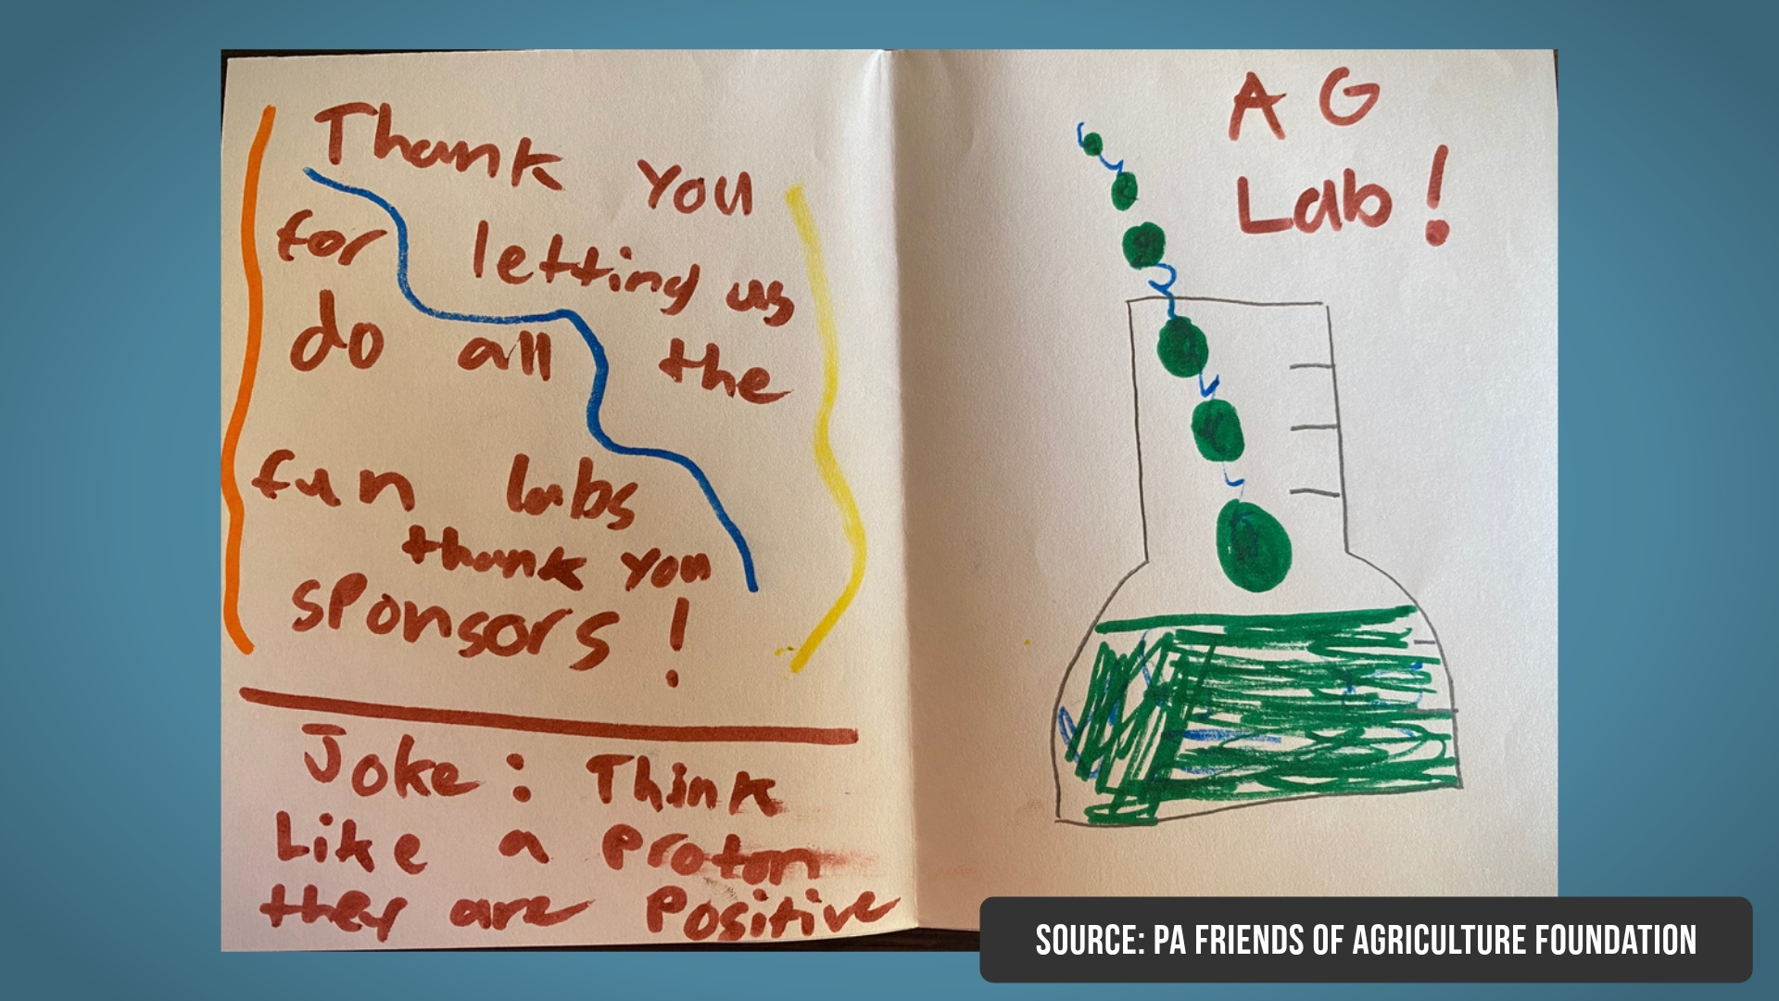

Slide 46
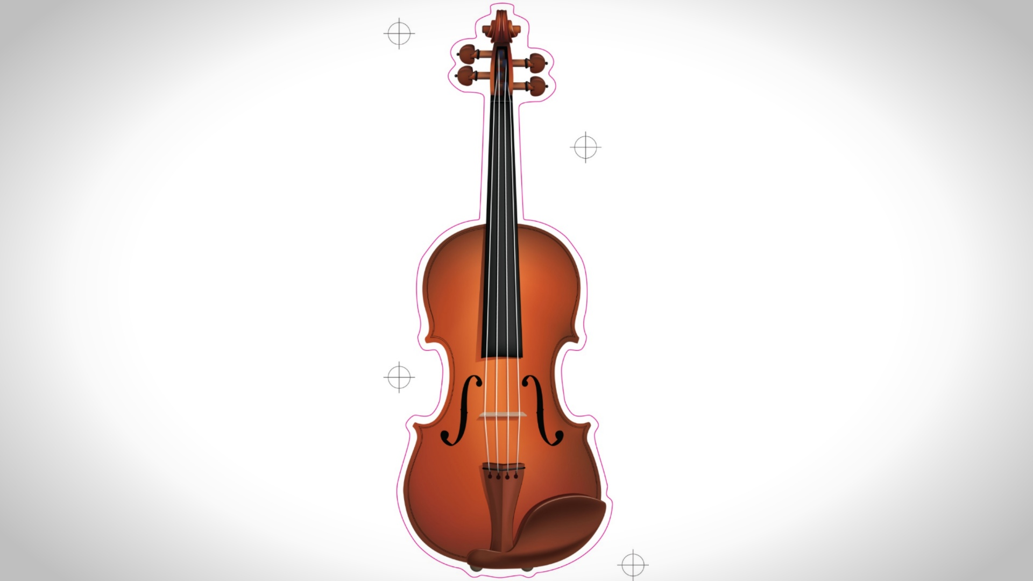
Notes:
Speak no more than 25% of the time

Slide 47
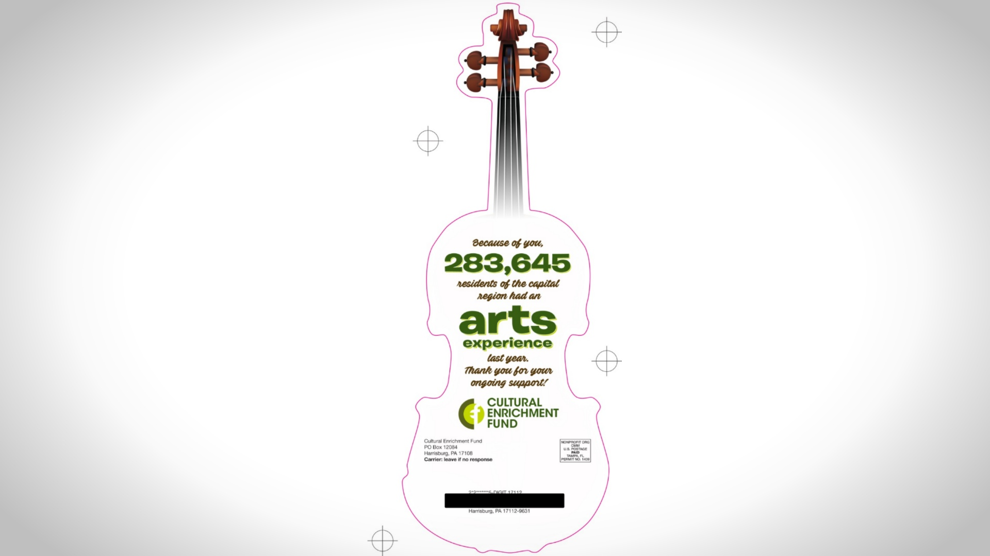
Notes:
Speak no more than 25% of the time

Slide 48
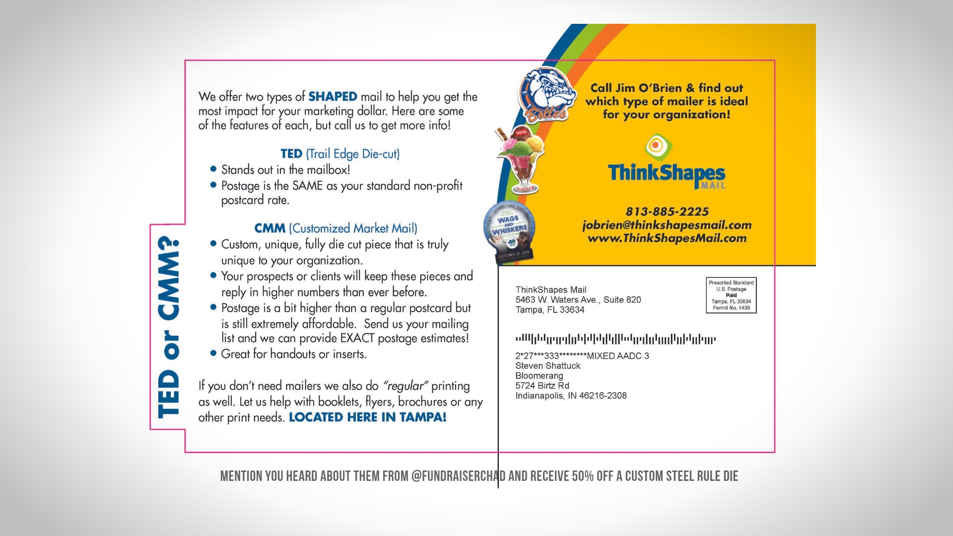
Notes:
Speak no more than 25% of the time

Slide 49
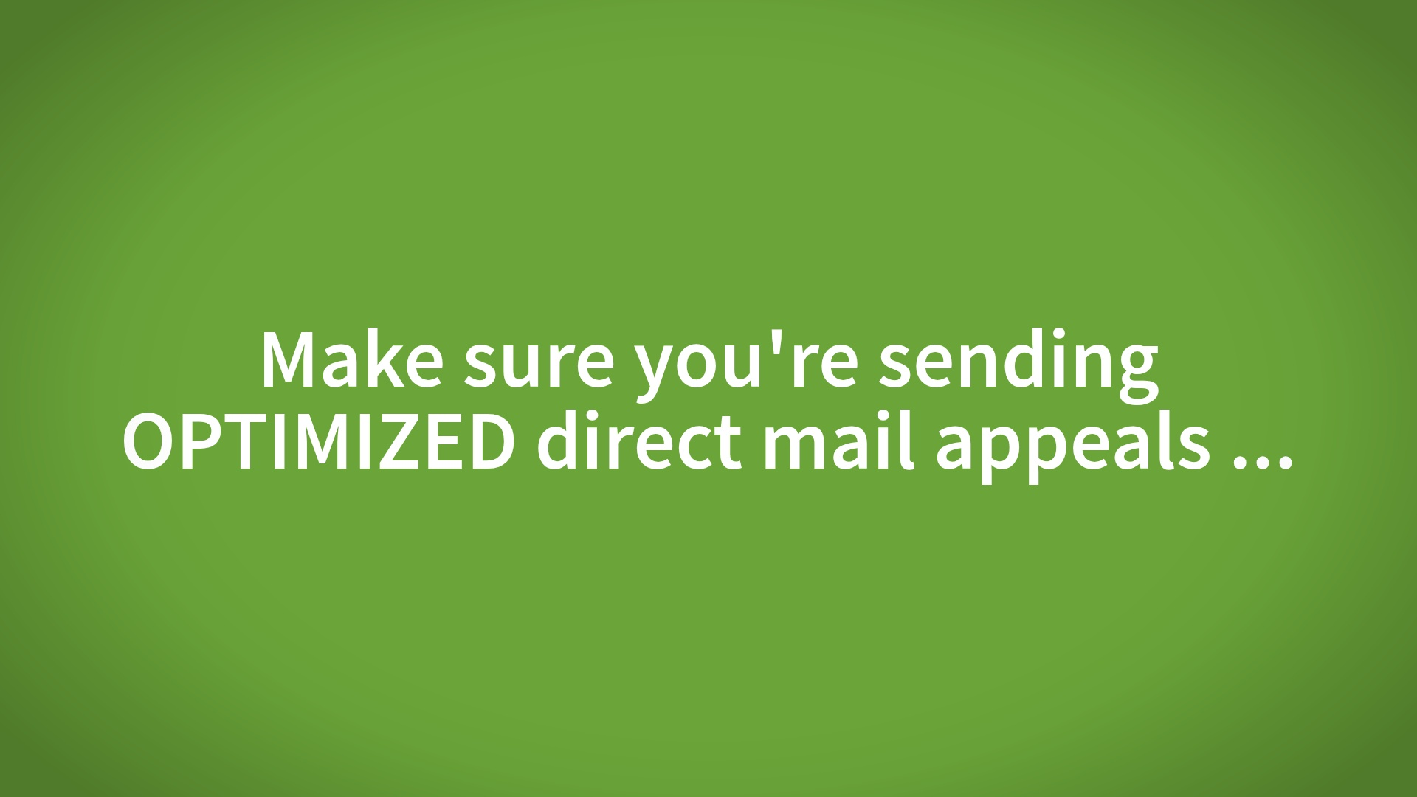

Slide 50
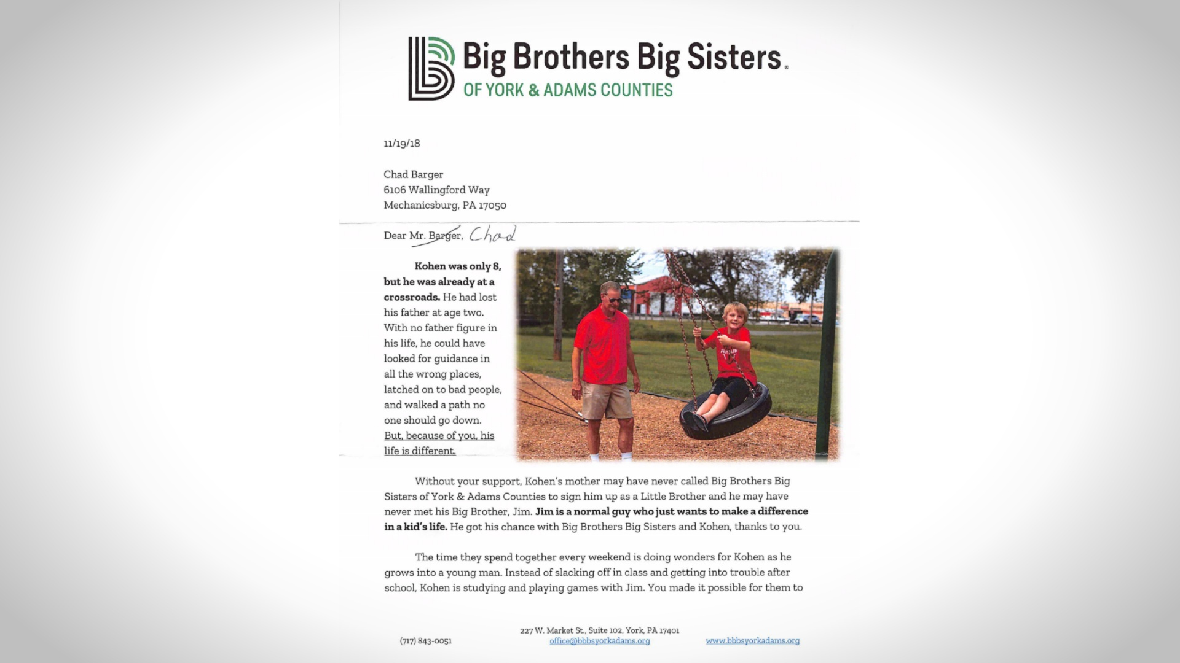

Slide 51
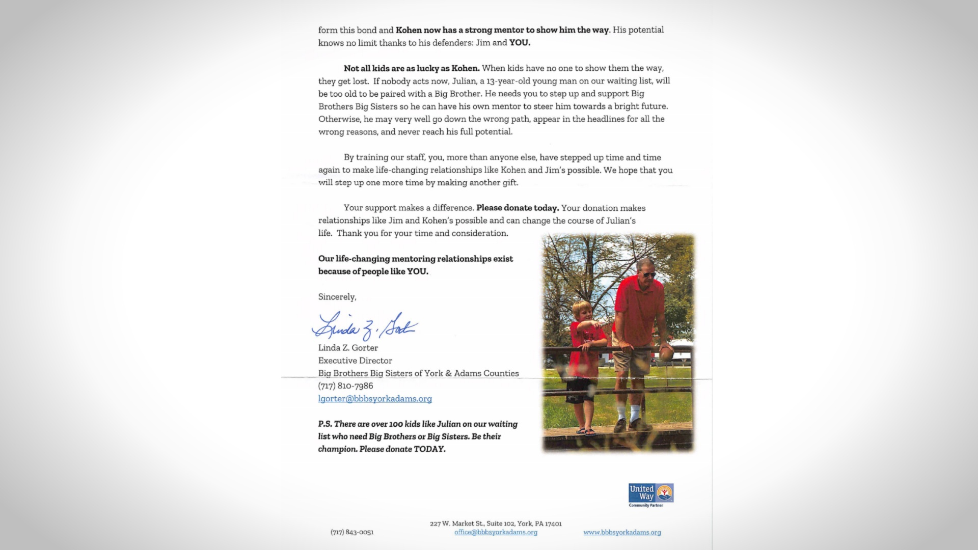

Slide 52
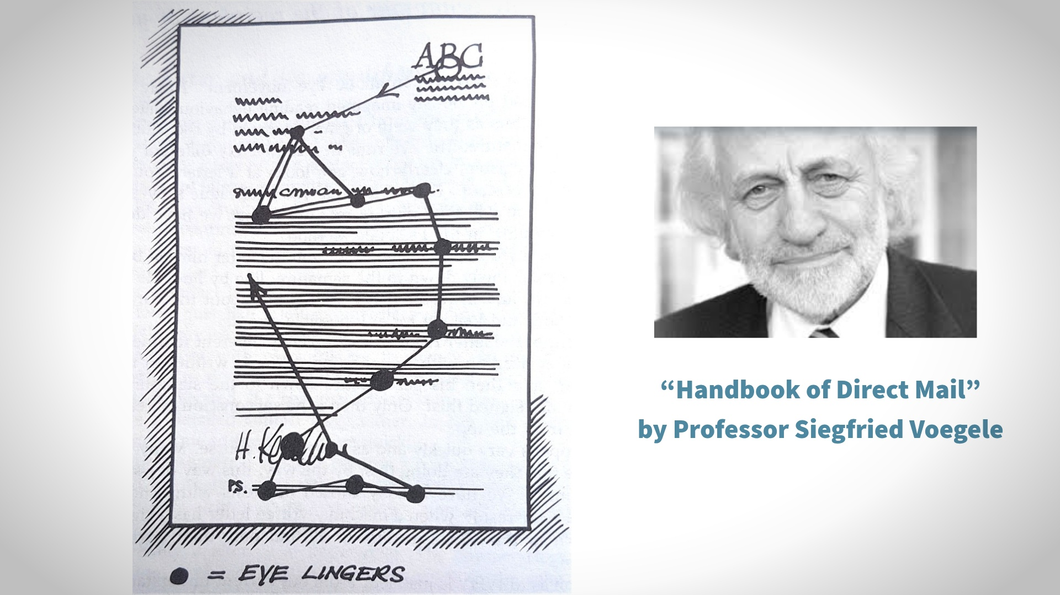

Slide 53
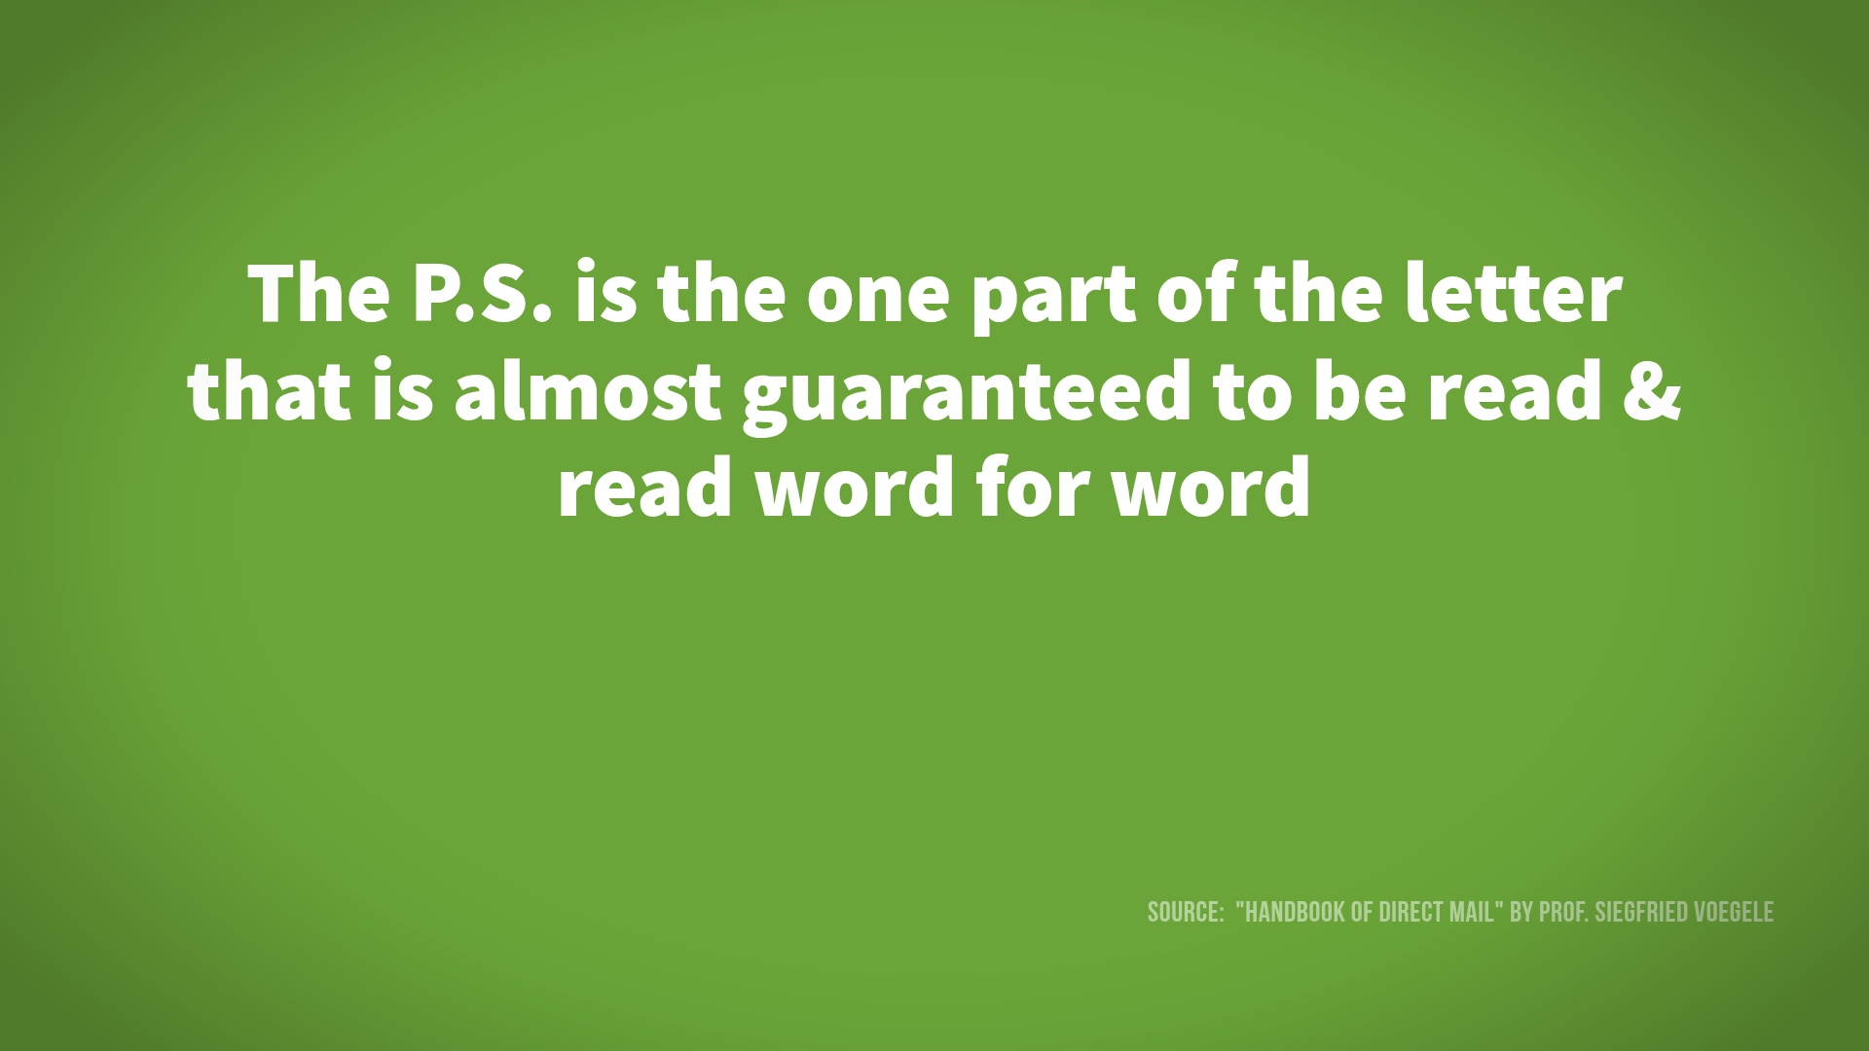

Slide 54
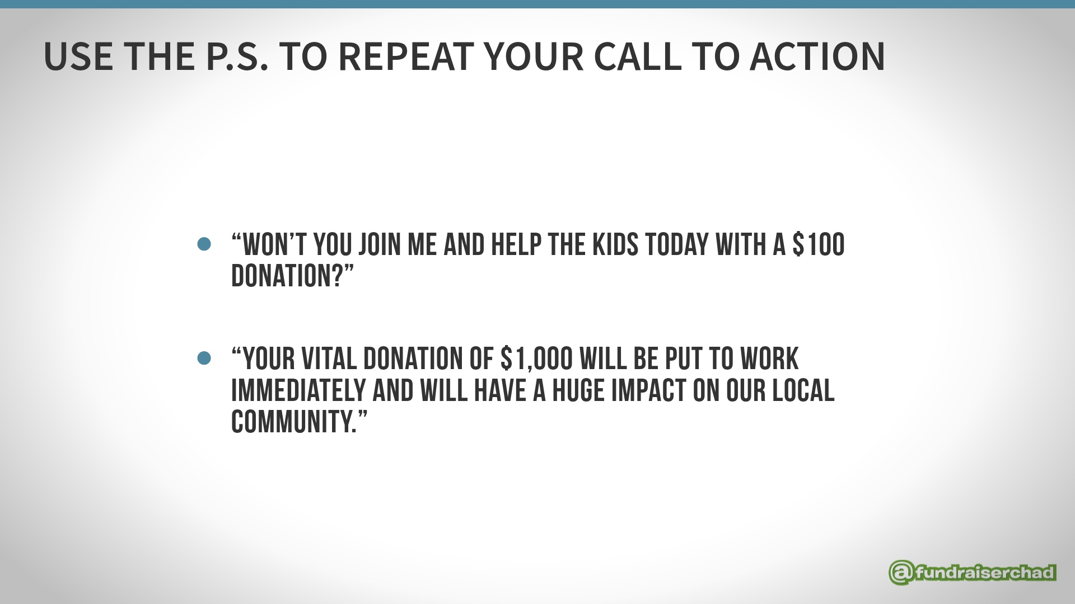

Slide 55
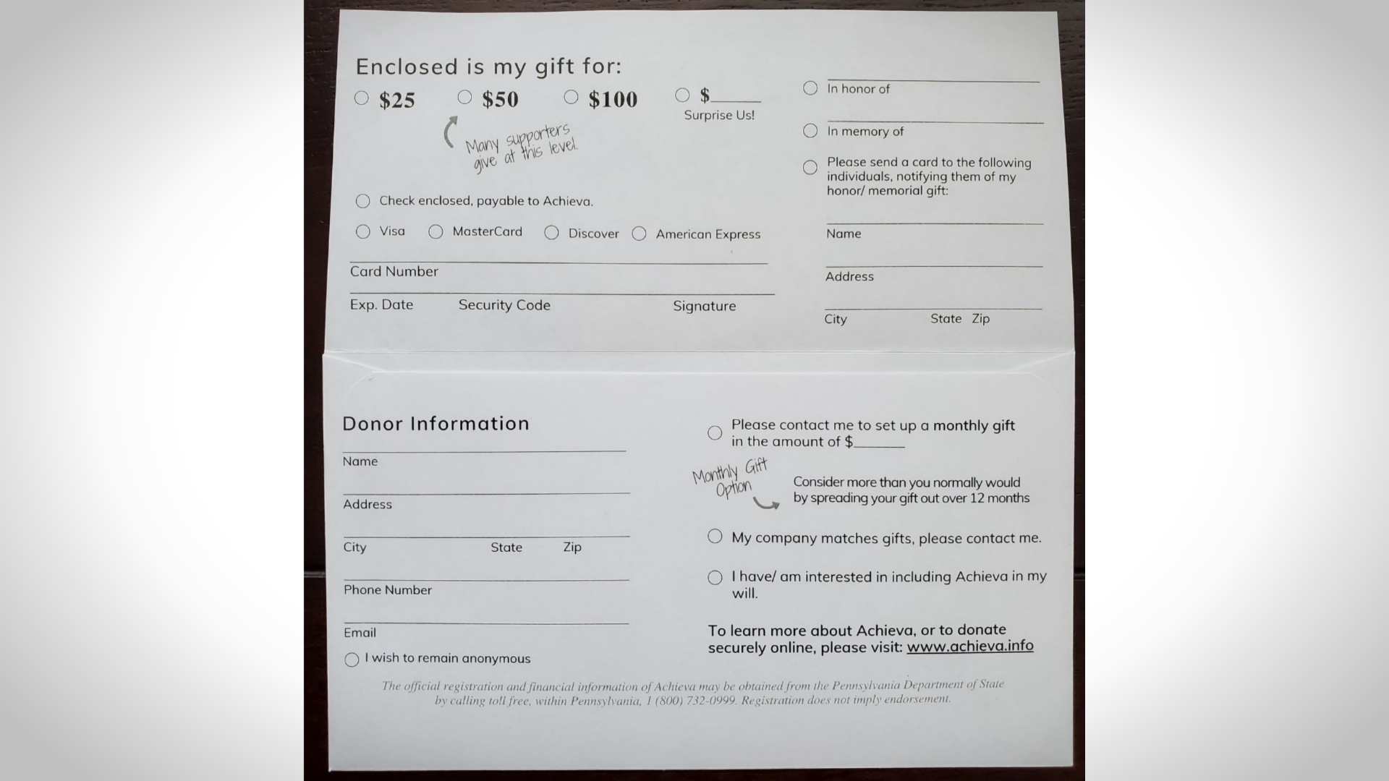

Slide 56
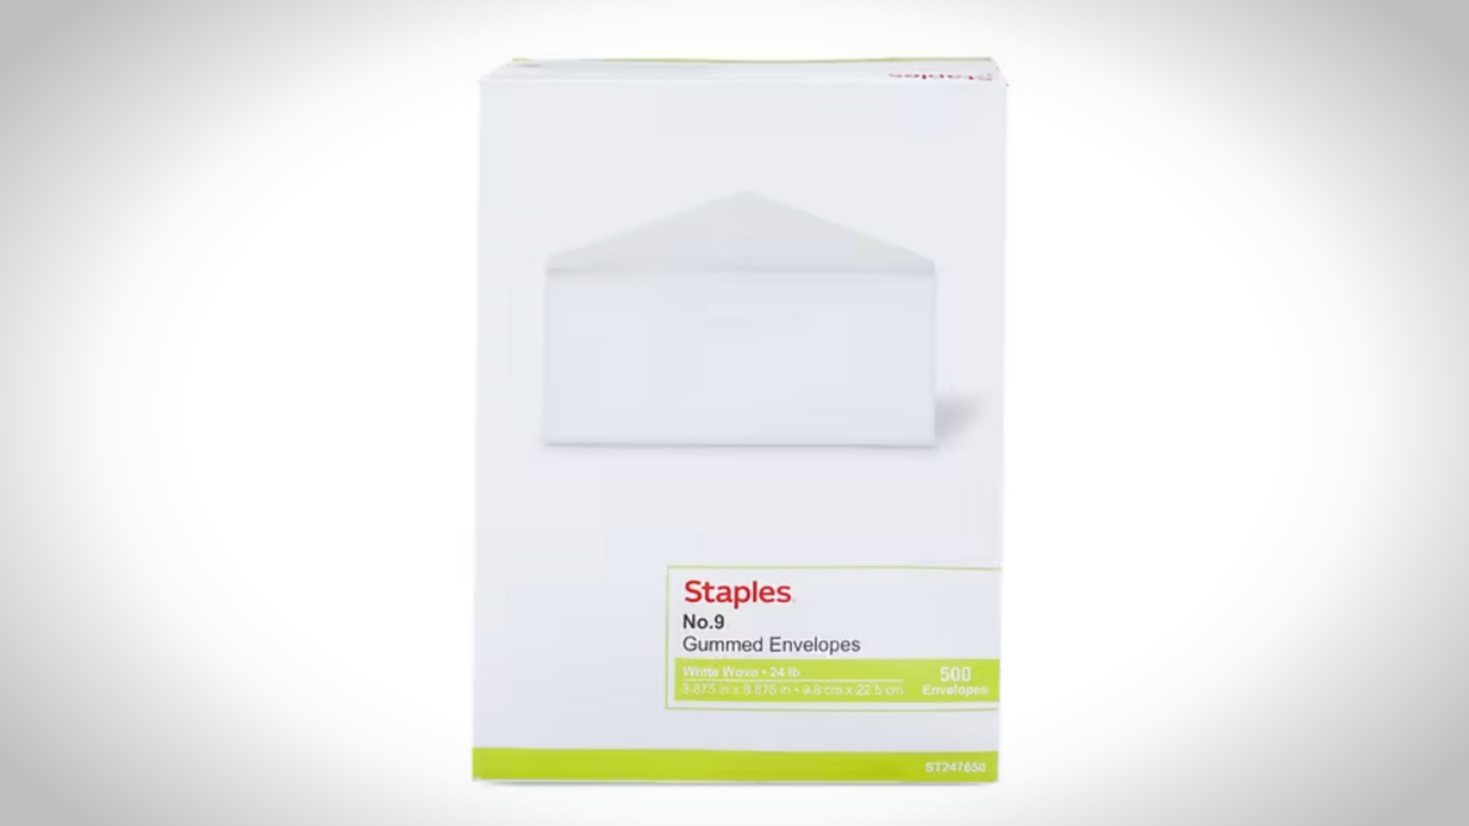

Slide 57


Slide 58
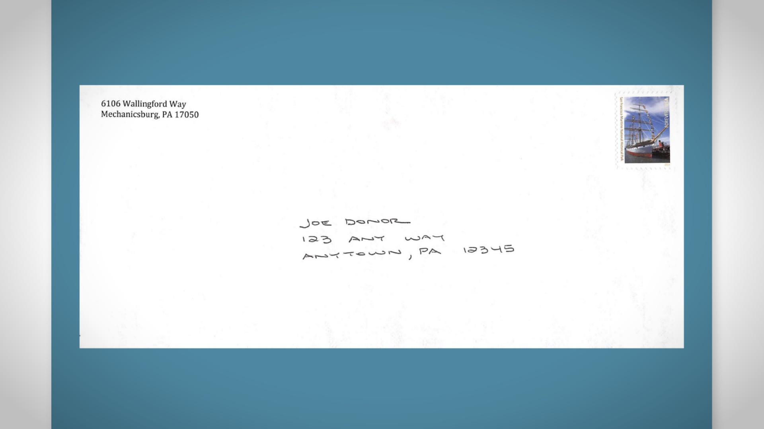

Slide 59
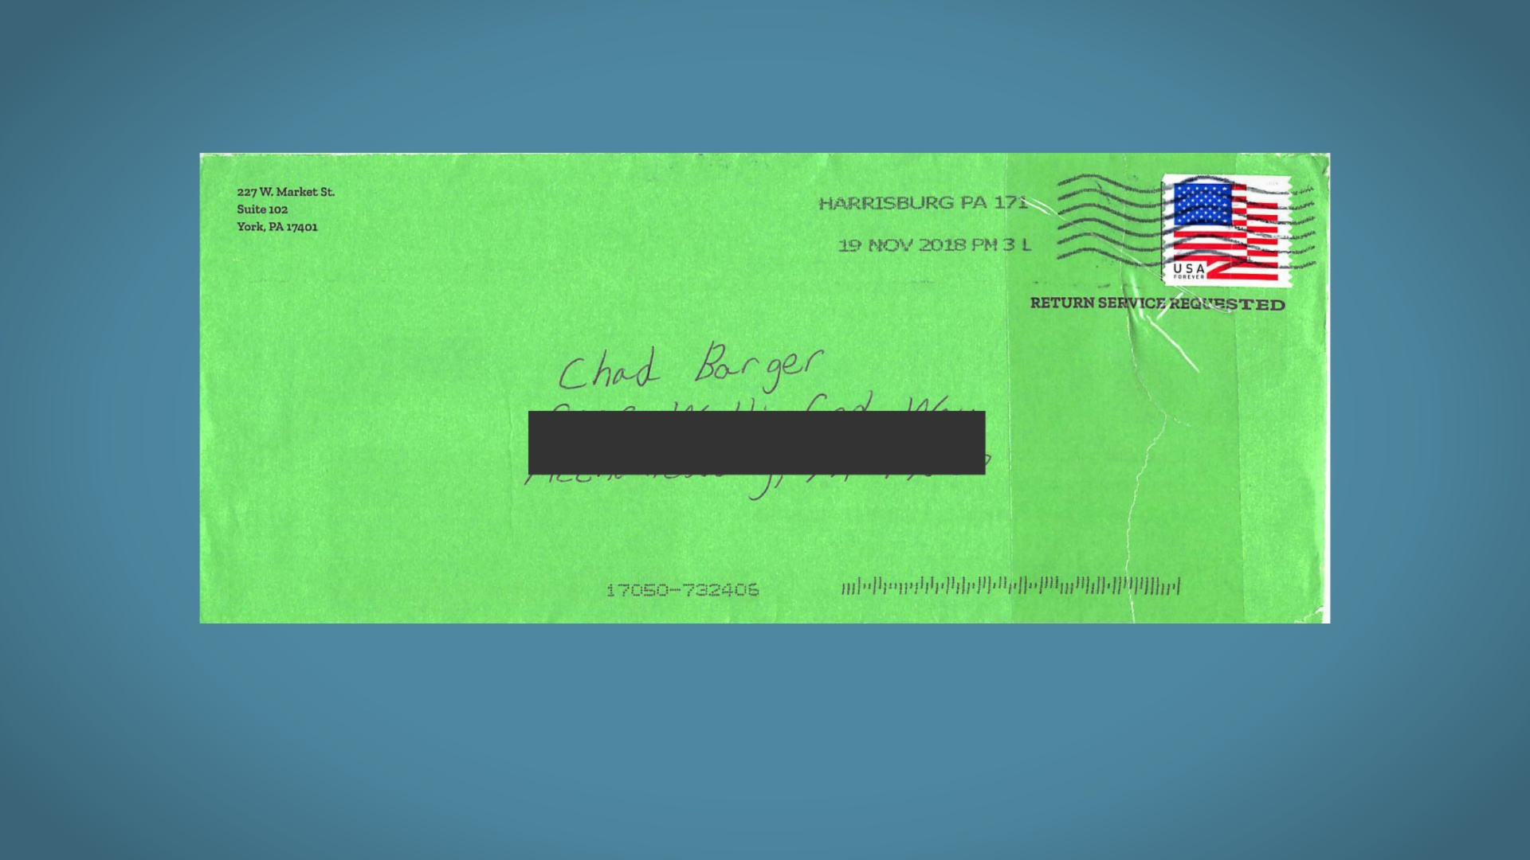

Slide 60
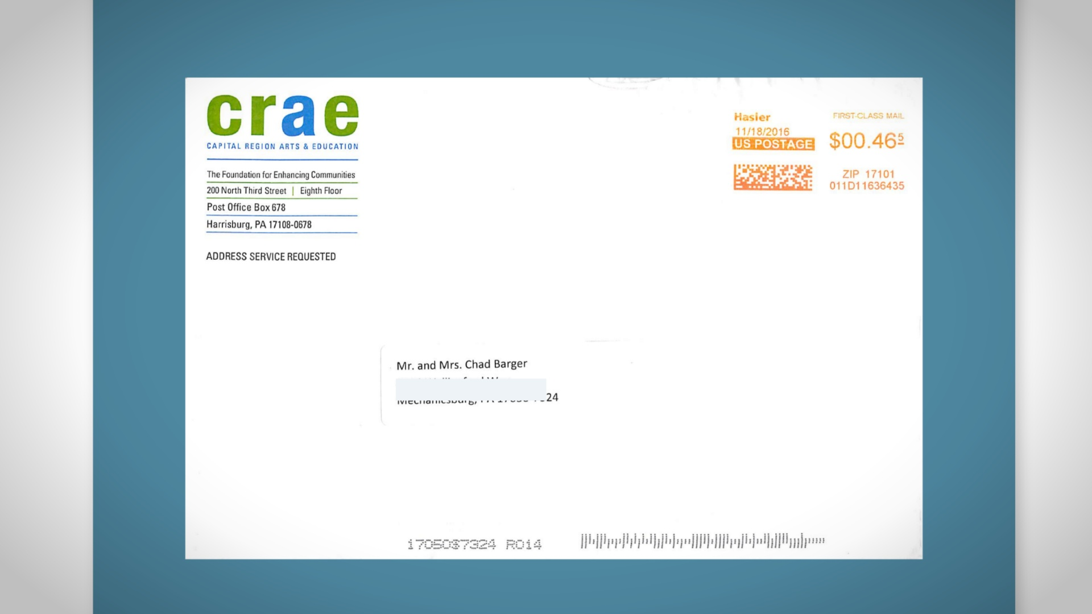

Slide 61
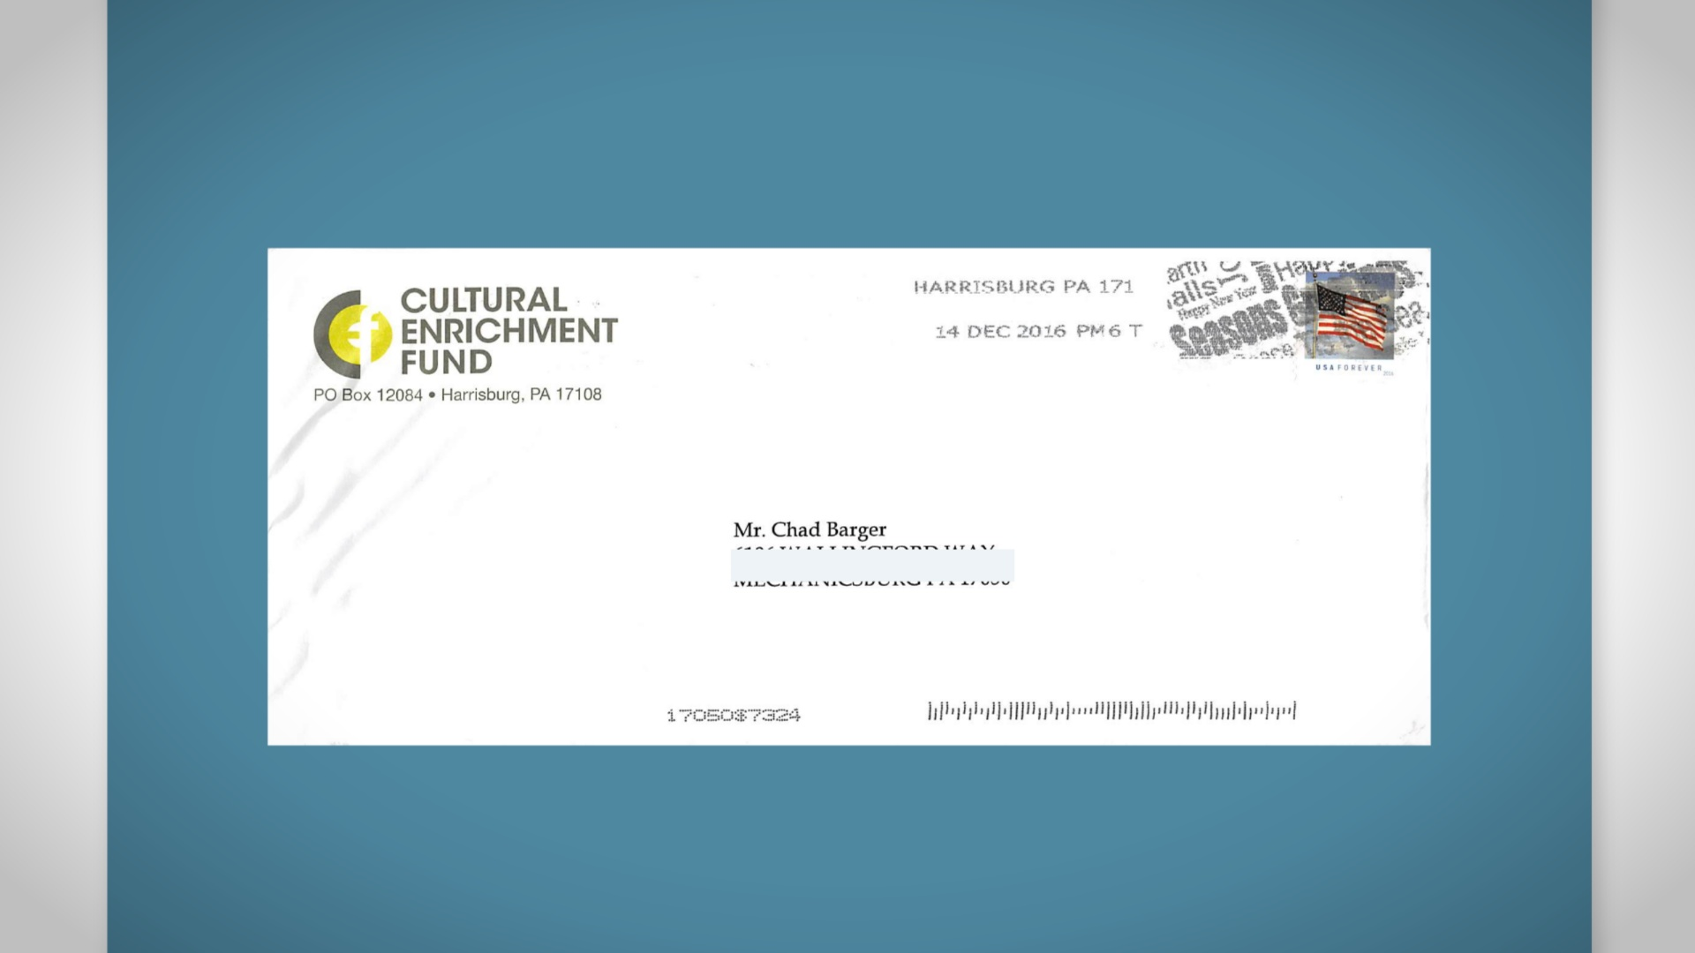

Slide 62


Slide 63

Notes:
Begin with small talk (weather, sports, hobbies, grandchildren, etc. – can be 50%+ of meeting) / create connection & likeability

Slide 64
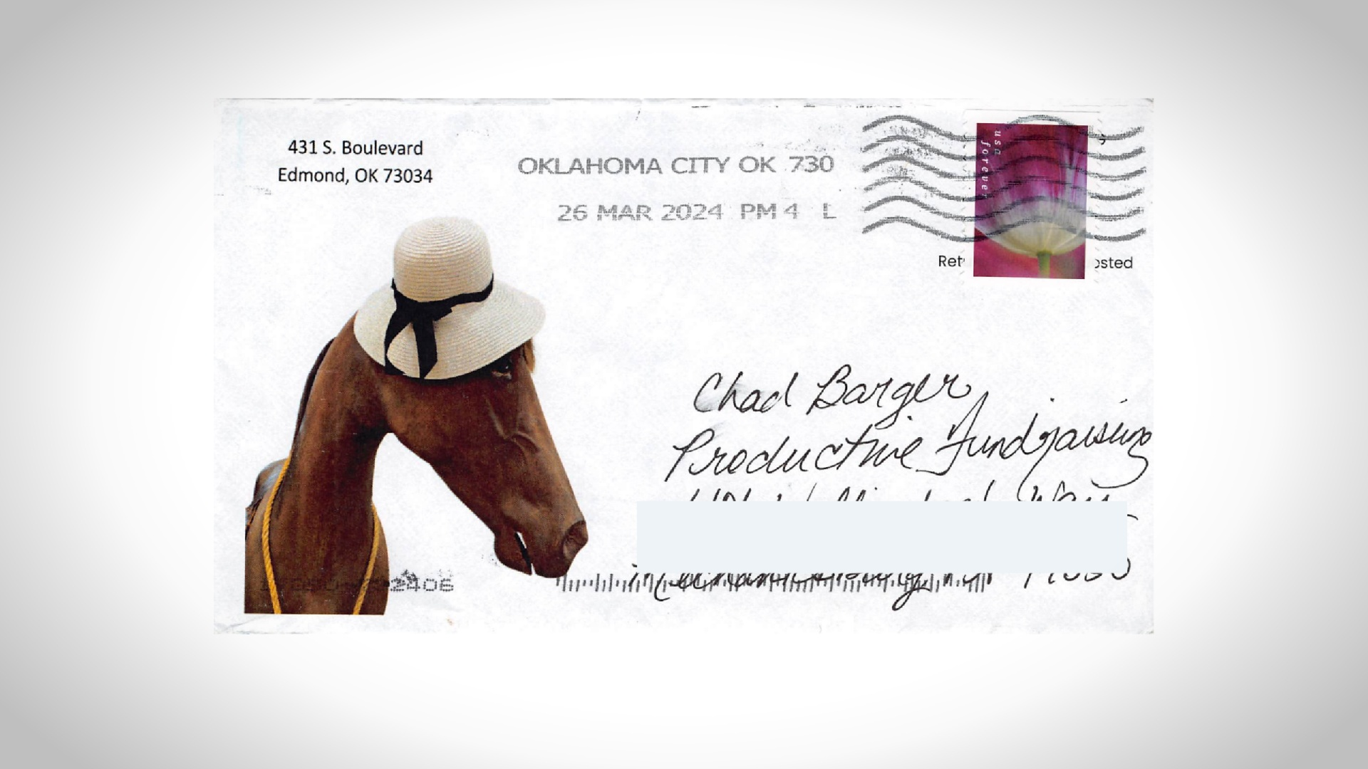

Slide 65


Slide 66


Slide 67


Slide 68


Slide 69


Slide 70


Slide 71


Slide 72


Slide 73


Slide 74


Slide 75


Slide 76


Slide 77


Slide 78


Slide 79


Slide 80


Slide 81


Slide 82


Slide 83


Slide 84


Slide 85


Slide 86


Slide 87


Slide 88


Slide 89


Slide 90


Slide 91


Slide 92


Slide 93


Slide 94


Slide 95


Slide 96


Slide 97


Slide 98


Slide 99


Slide 100


Slide 101


Slide 102


Slide 103


Slide 104


Slide 105


