Slide 1
The Voice of the Donor
Turning Feedback into Fuel for Impact
Michelle S. Gollapalli, MBA, CFRE, CAP
President, Distinction Dialogue

Slide 2
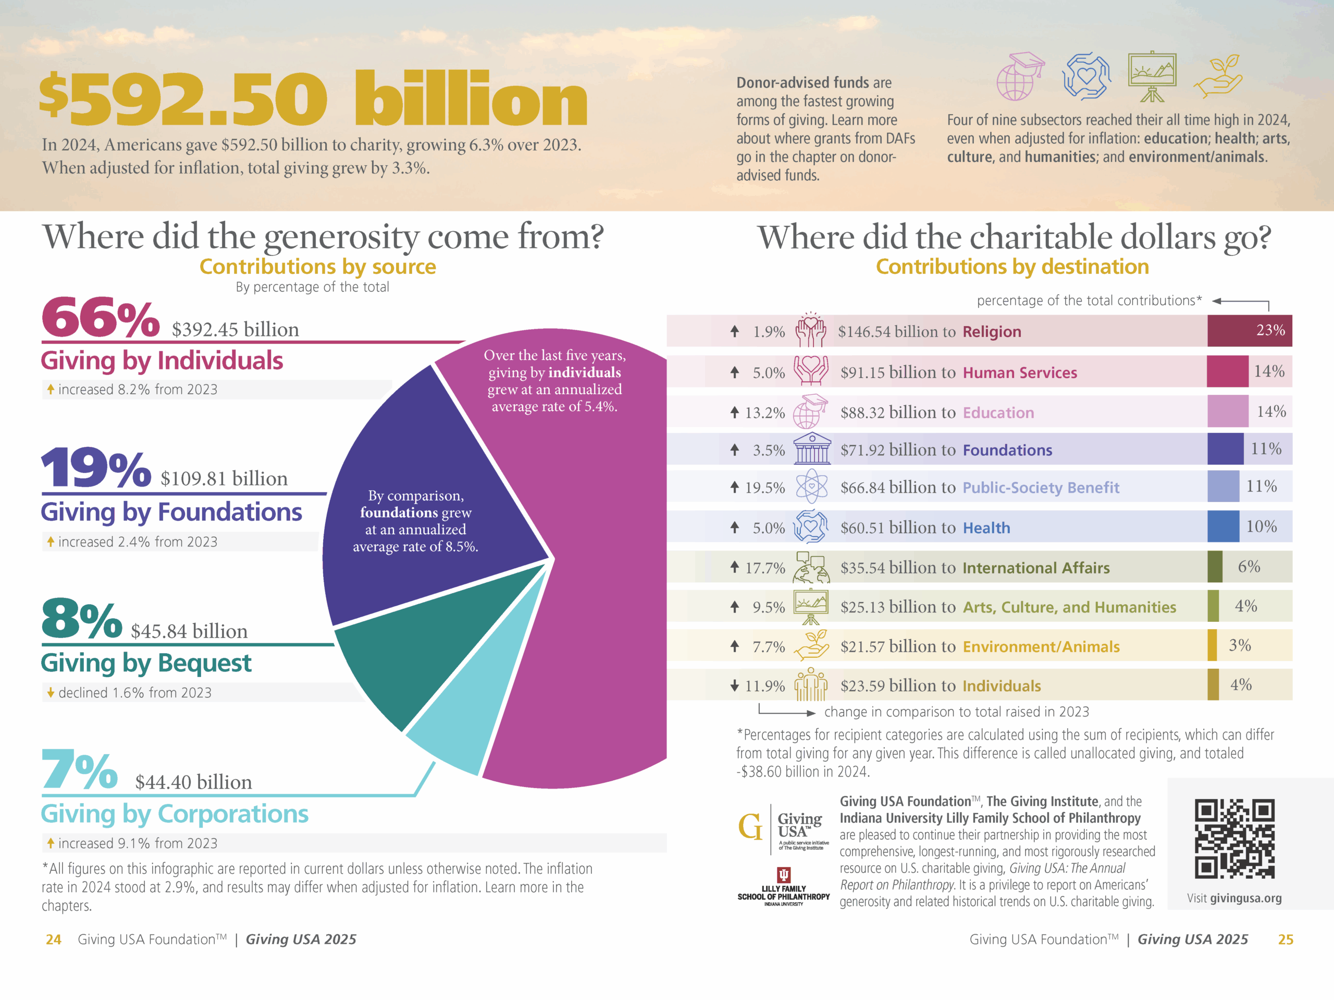

Slide 3
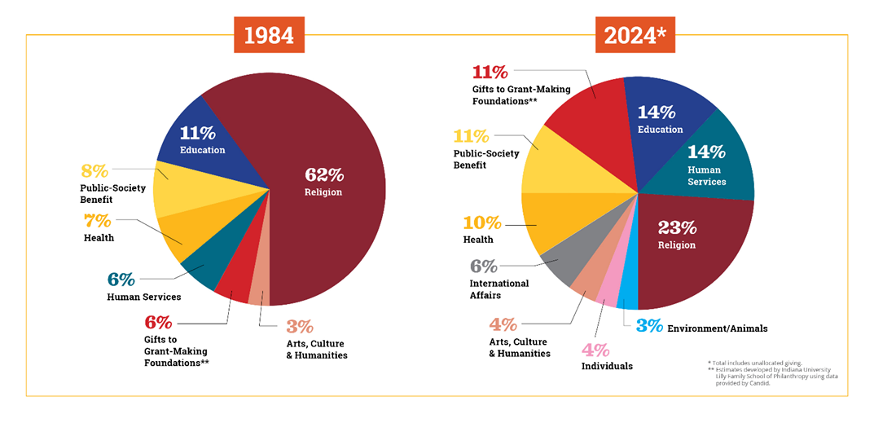

Slide 4
Good News vs. Bad News
Philanthropy at a record high
All sectors saw an increase
    Religion remains the largest sector of US giving ($145B) – but declining
Transformational Gifts make headlines
Fewer donors are giving – attrition high (66% - 49%)
Micro donors (<$100) are the most impacted
Declining religiosity, economy, trust,
social disconnection
Generational Divide

Slide 5
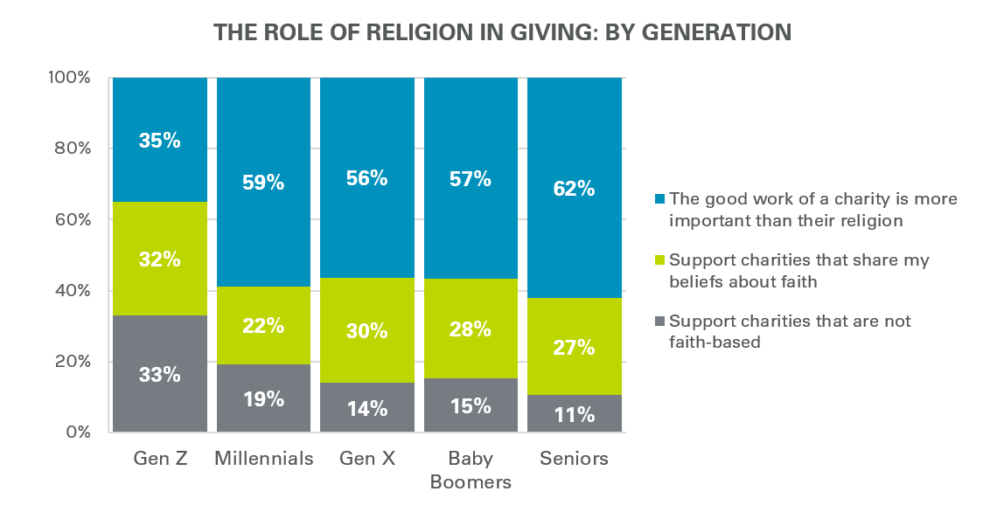

Slide 6
Shifting Donor Demographics*
Religious affiliation to spiritual
    44% say they pray at least once a day (62% Christian,
    29% unaffiliated)
    83% believe in a God or Universal Spirit
  Generational Divide
    Young adults far less religious – nonreligious upbringing on the rise
Gender
    Women more religious
Race and Ethnicity
    66% – Worship with their own race or ethnicity (down from 78%)
Immigration Status
    58% Christian, 14% other religions
    * Religious Landscape Study – Pew Research

Slide 7
Why Donor Voice Matters
Retention – Harsh Reality
The Case of the Invisible Donor
Donor expectations –shifting
Input shapes strategy
Secular world relevance
Notes:
Organizations have missions. They tend to go through –advancing said mission with a hyper focus on it- how do we grow, how do we serve, how do we do more, because the need is definitely out there – Pause. Stop. Breathe. Who is behind all of this growth, this service? Our donors. But are we listening to them? How often, in our excitement to ‘communicate’ do we just talk ‘at’ our donors, so much to share, so much to build, do,… stop. Pause.
Retention vs. Acquisition: Studies (e.g., from the Association of Fundraising Professionals [AFP] and the Fundraising Effectiveness Project) show that the average first-year donor retention rate in the U.S. is only ~45%. Listening to donors boosts loyalty and lifetime value. –Trust & Transparency: In the wake of rising donor skepticism, organizations that listen and respond transparently enjoy higher trust and unrestricted giving.
“By the end of this keynote, you’ll know how to capture, understand, and act on your donors’ voices in a way that grows loyalty and impact.”
Alignment: Donor voice data can surface priorities that align (or conflict) with your mission, guiding both messaging and program design.
Faith-based/religious giving is seeing a big shift: one of the striking trends is a “Gen Z faith-based giving surge” — very strong growth in religious giving among younger generations.
The “Great Wealth Transfer” (~$124 trillion over coming decades) is pushing nonprofits to rethink how they engage younger donors (Millennials, Gen Z) including via digital channels. Business Initiative+1
Technology / AI Readiness~77% of nonprofits plan to adopt AI in the next 3–5 years (for predictive analytics, personalized communication, etc.). Digital giving, mobile giving are especially more common among younger generations. CCS Fundraising+1

Slide 8
Defining the Voice of the Donor
Who are our donors?
Hopes, concerns, expectations
How do we listen?
Not a fundraising tactic – it's ministry

Slide 9
Source | Key Insight on Donor Voice
Giving USA | Trend reports show donors increasingly expect impact reporting and personalized stewardship.
Center for Effective Philanthropy (CEP) | For institutional donors/foundations, CEP surveys grantees to measure “voice of the grantee,” and similarly encourages funders to treat donors as partners whose input shapes strategy.
Donor-Centered Fundraising (Penelope Burk) | Classic research: donors give more and stay longer when thanked promptly, told how their gift was used, and offered meaningful opportunities for input.
Adrian Sargeant & the Institute for Sustainable Philanthropy | Emotional connection and feedback loops drive donor loyalty; collecting “donor commitment” data is as important as financial metrics.
Blackbaud Institute | “Donor journey mapping” and segmenting communications based on donor preferences increases retention and average gift size.

Slide 10
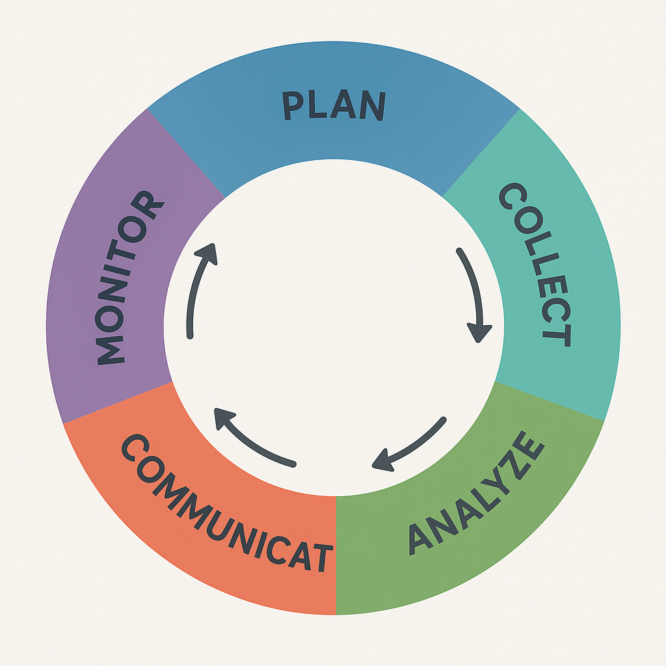

Slide 12
References
National Philanthropy Data
– Giving USA 2025: The Annual Report on Philanthropy for the Year 2024. Giving USA Foundation. Total U.S. giving $592.5 B; individuals ~66%; corporate giving up ~9%; religion largest sector. givingusa.org
– CCS Fundraising – The Philanthropic Landscape 2025. Gen Z growth in faith-based giving; $124 T wealth transfer; 77% nonprofits plan AI adoption. ccsfundraising.com
Diversity & Generational Giving
– Urban Institute / W.K. Kellogg Foundation reports on Black & Hispanic philanthropy: Black households give ~18% more; Hispanic giving participation fell faster 2008-2018.
– Fidelity Charitable and other DAF reports on secular donor pools.
Religious Affiliation & Participation (National & Pennsylvania)
– Pew Research Center – Religious Landscape Study (2023–24): National unaffiliated 28–30%; Pennsylvania 62% Christian (down from 73% in 2014); >50% rarely/never attend services. pewresearch.org/religion
– Axios Local Philadelphia report on church attendance (2024).
Pennsylvania Nonprofit Sector & Philanthropy
– Pennsylvania Association of Nonprofit Organizations (PANO) – 2025 Economic Impact of Pennsylvania’s Nonprofits: ~64,800 active nonprofits; ~49,000 are 501(c)(3); nonprofits drive ~$139.8 B state economy. pano.org
– Archdiocese of Philadelphia – Catholic Charities Appeal Annual Report 2024: ~$8.8 M from 37,111 gifts.
– Richard King Mellon Foundation, The Heinz Endowments – 2023 annual reports/990 filings (RK Mellon grants ~$175 M; Heinz revenue ~$93.9 M).
Other
– BBB Wise Giving Alliance – Give.org Donor Trust Report (trust factors across donor groups). give.org/donortrust
– Lilly Family School of Philanthropy – Lake Institute on Faith & Giving reports.

Slide 13

Michelle S. Gollapalli. MBA, CFRE, CAP
msgollapalli@outlook.com

